Slide 1

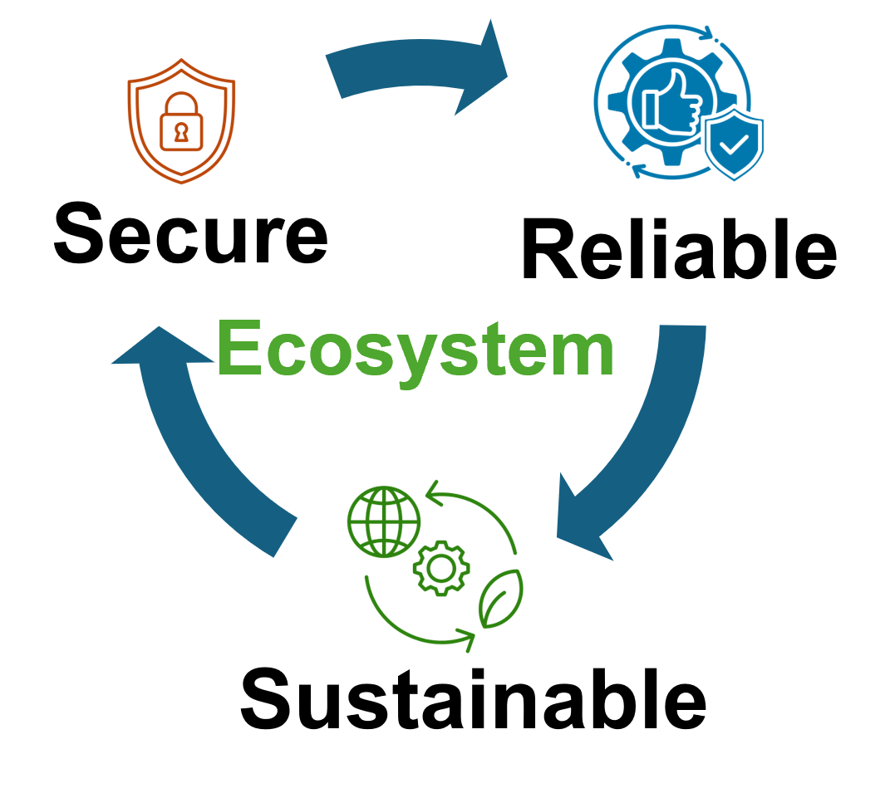


Update 25 March, 2025
Presented By,
Syed Emad Uddin Shubha
CS Grad Student, LSU

Slide 2
Topics
Review of previous paper on fault injection.
Answering some questions from previous meeting
Showing update of Paper

Slide 3
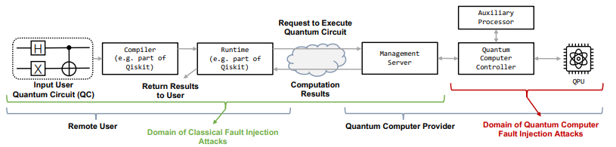
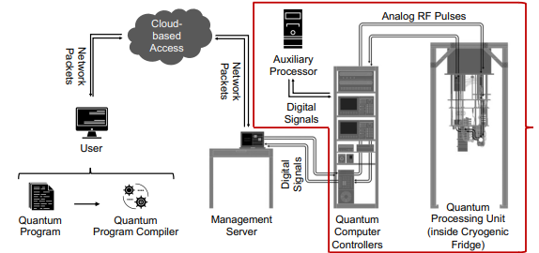
Quantum Computer Workflow

Slide 4
Gate Level Attacks
Gate-Level Program (High level, designing quantum circuits using gates):
Example: Qiskit, Quil
Faults can modify the digital bits specifying gates, leading to added, removed, or changed gates.
How to check?
Hash check is usually applied
Interface between user program and compilation requires channel verification.
focuses on the correct routing and allocation of pulse-level controls to the intended qubits as defined at the gate level
ensures that no pulses are applied to channels of qubits not intended for that custom gate

Slide 5
Pulse-Level attacks
Pulse-Level Program (Low level, precisely control the RF pulses to control qubits), Example: Qiskit Pulse
Faults can alter the digital specifications of control pulse parameters (amplitude, frequency, phase).
Pulse parameters are continuously changing and need frequent calibrations.
Pulse Syntax Verification
each individual pulse functions correctly as desired (calibration)
Pulse Semantic Verification
using Directed Acyclic Graphs (DAGs), qubits -> edges, gate -> nodes, check full quantum circuit

Slide 6
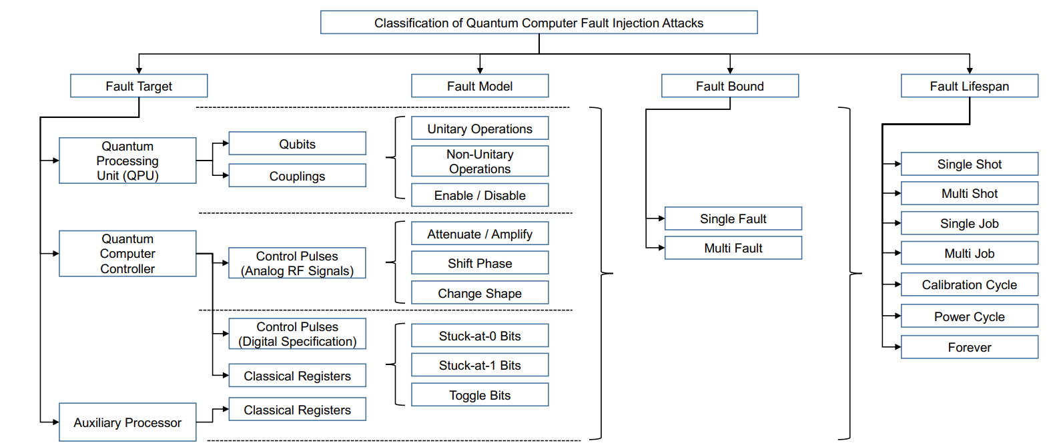
Classification of QC Fault Injection Attacks

Slide 7
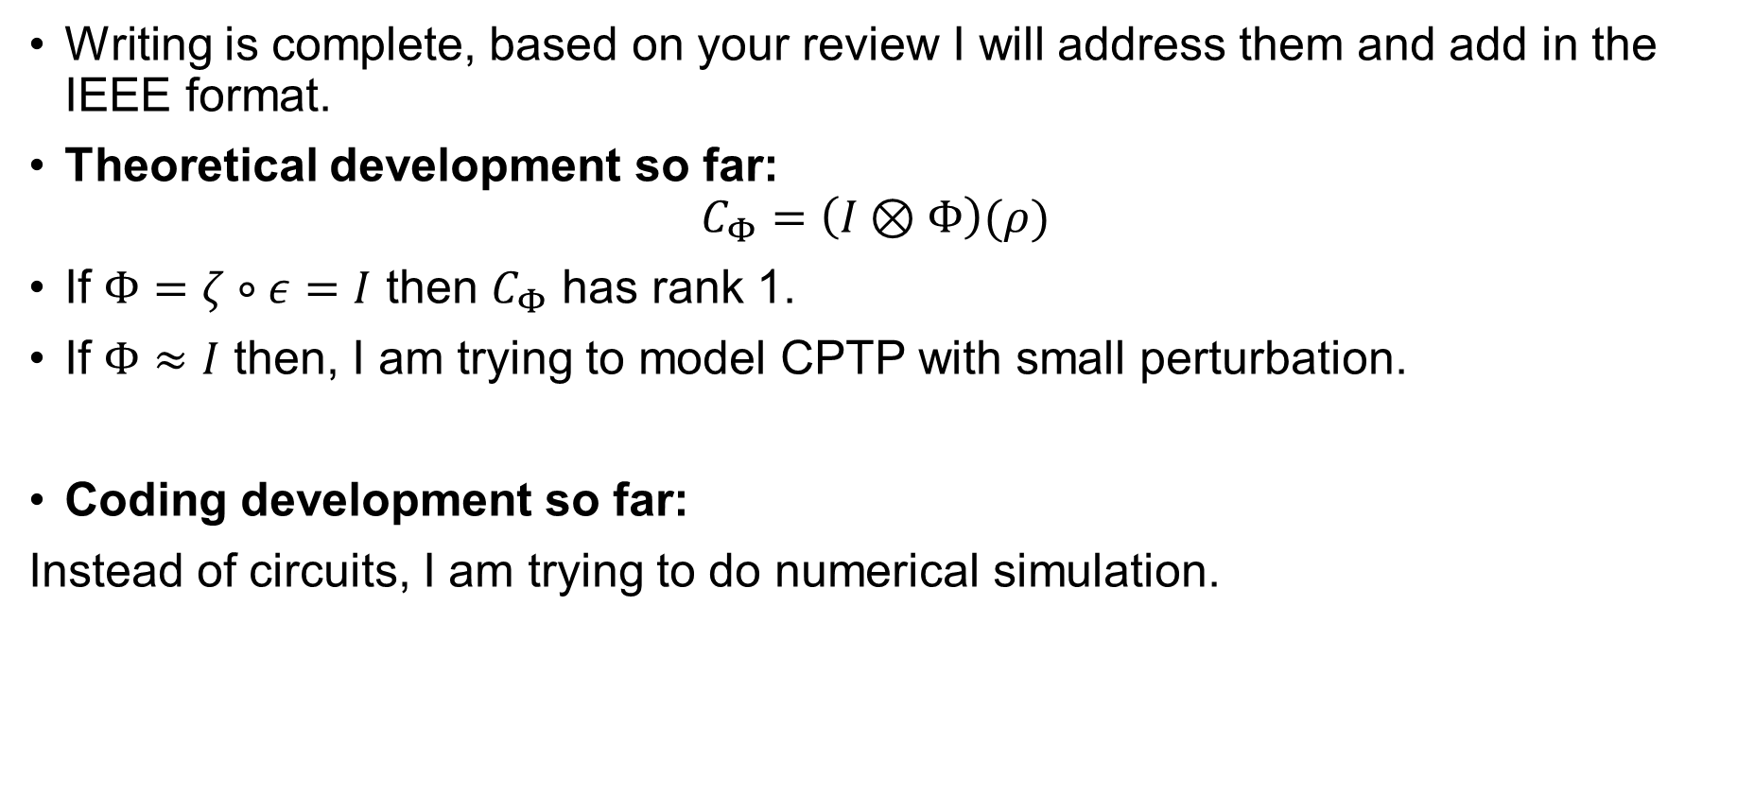
Paper Progress
Writing is complete, based on your review I will address them and add in the IEEE format.
Theoretical development so far:
$$C_{Φ}=\left(I⊗Φ\right)(ρ)$$
If $Φ=ζ∘ε=I$ then $C_{Φ}$ has rank 1.
If $Φ≈I$ then, I am trying to model CPTP with small perturbation.
Coding development so far:
Instead of circuits, I am trying to do numerical simulation.

