Slide 1

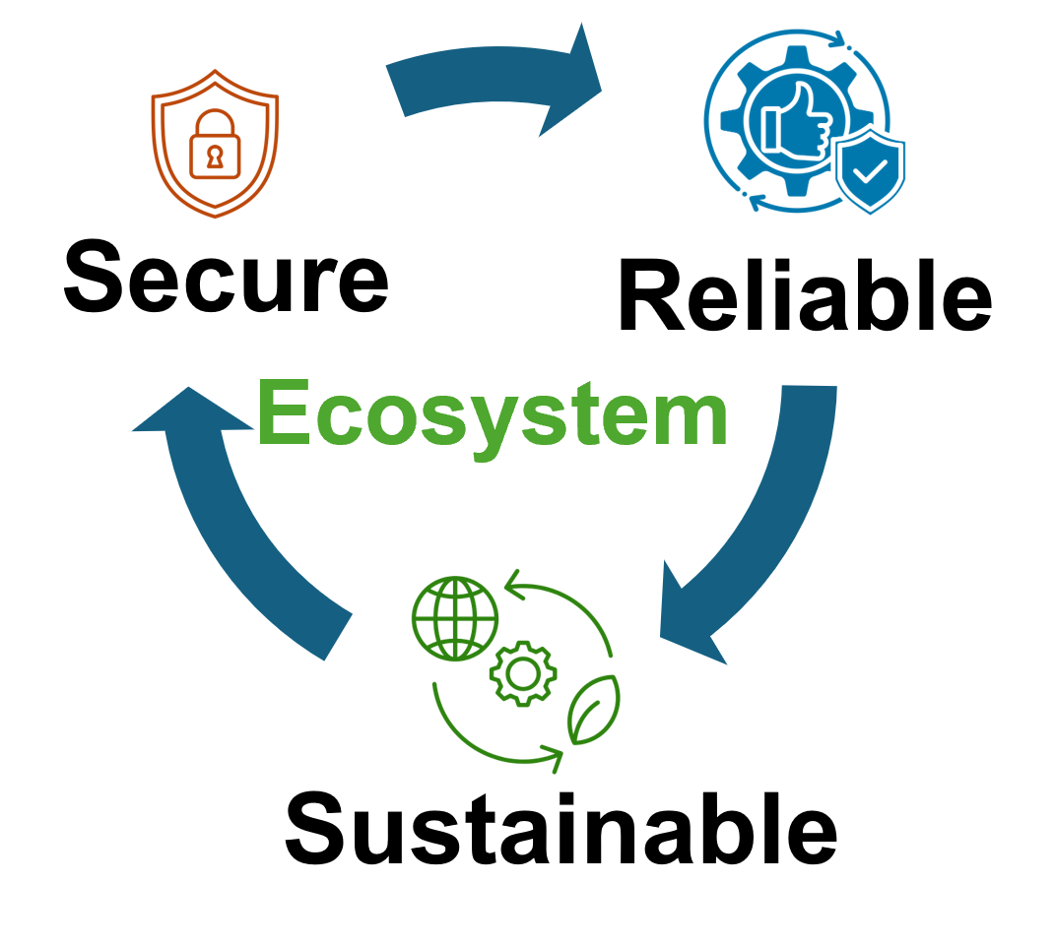


Quantum Computer Fault Injection Attacks Chuanqi Xu, Ferhat Erata, Jakub Szefer Yale University
Presented By,
Syed Emad Uddin Shubha
CS Grad Student, LSU

Slide 2
Introduction
Quantum computing is rapidly advancing, with increasing qubit counts (#q) and gate operations (#g). Example: IBM projects Quantum Computer (QC) with #q=200, #g=100M by 2029.
NISQ era QCs have potential in drug discovery and materials science.
As QCs grow and process sensitive data and valuable quantum programs (intellectual property), the need to secure them against security attacks becomes critical.
Physical attacks, especially insider threats (malicious insiders within data centers), can compromise the integrity of computations and resulting data.

Slide 3
Fault Injection Attacks
Today’s QCs have extensive classical control infrastructure unlike classical chips. This significantly extends the possible attack surface.
Quantum computers' size allows easier physical access for potential manipulation compared to classical transistors.
Fault injection attacks can compromise the integrity and confidentiality of both the data being processed and the quantum programs executed on QCs.
Attackers can potentially manipulate:
- The qubits themselves.
- Classical registers into which qubit measurements are read.
- Control signals.

Slide 4
Contribution of the Paper
Presents an in-depth exploration of QC fault injection attacks.
Key contributions:
Classification: Provides the initial classification of fault injection attacks.
Attack Domain: Define unique attacks on QC, contrasting with classical.
Fault Targets: Identifies three specific fault targets:
Quantum processing units (QPU), QC controllers, Auxiliary processors.
Target Components: Pinpoints six specific components within these targets vulnerable to attacks.
Fault Models: Presents fault models, bounds & lifespans for identified targets.

Slide 5
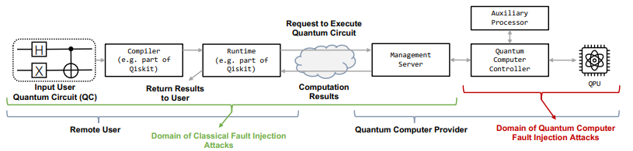
Quantum Computer Workflow
Compiler: Transpiling the user's gate-level program to decompose into elementary quantum gates supported by the hardware.
Management Server: Receiving quantum jobs, queuing them, and dispatching jobs to QC controllers. Also receives quantum computation results and sends back to user.
Runtime: Internal component that facilitates the transition between the user's compiled program and its execution on QC.

Slide 6
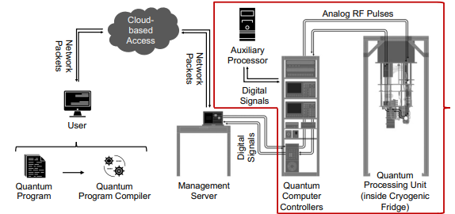
Example: Superconducting Hardware (IBM)
Auxiliary Server are classical processor coupled to QC controllers.
- Interprets quantum readout results and updates program parameters. May also contain user-defined code.
QPU contains the physical qubits.
SCQ are Josephson junctions
Located in a dilution refrigerator.
Performs computations using Microwave Pulses.
QC Controllers: Receives digital signals, uses AWGs and IQ mixers to generate analog RF pulses to manipulate qubits in QPU. It also handles measurement readouts and manages dynamic circuits using mid-measurement results.

Slide 7
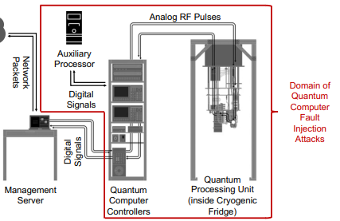
Domain and Targets of Fault Injection Attack
Focuses on superconducting QCs with cloud-based access: IBM, Rigetti, QCI.
Targets on QPU:
1. Qubits 2. Coupling (connections)
Targets on QC Controllers:
3. Analog control (RF) pulses.
4. Digital Signals to generate RF pulses.
5. Classical Registers to store Readouts.
Targets on Auxiliary Processor:
6. Classical registers used for post-processing and parameter optimization.

Slide 8
Fault Manifestation: How Faults are Observed
Fault manifestation is the observable effect of a fault injection. This can include changes in qubit states, altered gate operations, or incorrect algorithm results.
Gate-Level Program (High level, designing quantum circuits using gates):
Faults can modify the digital bits specifying gates, leading to added, removed, or changed gates.
Pulse-Level Program (Low level, precisely control the RF pulses to control qubits)
Faults can alter the digital specifications of control pulse parameters (amplitude, frequency, phase).
Pulse parameters are continuously changing and need frequent calibrations.
Faults in registers storing measurement outcomes lead to incorrect readouts. Modifying bits from mid-circuit measurements affects subsequent operations in dynamic circuits. Faults in final measurement bits manipulate the final circuit output.

Slide 9
Fault Models: Types of Faults in QCs
QPU | QC Controller | Classical Register
Unintended Gates Decoherence, Measurements Enable/Disable Couplings | Attenuate/amplify pulses. Change shape (envelope) Change Phases, Frequency | Stuck at 0-bits Stuck at 1-bits Toggle Bits
Classical Fault Injections:
Voltage glitching, clock glitching
EM (electromagnetic), lasers, or other sources of disturbance
* Classical Register is common is QC controller and Auxiliary Processors.

Slide 10
Fault Bound and Lifespan
Fault Bound: The maximum number of faults a system can tolerate without significant degradation (can be single or multiple fault threats).
Fault Lifespan: The duration for which a fault persists in the system. Quantum computers have more diverse lifespans than classical computers.
Types of Fault Lifespans:
Single Shot: Affects only a single execution of a quantum circuit.
Multi Shot: Persists across multiple executions of the same circuit.
Single Job: Multi-shot faults lasting throughout all shots of a single submitted quantum job.
Multi Job: Affects multiple quantum jobs, maybe from different users (i.e., register fault).
Calibration Cycle: (Unitary) Faults that can be corrected during the regular calibration.
Power Cycle: Faults requiring a full power cycle (warming up the cryogenic fridge) for resolution. (Example: changes causing flux trapping.)
Forever: Faults that result in permanent hardware alterations. (Example: disabling couplings.)

Slide 11
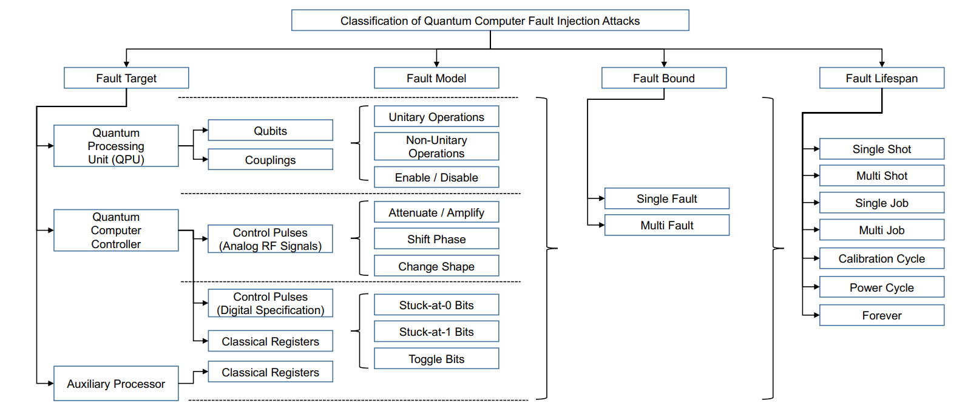
Classification of QC Fault Injection Attacks

Slide 12
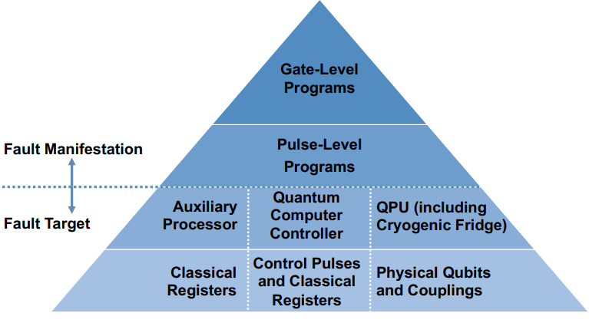
Related Work and Distinctions
The work draws inspiration from classical fault injection literature, using the framework of Fault Target, Model, Bound, and Lifespan.
Most prior work focuses on hardware faults in qubits.
The work is novel because it specifically addresses the unique attack surface and vulnerable components of quantum systems, focusing non-invasive attacks.
Security pyramid is introduced for superconducting quantum computers.

Slide 13
Future Research Directions
This work can serve as a foundation for future research on:
Developing specific attack techniques
Evaluating their impact
Designing effective countermeasures for quantum computers.
My observations:
The paper is largely theoretical focusing on conceptualization and classification of fault injection attacks.
There is no discussion of specific analytical models that predict the impact of injected faults on quantum algorithms or computations.
They didn’t expand on Fault Bound, just defined and categorized it.

