Slide 1

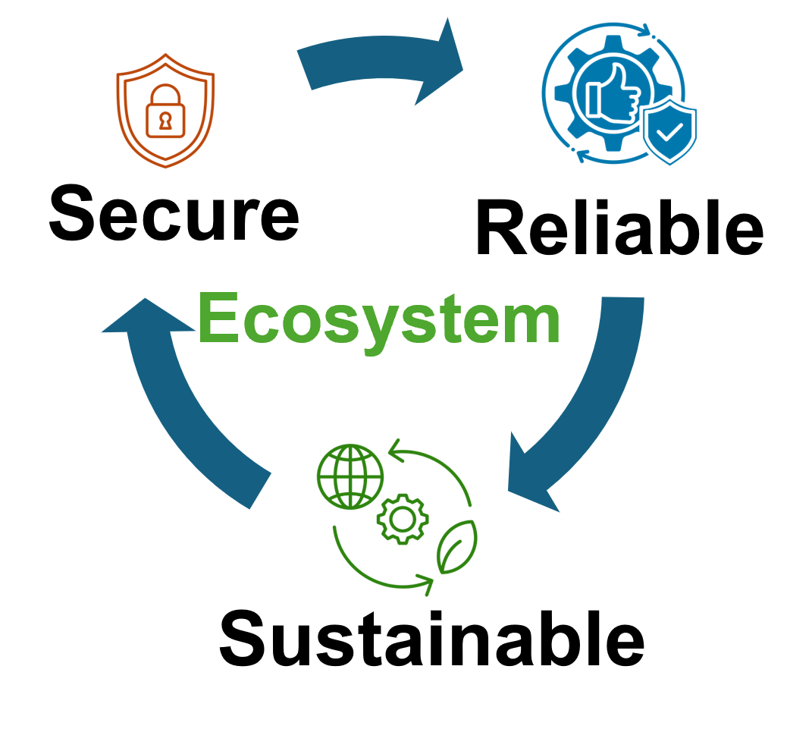


QubiC: An open-source FPGA-based control and measurement system for superconducting quantum information processors Yilun Xu et al.
Presented By,
Syed Emad Uddin Shubha
CS Grad Student, LSU

Slide 2
Introduction to QubiC
Scalable control for superconducting quantum processors.
Limits of AWG/DAQ in NISQ scaling.
QubiC: Open-source, FPGA-based control & measurement system.
Modular design across hardware, gateware, and software.
Supports pulse-level control and feedback.
Full-stack access for co-design and optimization.

Slide 3
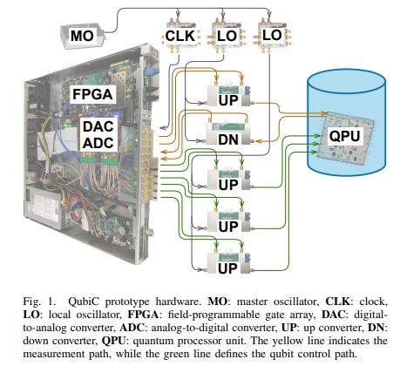
QubiC System Architecture
Hardware: FPGA + DAC/ADC + RF mixer + oscillator + connectors to cryostat
Gateware: Verilog DSP code running in the FPGA handles waveform generation, routing, signal processing
Software: Python API, GUI, compilers (OPTM/RUNC), integration with circuit-level tools
Hardware:
Xilinx VC707 FPGA + FMC120 DAC/ADC (1 GSPS).
Custom RF mixer (2.5–8.5 GHz) with 27 dBc image rejection.
LO module (Wenzel + LMX2595): ~1 ps jitter, compact & low-cost.

Slide 4
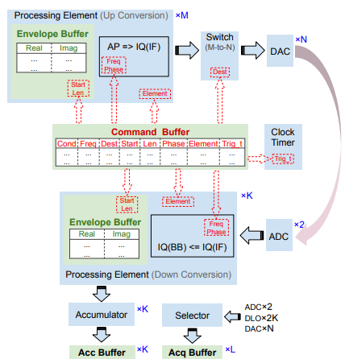
Gateware DSP Architecture
Digital modulation via Processing Elements (CORDIC-based).
Real-time waveform generation and phase injection.
acc/acq buffers for IQ integration and raw data capture.
Host Interface & Compilation:
128-bit commands: timing, freq, phase, DAC routing, etc.
3-Step compilation: Scheduler → TP Pairs → NV Pairs.
Supports both calibration (OPTM) and execution (RUNC).
*UC= to qubit, *DC=meas.
Command Buffer: Central controller, where all pulse definitions are stored.
Envelope Buffers: Store I/Q waveform data.
acc/acq Buffers: Store processed results for measurement & debugging.

Slide 5
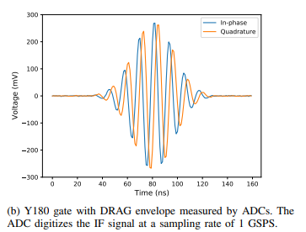
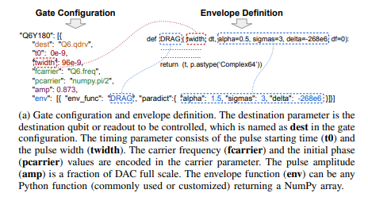
Waveform Generation & Verification
DRAG pulse envelope using Python NumPy functions.
Real/Imaginary mapping to I/Q DAC channels.
Loop-back validation via ADC shows correct waveform.

Slide 6
Conclusion & Impact
QubiC enables efficient pulse-level quantum control.
It was validated on an 8-qubit superconducting chip.
It demonstrated high gate fidelity and advanced error mitigation techniques like randomized compiling.
Open-source platform for research and development.
Ready for advanced algorithms like RC, QCVV, feedback.

