Slide 1



Security Attacks Abusing Pulse-level Quantum Circuits Chuanqi Xu, Jakub Szefer Prepared by: Syed Emad Uddin Shubha

Slide 2
Gate Level Quantum Computing
Quantum operations are expressed in terms of quantum gates.
User defines circuits using quantum SDK, i.e., QISKIT, CIRQ.
Knowing hardware details is not necessary.
Sometimes device independent algorithm is possible.
May not exploit hardware capabilities sometimes.
May be inefficient if standard gate set is significantly different from hardware native ones.
Circuit is actually an abstract concept.

Slide 3
Pulse-level Quantum Circuits
Lower level abstaction where operations are expressed using control pulses, such as, microwave or laser signals directly interacting with physical qubits.
Hardware dependent, even environment dependent.
Example: QISKIT's OpenPulse API.
Provides precision control over qubit behavior and timing.
Enables hardware specific optimization and error mitigation.
However, programming at this level is complex and requires details knowledge about the quantum hardware.
Since it improves "Expressivity", pulse level coding is often used.

Slide 4
From Gate Level to Pulse Level
Usually, people write gate level code, which Q-SDK's covert into Pulse level.
It converts non-native gates into native ones to meet specific device criteria.
Control pulses are analog and are varied due to different parameters.
Pulse parameters are: envelop, phase, and frequency.
Due to environment change device is calibrated and these pulses changes.
Translating pulses into gates is called Syntax, which is specific to one hardware, but same for all programs executed on that hardware.
Semantics writes general purpose algorithm and assumes pulses are syntactically correct.

Slide 5
Potential Threat
Supply chain attack: Attacker can alter the local code to change the pulse information, by secretly modifying user-level program.
We will mostly focus on Supply chain attack.
Attacker can alter the infrastructure too so that pulse specification doesn't produce the expected result (i.e., changing environment).
Gate level modification is possible but can be prevented by Hash check or Quantum Computer Antivirus.
Pulse level attacks are hard to detect.

Slide 6
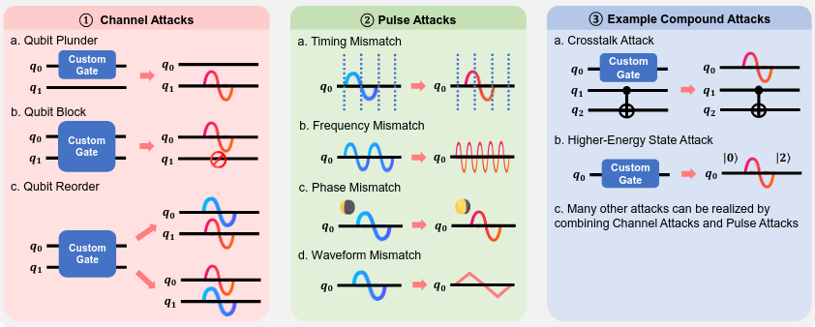
Proposed Attacks
They didn't tell how someone can perform these attacks.

Slide 7
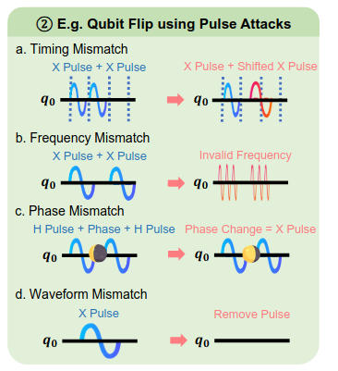
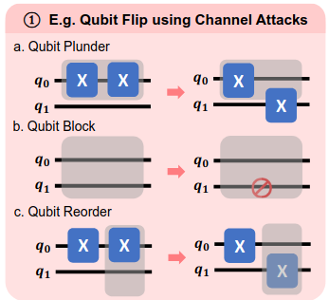
Example: Qubit Flip Pulse Attack
Algorithm specific attacks are also possible, such as Teleportation (??), Grovers search and
Quantum Neural Networks (shown in the paper, quite similar actually).

Slide 8
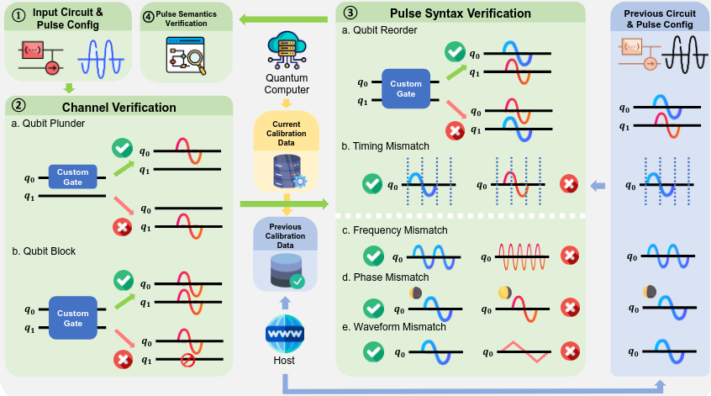
Proposed Defenses

Slide 9
Future Works
Improving verification, probably including tomography.
Including error in the defense.
Going into how these attacks can be done.
Paper: https://arxiv.org/html/2406.05941v2
Thank you!

