Slide 1



Jailbreaking Quantum Computers Chuanqi Xu, Jakub Szefer Prepared by: Syed Emad Uddin Shubha Date: May 20, 2025

Slide 2
Threat Model & Assumptions
How Pulse-Level Access Can Breach Quantum Programs?
Adversary Model:
Malicious tenant submits pulse-level jobs.
Runs in parallel or close to a victim on shared hardware.
Assumption:
No special privileges — just using allowed pulse-level features via Qiskit Pulse / QASM3 / opaque gates.

Slide 3
Key Vulnerabilities
Channel Attacks
Qubit Plunder: Hijack unused drive channels.
Qubit Block: Occupy qubits without acting.
Qubit Reorder: Change gate semantics via reordered qubit-channel mapping.
Pulse Attacks
Timing Mismatch: Break CR echo with delays.
Frequency Mismatch: Detuned drive → phase leakage.
Phase/Shape Mismatch: Alter waveform to create Z-rotations or fail gates.

Slide 4
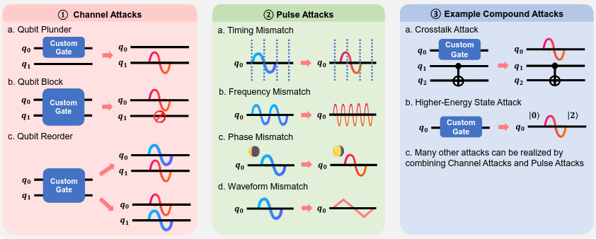
Proposed Attacks

Slide 5
Core Attack — CR Echo Cancellation
-CR (Cross Resonance) gates cancel residual terms using +CR and −CR pulses.
- If an attacker inserts a delay or barrier, it breaks cancellation.
- A residual ZX term remains → leaks control qubit state.

Slide 6
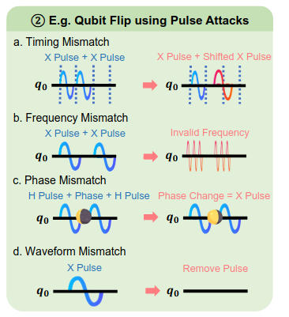
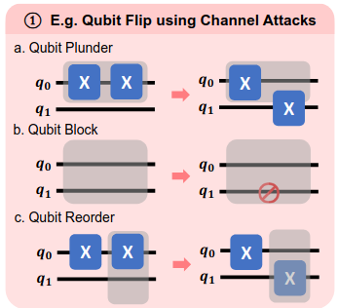
Example: Qubit Flip Pulse Attack

Slide 7
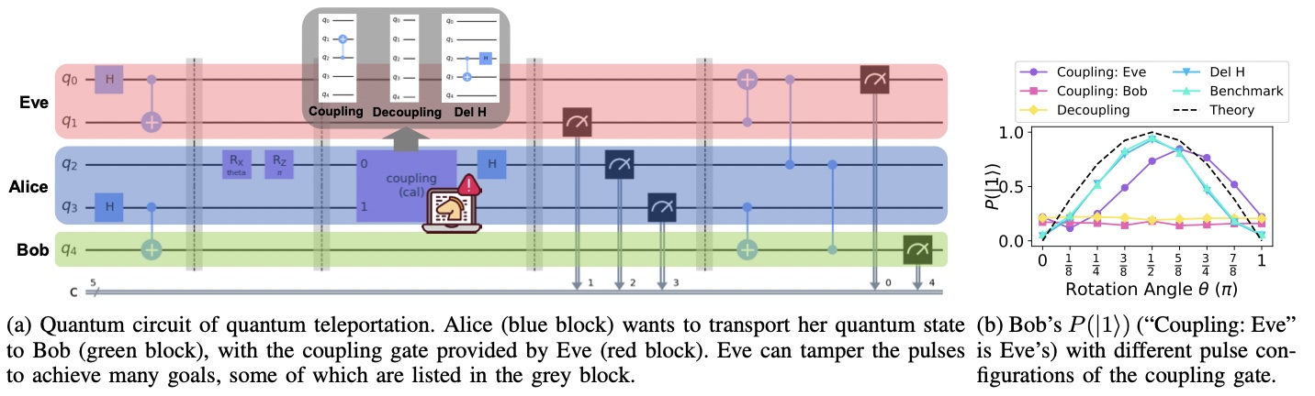
Example: Teleportation

Slide 8
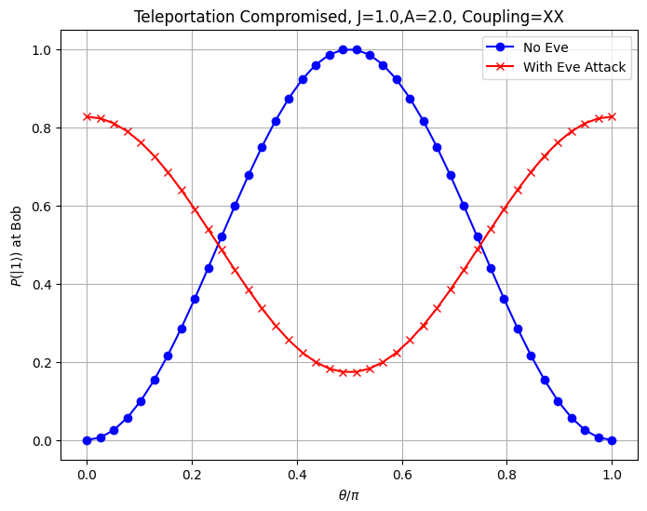
Simulation Attempt (J, A, Coupling can be changed)

Slide 9
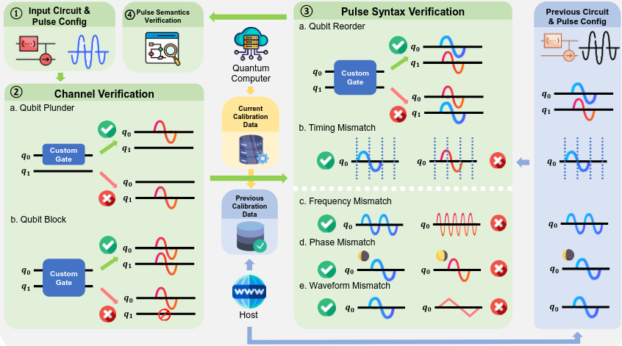
Proposed Defenses

Slide 10
Next Goals
Associating curve with circuit effect (i.e., which attack represents deleting Hadamard, or swapping CNOT etc.)
Using coupling between q0 and q1 to potentially reach more degree of attacks.
Finding attacks that might be undetectable by proposed defense mechanism.

