Slide 1



Quantum Crosstalk as Side Channel to Deploy Pulse Level Attack in Quantum MTC
Syed Emad Uddin Shubha
Graduate Student, CS LSU
Date: 4 June 2025

Slide 2
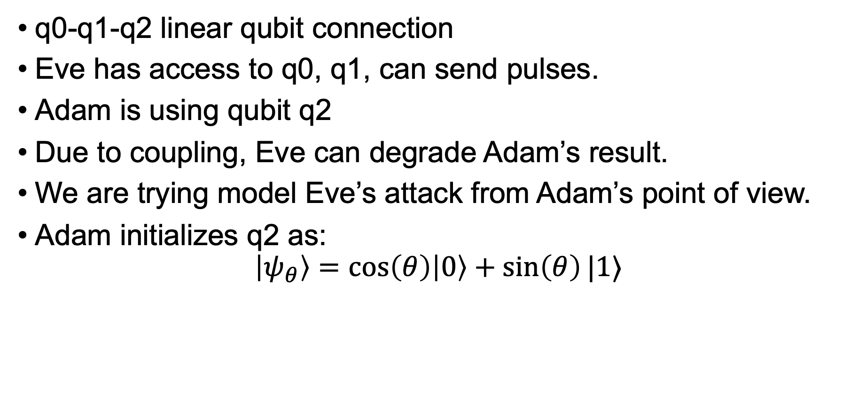
Attack Model
q0-q1-q2 linear qubit connection
Eve has access to q0, q1, can send pulses.
Adam is using qubit q2
Due to coupling, Eve can degrade Adam’s result.
We are trying model Eve’s attack from Adam’s point of view.
Adam initializes q2 as:
$$\left|ψ_{θ}\right\rangle =\cos\left(θ\right)\left|0\right\rangle +\sin\left(θ\right)|1⟩$$

Slide 3
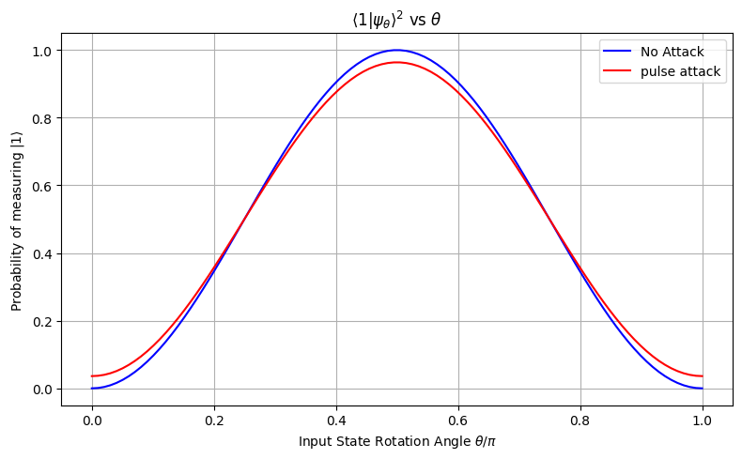

Example of Pulse Attack Degradation
Adam (q2) measures $|1⟩$, with probability ${\left|\left\langle ψ_{θ} | 1\right\rangle \right|}^{2}$
Eve can only send pulses to q0,q1 but still affect q2:

Slide 4
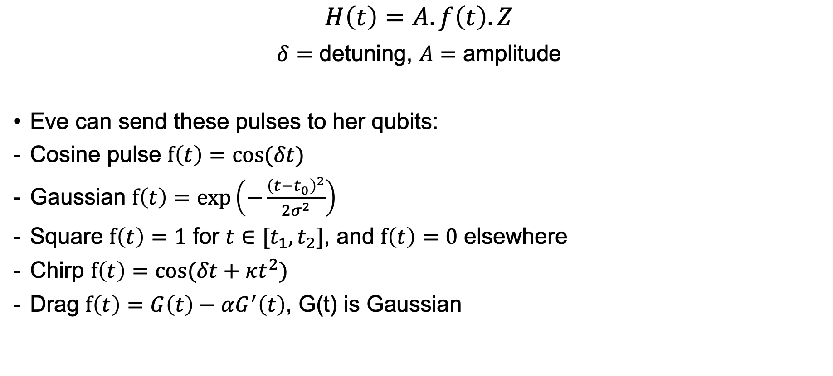
Pulse Shape
$$H\left(t\right)=A.f\left(t\right).Z$$
$δ=$ detuning, $A=$ amplitude
Eve can send these pulses to her qubits:
Cosine pulse $f\left(t\right)=cos⁡(δt)$
Gaussian $f\left(t\right)=\exp\left(−\frac{{\left(t−t_{0}\right)}^{2}}{2σ^{2}}\right)$
Square $f\left(t\right)=1$ for $t∈[t_{1},t_{2}]$, and $f\left(t\right)=0$ elsewhere
Chirp $f\left(t\right)=cos⁡(δt+κt^{2})$
Drag $f\left(t\right)=G\left(t\right)−αG^{′}\left(t\right)$, G(t) is Gaussian

Slide 5
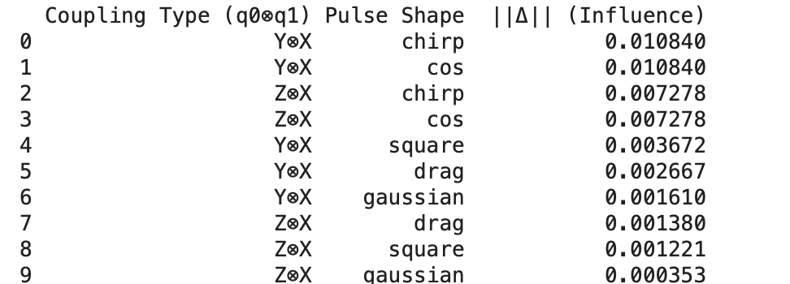
Effect of q0 on q2
We can see dominant crosstalk terms are YX and ZX

Slide 6
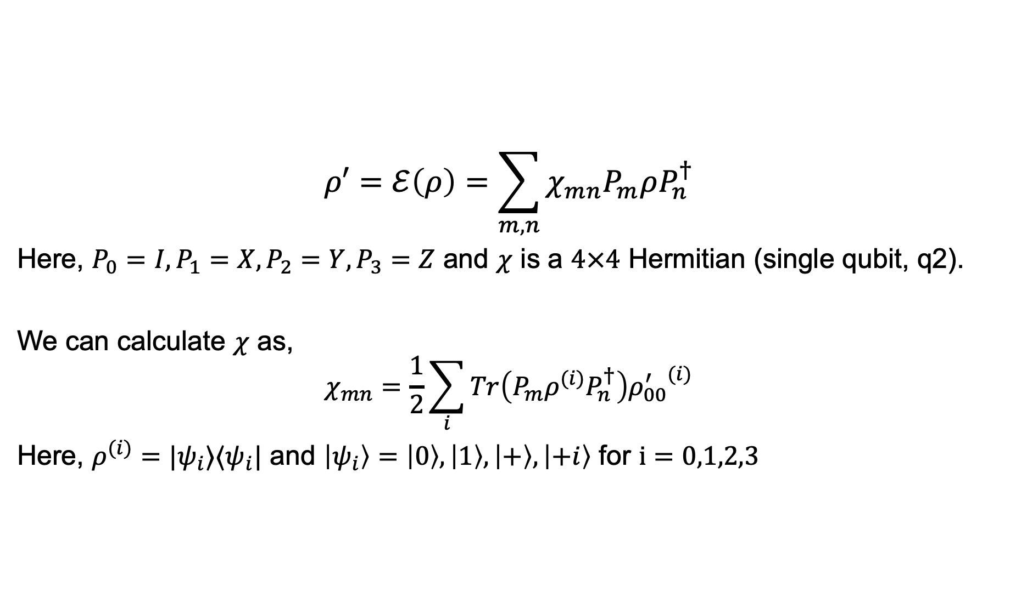
Chi Matrix
$$ρ′=ℰ\left(ρ\right)=\sum_{m,n}{χ_{mn}P_{m}ρP_{n}^{†}}$$
Here, $P_{0}=I, P_{1}=X, P_{2}=Y, P_{3}=Z$ and $χ$ is a $4×4$ Hermitian (single qubit, q2).
We can calculate $χ$ as,
$$χ_{mn}=\frac{1}{2}\sum_{i}{Tr\left(P_{m}ρ^{(i)}P_{n}^{†}\right){ρ_{00}^{′}}^{(i)}}$$
Here, $ρ^{(i)}=|ψ_{i}⟩⟨ψ_{i}|$ and $\left|ψ_{i}\right\rangle =\left|0\right\rangle ,\left|1\right\rangle ,\left|+\right\rangle ,\left|+i\right\rangle$ for $i=0,1,2,3$

Slide 7
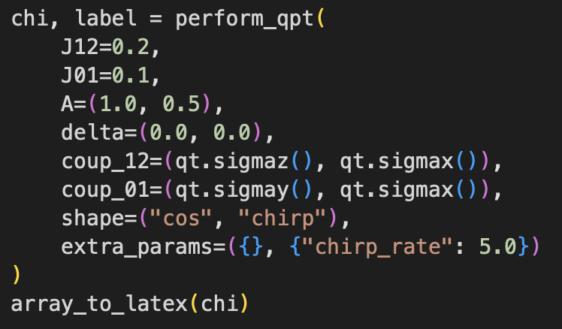
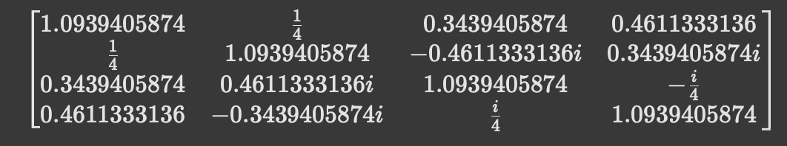
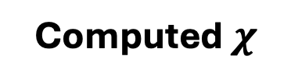
Result for a specific input pulse sequence
Input Pulse
Computed $χ$

Slide 8
Next Steps
Finding gate sequence equivalence to properly model the process tomography.
Finding a smart way to vary input pulse in order to achieve desired gate level effect.
Code link: https://github.com/syedshubha/PulseSCQ/blob/main/QPT_attack.ipynb

