Slide 1

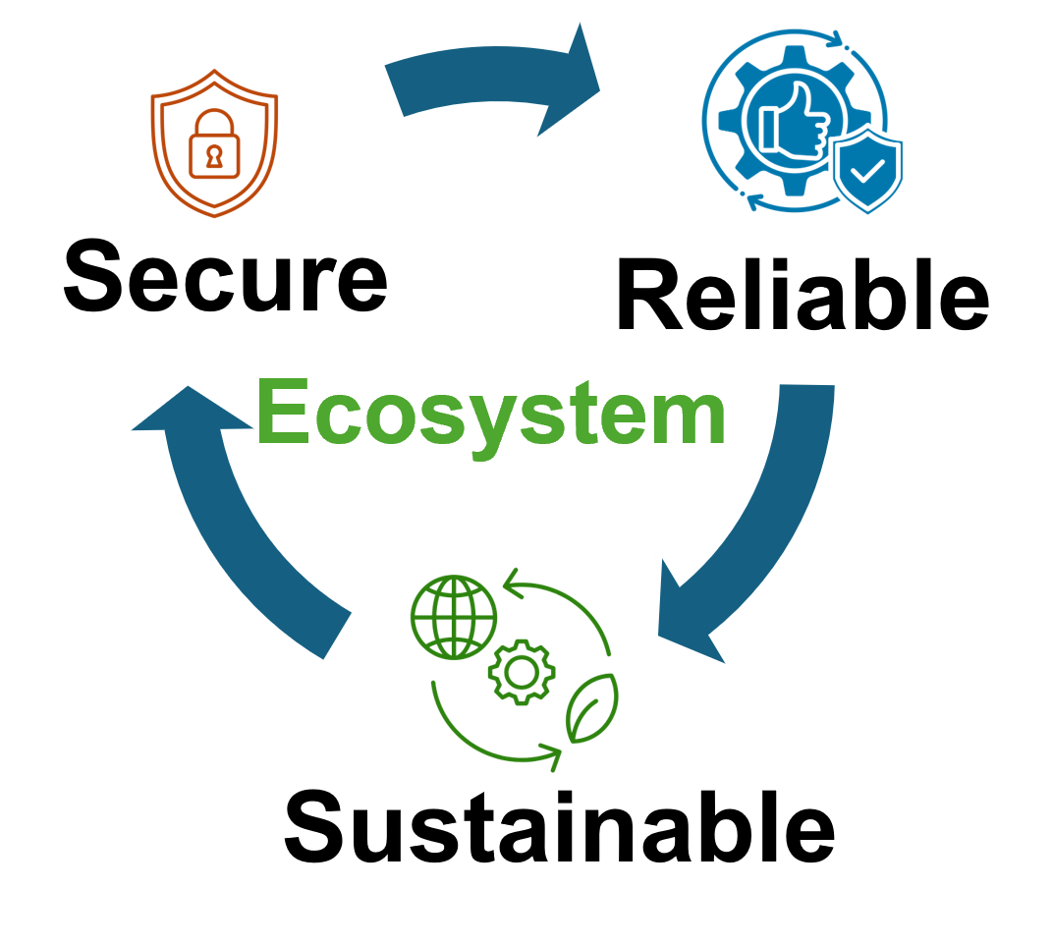


Implementing W-State on Superconducting Qubits via Pulse-Level Coding
Date: May 7, 2025
Syed Emad Uddin Shubha
CS Graduate Student,
Louisiana State University

Slide 2
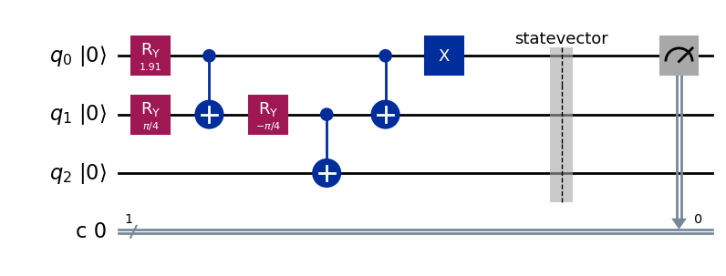

Objective
To implement a 3-qubit W state:
$$|W⟩ = \frac{1}{\sqrt{3}}(|001⟩+\left|010\right\rangle +\left|100\right\rangle )$$
Using Qiskit Pulse for fine-grained quantum control.

Slide 3
Why Pulse-Level Coding?
- Gate abstraction hides hardware noise
- Pulses enable:
• Gaussian envelopes
• Phase-shifted RY
• Calibrated cross-resonance CNOTs

Slide 4
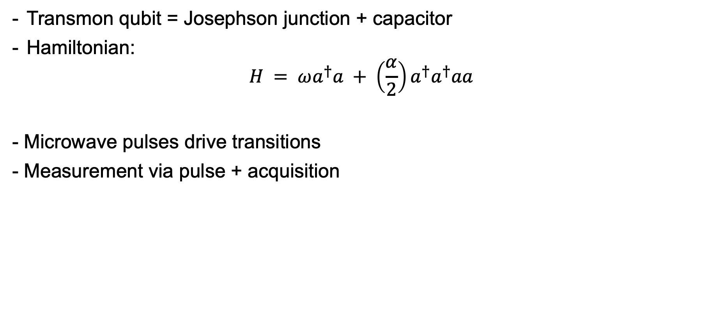
Superconducting Qubits: Physics & Control
Transmon qubit = Josephson junction + capacitor
Hamiltonian:
$$H = ωa^{†}a + \left(\frac{α}{2}\right)a^{†}a^{†}aa$$
- Microwave pulses drive transitions
- Measurement via pulse + acquisition

Slide 5
Superconducting Qubits: Physics & Control
Used actual ibm_sherbrooke.
Map: q0 to Q1, q1 to Q2, q2 to Q3
Physical connection Q1--Q2--Q3
Properties:
Qubit | T1 (µs) | T2 (µs) | RO Error (%) | Driving Freq. (GHz)
Q1 | 302.05 | 239.15 | 2.12 | 4.7363
Q2 | 282.9 | 195.78 | 1.15 | 4.8191
Q3 | 386.03 | 316.41 | 3 | 4.7472

Slide 6
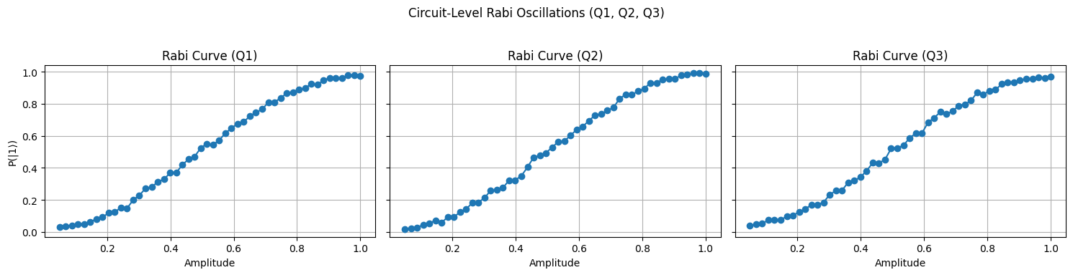

π-Amplitude Calibration (Rabi Experiment)
Simulated calibration via AerSimulator
Applied $R_{x}(θ)$, $θ=Aπ$
- Sweep $A: P(|1⟩) = sin²(θ/2)$
π-amps: $Q1 ≈ 0.9806, Q2 ≈ 0.9612, Q3 ≈ 1$
Measure A that maximizes $P(|1⟩)$

Slide 7

Single-Qubit Gate Pulse
$X(θ): A=θ/t$ from $H=(Ω/2)X$, $A=A_{π}$
- RY(θ):
shift_phase(+π/2)
apply Gaussian with amplitude $A=\frac{θA_{π}}{π}$
shift_phase(-π/2)
- $dt ≈ 0.222 ns$

Slide 8

Two-Qubit Gate: Cross-Resonance CNOT
- $H_{CR} = g_{CR} (X⊗Z)$
- Echoed CR sequence:
1. CR pulse
2. π pulse on target
3. -CR pulse
- Next: tune A and duration

Slide 9
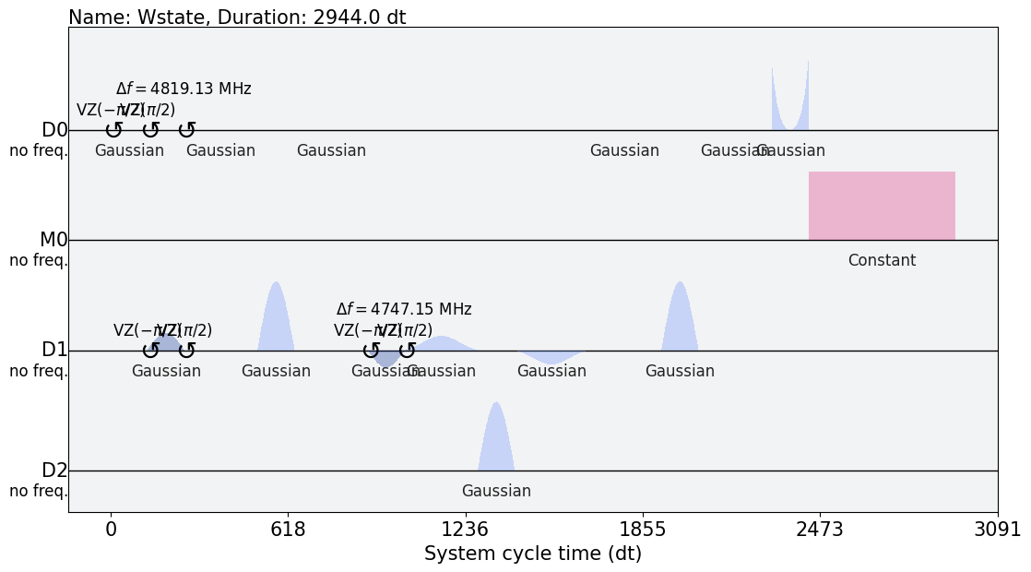
Generated Pulse Sequence

Slide 10

Conclusion
Pulse-level coding enables precise quantum control.
W-state prepared using calibrated RY, X, and CR pulses.
I still have to fix some calibration issue regarding CR.
I have yet to complete the measurement population.
Expected outcome: $P(|0⟩)=2/3$

