Slide 1



Pulse-Level Attack Analysis using Quantum Process Tomography and Kraus Isometry Fitting
Syed Emad Uddin Shubha
Graduate Student, CS LSU
Date: 24 June 2025

Slide 2
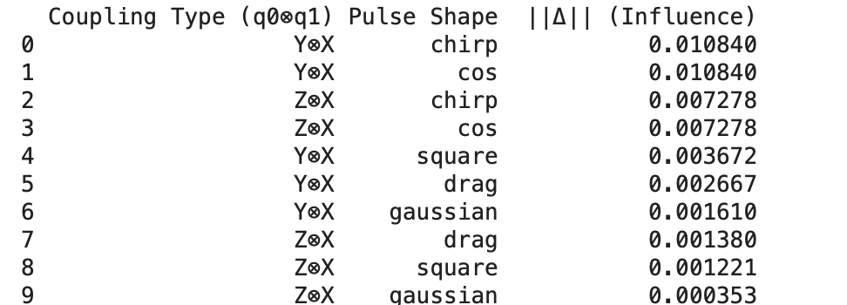
Effect of q0 on q2
We can see dominant crosstalk terms are YX and ZX

Slide 3
Motivation
IBM quantum devices primarily realize ZX-type cross-resonance coupling for entangling gates (CX).
YX-type couplings are also physically possible and, as my simulation shows, may lead to even richer adversarial control in some scenarios.
Understanding both ZX and YX crosstalk is critical for accurate security assessment of multi-tenant quantum hardwares.

Slide 4
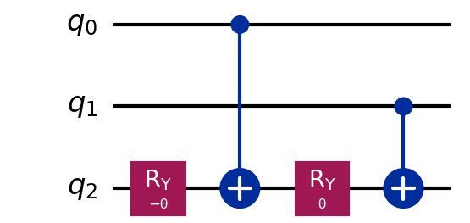
Methodology
Attacker (Eve) controls qubits q0 and q1, victim is q2, with linear topology:
q0–q1–q2
Eve sends shaped pulses to her qubits (q0, q1); coupling = (ZX-ZX or YX-ZX).
Simulate the full system with various pulse shapes, amplitudes, and detuning.
Extract the channel on q2 as χ-matrix (using Quantum Process Tomography) and decompose Kraus operators.
Use polar decomposition and isometry fitting to map the noisy channel to an effective quantum circuit:

Slide 5
Main Results: Detuning and Pulse Shapes
Detuning Robustness:
The attack's effectiveness is remarkably insensitive to frequency detuning on either q0 or q1.
This implies that an adversary could execute this attack without perfect system calibration—making it more practical and robust in real-world scenarios.
Pulse Shape Sensitivity:
Cosine and chirp pulses yield the most pronounced (but least ideal) attacks, leading to stronger but more non-ideal dynamics.
Square and drag pulses are more robust, leading to predictable but less effective attacks

Slide 6
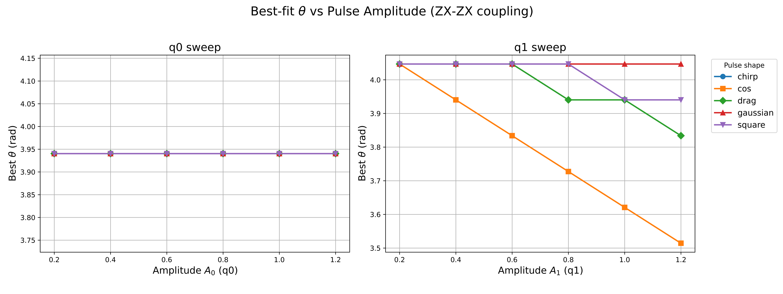
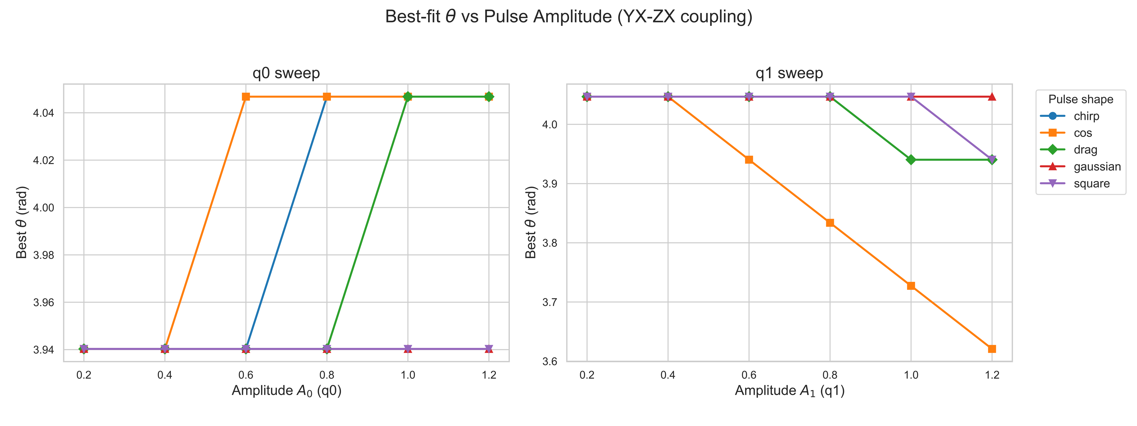
Best θ vs Pulse Amplitude

Slide 7
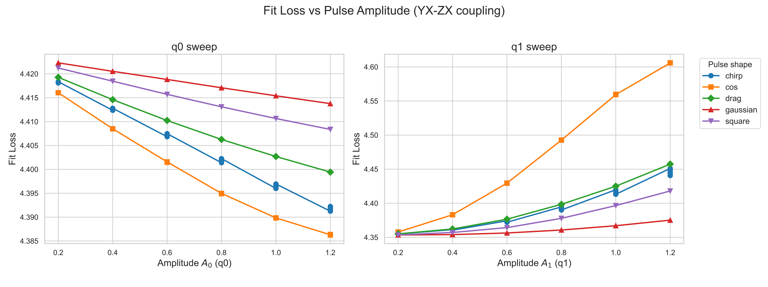
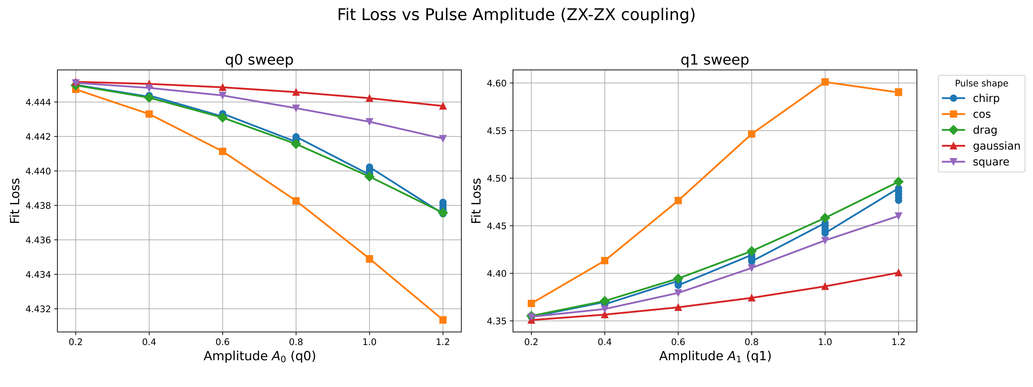
Fit loss vs Pulse Amplitude

Slide 8
Main Results: Coupling
Asymmetric Roles (Driver & Catalyst)
q1 (“driver”): Amplitude controls rotation angle θ. Increasing A1 increases attack strength but can degrade circuit-likeness (fit loss).
q0 (“catalyst”): Alone does not change θ, but reduces fit loss, improving the attack's coherence.
YX-ZX vs. ZX-ZX Coupling
In IBM’s native ZX-ZX, q0 is mostly a catalyst and q1 is the main driver.
In YX-ZX, both q0 and q1 can tune θ and fit loss: more attack flexibility.
YX-ZX coupling thus allows a richer set of adversarial controls, which could be more challenging to defend against as hardware evolves.

Slide 9
Major Novelty & Contributions
Simulation and analysis performed in rotating frame, with parameter regimes relevant to current superconducting quantum hardware.
Comprehensive pulse-level attack modeling: How adversarial pulses on qubits (q0, q1) impact a victim qubit (q2) via both ZX-ZX and YX-ZX coupling.
Isometry-based circuit approximation: Developed and applied an isometry (Kraus-space unitary) fitting method to directly map a noisy physical channel (χ-matrix) to an interpretable quantum circuit model.
Novel Findings: Results indicate some real challenges for multi-tenant quantum computing.

Slide 10
Next Steps
Step 1: Assumptions, threat model, framing of the attack, what access the attacker has and whether victim can notice or identify the attack.
Step 2: Find the goal. Writing the objective without being too technical.
Step 3: Literature Review and showing the gaps- mention explicitly.

