Slide 1

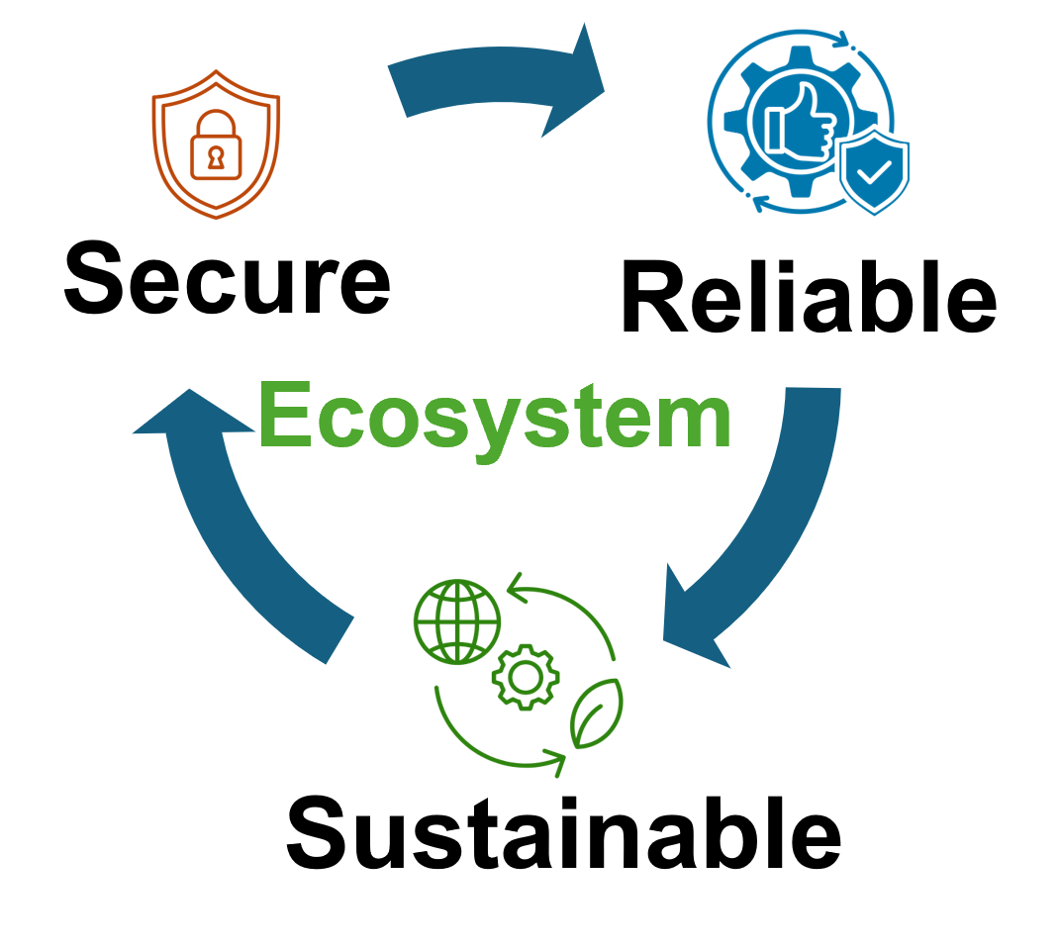


Enhancing Quantum Dense Coding Using Information Entropy-Based Metrics
Syed Emad Uddin Shubha, Tasnuva Farheen
Division of Computer Science And Engineering

Slide 2
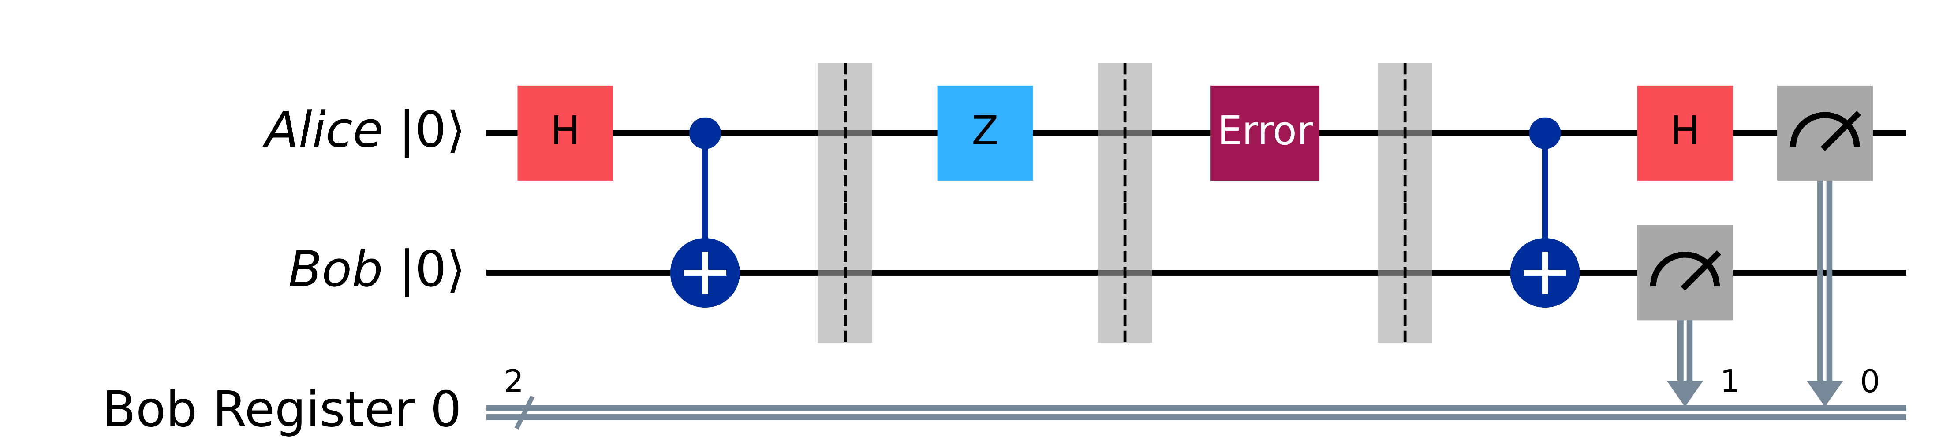

Quantum Internet: Dense Coding
Alice and Bob Share a Bell state ${\left|Φ^{+}\right\rangle }_{AB}=\frac{1}{\sqrt{2}}\left(\left|00\right\rangle +|11⟩\right)$
Alice encodes her qubit by applying either of I,X,Z,ZX to represent 00,01,10,11
Alice sends the qubit to Bob, he performs a Bell Basis measurement
1 qubit carries 2 bits of information [1].

Slide 3
What I am trying to do
Error Correction: Alice encodes her qubit using a 5-qubit perfect code to protect against errors.
Entanglement Quality Assessment: Bob decodes the received qubit and assesses the shared entanglement quality using metrics like Entanglement of Formation (EoF) and Quantum Discord (QD).
Adaptive Entanglement Purification: If the entanglement quality is low (based on QD/EoF), Bob applies an extra layer of entanglement purification using a DEJMPS-style protocol. The purification parameters are adaptively set based on the measured QD/EoF.
Machine Learning Optimization (optional): The strategy may incorporate machine learning to map the correlation measures (QD/EoF) to optimal correction parameters, further enhancing the entanglement purification process.

Slide 4
Todays Practice and Limitation
Standard practice: Shared entanglement (Bell pairs) is used to encode 2 classical bits per qubit, but noise models degrade the Bell state [1,6].
Error correction and purification: Fixed codes or standalone protocols are applied independently without real-time feedback [7-11].
Limitations: Existing protocols don't adapt to actual correlations [8,11], neglecting secondary measures like quantum discord (QD) or entanglement of formation (EoF). And they use either QECC or Purification, not both.

Slide 5
Novelty and Practicality
Integrated Adaptive Strategy: Our protocol uniquely combines QECC with an adaptive entanglement purification step.
Use of Quantum Correlation Metrics: Employing QD and EoF to guide the purification process is novel. Traditional protocols mainly monitor fidelity, which doesn't capture the whole picture.
Tailored Correction and Resource Efficiency: By adaptively tuning the purification parameters based on the state’s current quantum correlations, we may recover a higher degree of entanglement compared to fixed protocols.
Robustness Against Noise: Our combined strategy is designed to handle both phase and amplitude damping errors. By using advanced metrics (QD and EoF), the protocol might be extended for more general errors.
Potential ML Integration: We may use ML to relate DEJMPS with QD+EoF.

Slide 6
Applications
Developing next-gen quantum communication protocols with higher fidelity under realistic noise conditions.
Improving superdense coding schemes for more secure and higher-capacity quantum networks and QKD systems.
Informing hardware designs with adaptive error management to operate under NISQ-era limitations.
Exploring conceptual interest in integrating advanced quantum correlation measures for resource-optimized quantum protocols.
Dense Coding is the basis of Quantum Internet. If successful, our approach can make superdense coding and secure quantum communication more robust and resource-efficient, benefiting both fundamental research and practical implementations.

Slide 7

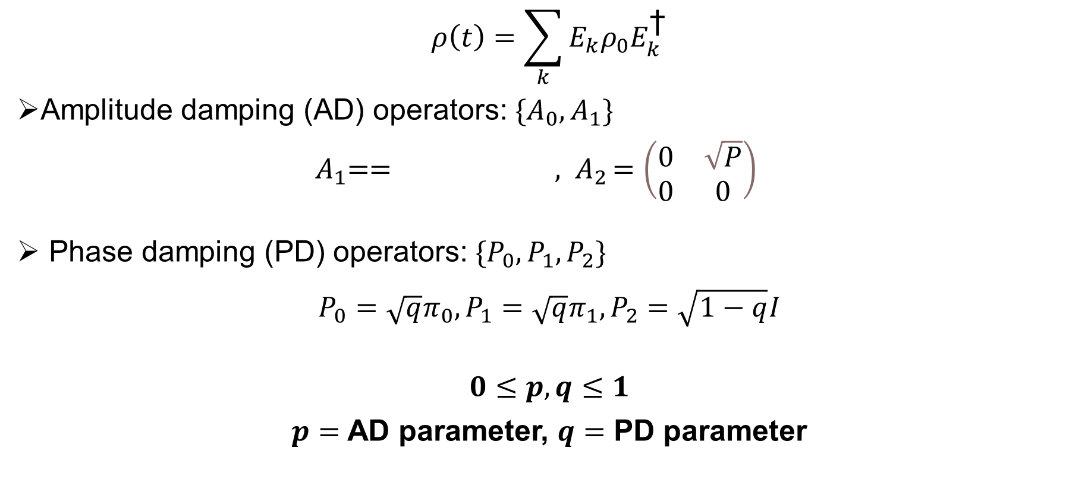
Quantum Noise (for our simulation)
$$ρ\left(t\right)=\sum_{k}{E_{k}ρ_{0}E_{k}^{\text{†}}}$$
Amplitude damping (AD) operators: $\{A_{0}, A_{1}\}$
${ A}_{1}== {, A}_{2}=\left(\begin{matrix}0 & \sqrt{P} \\ 0 & 0\end{matrix}\right)$
Phase damping (PD) operators: $\{P_{0}, P_{1}, P_{2}\}$
$${P_{0}=\sqrt{q}π_{0},P_{1}=\sqrt{q}π_{1},P}_{2}=\sqrt{1−q}I$$
$$0≤p,q≤1$$
$p=$ AD parameter, $q=$ PD parameter

Slide 8
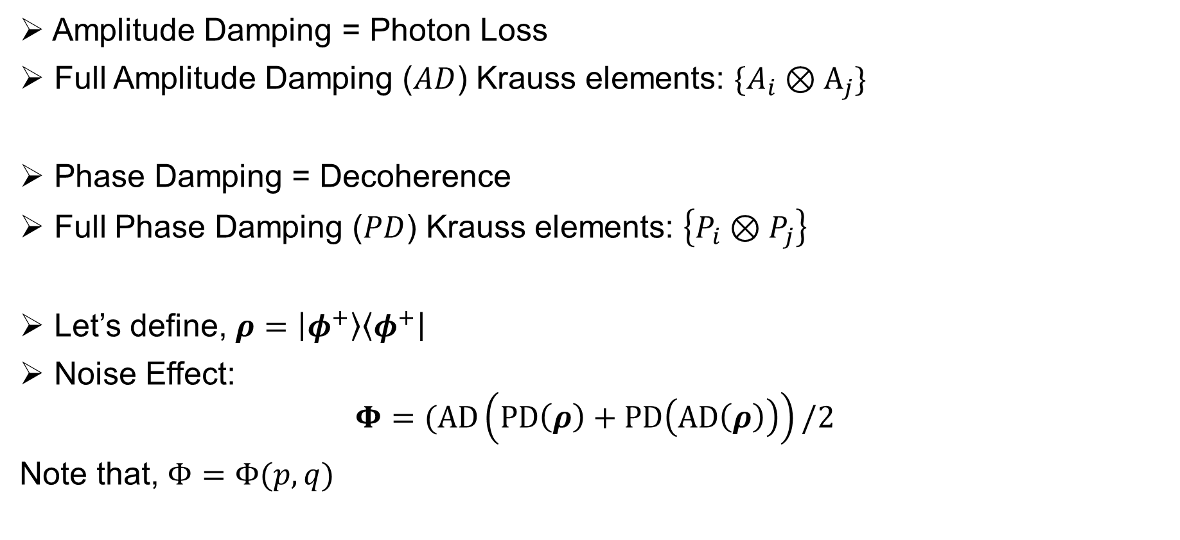
Our Model
Amplitude Damping = Photon Loss
Full Amplitude Damping ($AD$) Krauss elements: $\{A_{i}⊗A_{j}\}$
Phase Damping = Decoherence
Full Phase Damping ($PD$) Krauss elements: $\left\{P_{i}⊗P_{j}\right\}$
Let’s define, $ρ=\left|φ^{+}\right\rangle \left\langle φ^{+}\right|$
Noise Effect:
$$Φ=(AD\left(PD\left(ρ\right)+PD\left(AD\left(ρ\right)\right)\right)/2$$
Note that, $Φ=Φ(p,q)$

Slide 9
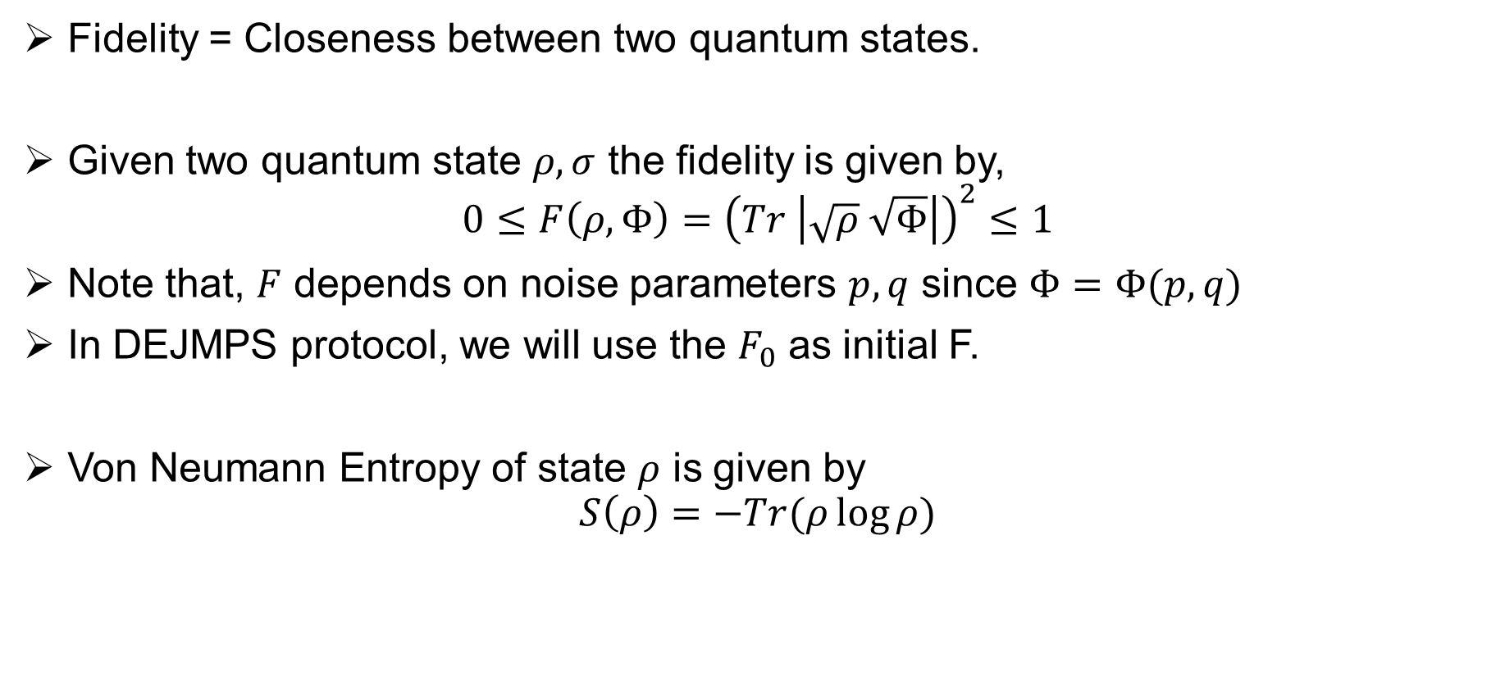
Fidelity and Von Neumann Entropy
Fidelity = Closeness between two quantum states.
Given two quantum state $ρ,σ$ the fidelity is given by,
$$0≤F\left(ρ,Φ\right)={\left(Tr \left|\sqrt{ρ} \sqrt{Φ}\right|\right)}^{2}≤1$$
Note that, $F$ depends on noise parameters $p, q$ since $Φ=Φ(p,q)$
In DEJMPS protocol, we will use the $F_{0}$ as initial F.
Von Neumann Entropy of state $ρ$ is given by
$$S\left(ρ\right)=−Tr(ρ\log{ρ)}$$

Slide 10
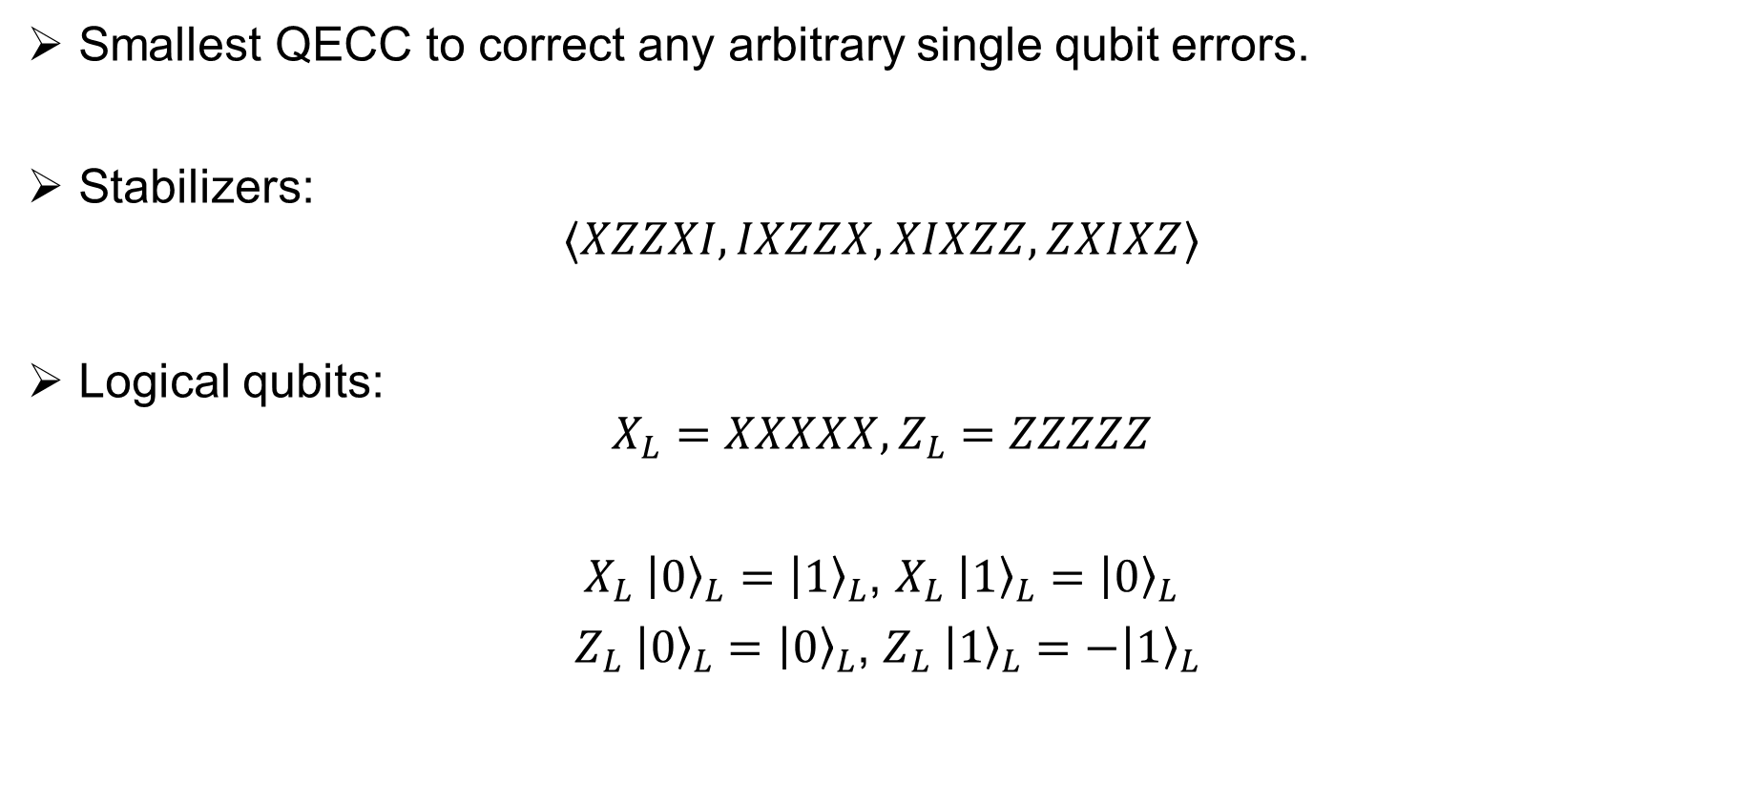
5 Qubit Code
Smallest QECC to correct any arbitrary single qubit errors.
Stabilizers:
$$⟨XZZXI, IXZZX,XIXZZ,ZXIXZ⟩$$
Logical qubits:
$$X_{L}=XXXXX, Z_{L}=ZZZZZ$$
$X_{L} {\left|0\right\rangle }_{L}={\left|1\right\rangle }_{L}$, $X_{L} {\left|1\right\rangle }_{L}={\left|0\right\rangle }_{L}$
$Z_{L} {\left|0\right\rangle }_{L}={\left|0\right\rangle }_{L}$, $Z_{L} {\left|1\right\rangle }_{L}=−{\left|1\right\rangle }_{L}$

Slide 11
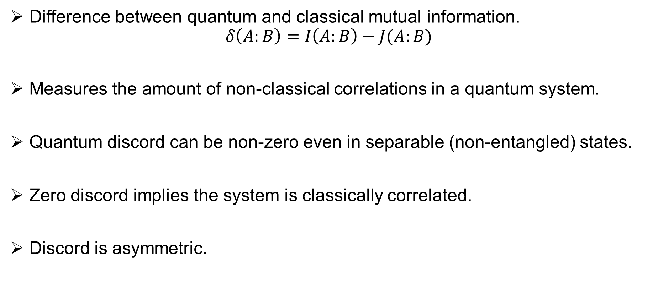
Quantum Discord (QD)
Difference between quantum and classical mutual information.
$$δ\left(A:B\right)=I\left(A:B\right)−J(A:B)$$
Measures the amount of non-classical correlations in a quantum system.
Quantum discord can be non-zero even in separable (non-entangled) states.
Zero discord implies the system is classically correlated.
Discord is asymmetric.

Slide 12
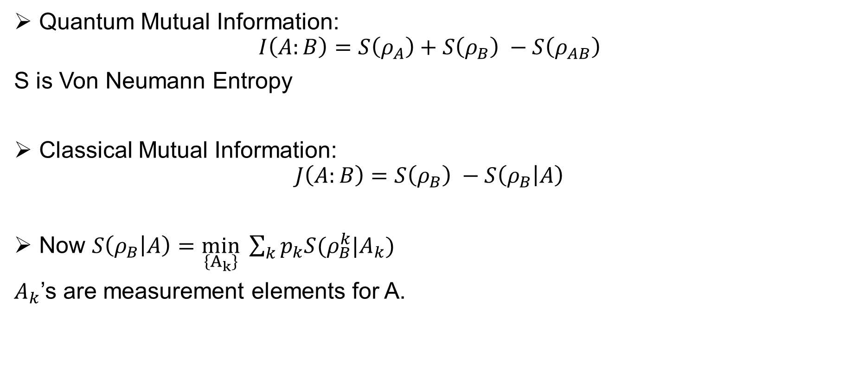
Finding 1
Quantum Mutual Information:
$$I\left(A:B\right)=S\left(ρ_{A}\right)+S\left(ρ_{B}\right) −S\left(ρ_{AB}\right)$$
S is Von Neumann Entropy
Classical Mutual Information:
$$J\left(A:B\right)=S\left(ρ_{B}\right) −S\left(ρ_{B} | A\right)$$
Now $S\left(ρ_{B} | A\right)=\min_{\left\{A_{k}\right\}} \sum_{k}{p_{k}S(ρ_{B}^{k}|A_{k})}$
$A_{k}$’s are measurement elements for A.

Slide 13
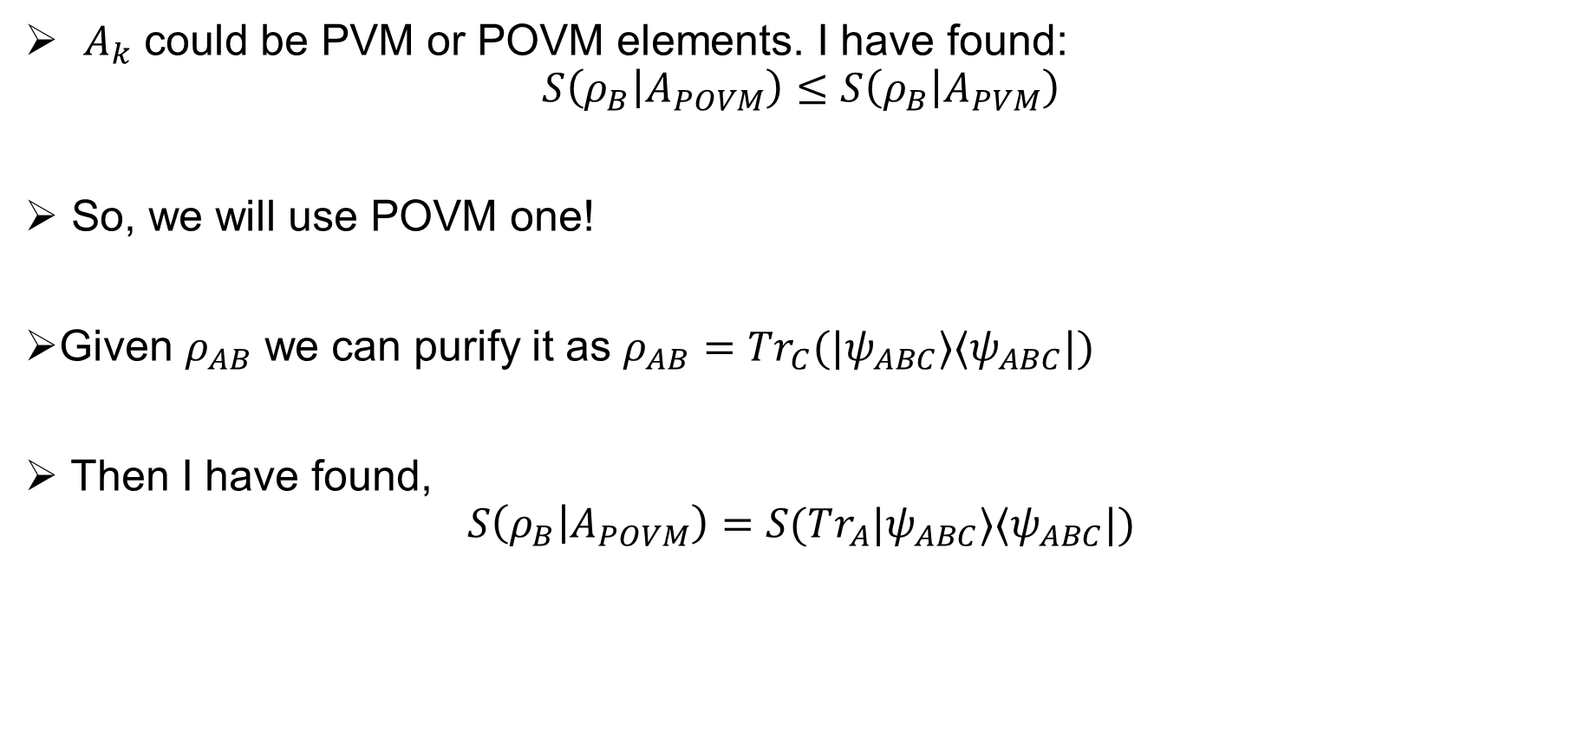
Finding 2
$A_{k}$ could be PVM or POVM elements. I have found:
$$S\left(ρ_{B} | A_{POVM}\right)≤S\left(ρ_{B} | A_{PVM}\right)$$
So, we will use POVM one!
Given $ρ_{AB}$ we can purify it as $ρ_{AB}=Tr_{C}(|ψ_{ABC}⟩⟨ψ_{ABC}|)$
Then I have found,
$$S\left(ρ_{B} | A_{POVM}\right)=S(Tr_{A}|ψ_{ABC}⟩⟨ψ_{ABC}|)$$

Slide 14
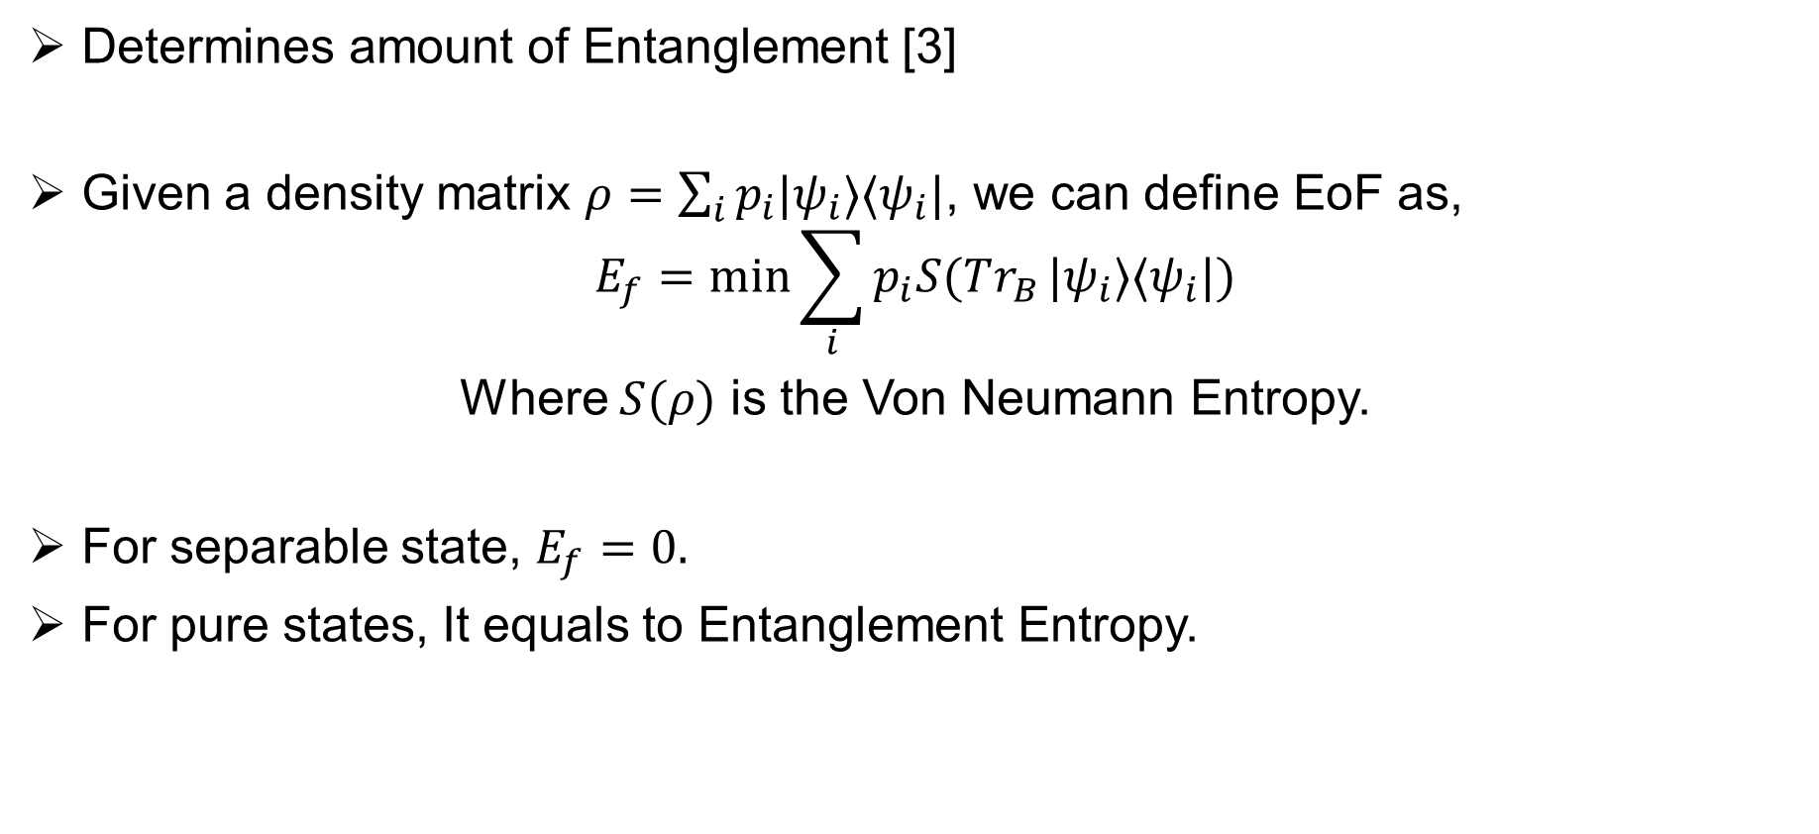
Entanglement of Formation (EoF)
Determines amount of Entanglement [3]
Given a density matrix $ρ=\sum_{i}{p_{i}|ψ_{i}⟩⟨ψ_{i}|}$, we can define EoF as,
$$E_{f}=\min{\sum_{i}{p_{i}S(Tr_{B}}|ψ_{i}⟩⟨ψ_{i}|)}$$
Where $S(ρ)$ is the Von Neumann Entropy.
For separable state, $E_{f}=0.$
For pure states, It equals to Entanglement Entropy.

Slide 15
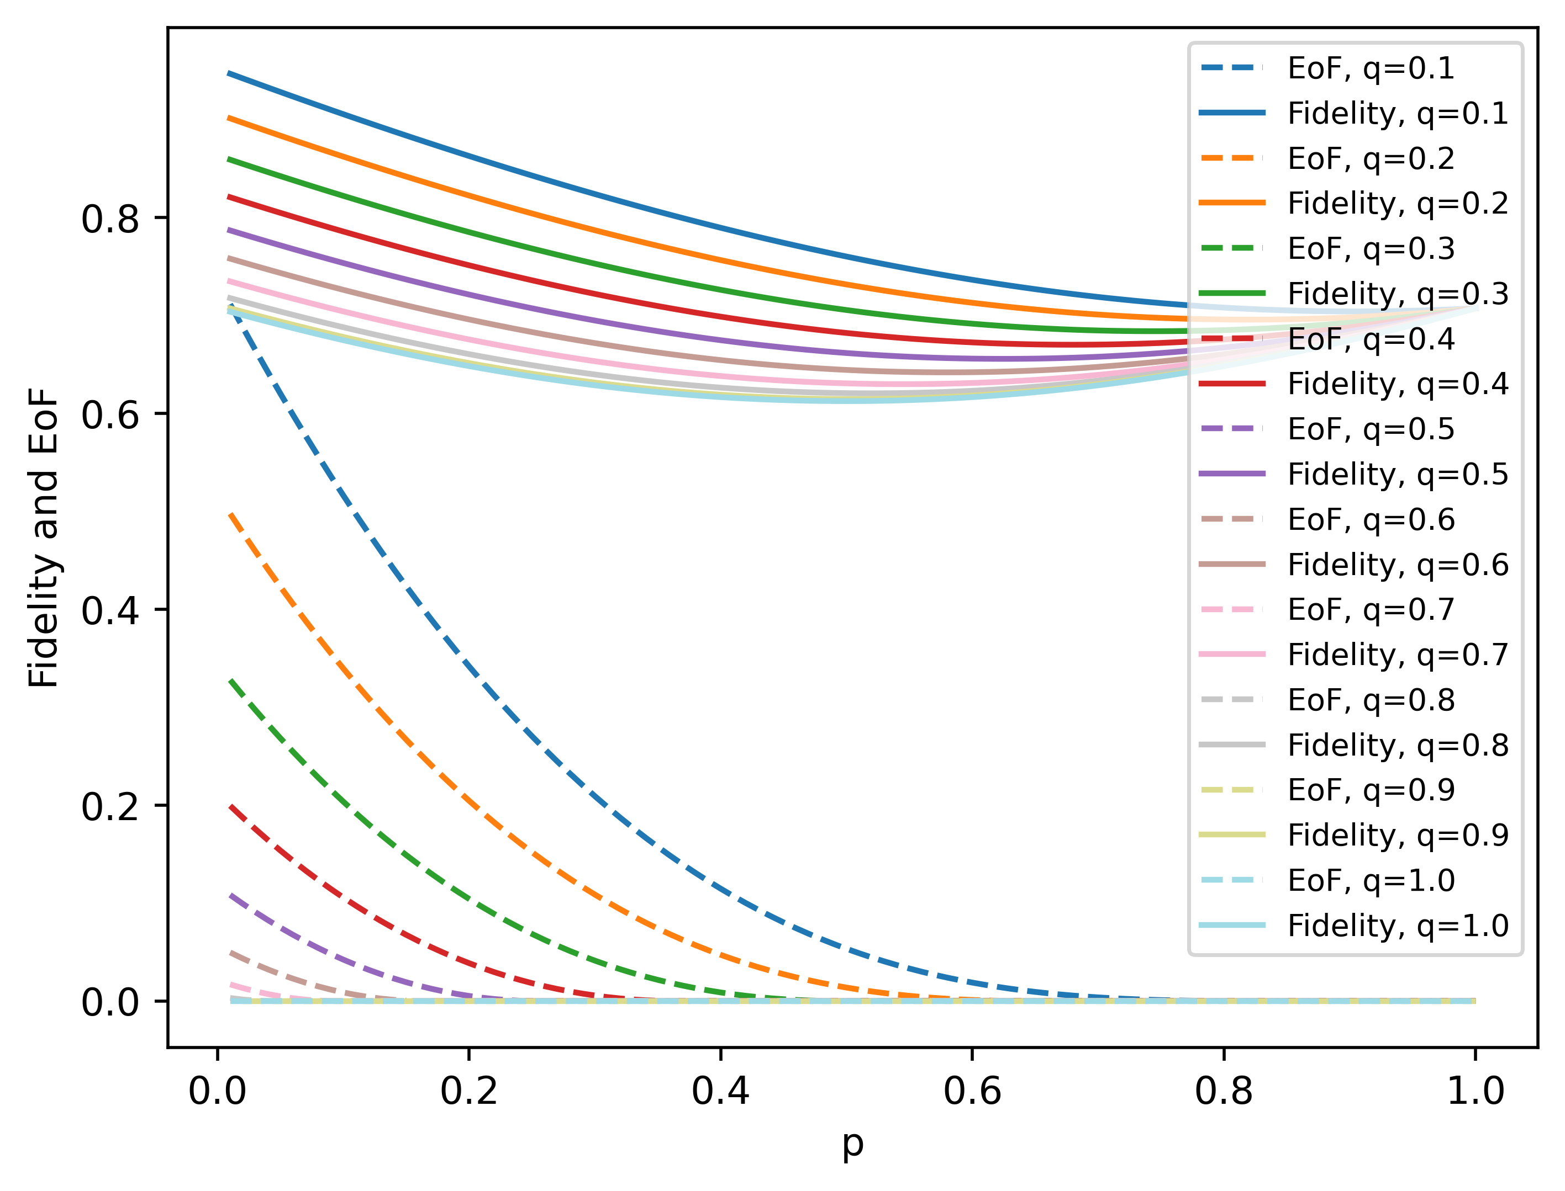
Research Note 1
When EoF is higher, fidelity is also higher. So, 5 Qubit Code is enough.

Slide 16
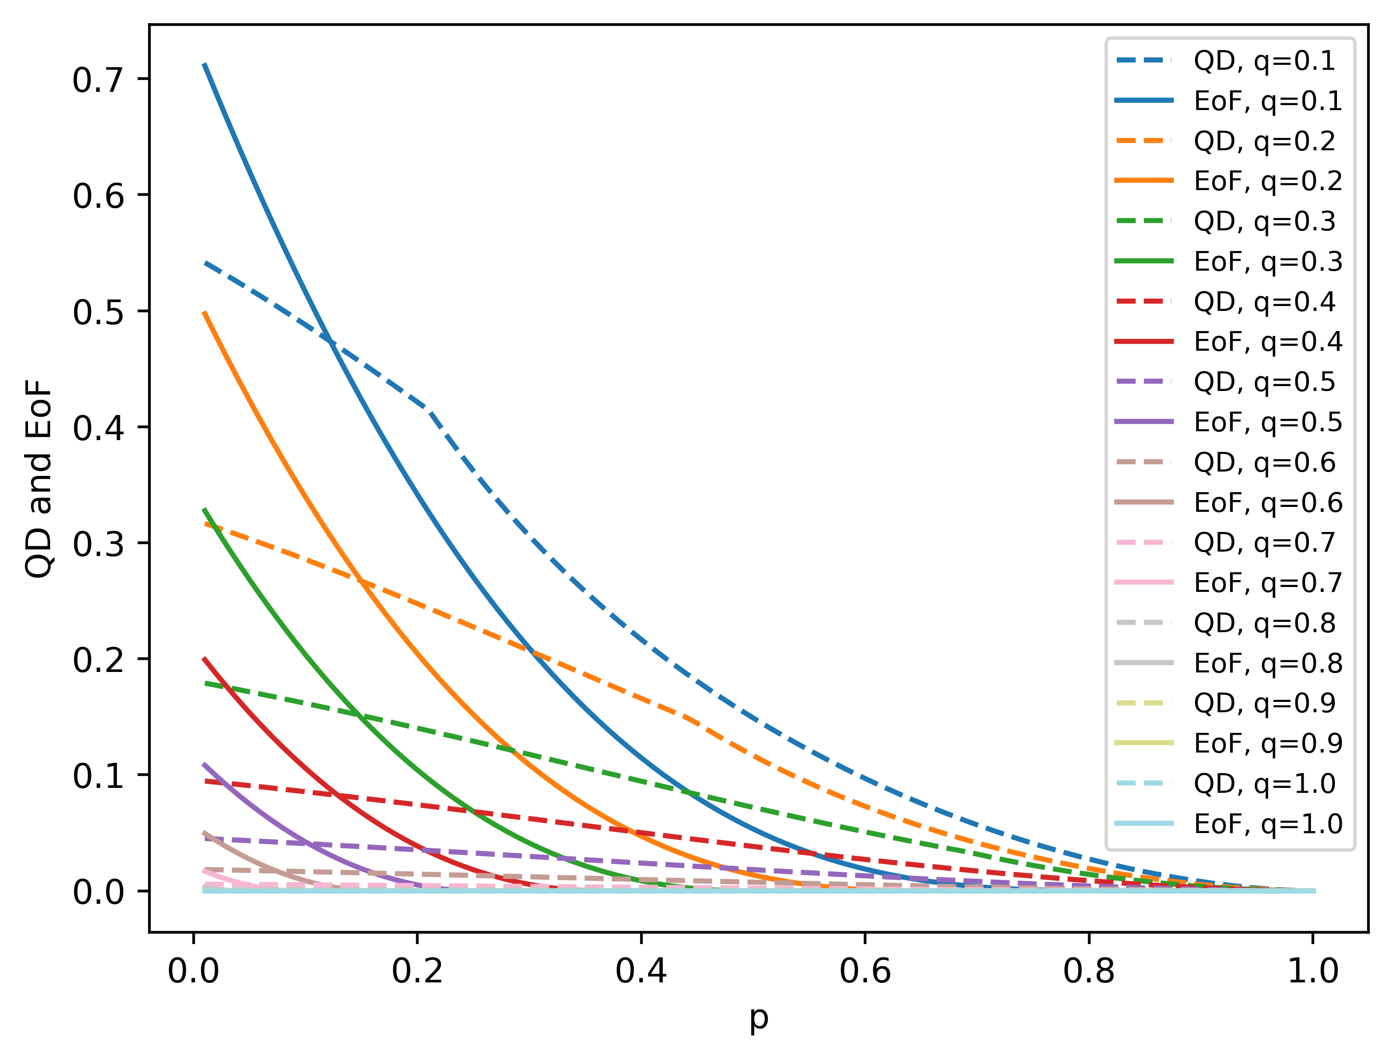
Research Note 2
When EoF is lower, there is still some QD.

Slide 17
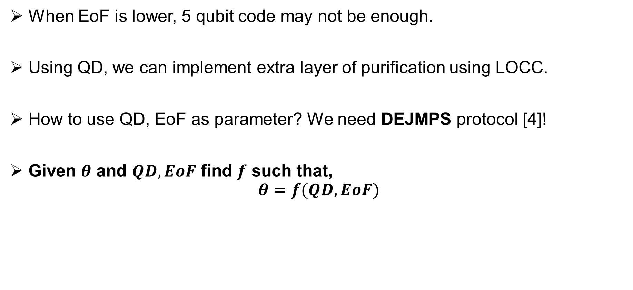
Research Note 3
When EoF is lower, 5 qubit code may not be enough.
Using QD, we can implement extra layer of purification using LOCC.
How to use QD, EoF as parameter? We need DEJMPS protocol [4]!
Given $θ$ and $QD,EoF$ find $f$ such that,
$$θ=f(QD,EoF)$$

Slide 18
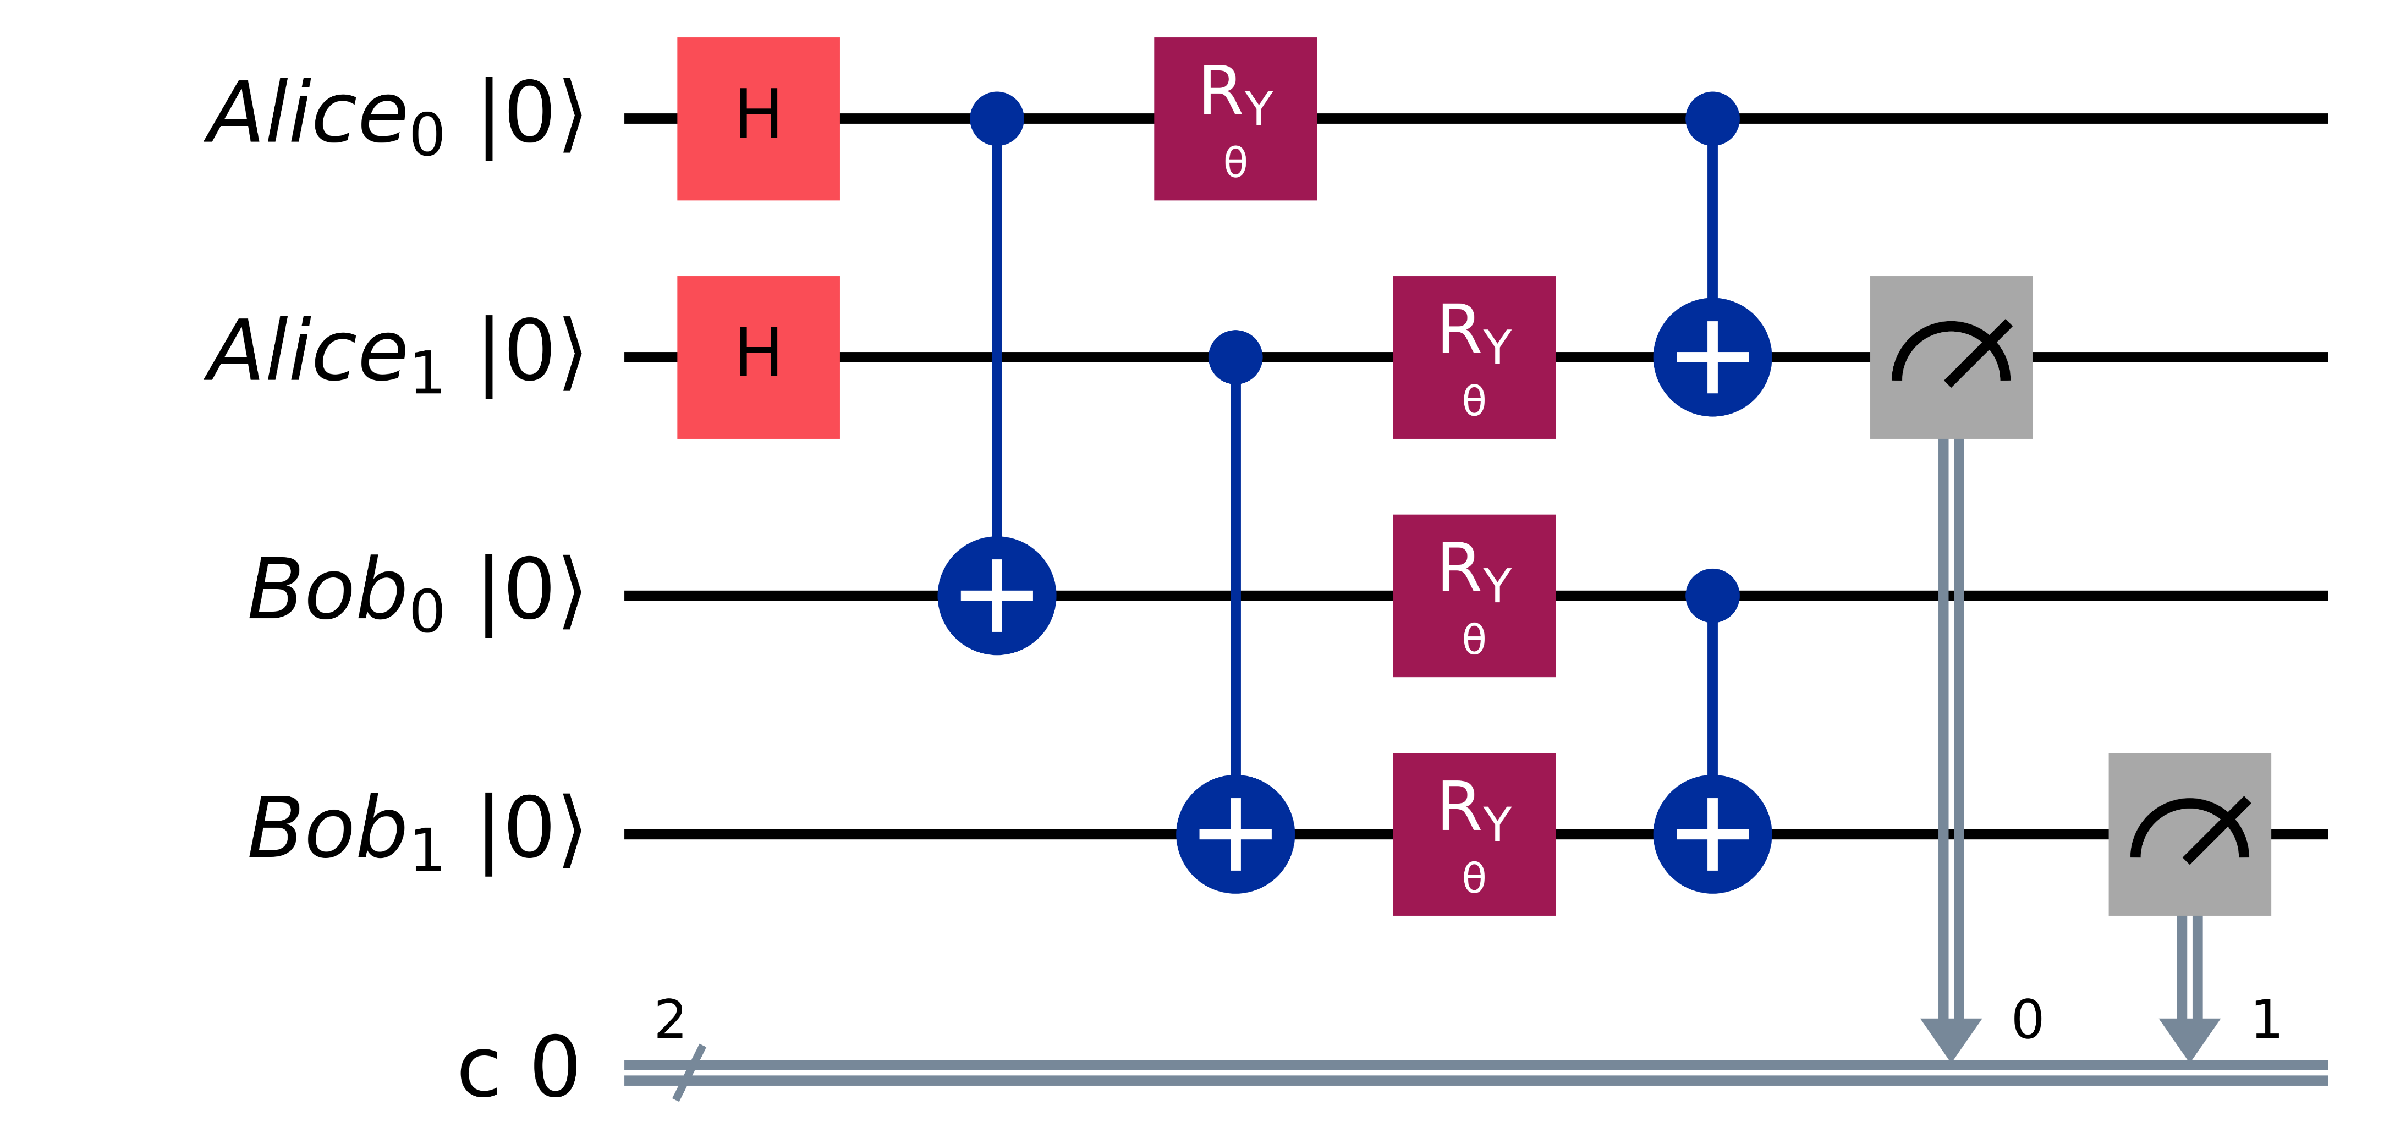

DEJMPS Protocol
$FN=\frac{F^{2}+{\left(1−F\right)}^{2}\sin{θ}}{F^{2}+2F\left(1−F\right)\sin^{2}{θ}+{\left(1−F\right)}^{2}}, p_{s}=F^{2}+2F\left(1−F\right)\sin^{2}{θ}+{\left(1−F\right)}^{2}$

Slide 19
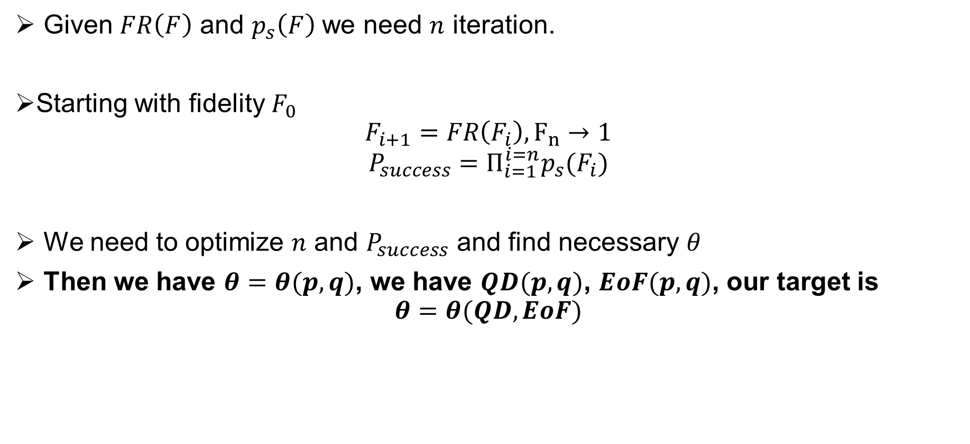
Research Note 4
Given $FR\left(F\right)$ and $p_{s}\left(F\right)$ we need $n$ iteration.
Starting with fidelity $F_{0}$
$$F_{i+1}=FR\left(F_{i}\right), F_{n}→1$$
$$P_{success}=Π_{i=1}^{i=n}p_{s}(F_{i})$$
We need to optimize $n$ and $P_{success}$ and find necessary $θ$
Then we have $θ=θ(p,q)$, we have $QD(p,q)$, $EoF(p,q)$, our target is
$$θ=θ(QD, EoF)$$

Slide 20
References
[1] https://doi.org/10.1103/PhysRevLett.69.2881
[2] https://doi.org/10.1038/srep06956
[3] https://doi.org/10.1103/PhysRevA.83.054101
[4] https://doi.org/10.1103/PhysRevLett.77.2818
[5] https://doi.org/10.1103/PhysRevLett.86.5811
[6] https://doi.org/10.1103/PhysRevLett.118.050501
[7] https://doi.org/10.1007/s11128-018-1920-z
[8] https://doi.org/10.48550/arXiv.2210.15161
[9] https://doi.org/10.48550/arXiv.quant-ph/0702156
[10] https://doi.org/10.1103/PRXQuantum.3.020302
[11] https://doi.org/10.1515/qmetro-2016-0001

