Slide 1

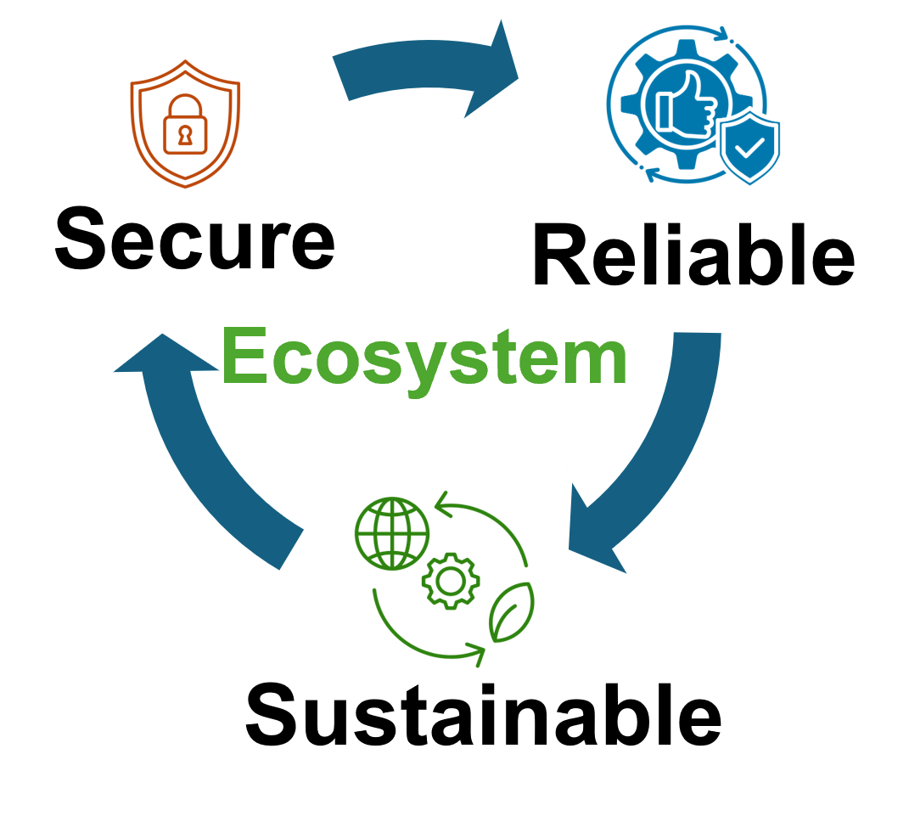


Enhanced Quantum Internet Using Metrics Based on Information Entropy
Syed Emad Uddin Shubha, Tasnuva Farheen
Division of Computer Science And Engineering

Slide 2
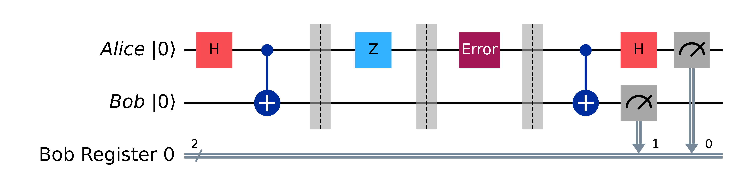

Quantum Internet: Dense Coding
Alice and Bob Share a Bell state ${\left|Φ^{+}\right\rangle }_{AB}=\frac{1}{\sqrt{2}}\left(\left|00\right\rangle +|11⟩\right)$
Alice encodes her qubit by applying either of I,X,Z,ZX to represent 00,01,10,11
Alice sends the qubit to Bob, he performs a Bell Basis measurement
1 qubit carries 2 bits of information [1].

Slide 3
Motivation
Quantum discord can be used as a resource for quantum cryptography [2].
Superdense Coding is the basis for quantum internet.
When Alice sends her qubit, it can be affected by noise.
This noise model is easier to simulate since it is just one qubit.
Alice can use 5 qubit perfect code to encode her qubit.
However it may not enough depending on the noise.
Fidelity alone isn’t enough to learn about the noise channel.
We can use another layer of entanglement purification based on Quantum Discord and Entanglement of Formation: DEJMPS protocol.
DEJMPS needs an angle which determines the efficiency of purification.
Why need Entanglement of Formation? To know the quality of Entanglement.

Slide 4

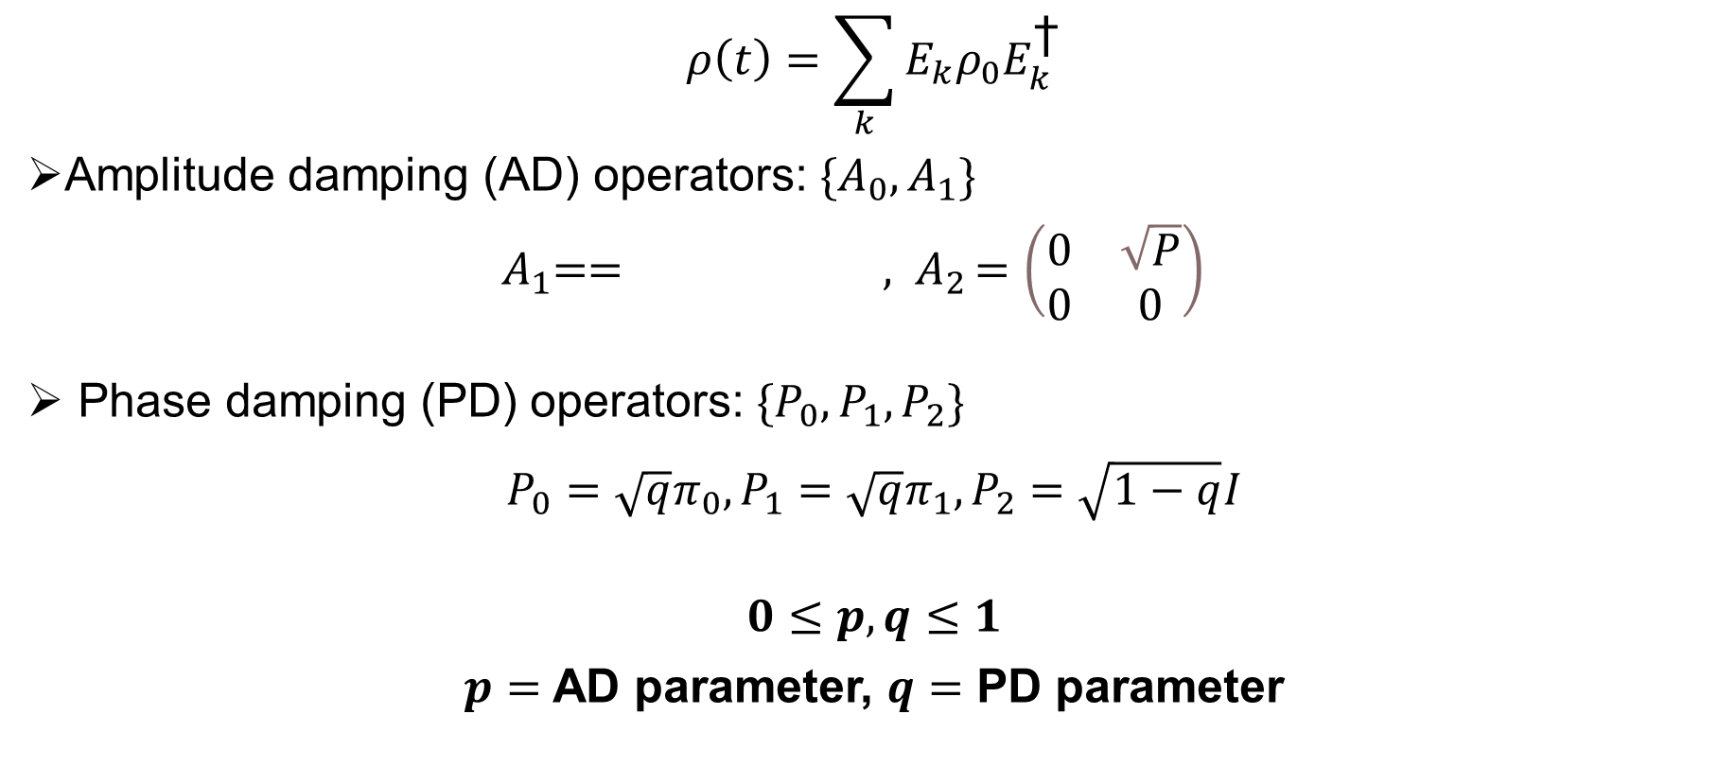
Quantum Noise (for our simulation)
$$ρ\left(t\right)=\sum_{k}{E_{k}ρ_{0}E_{k}^{\text{†}}}$$
Amplitude damping (AD) operators: $\{A_{0}, A_{1}\}$
${ A}_{1}== {, A}_{2}=\left(\begin{matrix}0 & \sqrt{P} \\ 0 & 0\end{matrix}\right)$
Phase damping (PD) operators: $\{P_{0}, P_{1}, P_{2}\}$
$${P_{0}=\sqrt{q}π_{0},P_{1}=\sqrt{q}π_{1},P}_{2}=\sqrt{1−q}I$$
$$0≤p,q≤1$$
$p=$ AD parameter, $q=$ PD parameter

Slide 5
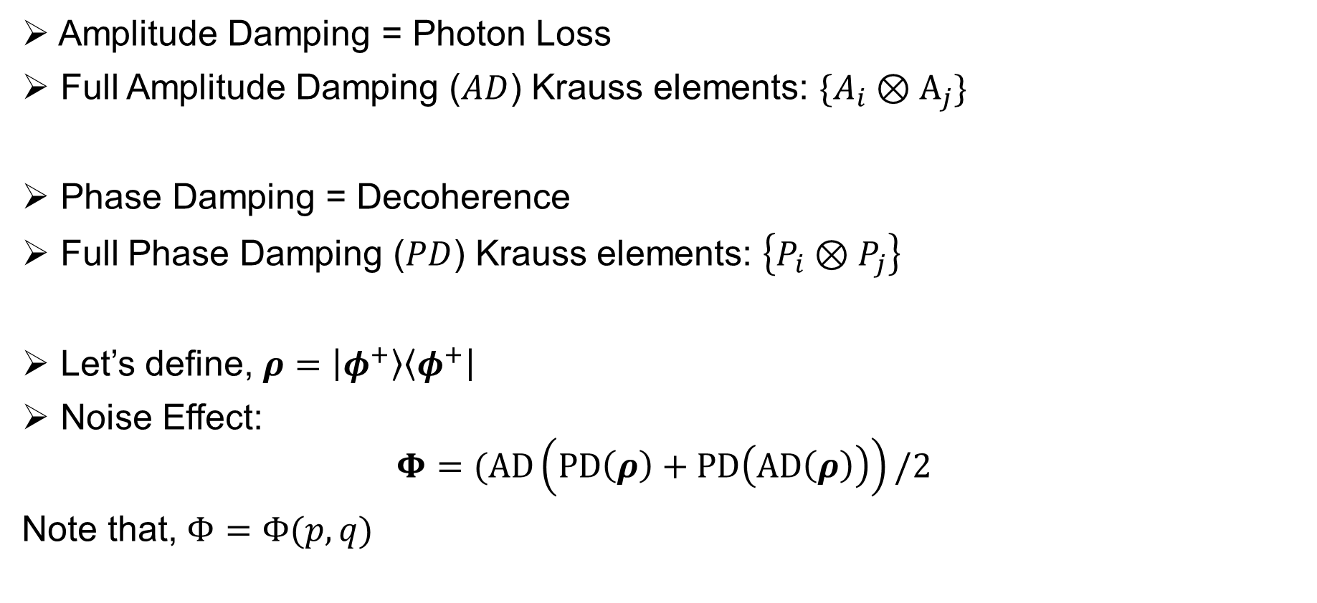
Our Model
Amplitude Damping = Photon Loss
Full Amplitude Damping ($AD$) Krauss elements: $\{A_{i}⊗A_{j}\}$
Phase Damping = Decoherence
Full Phase Damping ($PD$) Krauss elements: $\left\{P_{i}⊗P_{j}\right\}$
Let’s define, $ρ=\left|φ^{+}\right\rangle \left\langle φ^{+}\right|$
Noise Effect:
$$Φ=(AD\left(PD\left(ρ\right)+PD\left(AD\left(ρ\right)\right)\right)/2$$
Note that, $Φ=Φ(p,q)$

Slide 6
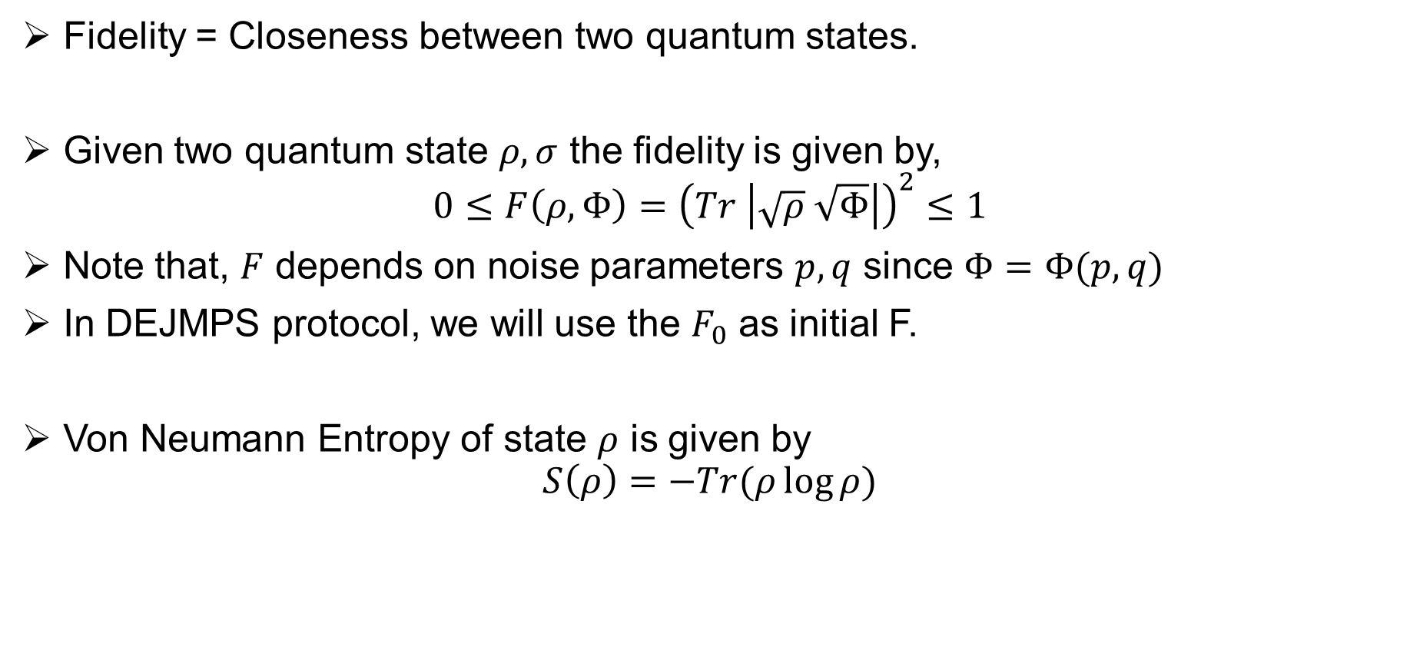
Fidelity and Von Neumann Entropy
Fidelity = Closeness between two quantum states.
Given two quantum state $ρ,σ$ the fidelity is given by,
$$0≤F\left(ρ,Φ\right)={\left(Tr \left|\sqrt{ρ} \sqrt{Φ}\right|\right)}^{2}≤1$$
Note that, $F$ depends on noise parameters $p, q$ since $Φ=Φ(p,q)$
In DEJMPS protocol, we will use the $F_{0}$ as initial F.
Von Neumann Entropy of state $ρ$ is given by
$$S\left(ρ\right)=−Tr(ρ\log{ρ)}$$

Slide 7
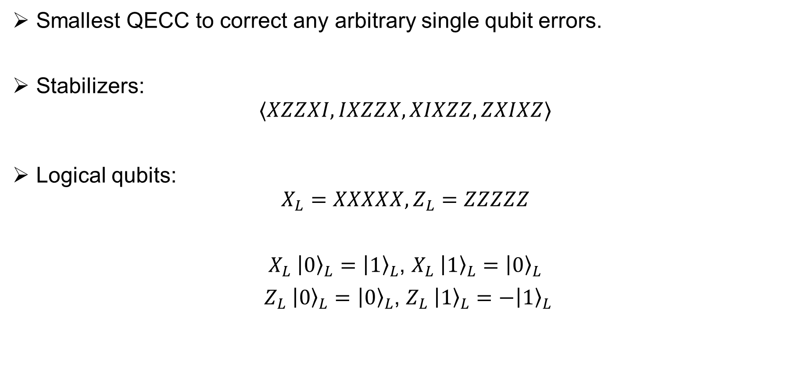
5 Qubit Code
Smallest QECC to correct any arbitrary single qubit errors.
Stabilizers:
$$⟨XZZXI, IXZZX,XIXZZ,ZXIXZ⟩$$
Logical qubits:
$$X_{L}=XXXXX, Z_{L}=ZZZZZ$$
$X_{L} {\left|0\right\rangle }_{L}={\left|1\right\rangle }_{L}$, $X_{L} {\left|1\right\rangle }_{L}={\left|0\right\rangle }_{L}$
$Z_{L} {\left|0\right\rangle }_{L}={\left|0\right\rangle }_{L}$, $Z_{L} {\left|1\right\rangle }_{L}=−{\left|1\right\rangle }_{L}$

Slide 8
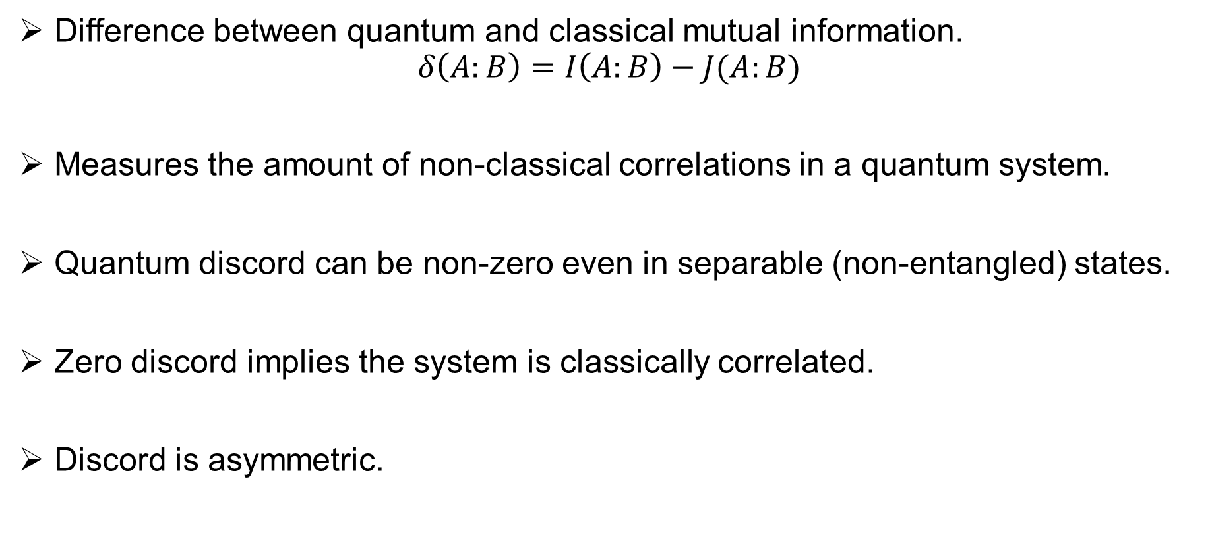
Quantum Discord (QD)
Difference between quantum and classical mutual information.
$$δ\left(A:B\right)=I\left(A:B\right)−J(A:B)$$
Measures the amount of non-classical correlations in a quantum system.
Quantum discord can be non-zero even in separable (non-entangled) states.
Zero discord implies the system is classically correlated.
Discord is asymmetric.

Slide 9
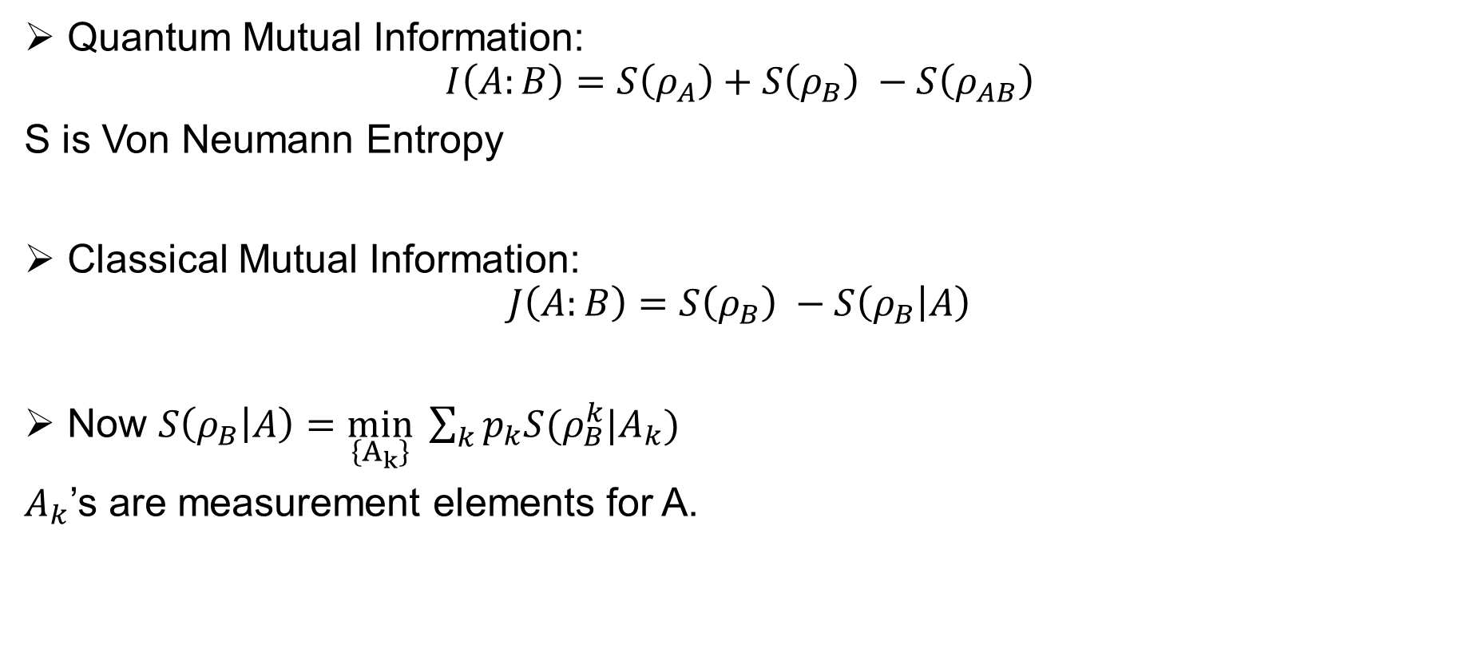
Finding 1
Quantum Mutual Information:
$$I\left(A:B\right)=S\left(ρ_{A}\right)+S\left(ρ_{B}\right) −S\left(ρ_{AB}\right)$$
S is Von Neumann Entropy
Classical Mutual Information:
$$J\left(A:B\right)=S\left(ρ_{B}\right) −S\left(ρ_{B} | A\right)$$
Now $S\left(ρ_{B} | A\right)=\min_{\left\{A_{k}\right\}} \sum_{k}{p_{k}S(ρ_{B}^{k}|A_{k})}$
$A_{k}$’s are measurement elements for A.

Slide 10
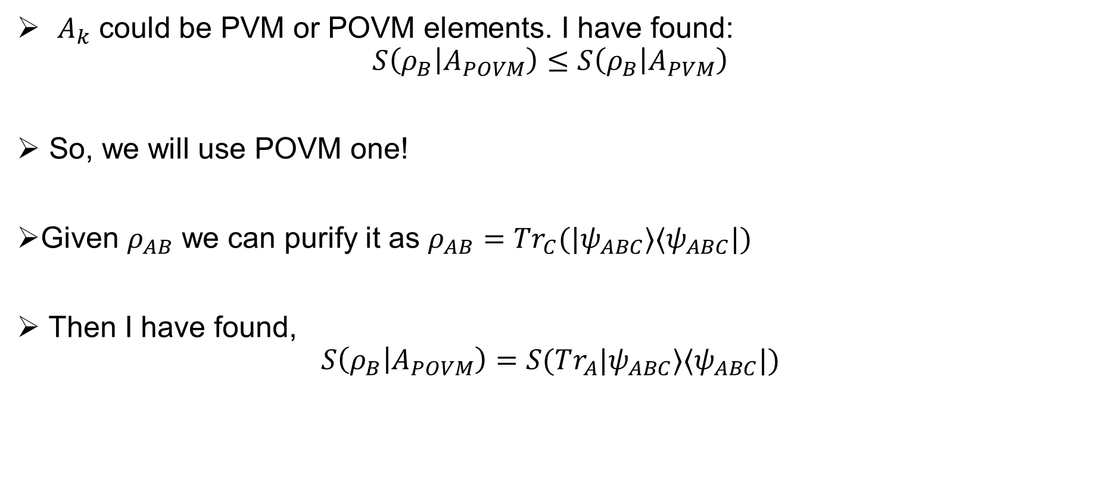
Finding 2
$A_{k}$ could be PVM or POVM elements. I have found:
$$S\left(ρ_{B} | A_{POVM}\right)≤S\left(ρ_{B} | A_{PVM}\right)$$
So, we will use POVM one!
Given $ρ_{AB}$ we can purify it as $ρ_{AB}=Tr_{C}(|ψ_{ABC}⟩⟨ψ_{ABC}|)$
Then I have found,
$$S\left(ρ_{B} | A_{POVM}\right)=S(Tr_{A}|ψ_{ABC}⟩⟨ψ_{ABC}|)$$

Slide 11
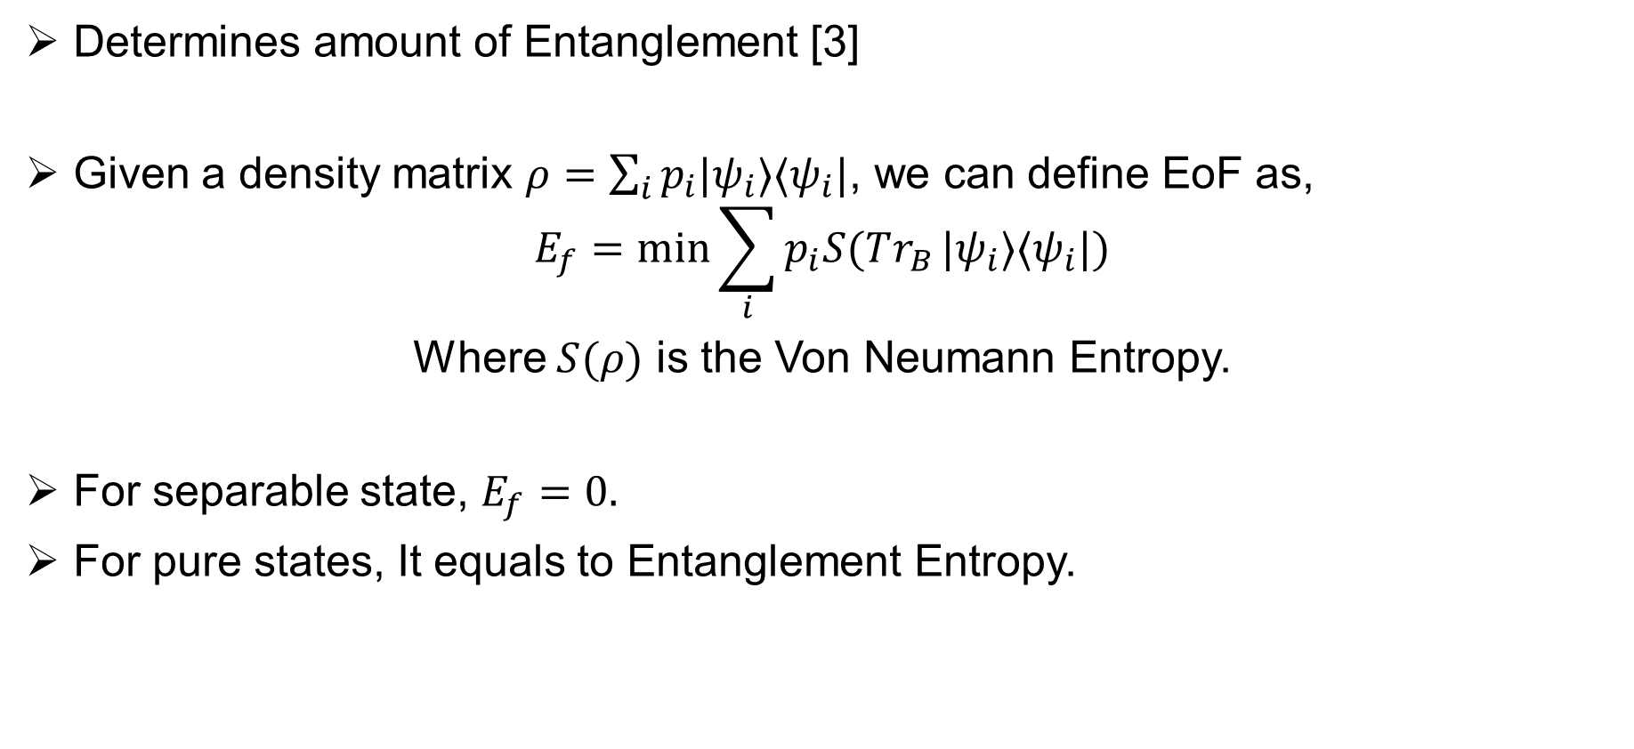
Entanglement of Formation (EoF)
Determines amount of Entanglement [3]
Given a density matrix $ρ=\sum_{i}{p_{i}|ψ_{i}⟩⟨ψ_{i}|}$, we can define EoF as,
$$E_{f}=\min{\sum_{i}{p_{i}S(Tr_{B}}|ψ_{i}⟩⟨ψ_{i}|)}$$
Where $S(ρ)$ is the Von Neumann Entropy.
For separable state, $E_{f}=0.$
For pure states, It equals to Entanglement Entropy.

Slide 12
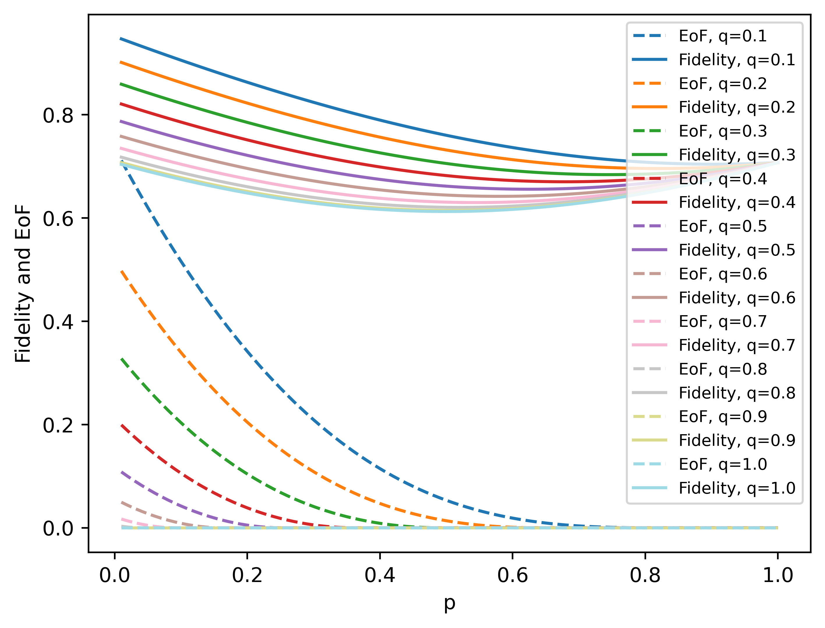
Research Note 1
When EoF is higher, fidelity is also higher. So, 5 Qubit Code is enough.

Slide 13
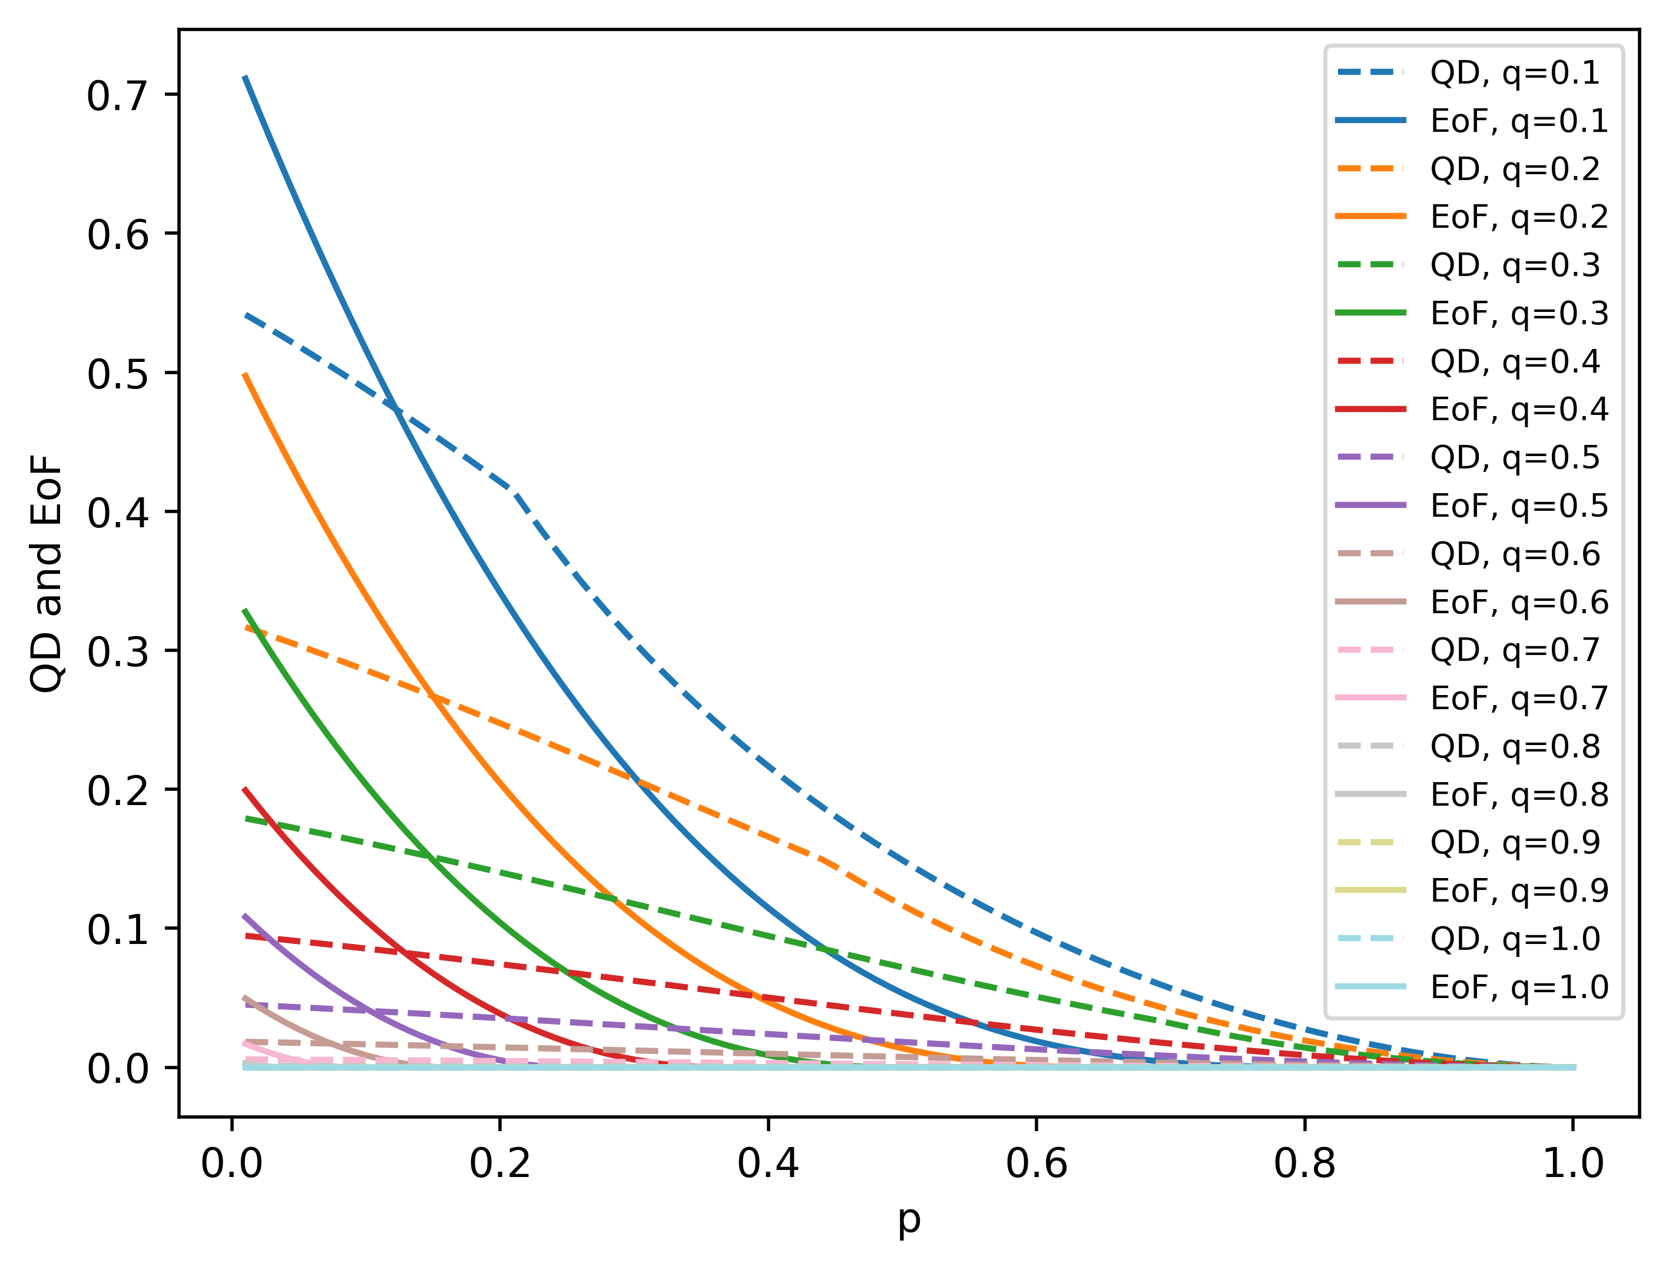
Research Note 2
When EoF is lower, there is still some QD.

Slide 14
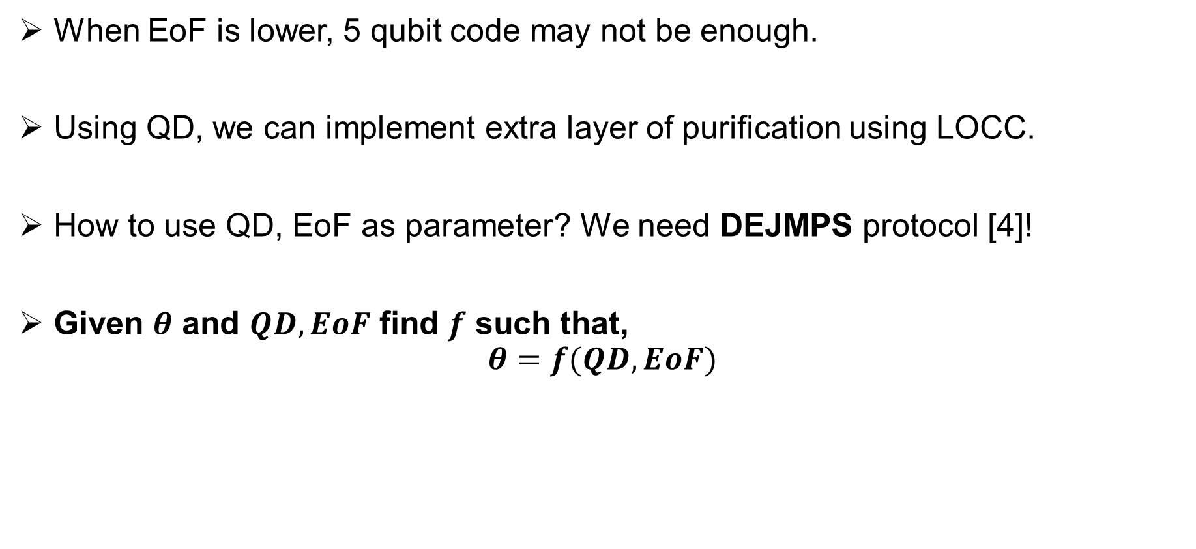
Research Note 3
When EoF is lower, 5 qubit code may not be enough.
Using QD, we can implement extra layer of purification using LOCC.
How to use QD, EoF as parameter? We need DEJMPS protocol [4]!
Given $θ$ and $QD,EoF$ find $f$ such that,
$$θ=f(QD,EoF)$$

Slide 15
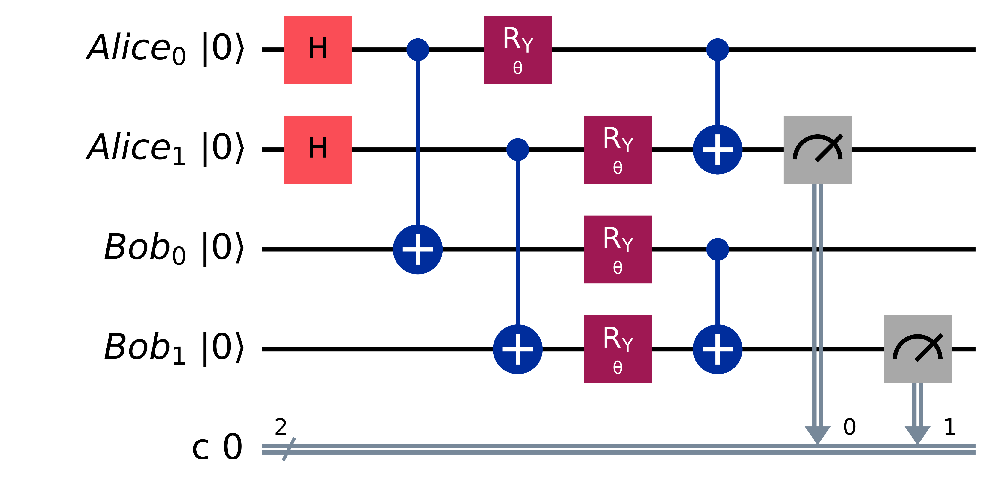

DEJMPS Protocol
$FN=\frac{F^{2}+{\left(1−F\right)}^{2}\sin{θ}}{F^{2}+2F\left(1−F\right)\sin^{2}{θ}+{\left(1−F\right)}^{2}}, p_{s}=F^{2}+2F\left(1−F\right)\sin^{2}{θ}+{\left(1−F\right)}^{2}$

Slide 16
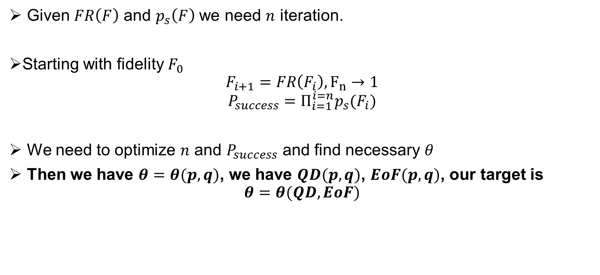
Research Note 4
Given $FR\left(F\right)$ and $p_{s}\left(F\right)$ we need $n$ iteration.
Starting with fidelity $F_{0}$
$$F_{i+1}=FR\left(F_{i}\right), F_{n}→1$$
$$P_{success}=Π_{i=1}^{i=n}p_{s}(F_{i})$$
We need to optimize $n$ and $P_{success}$ and find necessary $θ$
Then we have $θ=θ(p,q)$, we have $QD(p,q)$, $EoF(p,q)$, our target is
$$θ=θ(QD, EoF)$$

Slide 17
References
[1] https://doi.org/10.1103/PhysRevLett.69.2881
[2] https://doi.org/10.1038/srep06956
[3] https://doi.org/10.1103/PhysRevA.83.054101
[4] https://doi.org/10.1103/PhysRevLett.77.2818
[5] https://doi.org/10.1103/PhysRevLett.86.5811

