Slide 1



Increasing Teleportation Fidelity using Stabilizer Code based on Information Entropy Metrics
Syed Emad Uddin Shubha
Graduate Research Assistant
Louisiana State University

Slide 2
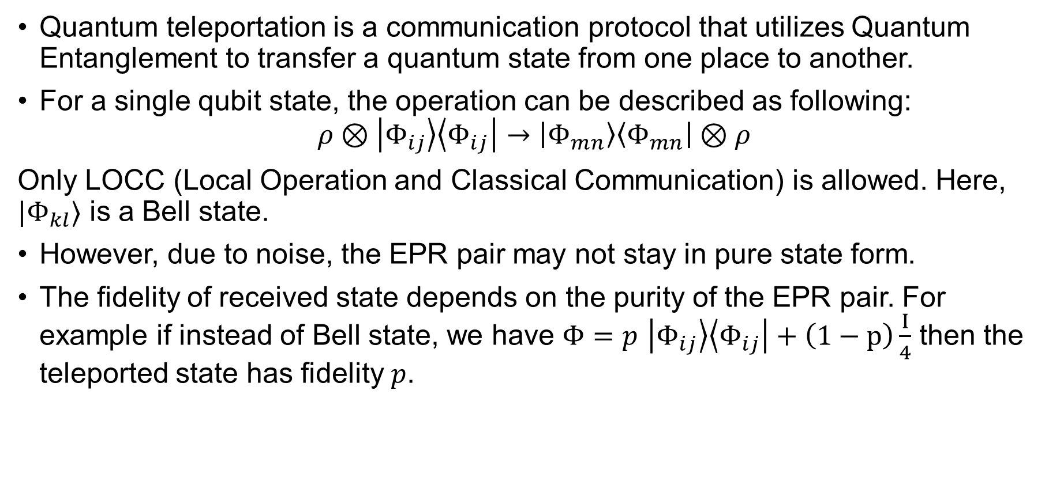
Quantum Teleportation
Quantum teleportation is a communication protocol that utilizes Quantum Entanglement to transfer a quantum state from one place to another.
For a single qubit state, the operation can be described as following:
$$ρ⊗\left|Φ_{ij}\right\rangle \left\langle Φ_{ij}\right|→\left|Φ_{mn}\right\rangle \left\langle Φ_{mn}\right|⊗ρ$$
Only LOCC (Local Operation and Classical Communication) is allowed. Here, $|Φ_{kl}⟩$ is a Bell state.
However, due to noise, the EPR pair may not stay in pure state form.
The fidelity of received state depends on the purity of the EPR pair. For example if instead of Bell state, we have $Φ=p$ $\left|Φ_{ij}\right\rangle \left\langle Φ_{ij}\right|+\left(1−p\right)\frac{I}{4}$ then the teleported state has fidelity $p$.

Slide 3
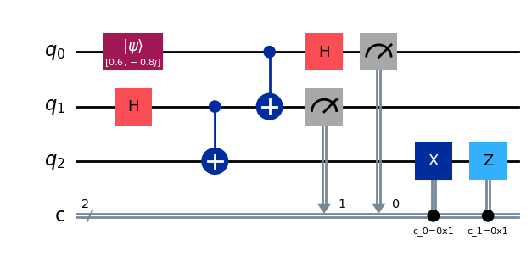
Circuit for Quantum Teleportation
Library used: Qiskit and Matplotlib
Code link: QNET25_Shubha/QNET25Sh1.ipynb at main · syedshubha/QNET25_Shubha

Slide 4


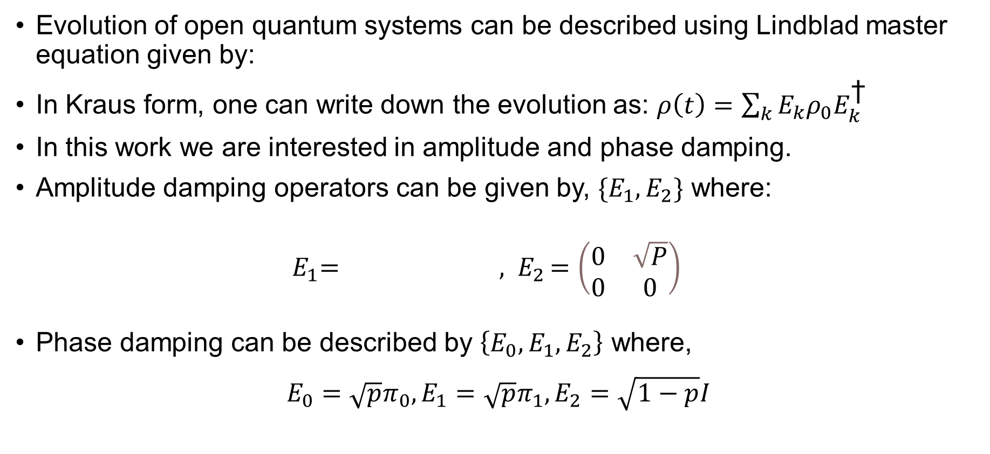
Quantum Noise
Evolution of open quantum systems can be described using Lindblad master equation given by:
In Kraus form, one can write down the evolution as: $ρ\left(t\right)=\sum_{k}{E_{k}ρ_{0}E_{k}^{\text{†}}}$
In this work we are interested in amplitude and phase damping.
Amplitude damping operators can be given by, $\{E_{1},E_{2}\}$ where:
${ E}_{1}= {, E}_{2}=\left(\begin{matrix}0 & \sqrt{P} \\ 0 & 0\end{matrix}\right)$
Phase damping can be described by $\left\{E_{0}, E_{1},E_{2}\right\}$ where,
$${E_{0}=\sqrt{p}π_{0},E_{1}=\sqrt{p}π_{1},E}_{2}=\sqrt{1−p}I$$

Slide 5
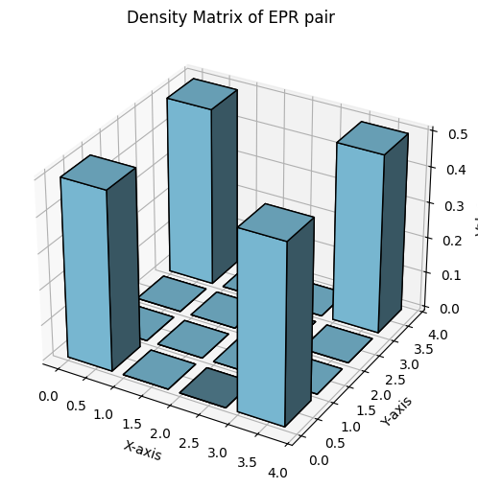
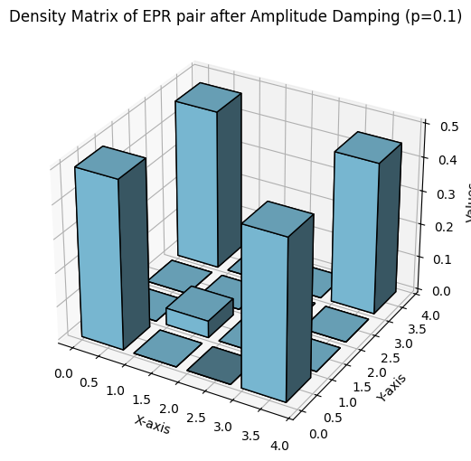

Amplitude Damping on 1st qubit (p=0.1)
We are applying amplitude damping on the first qubit of EPR state:
$$\left|Φ^{+}\right\rangle =\frac{1}{\sqrt{2}}\left(\left|00\right\rangle +|11⟩\right)$$

Slide 6
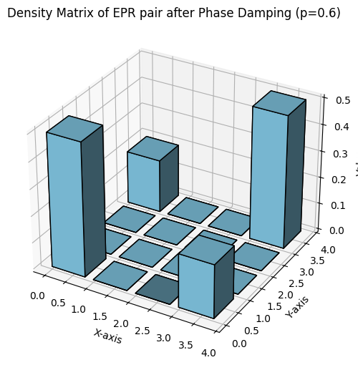

Phase Damping on 2nd Qubit (p=0.1)
We are applying phase damping on the first qubit of EPR state:
$$\left|Φ^{+}\right\rangle =\frac{1}{\sqrt{2}}\left(\left|00\right\rangle +|11⟩\right)$$

Slide 7
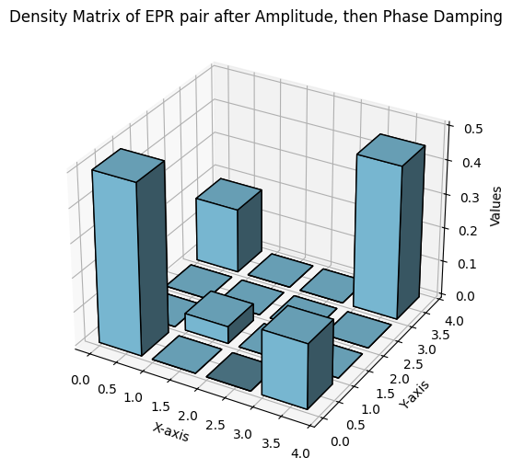
Amplitude Damping on 1st qubit, Phase Damping on 2nd Qubit

Slide 8
Amplitude Damping on 1st qubit, Phase Damping on 2nd Qubit

Slide 9
Both Amplitude Damping & Phase Damping

Slide 10
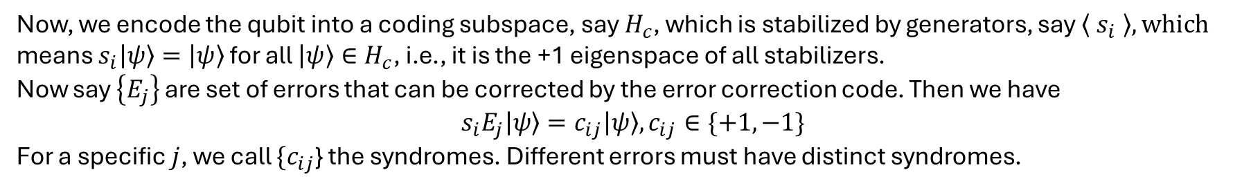
Stabilizer Code
Now, we encode the qubit into a coding subspace, say $H_{c}$, which is stabilized by generators, say $\left\langle s_{i} \right\rangle , which$
means $s_{i}\left|ψ\right\rangle =\left|ψ\right\rangle$ for all $\left|ψ\right\rangle ∈H_{c}$, i.e., it is the +1 eigenspace of all stabilizers.
Now say $\left\{E_{j}\right\}$ are set of errors that can be corrected by the error correction code. Then we have
$$s_{i}E_{j}\left|ψ\right\rangle =c_{ij}\left|ψ\right\rangle , c_{ij}∈\{+1, −1\}$$
For a specific $j$, we call $\{c_{ij}$} the syndromes. Different errors must have distinct syndromes.
Most Quantum Error Correcting Codes can be described using Stabilizer Formalism.
However, the question remains, which code to use?

Slide 11
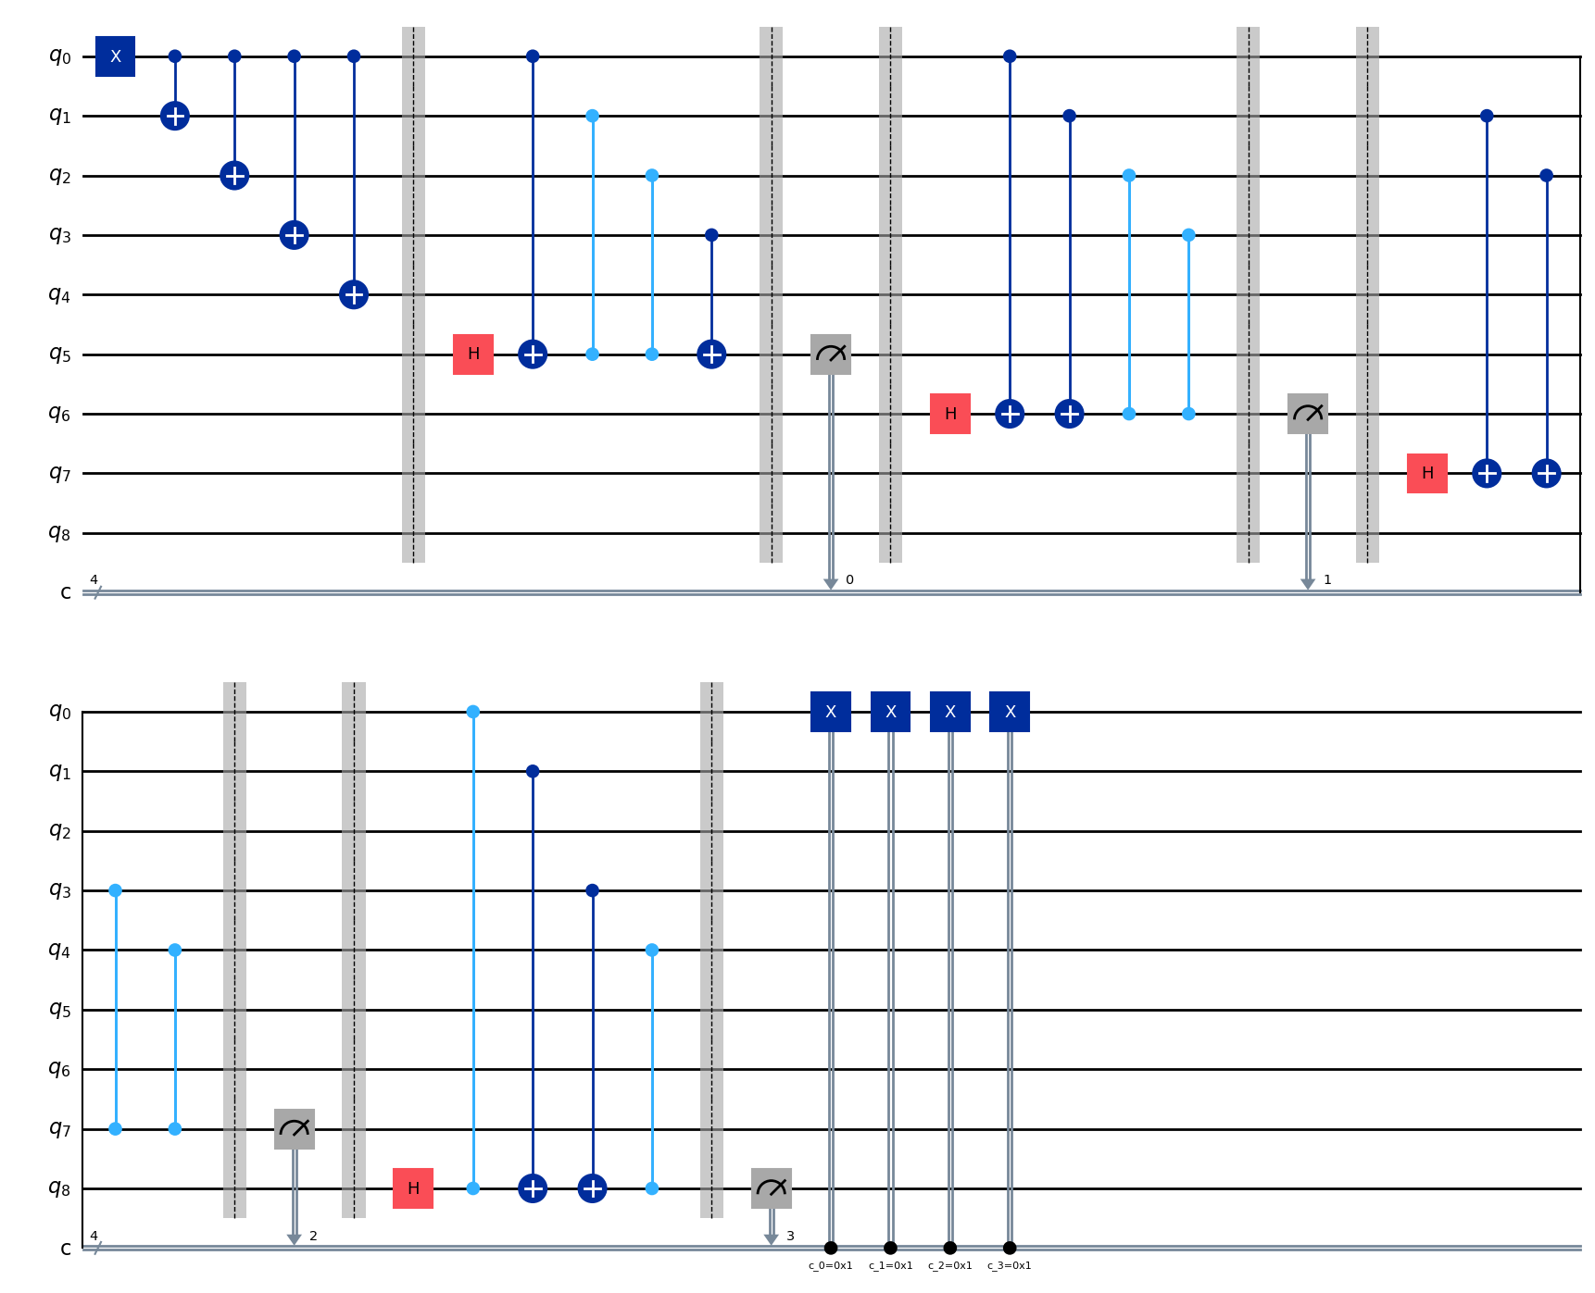
5 Qubit Perfect Code

Slide 12
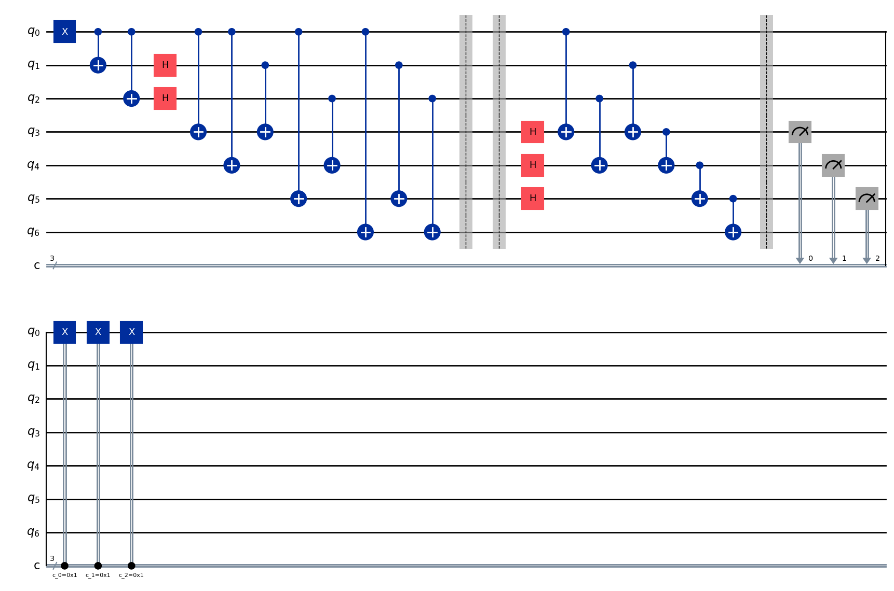
Steane Code

Slide 13
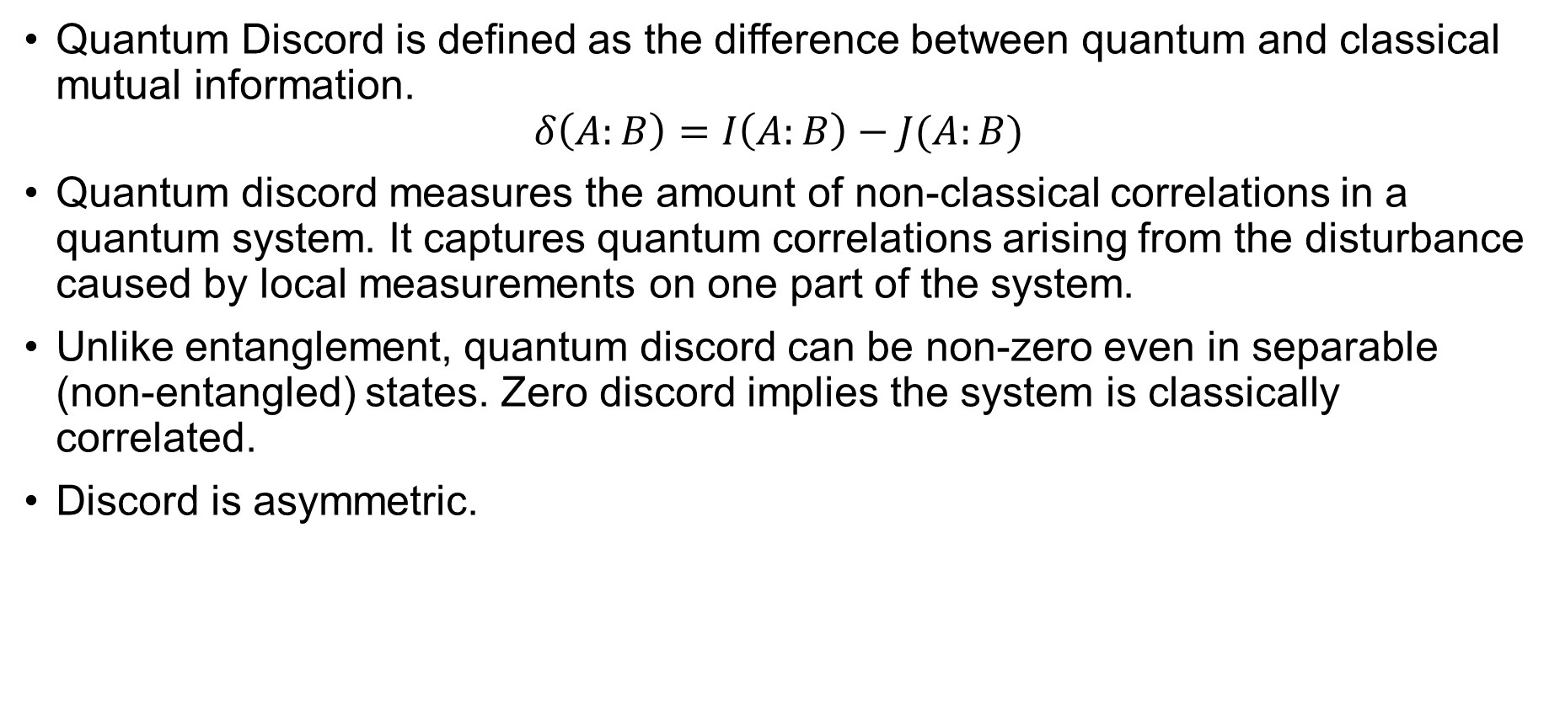
Quantum Discord (QD)
Quantum Discord is defined as the difference between quantum and classical mutual information.
$$δ\left(A:B\right)=I\left(A:B\right)−J(A:B)$$
Quantum discord measures the amount of non-classical correlations in a quantum system. It captures quantum correlations arising from the disturbance caused by local measurements on one part of the system.
Unlike entanglement, quantum discord can be non-zero even in separable (non-entangled) states. Zero discord implies the system is classically correlated.
Discord is asymmetric.

Slide 14
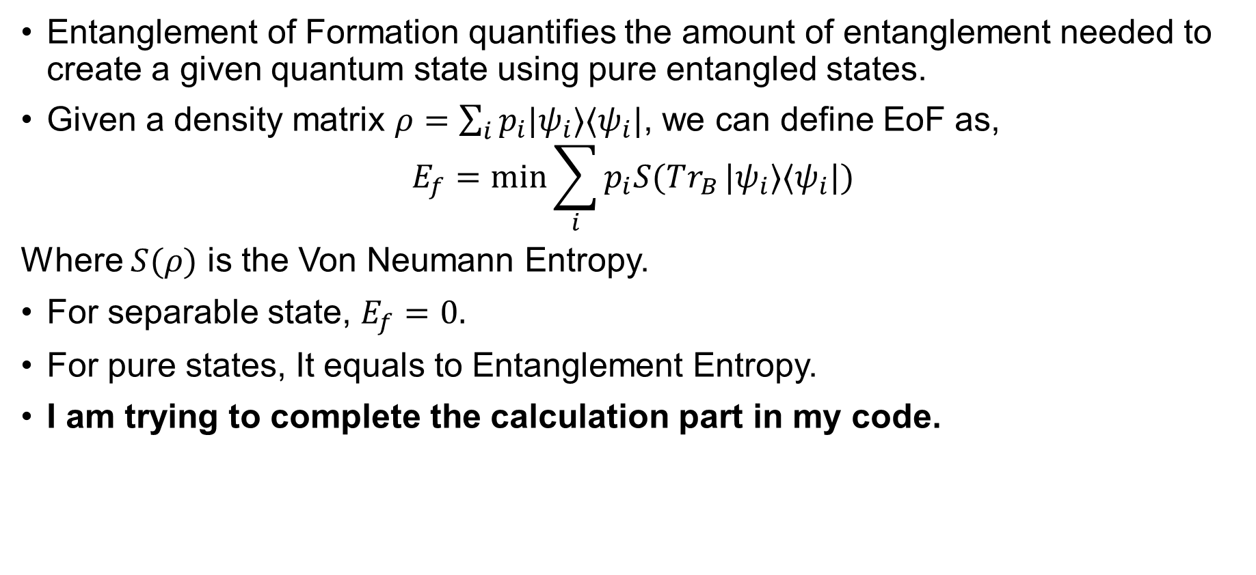
Entanglement of Formation (EoF)
Entanglement of Formation quantifies the amount of entanglement needed to create a given quantum state using pure entangled states.
Given a density matrix $ρ=\sum_{i}{p_{i}|ψ_{i}⟩⟨ψ_{i}|}$, we can define EoF as,
$$E_{f}=\min{\sum_{i}{p_{i}S(Tr_{B}}|ψ_{i}⟩⟨ψ_{i}|)}$$
Where $S(ρ)$ is the Von Neumann Entropy.
For separable state, $E_{f}=0.$
For pure states, It equals to Entanglement Entropy.
I am trying to complete the calculation part in my code.

Slide 15
Hypothesis for the Project
We will determine which type of Error Correction is required based on QD and EoF. Our hypothesis is as follows:
 | Meaning | QEC Code
Low EoF, High QD | Weak entanglement but strong quantum correlation. So we should focus on preserving residual quantum properties efficiently. | 5 Qubit Code
High Eof, Low QD | Strong entanglement, but weak correlations. We should protect entanglement for high-fidelity teleportation. | Steane codes
Low Eof, low QD | Weak entanglement and correlations. Most likely not usable. | Out of our hand
High Eof, High QD | Strong entanglement and correlations. | Not required

Slide 16
Planning
Completing code for Metrics.
Applying the error in Teleportation Circuit.
Testing our hypothesis.
Code link: QNET25_Shubha/QNET25Sh1.ipynb at main · syedshubha/QNET25_Shubha
Thank you!

