Slide 1

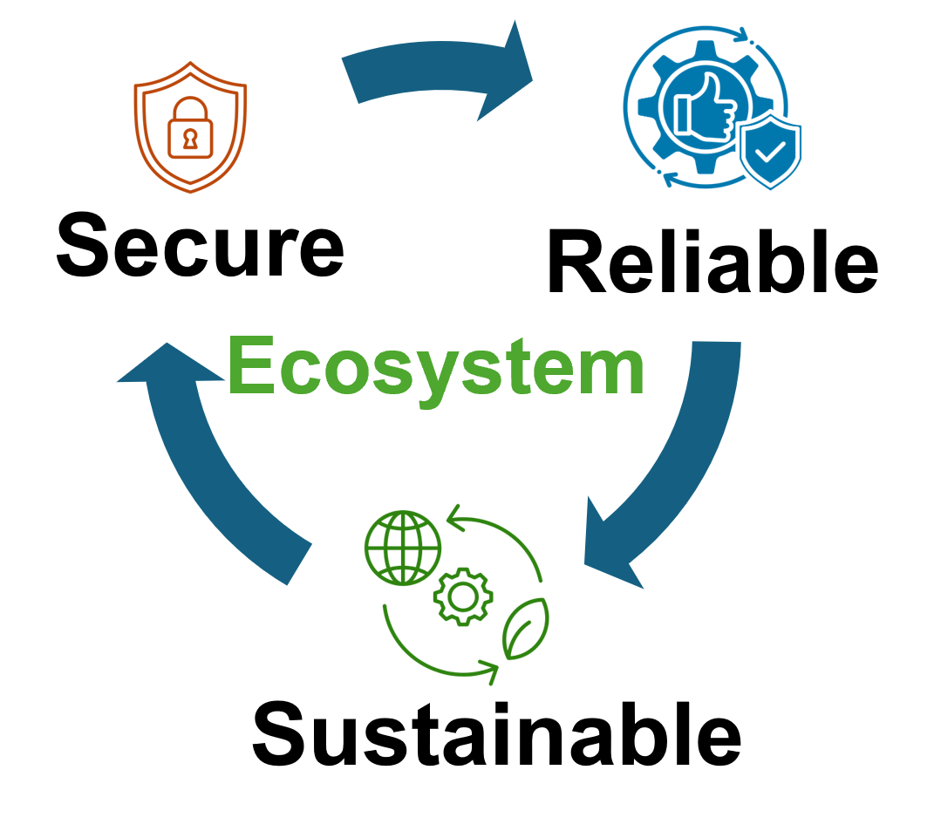


Enhanced Quantum Teleportation Using Metrics Based on Information Entropy
Syed Emad Uddin Shubha, Tasnuva Farheen
Division of Computer Science And Engineering

Slide 2
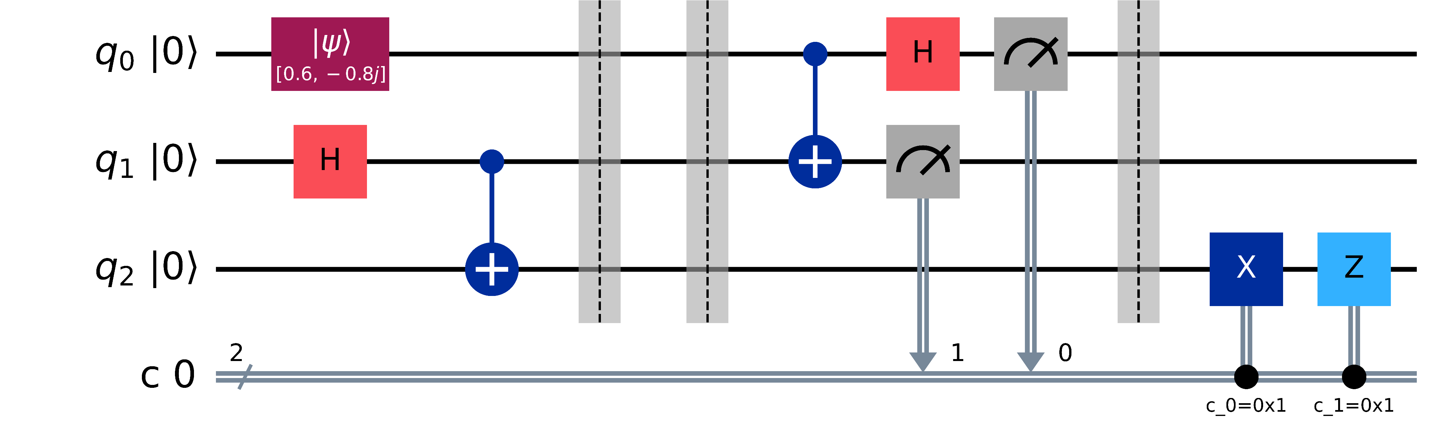

Quantum Teleportation
$$ρ⊗\left|Φ_{ij}\right\rangle \left\langle Φ_{ij}\right|→\left|Φ_{mn}\right\rangle \left\langle Φ_{mn}\right|⊗ρ$$
Only LOCC (Local Operation and Classical Communication) is allowed.
$$\left|Φ^{+}\right\rangle =\frac{1}{\sqrt{2}}\left(\left|00\right\rangle +|11⟩\right)$$

Slide 3

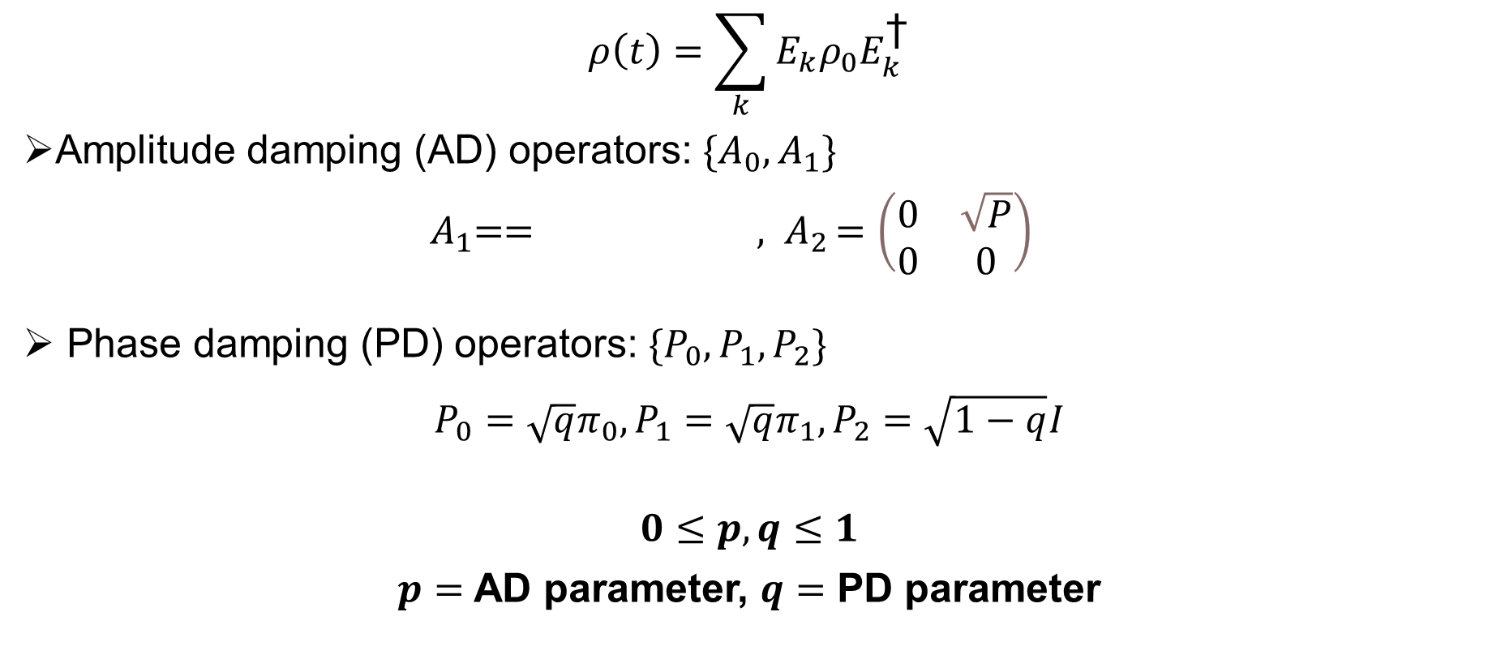
Quantum Noise
$$ρ\left(t\right)=\sum_{k}{E_{k}ρ_{0}E_{k}^{\text{†}}}$$
Amplitude damping (AD) operators: $\{A_{0}, A_{1}\}$
${ A}_{1}== {, A}_{2}=\left(\begin{matrix}0 & \sqrt{P} \\ 0 & 0\end{matrix}\right)$
Phase damping (PD) operators: $\{P_{0}, P_{1}, P_{2}\}$
$${P_{0}=\sqrt{q}π_{0},P_{1}=\sqrt{q}π_{1},P}_{2}=\sqrt{1−q}I$$
$$0≤p,q≤1$$
$p=$ AD parameter, $q=$ PD parameter

Slide 4
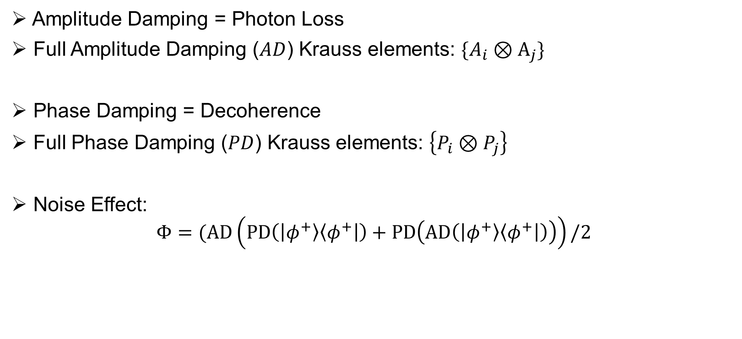
Our Model
Amplitude Damping = Photon Loss
Full Amplitude Damping ($AD$) Krauss elements: $\{A_{i}⊗A_{j}\}$
Phase Damping = Decoherence
Full Phase Damping ($PD$) Krauss elements: $\left\{P_{i}⊗P_{j}\right\}$
Noise Effect:
$$Φ=(AD\left(PD\left(\left|φ^{+}\right\rangle \left\langle φ^{+}\right|\right)+PD\left(AD\left(\left|φ^{+}\right\rangle \left\langle φ^{+}\right|\right)\right)\right)/2$$

Slide 5
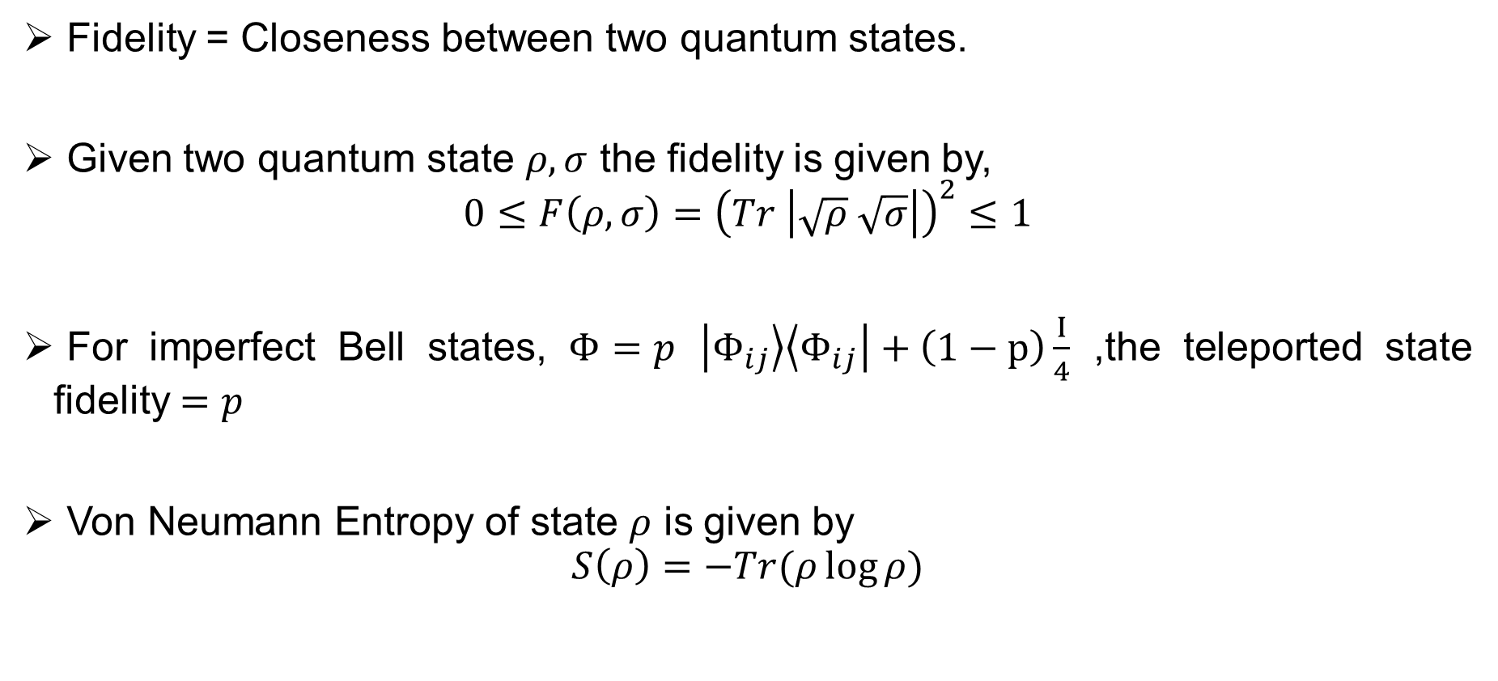
Fidelity and Von Neumann Entropy
Fidelity = Closeness between two quantum states.
Given two quantum state $ρ,σ$ the fidelity is given by,
$$0≤F\left(ρ,σ\right)={\left(Tr \left|\sqrt{ρ} \sqrt{σ}\right|\right)}^{2}≤1$$
For imperfect Bell states, $Φ=p$ $\left|Φ_{ij}\right\rangle \left\langle Φ_{ij}\right|+\left(1−p\right)\frac{I}{4}$ ,the teleported state fidelity $=p$
Von Neumann Entropy of state $ρ$ is given by
$$S\left(ρ\right)=−Tr(ρ\log{ρ)}$$

Slide 6
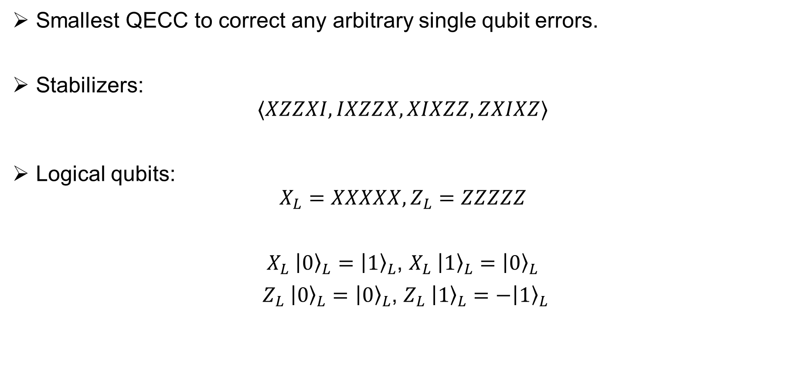
5 Qubit Code
Smallest QECC to correct any arbitrary single qubit errors.
Stabilizers:
$$⟨XZZXI, IXZZX,XIXZZ,ZXIXZ⟩$$
Logical qubits:
$$X_{L}=XXXXX, Z_{L}=ZZZZZ$$
$X_{L} {\left|0\right\rangle }_{L}={\left|1\right\rangle }_{L}$, $X_{L} {\left|1\right\rangle }_{L}={\left|0\right\rangle }_{L}$
$Z_{L} {\left|0\right\rangle }_{L}={\left|0\right\rangle }_{L}$, $Z_{L} {\left|1\right\rangle }_{L}=−{\left|1\right\rangle }_{L}$

Slide 7
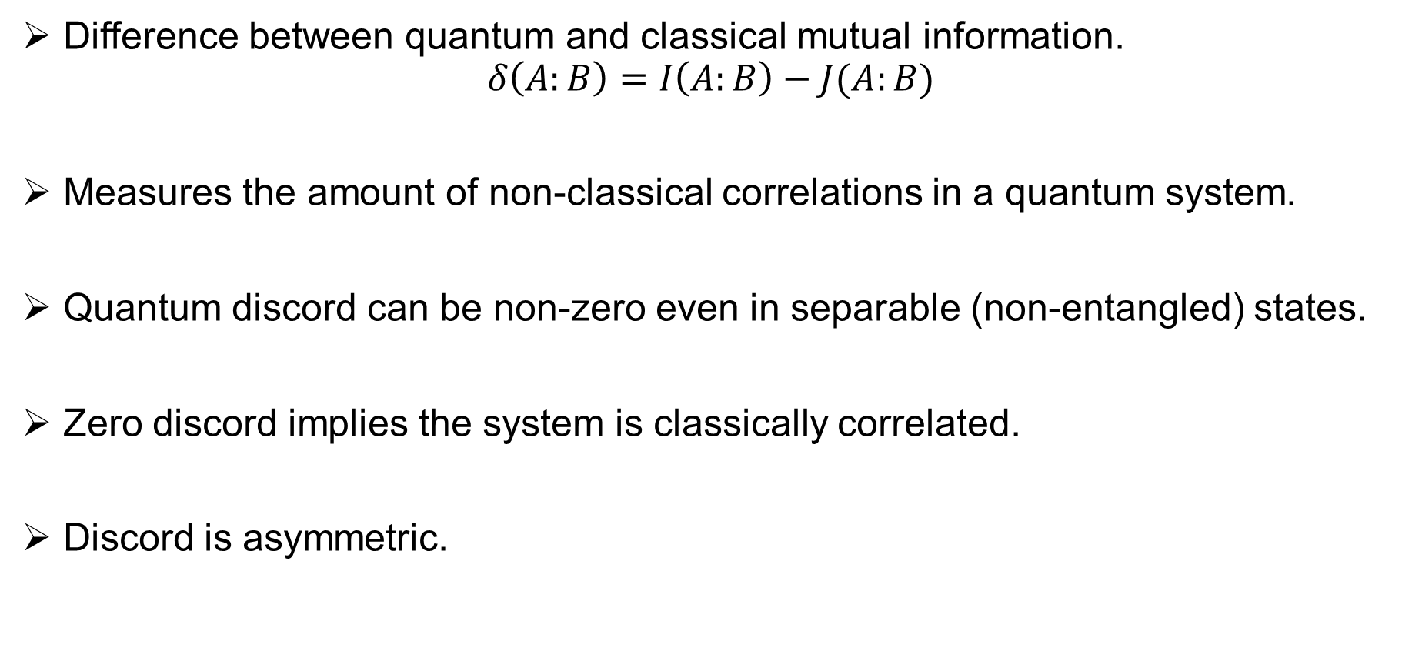
Quantum Discord (QD)
Difference between quantum and classical mutual information.
$$δ\left(A:B\right)=I\left(A:B\right)−J(A:B)$$
Measures the amount of non-classical correlations in a quantum system.
Quantum discord can be non-zero even in separable (non-entangled) states.
Zero discord implies the system is classically correlated.
Discord is asymmetric.

Slide 8
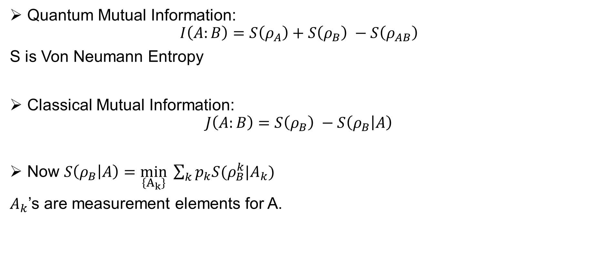
Finding 1
Quantum Mutual Information:
$$I\left(A:B\right)=S\left(ρ_{A}\right)+S\left(ρ_{B}\right) −S\left(ρ_{AB}\right)$$
S is Von Neumann Entropy
Classical Mutual Information:
$$J\left(A:B\right)=S\left(ρ_{B}\right) −S\left(ρ_{B} | A\right)$$
Now $S\left(ρ_{B} | A\right)=\min_{\left\{A_{k}\right\}} \sum_{k}{p_{k}S(ρ_{B}^{k}|A_{k})}$
$A_{k}$’s are measurement elements for A.

Slide 9
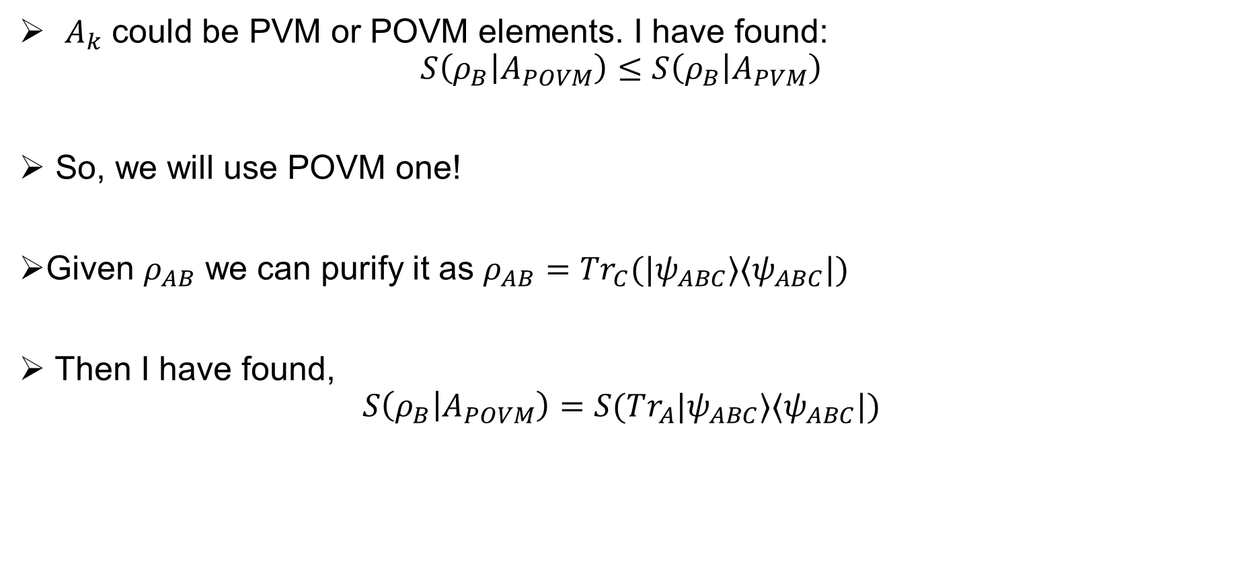
Finding 2
$A_{k}$ could be PVM or POVM elements. I have found:
$$S\left(ρ_{B} | A_{POVM}\right)≤S\left(ρ_{B} | A_{PVM}\right)$$
So, we will use POVM one!
Given $ρ_{AB}$ we can purify it as $ρ_{AB}=Tr_{C}(|ψ_{ABC}⟩⟨ψ_{ABC}|)$
Then I have found,
$$S\left(ρ_{B} | A_{POVM}\right)=S(Tr_{A}|ψ_{ABC}⟩⟨ψ_{ABC}|)$$

Slide 10
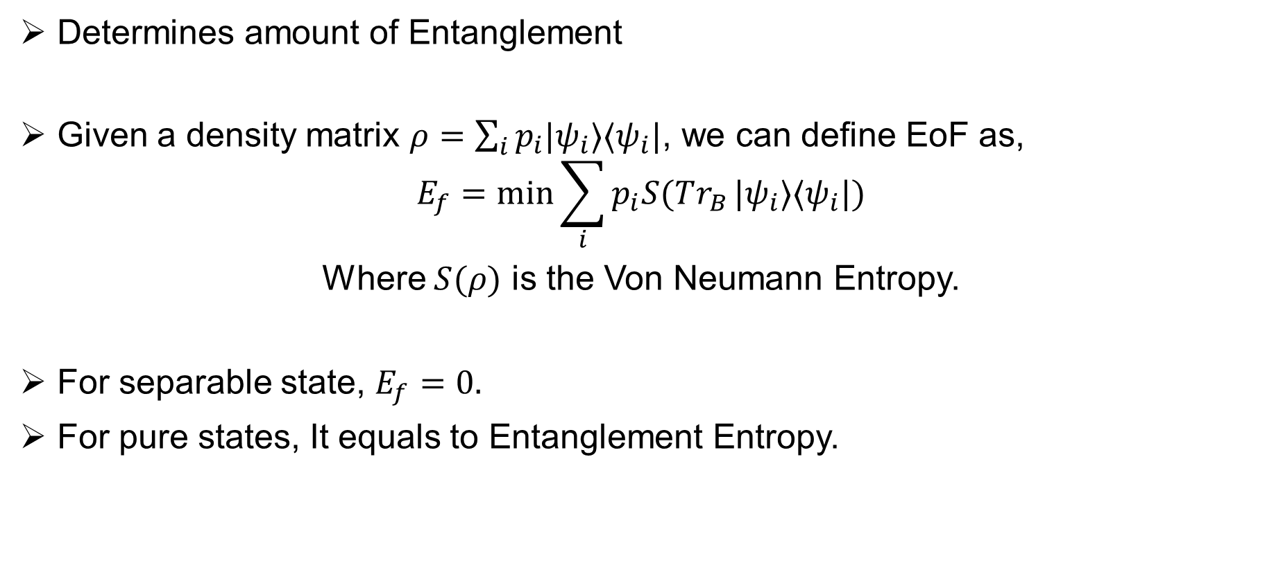
Entanglement of Formation (EoF)
Determines amount of Entanglement
Given a density matrix $ρ=\sum_{i}{p_{i}|ψ_{i}⟩⟨ψ_{i}|}$, we can define EoF as,
$$E_{f}=\min{\sum_{i}{p_{i}S(Tr_{B}}|ψ_{i}⟩⟨ψ_{i}|)}$$
Where $S(ρ)$ is the Von Neumann Entropy.
For separable state, $E_{f}=0.$
For pure states, It equals to Entanglement Entropy.

Slide 11
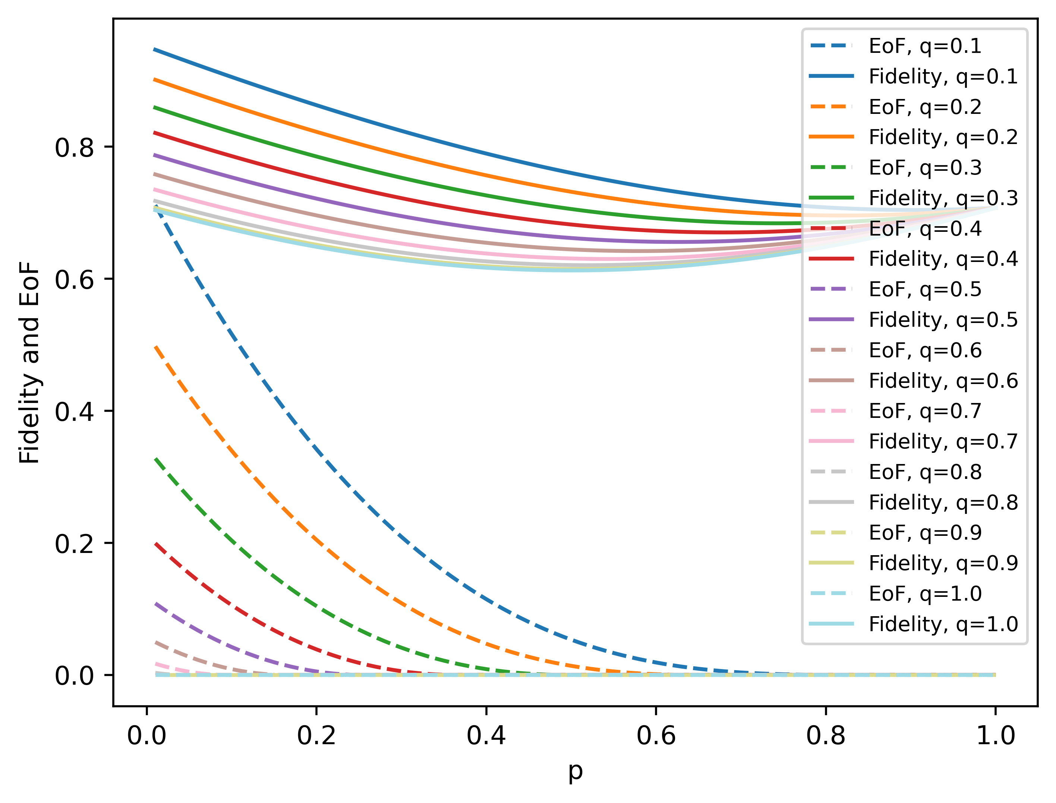
Research Note 1
When EoF is higher, fidelity is also higher. So, 5 Qubit Code is enough.

Slide 12
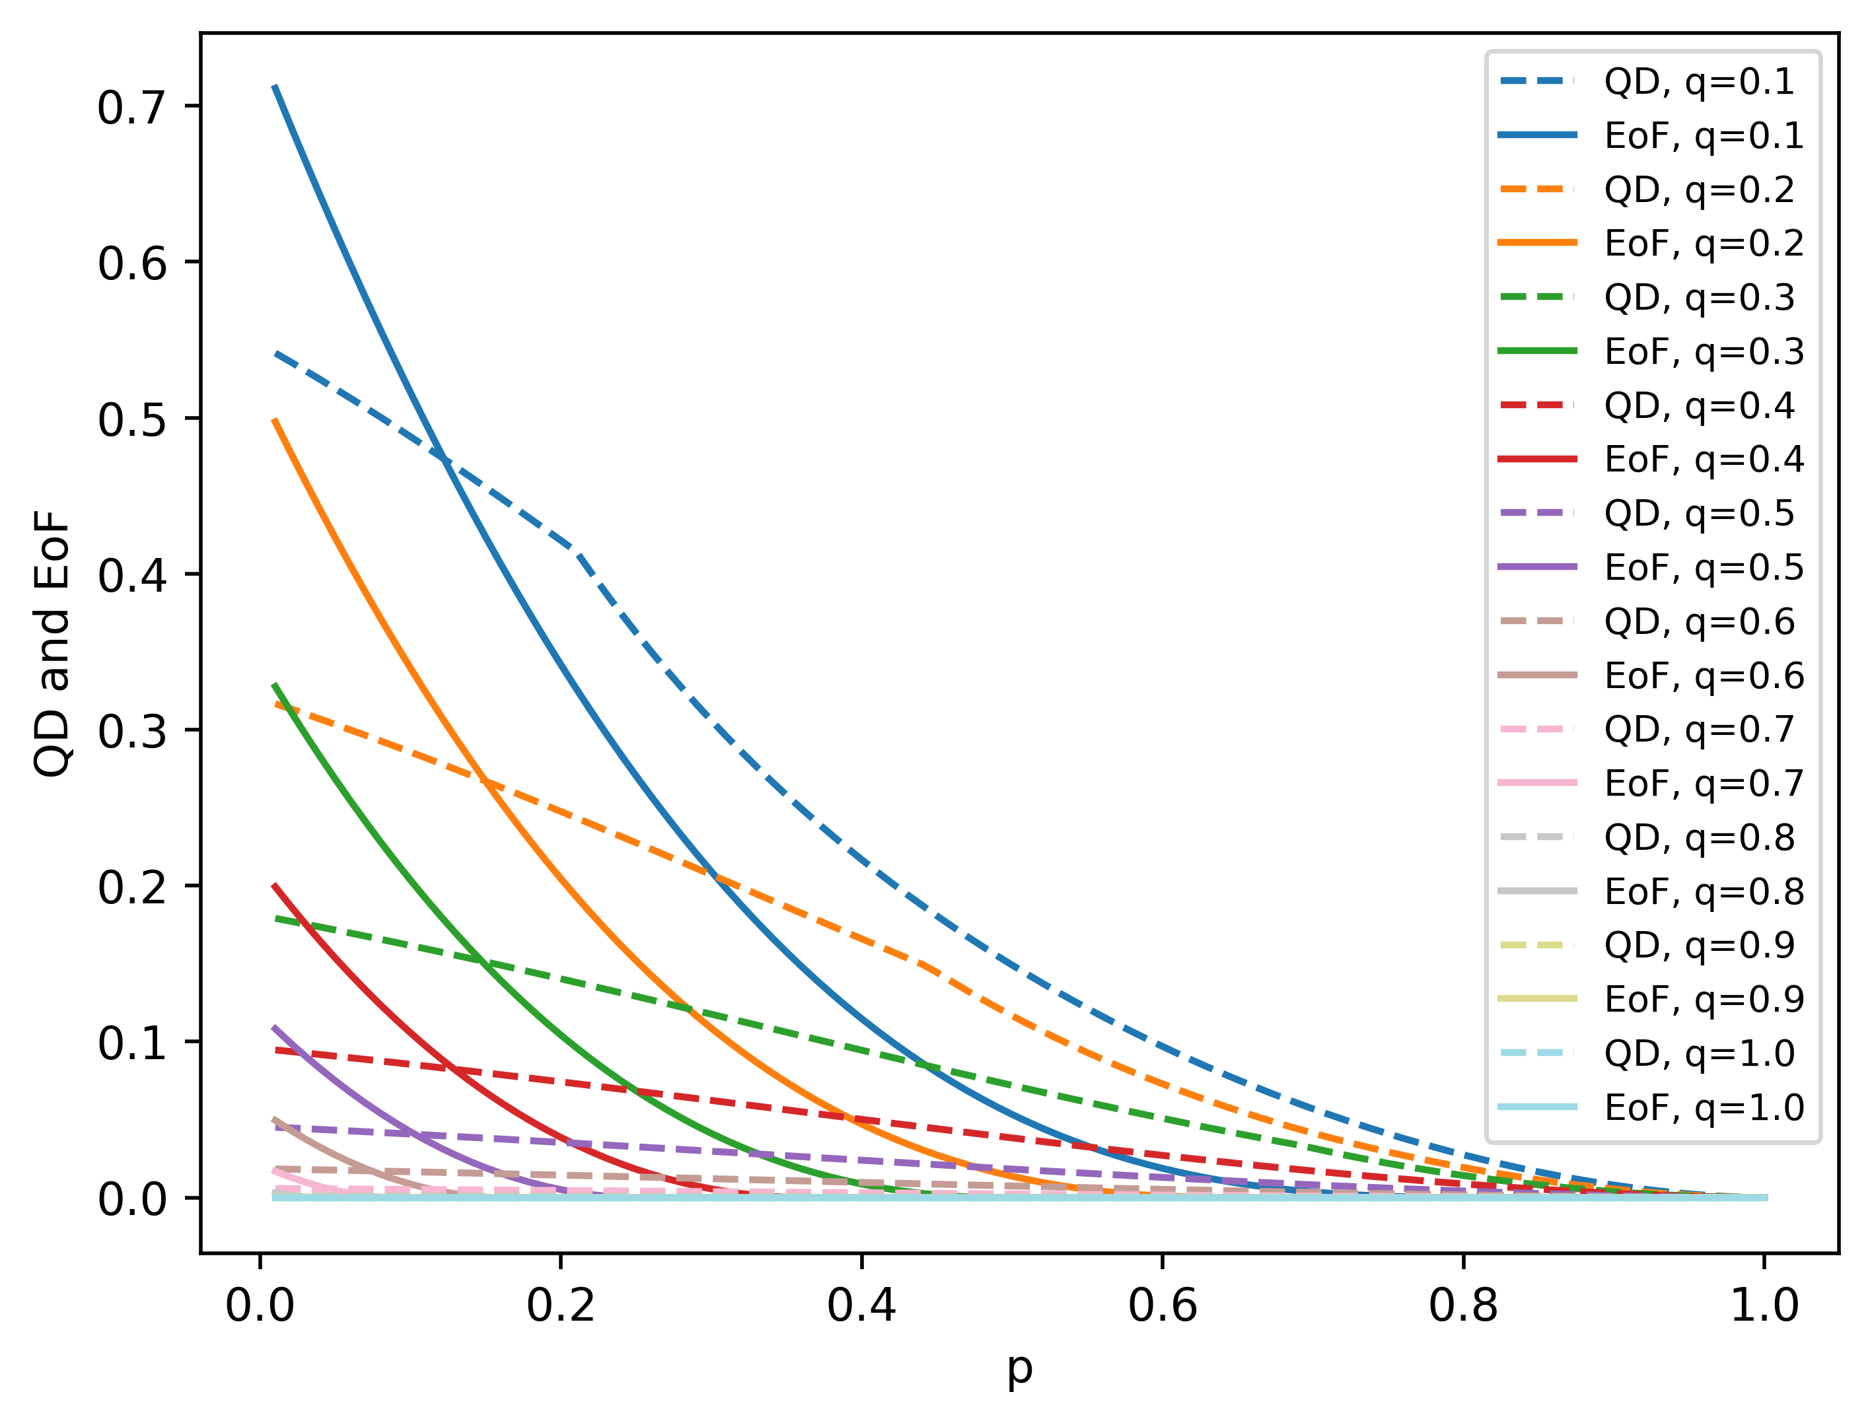
Research Note 2
When EoF is lower, there is still some QD.

Slide 13
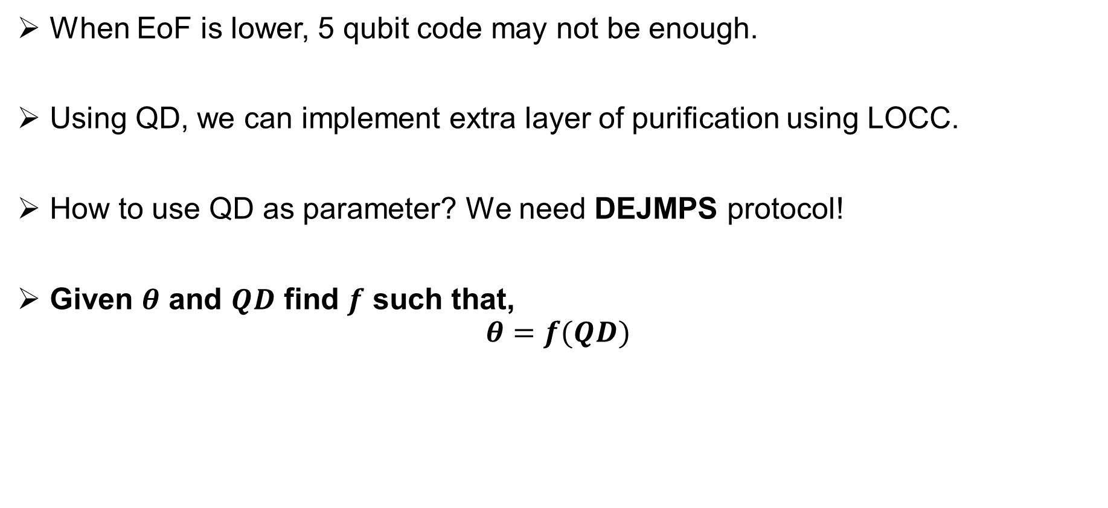
Research Note 3
When EoF is lower, 5 qubit code may not be enough.
Using QD, we can implement extra layer of purification using LOCC.
How to use QD as parameter? We need DEJMPS protocol!
Given $θ$ and $QD$ find $f$ such that,
$$θ=f(QD)$$

Slide 14
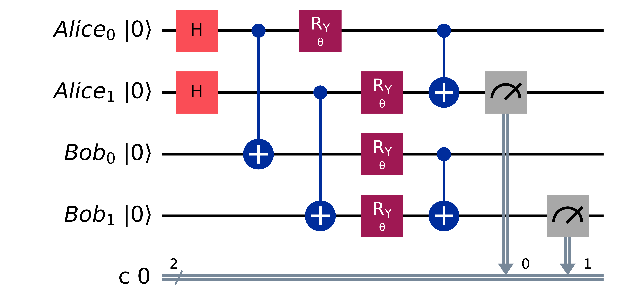

DEJMPS Protocol
$FN=\frac{F^{2}+{\left(1−F\right)}^{2}\sin{θ}}{F^{2}+2F\left(1−F\right)\sin^{2}{θ}+{\left(1−F\right)}^{2}}, p_{s}=F^{2}+2F\left(1−F\right)\sin^{2}{θ}+{\left(1−F\right)}^{2}$

Slide 15

Research Note 4
Given $FR\left(F\right)$ and $p_{s}\left(F\right)$ we need $n$ iteration.
Starting with fidelity $F_{0}$
$$F_{i+1}=FR\left(F_{i}\right), F_{n}→1$$
$$P_{success}=Π_{i=1}^{i=n}p_{s}(F_{i})$$
We need to optimize $n$ and $P_{success}$ and find necessary $θ$

