Slide 1
Neural Shadows: A Machine Learning Approach to Classifying Entanglement Phases
Syed Emad Uddin Shubha and Joseph Masters
Machine Learning (CSC 7333)
Department of Computer Science,
Louisiana State University

Slide 2
Overview
Introduction and Motivation
Background and Related Work
Problem Formulation and Dataset
Methodology: ML System Design
Experimental Setup
Results and Discussion
Summary, Limitations, and Future Work

Slide 3
Introduction and Motivation
Quantum entanglement is essential for quantum information processing
Verifying entanglement experimentally is computationally expensive
Full quantum state tomography scales exponentially with qubit number
Classical shadows offer a resource-efficient alternative:
  Uses randomized local Pauli measurements to construct approximate classical representations of quantum states using several measurements that scale logarithmically with the number of observables

Slide 4
Research Question
Given only classical-shadow data from a noisy 2-qubit system, how do different machine learning architectures (LR, RF, FNN, RBF SVM) compare in classifying entangled versus separable phases, particularly in low-data, low-shot regimes?

Slide 5


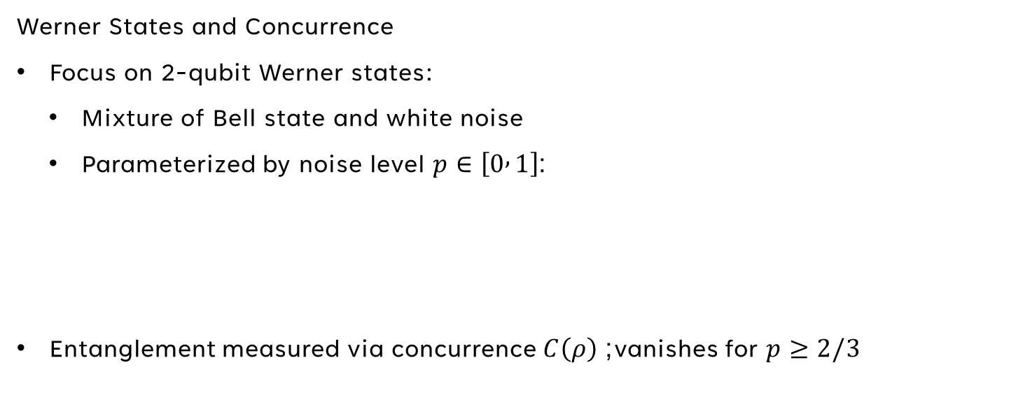
Background and Related Work
Werner States and Concurrence
Focus on 2-qubit Werner states:
  Mixture of Bell state and white noise
  Parameterized by noise level $p∈\left[0 , 1\right]$:
Entanglement measured via concurrence $C\left(ρ\right)$; vanishes for $p≥2/3$

Slide 6
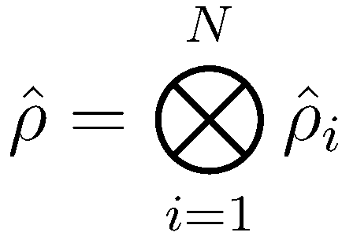
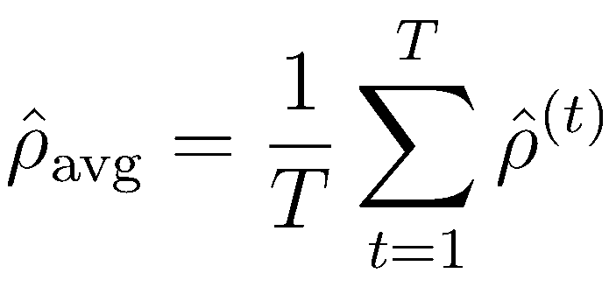
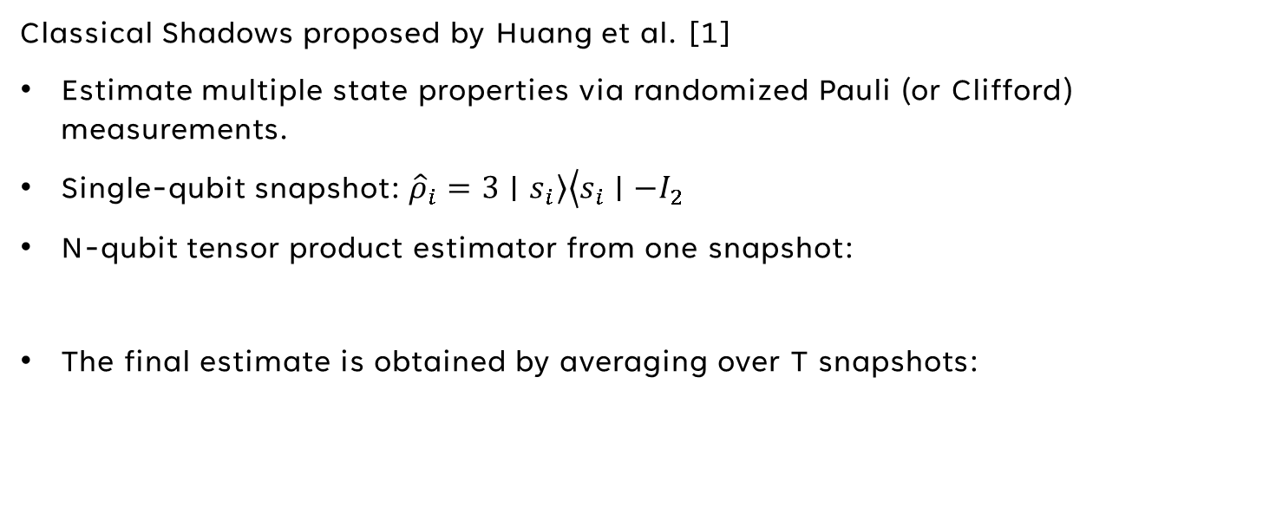
Background and Related Work
Classical Shadows proposed by Huang et al. [1]
Estimate multiple state properties via randomized Pauli (or Clifford) measurements.
Single-qubit snapshot: $\left.{\hat{ρ}}_{i}=3∣s_{i}\right\rangle \left\langle s_{i}∣−I_{2}\right.$
N-qubit tensor product estimator from one snapshot:
The final estimate is obtained by averaging over T snapshots:

Slide 7
Background and Related Work
Machine Learning Models:
Logistic Regression (LR): Linear baseline for binary classification
Random Forest (RF): Ensemble of decision trees, captures non-linear patterns
Feedforward Neural Network (FNN): Fully-connected network, trained with backpropagation
Support Vector Machine (SVM): Margin-based classifier with radial basis function (RBF) kernel

Slide 8
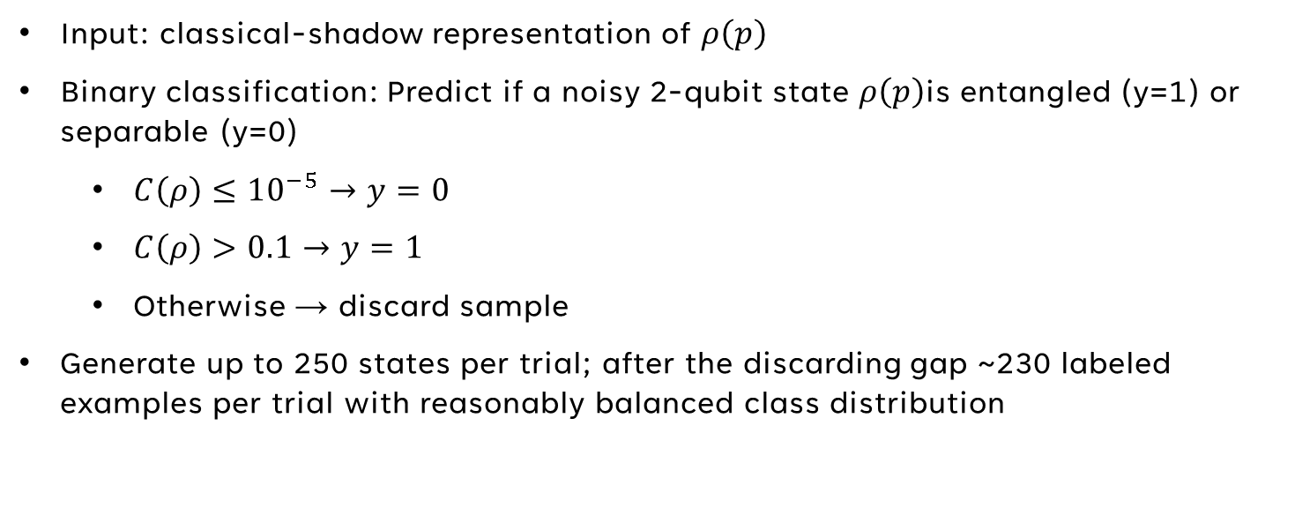
Problem Formulation and Dataset
Input: classical-shadow representation of $ρ\left(p\right)$
Binary classification: Predict if a noisy 2-qubit state $ρ\left(p\right)$is entangled (y=1) or separable (y=0)
    $C\left(ρ\right)≤{10}^{−5}→y=0$
    $C\left(ρ\right)>0.1→y=1$
    Otherwise → discard sample
Generate up to 250 states per trial; after the discarding gap ~230 labeled examples per trial with reasonably balanced class distribution

Slide 9
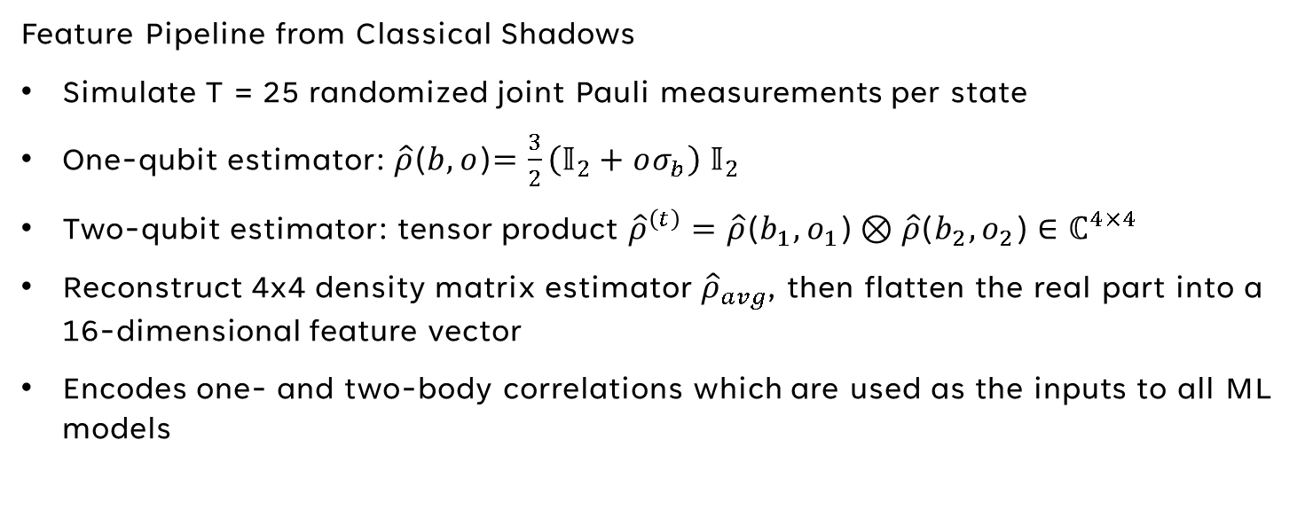
Methodology: ML System Design
Feature Pipeline from Classical Shadows
Simulate T = 25 randomized joint Pauli measurements per state
One-qubit estimator: $\hat{ρ}$($b,o$)$=\frac{3}{2}\left(𝕀_{2}+oσ_{b}\right) 𝕀_{2}$
Two-qubit estimator: tensor product ${\hat{ρ}}^{\left(t\right)}=\hat{ρ}\text{(}b_{1},o_{1}\text{)}⊗\hat{ρ}\text{(}b_{2},o_{2}\text{)}∈ℂ^{4×4}$
Reconstruct 4x4 density matrix estimator ${\hat{ρ}}_{avg}$, then flatten the real part into a 16-dimensional feature vector
Encodes one- and two-body correlations which are used as the inputs to all ML models

Slide 10
Methodology: ML System Design
Model Architectures
Logistic Regression (LR): The linear baseline with ℓ2 regularization and class-balanced weights
Random Forest (RF): An ensemble of decision trees where we tune the number of trees {50, 100} and max depth {none, 10}
Feedforward Neural Network (FNN): A fully connected NN with architecture of 16 → 64 → 32 → 1, ReLU activation, dropout 0.4, sigmoid output, and trained with the Adam optimizer
Support Vector Machine (SVM): A margin-based classifier with an RBF kernel and tuned regularization C and kernel width γ values

Slide 11
Methodology: ML System Design
Training and Hyperparameter Tuning
Dataset split: 80/20 stratified train/test to preserve class balance
LR, RF, SVM: Grid SearchCV with 3- to 5-fold cross-validation with F1 scoring as the selection metric
FNN: Manual grid search over hidden layer size, dropout rate, and learning rate with a 5-fold cross-validation to select the best model
Final evaluation for all models: Retrain on the full training set and test on the hold-out set using F1 scores for as the evaluation metric

Slide 12
Experimental Setup
Implementation Platform and Software
Python on Google Colab with NVIDIA T4 GPU
Libraries:
  QuTiP: Quantum state preparation and measurement simulation
  NumPy / SciPy: Numerical operations
  scikit-learn: LR, RF, SVM, grid search, train/test split
  PyTorch: FNN implementation and training
  Matplotlib: Visualization

Slide 13
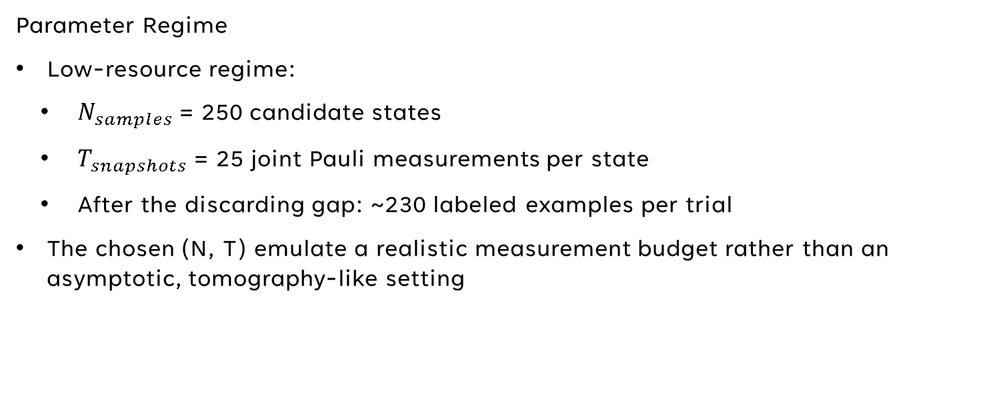
Experimental Setup
Parameter Regime
Low-resource regime:
  $N_{samples}$= 250 candidate states
  $T_{snapshots}$= 25 joint Pauli measurements per state
  After the discarding gap: ~230 labeled examples per trial
The chosen (N, T) emulate a realistic measurement budget rather than an asymptotic, tomography-like setting

Slide 14
Experimental Setup
Monte Carlo Stability Evaluation
Account for variance from small datasets and possible lucky splits
R = 100 trials:
  Regenerate dataset for each trial
  80/20 stratified train/test split
  Train all models and record F1 scores on the hold-out test set
Report mean ± std of F1 across trials

Slide 15
Results
Representative Low-Resource Trial
Example run: (95 separable vs. 135 entangled states)
F1 scores:
  LR: 0.831
  RF: 0.829
  FNN: 0.812
  SVM: 0.844
Each of the models performed similarly, with the SVM achieving the highest F1 score or 0.844

Slide 16
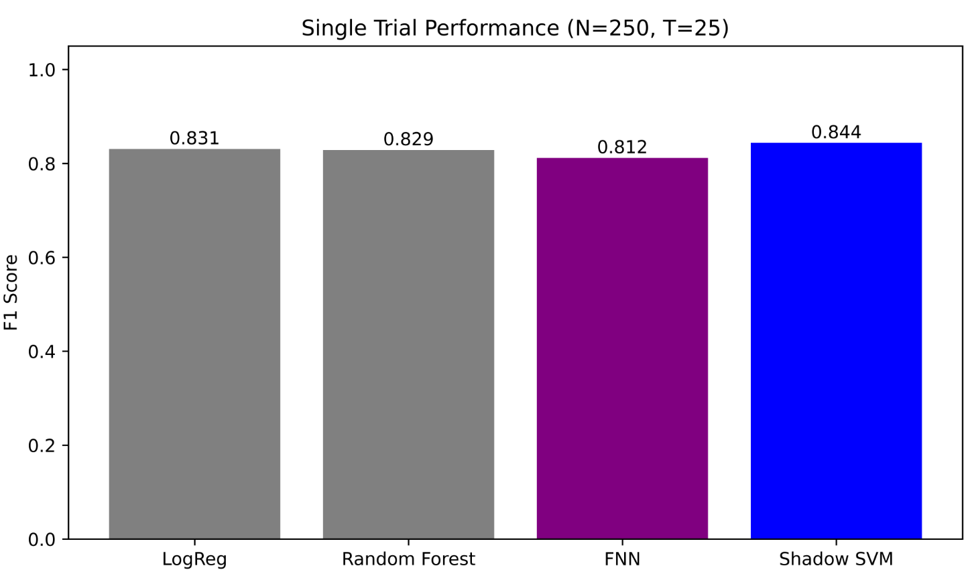
Results
Figure 1.
Single Trial Performance (N=250, T=25)
Single-trial performance of all four models on a representative dataset (N ≈ 230,T = 25). In this particular realization, the Shadow SVM achieves the highest F1 score (≈ 0.84),followed closely by Logistic Regression and Random Forest. The FNN lags slightly but remains in the same performance band

Slide 17
Results
Monte Carlo Stability Analysis
To account for sampling, measurement, and data split randomness
R = 100 times
Mean ± std F1:
  LR: 0.802 ± 0.049
  RF: 0.820 ± 0.044
  FNN: 0.814 ± 0.048
  SVM: 0.799 ± 0.053
No clear winner, even the linear and non-linear models are comparable

Slide 18
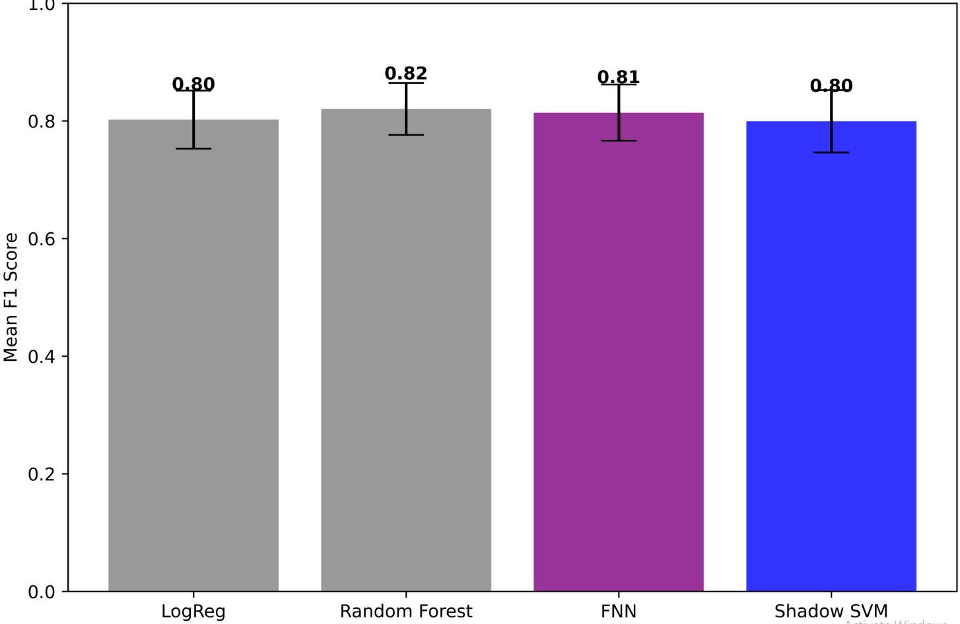
Results
Figure 2.
Single Trial Performance (N=250, T=25)
Monte Carlo stability analysis over R = 100 independent trials in the low-resourceregime (N ≈ 230, T = 25). Error bars show one standard deviation around the mean F1 score.All non-linear models form a statistical tie around F1 ≈ 0.8

Slide 19
Results
Effect of Hyperparameter Tuning
Grid search / CV improves baseline models:
  LR: F1 improved from 0.806 to 0.845
  FNN: F1 improved from 0.806 to 0.866
Hyperparameter tuning and cross-validation helps improve model performance
However, these tuned scores are still bounded by the information content of the shadow: they do not contradict the Monte Carlo result that all models saturate near F1 ≈ 0.8 on average when we vary the underlying physics and measurement noise

Slide 20
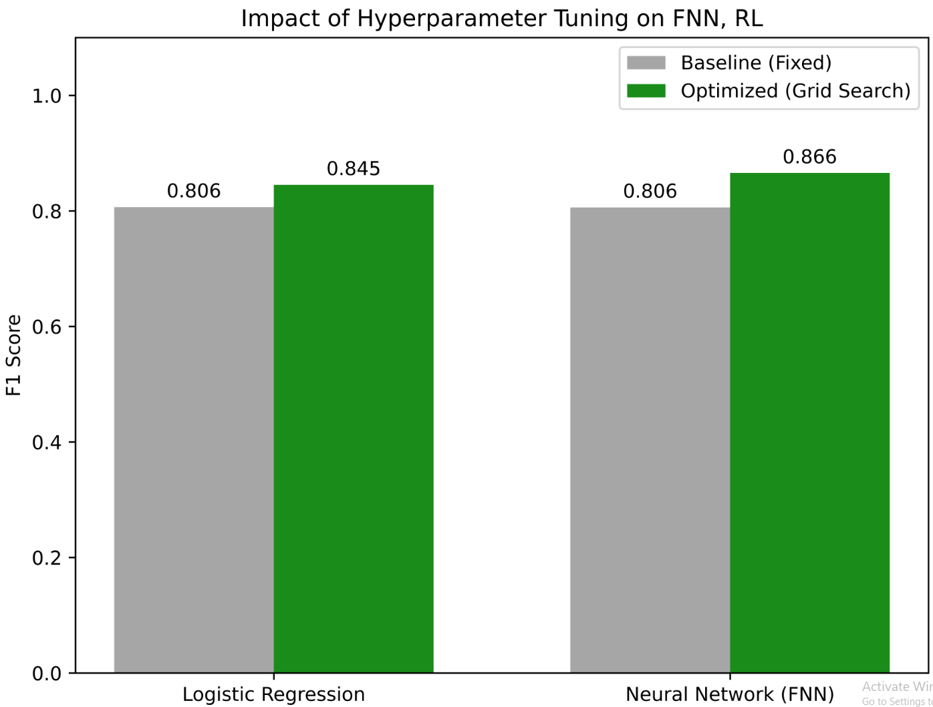
Results
Figure 3.
Impact of Hyperparameter Tuning on FNN and RL
Impact of hyperparameter tuning on Logistic Regression and the FNN for a fixed representative dataset. “Baseline” denotes the hand-chosen configurations used in the main Montecarlo experiment, whereas “Optimized” refers to models selected via grid search / cross-validation. Both models benefit from tuning, with the FNN showing the largest relative improvement

Slide 21
Discussion
Classical shadows are the primary bottleneck: The 16D feature vectors capture most of the exploitable information, as increasing model complexity only yields modest improvements
Model choice is secondary to the measurements: No single model consistently outperforms any other, as the dominant factor is the limited dataset size and shot noise
Tuning helps but doesn’t break ceiling: Hyperparameter tuning and CV improves F1 scores, but they are still limited by the low N and T
Simple classical models with classical shadows are resource-efficient for 2-qubit entanglement detection
Complex models offer little advantage in the 2-qubit Werner case

Slide 22
Summary
Built an end-to-end classical shadow pipeline for entanglement detection in 2-qubit Werner states
Tested four models: LR, RF, FNN, SVM in a low-resource regime (N≈ 230, T = 25)
All non-linear models achieve ≈ 0.8 F1 with overlapping error bars across 100 Monte Carlo trials
Logistic Regression remains surprisingly competitive (within ~0.02 F1 of best non-linear model)
Hyperparameter tuning improves LR and FNN on a fixed dataset, but performance is limited by shadow information, not model complexity
Conclusion: With 25 snapshots, simple classical models nearly saturate the extractable information for binary entanglement detection

Slide 23
Limitations
Physics model: We restrict attention to 2-qubit Werner states with a simple depolarizing channel. Real quantum hardware exhibits additional error sources such as readout bias, coherent control errors, and crosstalk, which are not included here
System size: For N = 2 and T = 25, the reconstructed density matrices are still reasonably well estimated. This regime does not fully stress-test the asymptotic advantages of classical shadows in high dimensions, where full reconstruction is impossible
Task complexity: The classification task is binary (entangled vs. separable) with a clean analytical label (concurrence). More complex phase diagrams (e.g., multiple entangled phases or topological order) are not considered

Slide 24
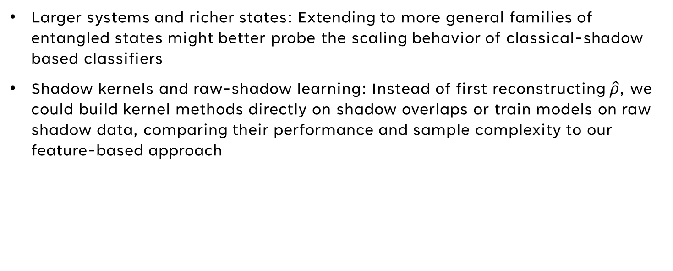
Future Work
Larger systems and richer states: Extending to more general families of entangled states might better probe the scaling behavior of classical-shadow based classifiers
Shadow kernels and raw-shadow learning: Instead of first reconstructing $\hat{ρ}$, we could build kernel methods directly on shadow overlaps or train models on raw shadow data, comparing their performance and sample complexity to our feature-based approach

Slide 25
Thank You

Slide 26
References
[1] H.-Y. Huang, R. Kueng, and J. Preskill, “Predicting many properties of a quantum system from very few measurements,” Nature Physics, vol. 16, pp. 1050–1057, 2020.
[2] F. Pedregosa et al., “Scikit-learn: Machine Learning in Python,” Journal of Machine Learning Research, vol. 12, pp. 2825–2830, 2011.
[3] J.R. Johansson, P.D. Nation, and F. Nori, “QuTiP: An open-source Python framework for the dynamics of open quantum systems,” Computer Physics Communications, vol. 183, pp.1760–1772, 2012.

