Slide 1

GUIDEWIRE PROJECT
AUTHOR – TAQI RAZA

Slide 2

Design Insurance Software
Enter Claim#/Policy# Claim####
Display insurance related Data…
Enter Claim#/Policy#
Search in Database, and Display insurance related information

Slide 3

Display the data using switch statements…
Input Policy###
Input Claim###
Claim# Name Sex Insurance Type Amount
Prints Information
Policy# Name Sex Insurance Type Amount

Slide 4
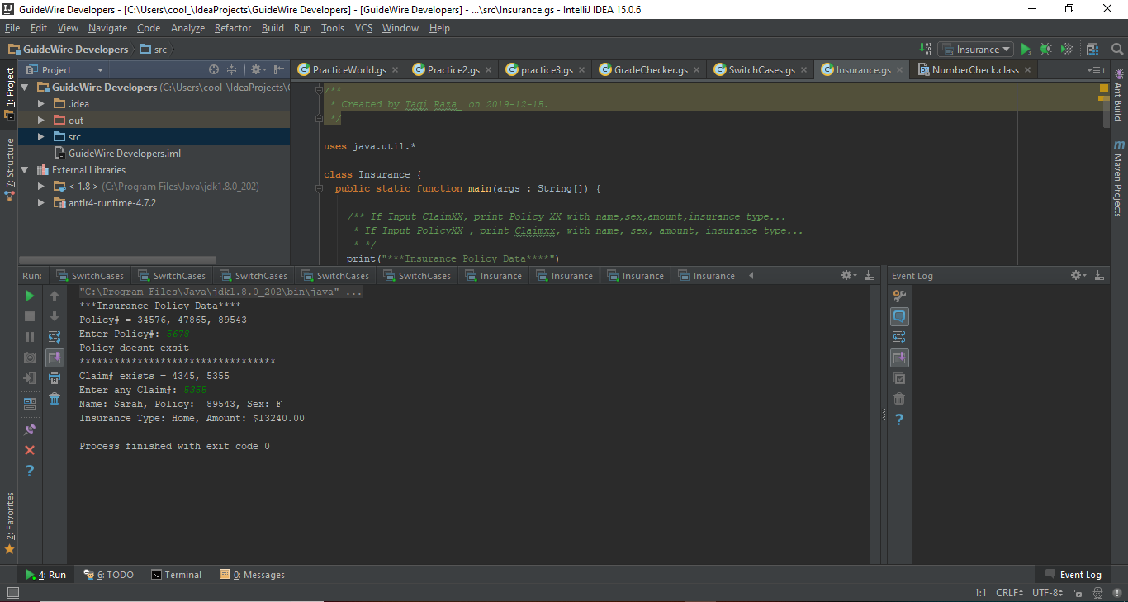
Insurance code…
Prints Data against the Claim# and Policy# as required

Slide 5

Fetch Data from Database, when entered something….
User Input Policy# / claim# Fetch information
Claim# Name Sex Insurance Type Amount (DATABASE)
Policy# Name Sex Insurance Type Amount (DATABASE)

Slide 6
Build table for information fetching..
User Input Policy# / claim# Fetch information
Claim# Name Sex Insurance Type Amount (DATABASE)
Policy# Name Sex Insurance Type Amount (DATABASE)

Slide 7
Design Insurance Software
Enter
Enter Claim#/Policy# Claim####
Display
Display insurance related Data…
Enter
Enter Claim#/Policy#
Find/Display
Search in Database, and Display insurance related information

