Slide 1
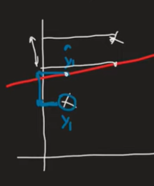

Mean Absolute Error (MAE)
MAE = (1/n) Σ |yi - ŷi|
Concept: MAE measures the average of the absolute differences between the actual and predicted values.
Advantages:
The output is in the same unit as the target variable (e.g., if predicting salary in LPAs, MAE will also be in LPAs). It is more robust to outliers compared to MSE
Average absolute error
Same unit as target
Robust to outliers
Disadvantage:
The absolute function is not differentiable at zero, which can be problematic for certain optimization algorithms like Gradient Descent.

Slide 2
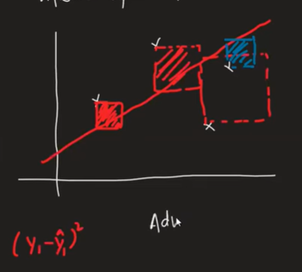

Mean Squared Error (MSE)
MSE = (1/n) Σ (yi - ŷi)^2
Concept:
MSE calculates the average of the squared differences between actual and predicted values.
Advantage:
It is widely used as a loss function because it is differentiable everywhere, making it ideal for optimization.
Squares error
Disadvantage:
The units are squared (e.g., $LPA^2$), making it hard to interpret directly. It also heavily penalizes outliers due to the squaring effect.
Penalizes large errors
Sensitive to outliers

Slide 3

Root Mean Squared Error (RMSE)
RMSE = sqrt(MSE)
Concept:
RMSE is simply the square root of the MSE.
Advantage:
It brings the error back to the original units of the target variable, making interpretation easier while retaining the differentiability benefits of MSE.
Same unit as target
Better interpretability
Disadvantage:
Like MSE, it is still sensitive to outliers.
Still sensitive to outliers

Slide 4
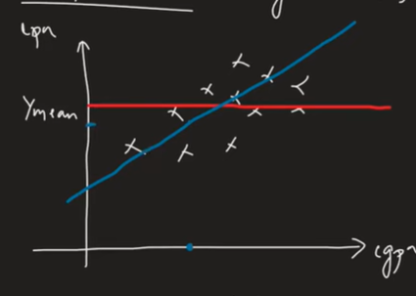
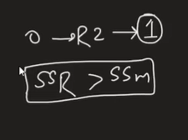

R² Score
R² = 1 - (SSres / SStot)
SS{res} is the sum of squares of residuals (errors from your model).
SS{tot} is the total sum of squares (errors from the mean line).
Concept: (Goodness of fit, Coefficient of Depth)
It represents the proportion of the variance in the dependent variable that is predictable from the independent variables. It compares your model to a simple "mean line" model.
Interpretation:
0: Model is as good as the mean line.
1: Perfect model with zero error.
Negative: Model is worse than the mean line.
Variance explained
1 = perfect
0 = mean model

Slide 5
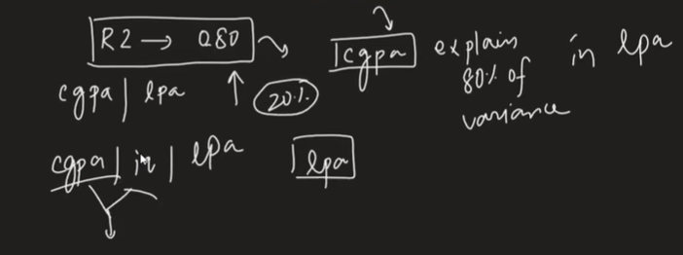
Explain the outlier or read the scatter plot

Slide 6
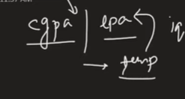

Adjusted R²
Adj R² = 1 - ((1-R²)(n-1)/(n-k-1))
n: Number of data points.
k: Number of independent variables.
Problem with R²:
The R² score never decreases when you add new features, even if they are irrelevant (like adding "outside temperature" to predict "salary")
Solution:
Adjusted R² penalizes the addition of irrelevant features.
Penalizes extra features
Better for multiple regression

