Slide 1
Multiple Linear Regression (MLR)
Used for multiple input variables
Predicts one numerical output
Widely used in real-world problems

Slide 2
SLR vs MLR
SLR: 1 input → 1 output
MLR: multiple inputs → 1 output
MLR handles complex relationships
* SLR: 1 Input (X) → 1 Output (Y)
MLR: Multiple Inputs (X1, X2, ……, Xn) → 1 Output (Y)

Slide 3
Geometric Intuition
SLR: Best Fit Line (2D)
In 2D space, the relationship is represented by a Best Fit Line
MLR: Best Fit Plane (3D)
If you have two input variables (e.g., CGPA and IQ) to predict a third (e.g., Package), the data is plotted in a 3D graph
Higher dimension → Hyperplane

Slide 4
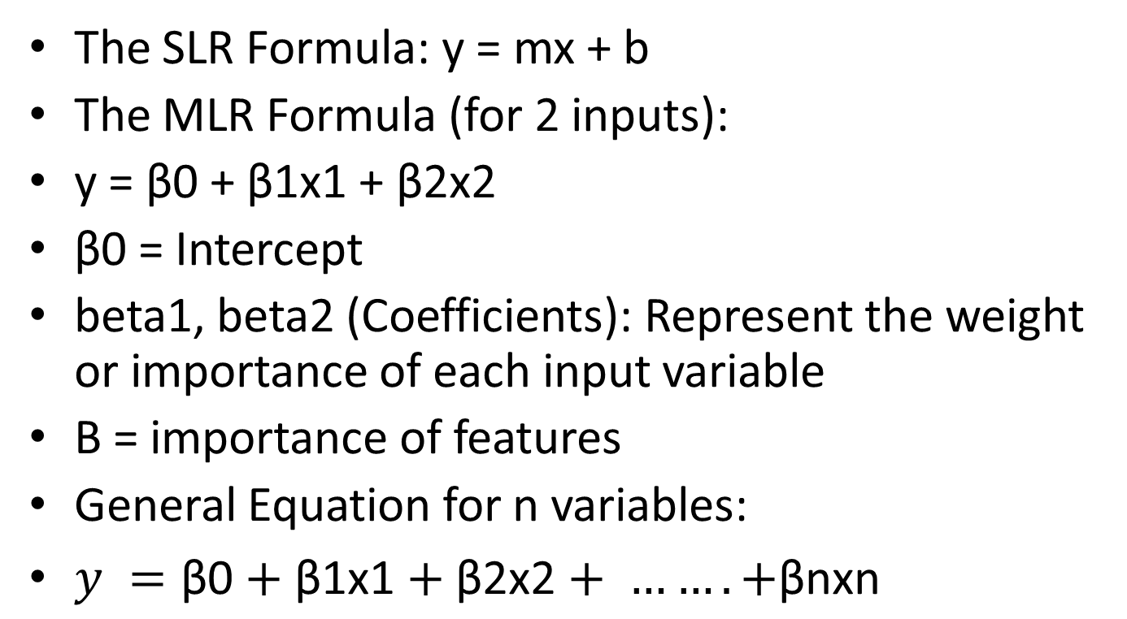
Mathematical Model
The SLR Formula: y = mx + b
The MLR Formula (for 2 inputs):
y = β0 + β1x1 + β2x2
β0 = Intercept
beta1, beta2 (Coefficients): Represent the weight or importance of each input variable
Β = importance of features
General Equation for n variables:
$y =\text{β}\text{0}+\text{β}\text{1}\text{x}\text{1}+\text{β}\text{2}\text{x}\text{2}+ ……. +\text{β}\text{n}\text{x}\text{n}$

Slide 5
Feature Importance
Large β → strong influence
Small β → weak influence
Helps in decision making
Importance of Features: The coefficients indicate how much the output depends on a specific input
Intercept (β0): This represents the baseline value of the output if all input variables were zero

Slide 6
Scikit-Learn Implementation
Import LinearRegression
Train using model.fit()
Predict using model.predict()

Slide 7
Evaluation Metrics
MSE → Error measurement
R2 Score → Accuracy of model
Higher R2 = Better fit

Slide 8
3D Visualization Concept
Visualize plane in 3D
Use Plotly for interactive graphs
Rotate and analyze data

Slide 9
Sample Code
from sklearn.linear_model import LinearRegression
model = LinearRegression()
model.fit(X_train, y_train)
pred = model.predict(X_test)

Slide 10
Conclusion
MLR is powerful for real-world problems
Captures multiple relationships
Next: Deep dive into math & optimization

