Slide 1
AI Operational Analytics Command Center
Enterprise analytics, AI-assisted diagnostics, governance-aware reporting, and future-ready decision support.
Purpose
Operational analytics + conversational AI experience
Technologies
Power BI • Fabric • Streamlit • Python • OpenAI • Oracle
Focus Areas
Governance • KPI standardization • AI-ready reporting
Vision
Moving beyond static dashboards toward AI-assisted operational decision support using governed analytics, semantic models, and conversational experiences.
Portfolio positioning • Senior BI • Analytics Architecture • AI-ready Reporting

Slide 2
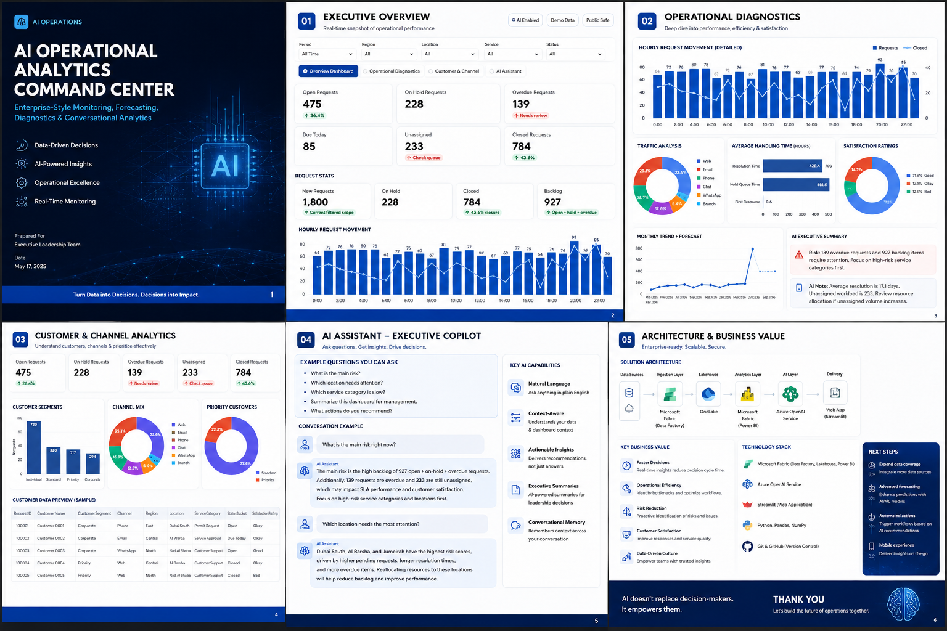
AI Operational Analytics Command Center • AI-ready analytics portfolio
AI Operational Analytics Command Center • AI-ready Analytics Portfolio

Slide 3
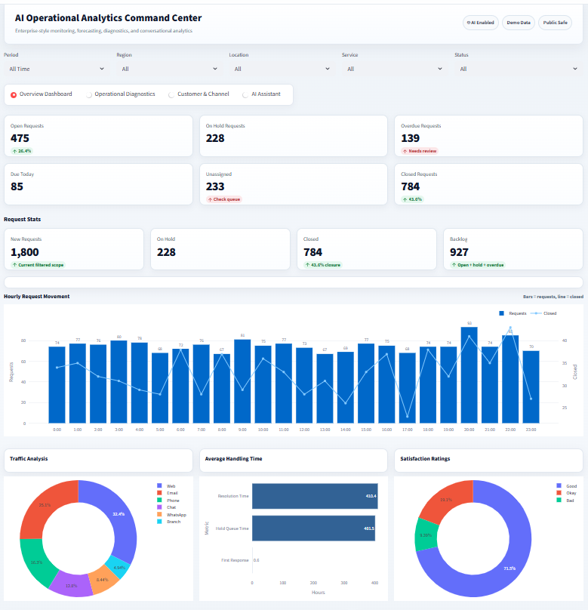
Executive overview: KPI-first command center
Designed for quick monitoring of workload, backlog, risk, and operating movement.
What it demonstrates
A clear executive KPI layer that makes workload, overdue items, closure, and backlog visible at a glance.
UX decision
Filters and navigation stay above the metrics, so leaders can change context without losing orientation.
Portfolio value
Shows dashboard design, KPI framing, operational analytics, and presentation thinking together.
Open requests
Backlog
Closed
Overdue
475
927
784
139
AI Operational Analytics Command Center • Portfolio Showcase
03

Slide 4
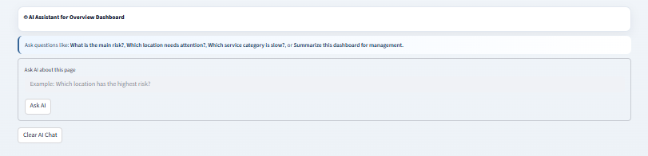
Conversational analytics: governed KPI chat
The AI layer supports exploration when users need answers beyond fixed dashboard visuals.
AI positioning
The prototype uses safe demo data today, but the architecture can evolve toward governed enterprise data and approved AI services.
Security principle
The AI should answer from semantic models and approved data scopes, not unrestricted raw data.
Example questions
Portfolio value
Shows ability to bridge BI, data governance, AI adoption, and business experience design.
• What is the main risk?
• Which location needs attention?
• Which service category is slow?
• Summarize this dashboard for management.
AI Operational Analytics Command Center • Portfolio Showcase
06

Slide 5
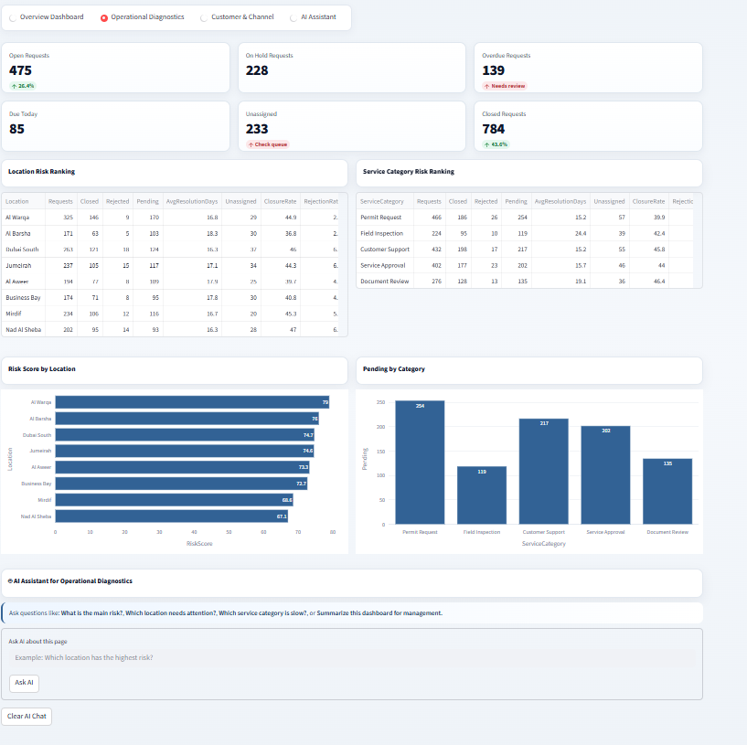
Operational diagnostics: risk visibility
Moving from descriptive reporting toward diagnostic decision support.
Diagnostic lens
This page is not only a chart view. It is designed to guide managers toward the queues, locations, and service categories that require action.
Risk ranking
Compares locations and service categories using volume, closure, pending, and resolution signals.
Actionability
The dashboard should tell leadership where to investigate first, not only what happened.
Senior skill shown
Business logic + metric design + operational process understanding.

Slide 6
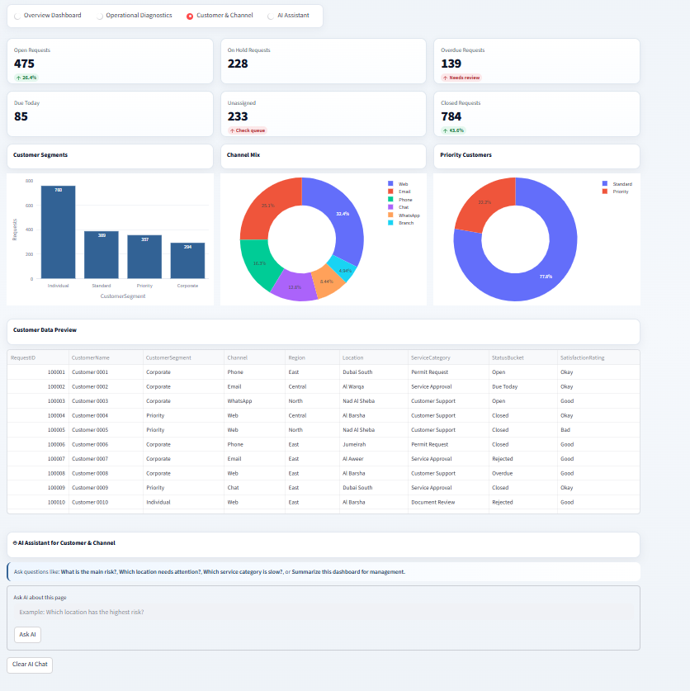
Customer & channel analytics
A page designed to explain how demand arrives and which customer groups are affected.
Channel mix
Highlights how requests arrive across web, email, phone, WhatsApp, chat, and branch channels.
Customer view
Connects operations to customer segments and priority populations.
BI value
Shows report consumers both top-level metrics and supporting transaction-level preview.
Designed for business users, not only analysts.

Slide 7
Target architecture: AI-assisted analytics
The prototype is static today; the design direction is scalable and governance-aware.
Architecture decision
The AI is not a separate toy app. It sits on top of trusted analytics assets: curated data, semantic definitions, and governed access. That is the difference between a demo and an enterprise-ready direction.
Oracle / ERP
Operational Data
OneLake /
Lakehouse
Bronze • Silver
Gold Layers
Power BI
Semantic Model
Dashboard
Experience
AI Assistant
Layer
Executive
Insights
Governance layer
Scalability layer
Business layer
Role-based access, approved datasets, semantic KPI definitions, and safe AI boundaries.
Move from static demo data to live enterprise sources, Fabric, Lakehouse, and Azure/OpenAI services.
Dashboard for fixed visibility; AI chat for flexible diagnostic exploration.
AI Operational Analytics Command Center • Portfolio Showcase
07

