Slide 1
Plant Seedlings Classification using CNNs
MACHINE LEARNING - IMAGE CLASSIFICATION

Slide 2
INTRODUCTION
If the process of classifying plant seedlings is carried out effectively, it can result in yielding better quality crops and plantation. It can also help in better supervision of the crop-producing lands.

Slide 3
Dataset - 4750 images (12 classes)
▸ Training Images - 3040
▸ Validation Images - 950
▸ Testing Images - 760

Slide 4
Framework
Keras
▸ Open-source Python library
▸ Neural Network library
▸ Supports Convolutional …..Neural Network
▸ Enables fast experimentation

Slide 5
Model:
Simplified VGG Net
▸ 5 Convolutional Layers
▸ ReLu - Activation Function
▸ Max Pooling
▸ Batch Normalization
▸ DropOut
▸ Fully Connected Layer
▸ Sigmoid - Activation Function
▸ SGD - Loss Function

Slide 6
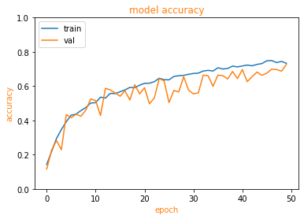
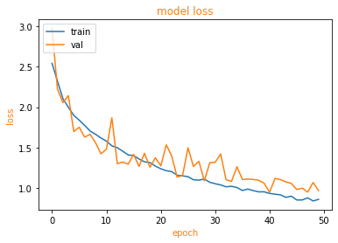
Training and Validation Accuracy and Loss
Trained over : 50 epochs
Validation Accuracy : 72.74%

Slide 7
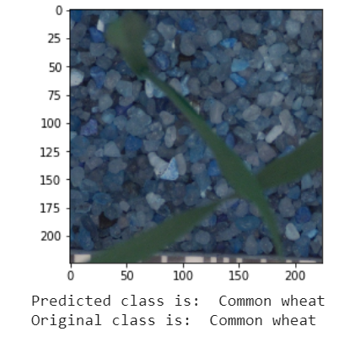
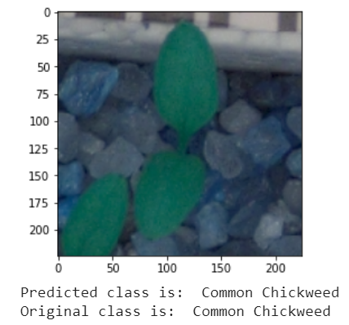
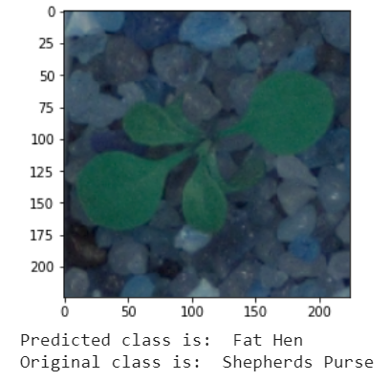
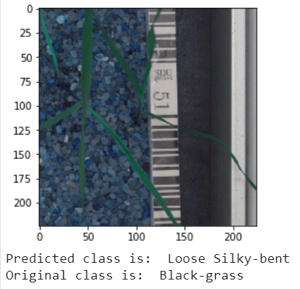
Results
Test Accuracy : 71.71%

Slide 8
Thankyou

