Slide 1
Mthree Stock Exchange Team project
Team Members:
External Roles besides coding
1)Seow Shou Yang Brian – Product Owner / Front-End Developer
2)Syed Waseem Fahad - Scrum Master
3)Sai Priya – Back-End Developer / Tester
4)Bindu Jahnavi – Back-End Developer

Slide 2
Planning Phase
User Stories:
1) As a User , I wish to be able to Login to my own account
2)As a User, I wish to be able to Register a new account
3)As a User, I wish to be able to submit new order
4)As a User, I wish to be able to view all my orders
5)As a User, I wish to be able to delete any existing order
6)As a User, I wish for my exchanges to perform internal crossing if the conditions are met
7)As a User, I wish to be able to view the status of my order.

Slide 3
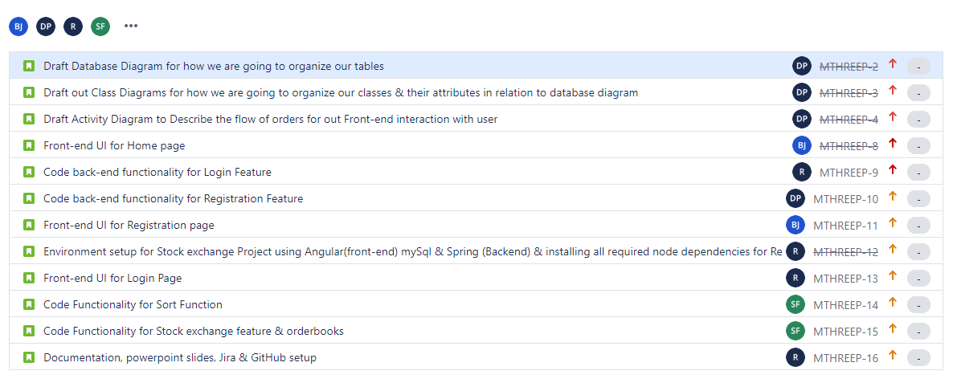
Sprint 1 Backlog

Slide 4
Scrum Meetings
Weekly Meeting minutes (12th June 2020)
Agenda: Discussion of features to be implemented and work split
Time Taken | 1hour 43 minutes | Attendance: | All Present
Work to be done: 1)Research on what environment to use e.g (ReactJs or Angular) & study 2)Features required for front-end & back end to be implemented 3)Workload allocation & time constraints 4) Voicing out of opinions and sharing strengths & weaknesses. 5)Scheduling Work time in accordance to everyone’s schedule.

Slide 5
Scrum Meeting
Example of a Daily Scrum Meeting
Name: <Insert name> Date:13th June 2020
What did you do yesterday? | Researching & reading up on environment, JIRA + Confluence
What is your goal today? | Design Wireframe lay out, implement UI for page.
Are there any obstacles you are facing? | Setting up environment & learning the basics for front-end coding.

Slide 6
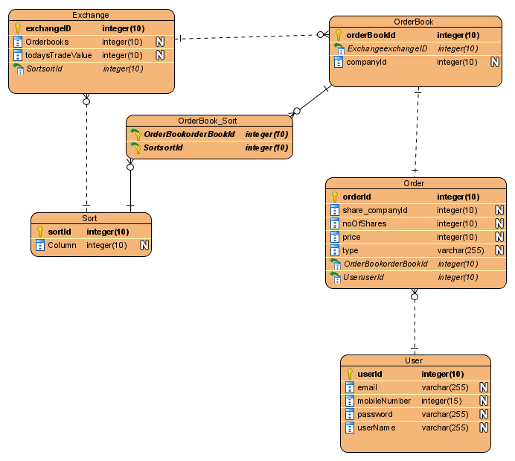
Diagrams
Database Diagram

Slide 7
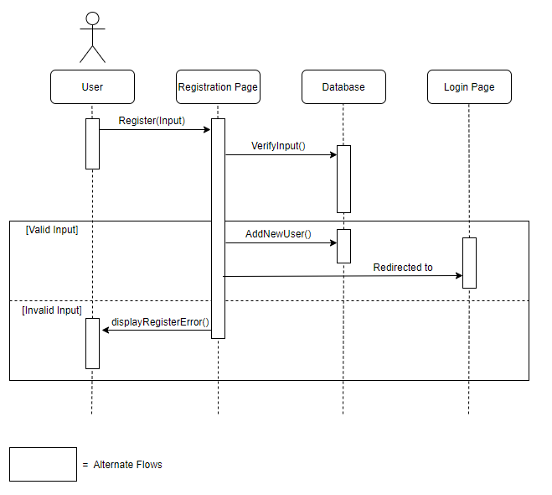
Diagrams : Registration
Activity Diagram

Slide 8
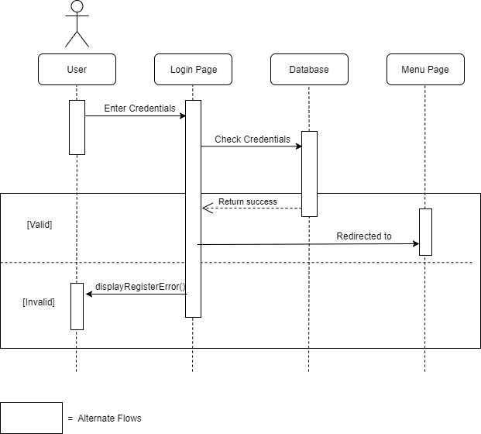
Diagrams: Login
Activity Diagram

Slide 9
Test-cases
Test-case examples
Register Account
Description | Register a valid user account
Actions | Click on Register Button User should be redirected to registration page Ensure all fields are available to fill in (username, email, password) Clicks on Register. Message pops up that account has been created & Press Okay
Expected Result | User’s input is accepted. System notifies users of successful registration.
Actual Result | User’s input is accepted. System notifies users of successful registration.
Status (Pass/Fail) | Pass
Observations | Null
Login to Account
Description | Login to a valid user account
Actions | User should see two input texts for Username & password User fills the input files with VALID username & password. User clicks on enter and login will be successful if user enters valid login credentials.
Expected Result | User’s input is accepted. System notifies users of successful Login.
Actual Result | User’s input is accepted. System notifies users of successful Login.
Status (Pass/Fail) | Pass
Observations | Null

Slide 10
Problems Faced & Solutions
Problems Faced | Lesson Learned
All members adapting to the new language and environment for Angular | Each self organizing team member will volunteer, select their task and discuss their findings while implementing. This enables the group to learn together and reduces the workload of having to learn the entire system alone. Everyone learns their own part and shares the knowledge.
CSS designs are not consistent when working on individual pages | Always inform whoever is working on front-end and make sure to always share & update the CSS style used to maintain a consistent theme.
Having version inconsistencies between Spring & angular. Causes certain features & keywords to not work | Project manager needs to ensure that everyone’s application version is the same
Learning & managing state of variables in angular | Adequate research must be done for this as there are a lot of state interactions in angular
Connection between Front-end & Back-End communication for transfer of states & other information | Proper understanding of using end points of both front-end & back-end and make sure they are connected correctly using the same names

Slide 11
Conclusion
Questions?

