Slide 1
Final Project Data management and masking on Azure
Yenneti,Swati
Deep Azure@McKesson

Slide 2
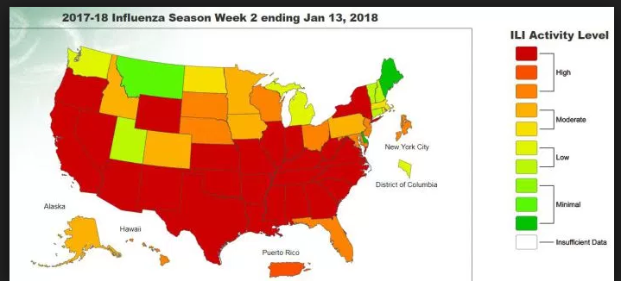
Problem Statement
Although most organizations have stringent security controls in place to protect production data in storage or in business use, sometimes that same data has been used for operations that are less secure. The issue is often compounded if these operations are outsourced and the organization has less control over the environment. In the wake of compliance legislation, most organizations are no longer comfortable exposing real data unnecessarily. In data masking, the format of data remains the same; only the values are changed.
In this example we are going to demonstrate how to mask the patient data using Azure and make it available for the analytics. We are going to measure the number of Influenza cases in 2018 in all the United States without comprising any of the patient PHI.

Slide 3
Background
Data involved in any data-masking or obfuscation must remain meaningful at several levels:
The data must remain meaningful for the application logic. For example, if elements of addresses are to be obfuscated and city and suburbs are replaced with substitute cities or suburbs, then, if within the application there is a feature that validates postcode or post code lookup, that function must still be allowed to operate without error and operate as expected. The same is also true for credit-card algorithm validation checks and Social Security Number validations.
The data must undergo enough changes so that it is not obvious that the masked data is from a source of production data. Theoretically, if the data is obviously masked or obfuscated, then it would be reasonable for someone intending a data breach to assume that they could reverse engineer identity-data if they had some degree of knowledge of the identities in the production data-set. Accordingly, data obfuscation or masking of a data-set applies in such a manner as to ensure that identity and sensitive data records are protected - not just the individual data elements in discrete fields and tables.

Slide 4
Different Types of Masking
There are sever techniques for Masking like
Substitution, Shuffling, Number and date variance, Encryption, Nulling out or deletion, Masking out . There are different types of masking like
Static Data Masking is usually performed on the golden copy of the database, but can also be applied to values in other sources, including files.
On-the-Fly Data Masking happens in the process of transferring data from environment to environment without data touching the disk on its way. The same technique is applied to "Dynamic Data Masking" but one record at a time.
Dynamic Data Masking is similar to On-the-Fly Data Masking but it differs in the sense that On-the-Fly Data Masking is about copying data from one source to another source so that the latter can be shared. Dynamic data masking happens at runtime, dynamically, and on-demand so that there doesn't need to be a second data source where to store the masked data dynamically.

Slide 5
Dynamic Data Masking on Azure
DDM is one of several security features for Azure SQL Database, which serve to protect data, control access and monitor database activity. Each of these features are valuable and in total they provide a comprehensive security solution for your database.
The benefits DDM specifically offers include:
It is especially simple to create a data masking policy, whether via the Azure Portal, PowerShell cmdlets or T_SQL Configuration
There is no need to modify database procedures or application code
DDM introduces little if any performance impact on database operations
DDM supports AAD authentication, and AAD users and groups can be granted DDM exclusion permissions

Slide 6
SQL Database dynamic data masking
Dynamic data masking permissions:
Dynamic data masking can be configured by the Azure Database admin, server admin, or security officer roles.
Dynamic data masking policy
SQL users excluded from masking - A set of SQL users or AAD identities that get unmasked data in the SQL query results. Users with administrator privileges are always excluded from masking, and see the original data without any mask.
Masking rules - A set of rules that define the designated fields to be masked and the masking function that is used. The designated fields can be defined using a database schema name, table name, and column name.
Masking functions - A set of methods that control the exposure of data for different scenarios.

Slide 7
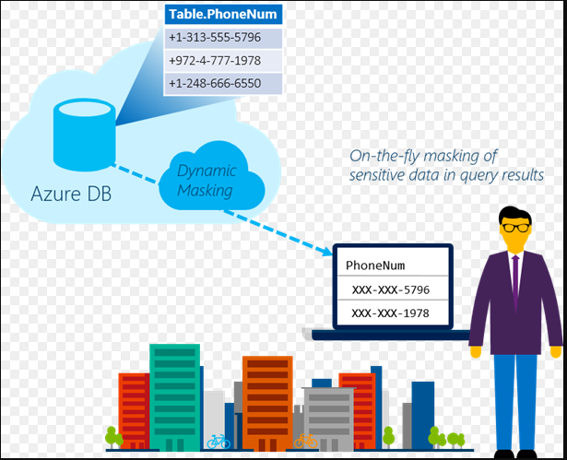
Dynamic Data Masking on Azure

Slide 8
Masking Functions
Default | Full masking according to the data types of the designated fields • Use XXXX or fewer Xs if the size of the field is less than 4 characters for string data types (nchar, ntext, nvarchar). • Use a zero value for numeric data types (bigint, bit, decimal, int, money, numeric, smallint, smallmoney, tinyint, float, real). • Use 01-01-1900 for date/time data types (date, datetime2, datetime, datetimeoffset, smalldatetime, time). • For SQL variant, the default value of the current type is used. • For XML the document is used. • Use an empty value for special data types (timestamp table, hierarchyid, GUID, binary, image, varbinary spatial types).

Slide 9
Masking Functions
Credit card | Masking method, which exposes the last four digits of the designated fields and adds a constant string as a prefix in the form of a credit card.
 | XXXX-XXXX-XXXX-1234
Email | Masking method, which exposes the first letter and replaces the domain with XXX.comusing a constant string prefix in the form of an email address.
 | aXX@XXXX.com
Random number | Masking method, which generates a random number according to the selected boundaries and actual data types. If the designated boundaries are equal, then the masking function is a constant number.
Custom text | Masking method, which exposes the first and last characters and adds a custom padding string in the middle. If the original string is shorter than the exposed prefix and suffix, only the padding string is used.

Slide 10
Data Set
The patient data set is download from https://www.challenge.gov/challenge/patient-matching-algorithm-challenge/
A dummy provider table and a Influenza diagnosis table is added to the dataset.
The patient dataset will consist of 50K records of Flu like patient demographics like first name, last name, medical record number ,SSN, DOB, address, city, State and provider.
Patient Diagnosis dataset has the list of various categories of Influenza and Pneumonia .
Provider dataset has the Provider first name, last name and NPI

Slide 11



Technology and Software
Visual Studio 2017 is used to run the C# code. This can be downloaded from
https://www.visualstudio.com/downloads/
C# is used to create the Data factory
SQL Server Management studio 2017 is used to connect to the SQL server and create the tables and users . This can be downloaded from
https://docs.microsoft.com/en-us/sql/ssms/download-sql-server-management-studio-ssms
Tableau 10.5 is used to create and view and the reports
Can be downloaded from https://www.tableau.com/products/desktop/download

Slide 12
Code Overview
Overview of steps:
Prepare a clean Patient data set , Patient Diagnosis with Influenza like cases and save as CSV
Create a SQL server and a sql database
Create tables and multiple users with access to the newly created database
Create azure storage account and container to hold your source data files
Create Azure data factory to load the data from flat file into the SQL database
Mask the data on the sql server for the required users using Azure Data Masking
Connect to Sql Server DB using Tableau and import all the required tables to measure the Influenza cases
Build a map report to show the number of Influenza cases in different states of U.S.

Slide 13
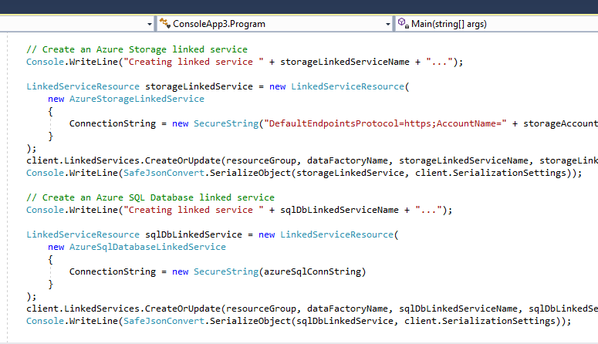
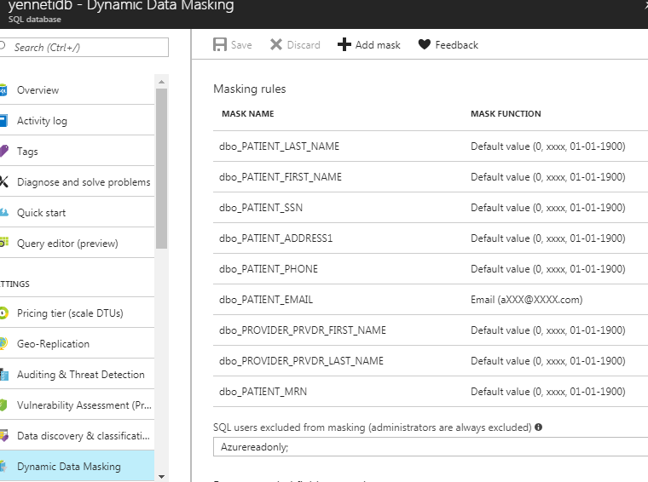
Sample Code

Slide 14
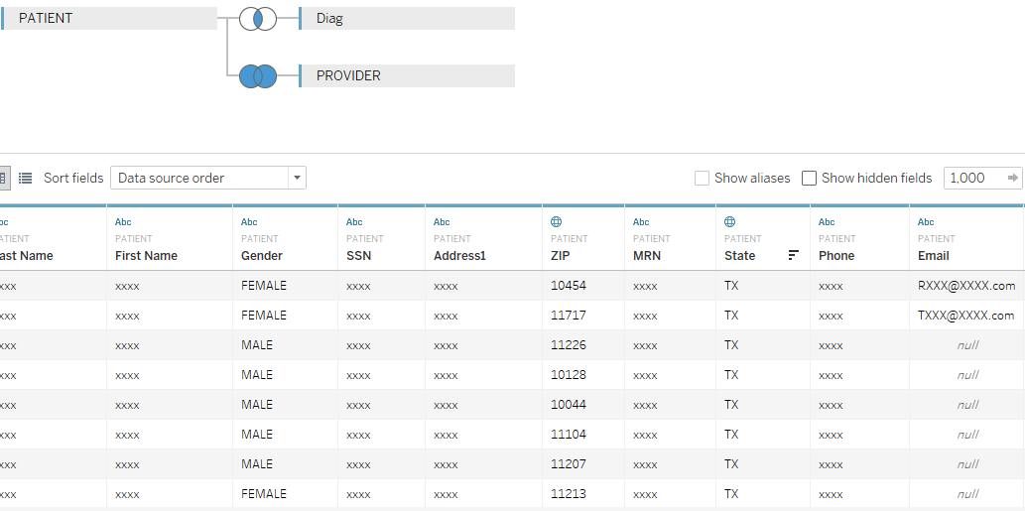
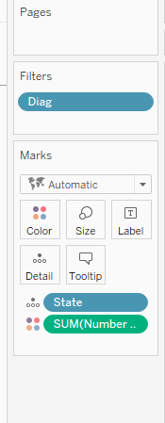
Sample Data and Reports

Slide 15
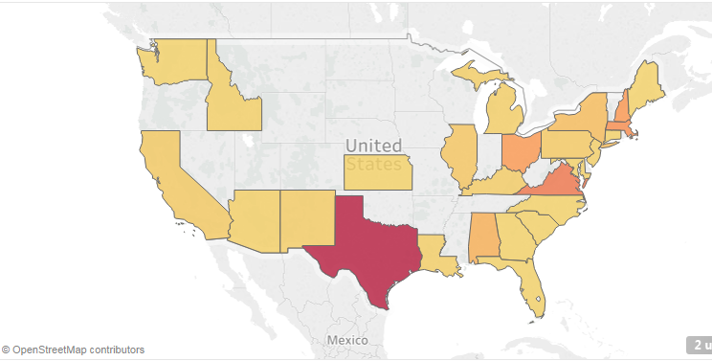
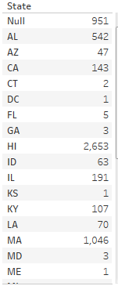
Map showing the Influenza patients across U.S

Slide 16
Final Results
It is obvious and easy to determine from the report that Texas has the highest number of recorded cases.
This report was built very easily without violating any patient PHI rights.
Most of the PHI columns was automatically recognized by Azure Data Masking tool.
The administrator and the privileged user can still view the original data .

Slide 17
Manage access to resources with Azure Active Directory groups
Azure Active Directory (Azure AD) is a comprehensive identity and access management solution that provides a robust set of capabilities to manage access to on-premises and cloud applications and resources including Microsoft online services like Office 365 and a world of non-Microsoft SaaS applications.
Within Azure AD, one of the major features is the ability to manage access to resources. These resources can be part of the directory, as in the case of permissions to manage objects through roles in the directory, or resources that are external to the directory, such as SaaS applications, Azure services, and SharePoint sites or on-premises resources. There are four ways a user can be assigned access rights to a resource:
Direct assignment: Users can be assigned directly to a resource by the owner of that resource.
Group membership: A group can be assigned to a resource by the resource owner, and by doing so, granting the members of that group access to the resource. Membership of the group can then be managed by the owner of the group. Effectively, the resource owner delegates the permission to assign users to their resource to the owner of the group.

Slide 18
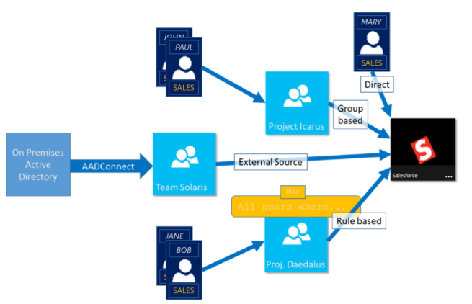
Manage access to resources with Azure Active Directory groups
Rule-based: The resource owner can use a rule to express which users should be assigned access to a resource. The outcome of the rule depends on the attributes used in that rule and their values for specific users, and by doing so, the resource owner effectively delegates the right to manage access to their resource to the authoritative source for the attributes that are used in the rule. The resource owner still manages the rule itself and determines which attributes and values provide access to their resource.

Slide 19
Lessons Learned and Future Works
Right now there is no option to mask the data by Substitution, Shuffling or Nullification.
Also there is no way to do the masking from a script. Right now it can be only done from Azure portal GUI. For a very big database this might become tedious task
Masking can be only done on a SQL database. There is no way to apply masking on a SQL Warehouse
Masking on a non-relational database is not possible
A masking rule cannot be defined for the following column types:
Encrypted columns (Always Encrypted) ,FILESTREAM , COLUMN_SET or a sparse column that is part of a column set.
A mask cannot be configured on a computed column, but if the computed column depends on a column with a MASK, then the computed column will return masked data.
A column with data masking cannot be a key for a FULLTEXT index.
For users without the UNMASK permission, the deprecated READTEXT, UPDATETEXT, and WRITETEXT statements do not function properly on a column configured for Dynamic Data Masking.

Slide 20
YouTube URLs, GitHub URL, Last Page
Two minute (short): https://youtu.be/8OWP0vaV6bc
15 minutes (long): https://youtu.be/2ye9KoqC4Xo
GitHub Repository with all artifacts: https://github.com/syenneti/FinalProject.git

