Slide 1
Mobile Application
Courses
Pemrograman Perangkat Bergerak
MJ 4B Regular
Mustika Embun Jati 4311801031
Syenni Gracia Fanggidae 4311801054
Muhammad Prayoga 4311601065

Slide 2
What is Sweet Recipes?
This application presents a variety of interesting info about simple dessert recipes with ingredients that are easily available.

Slide 3
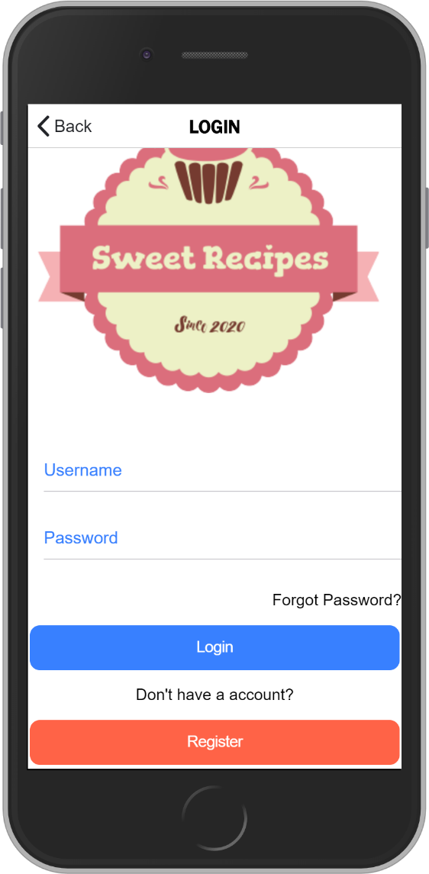
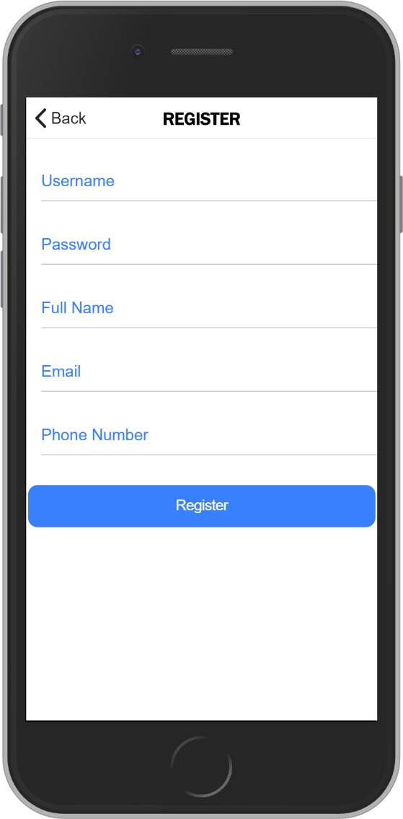
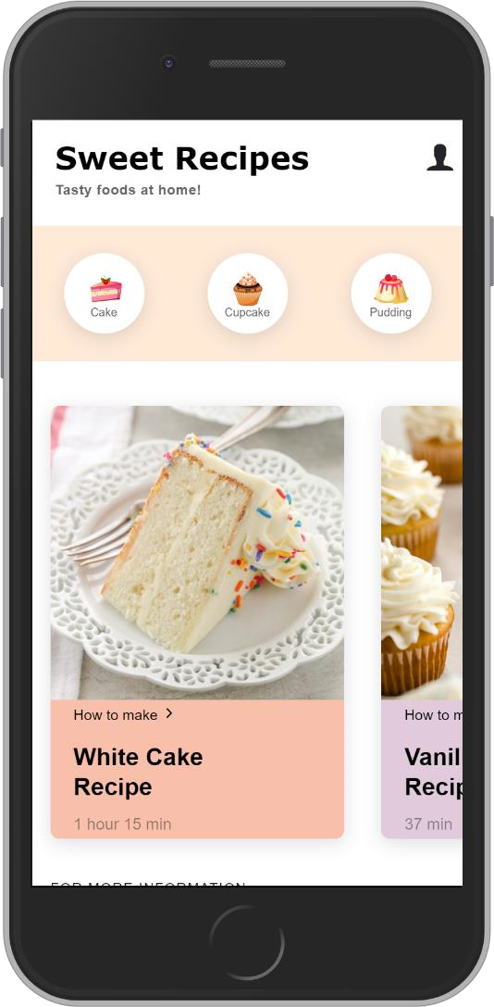
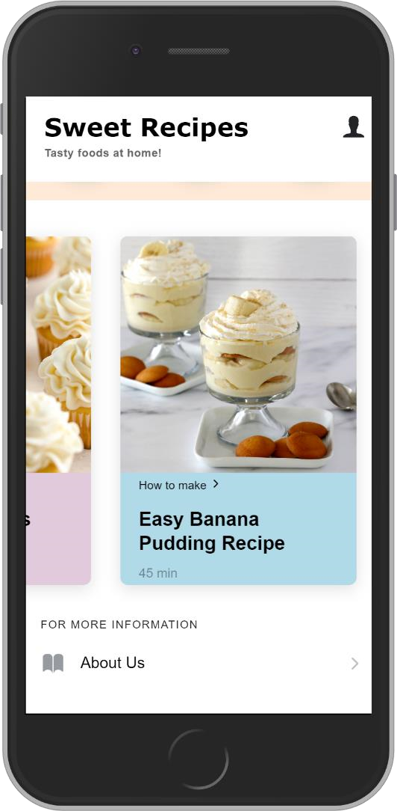
The Design

Slide 4
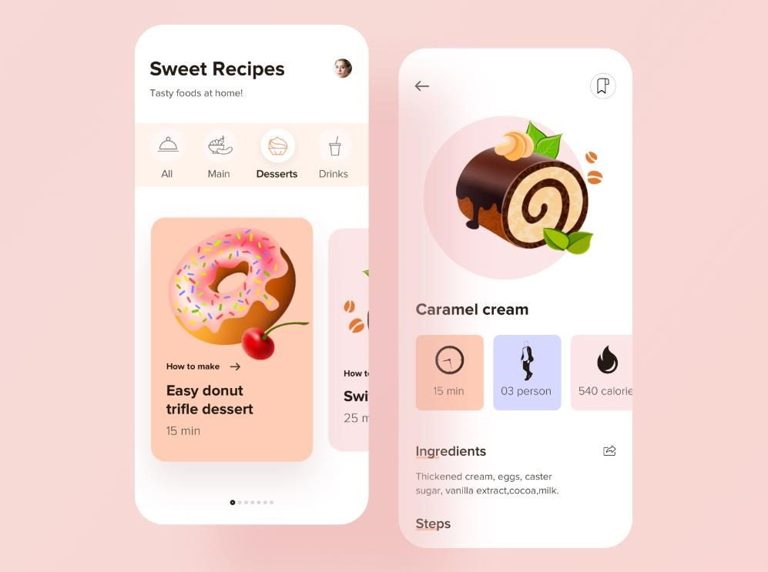
REFERENCE
https://dribbble.com/shots/8497072-Recipe-App-Design

Slide 5
Login and Register Page

Slide 6
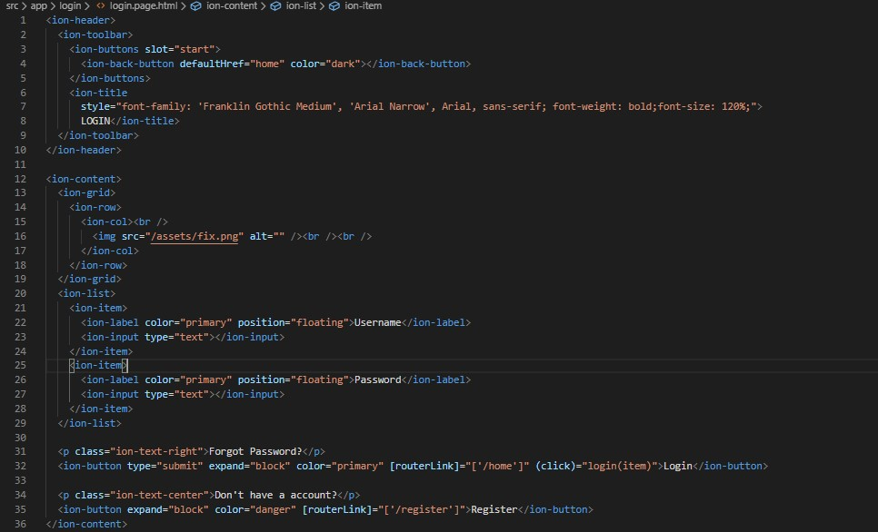
Login Page

Slide 7
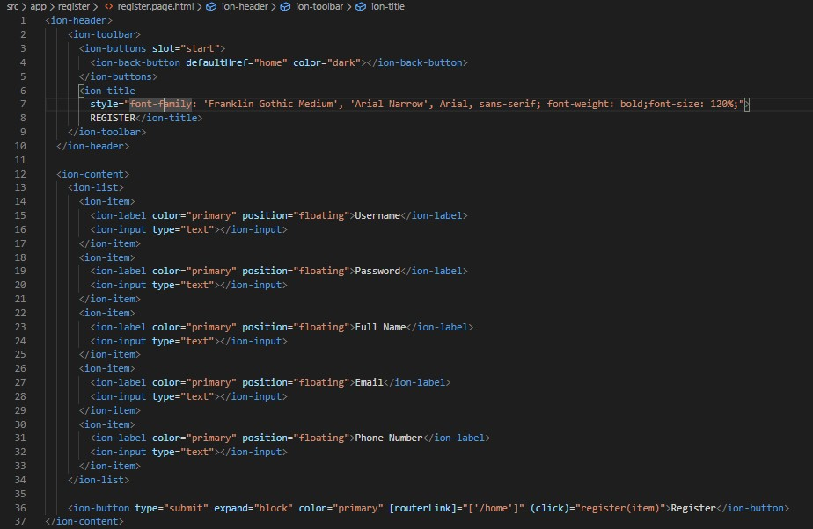
Register Page

Slide 8
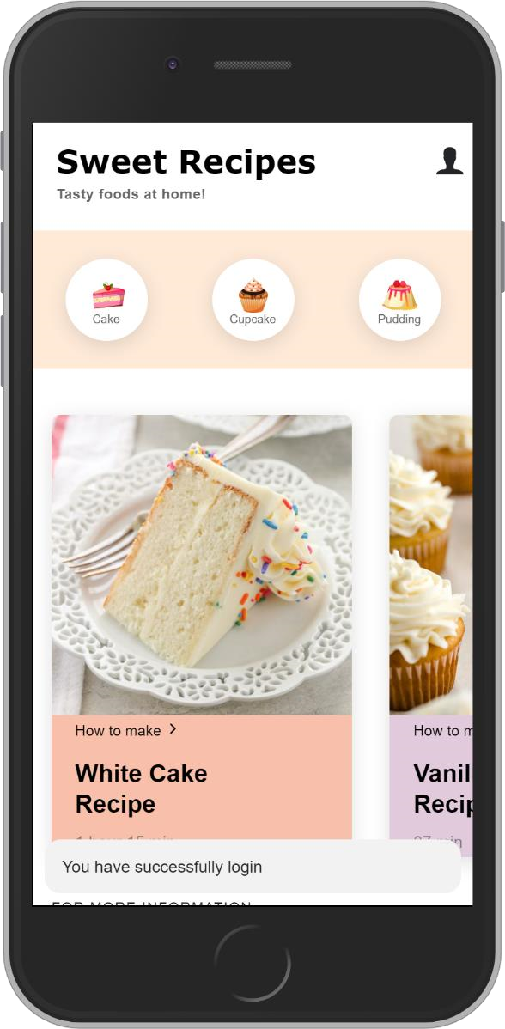
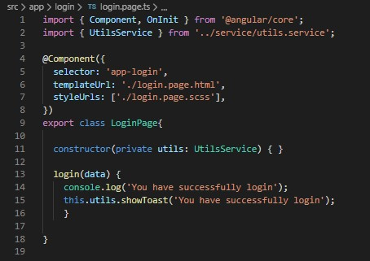
If you have successfully logged in or registered by filling out the form, you will be directed to the home page and the text "You have logged in heavily" will appear.

Slide 9
Home Page

Slide 10
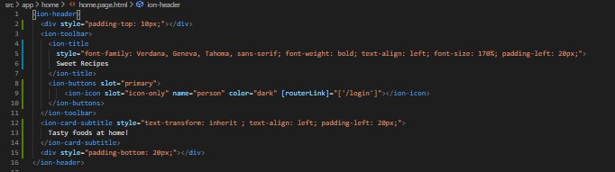
To display
the
Login page

Slide 11
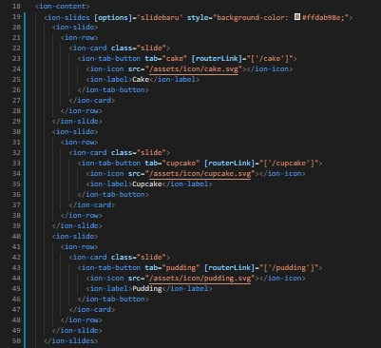
To display
the
Navigation bar

Slide 12
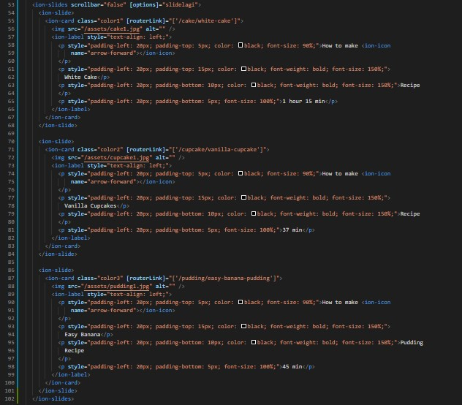
To display
the
Recipe recommendation

Slide 13
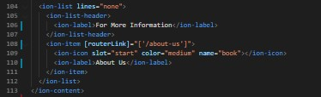
To display
“For more Information”
And
About us

Slide 14
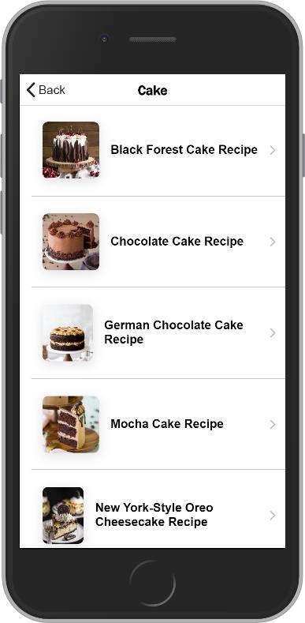
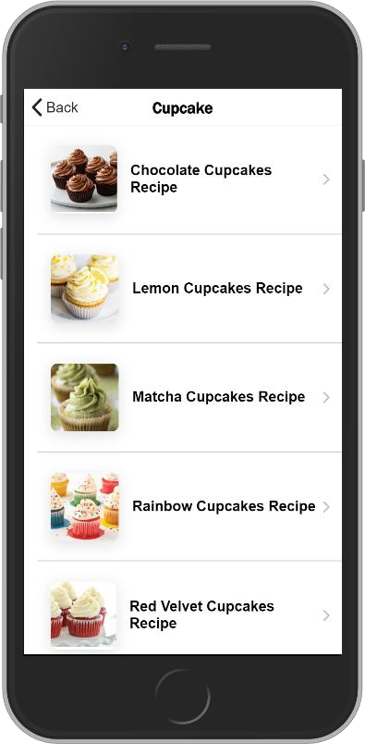
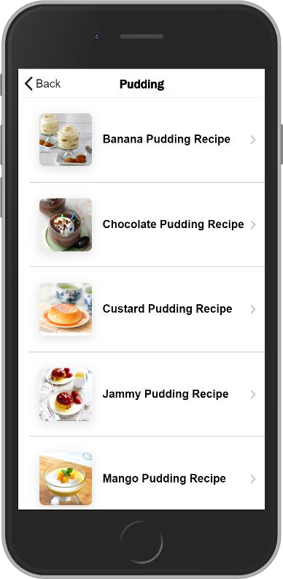
Recipes Page
(Cake, Cupcake, and Pudding).

Slide 15
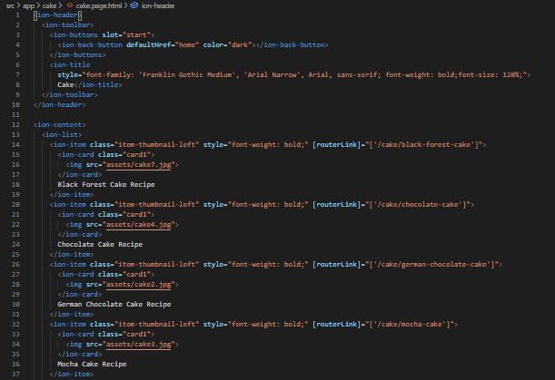
Recipes Page

Slide 16
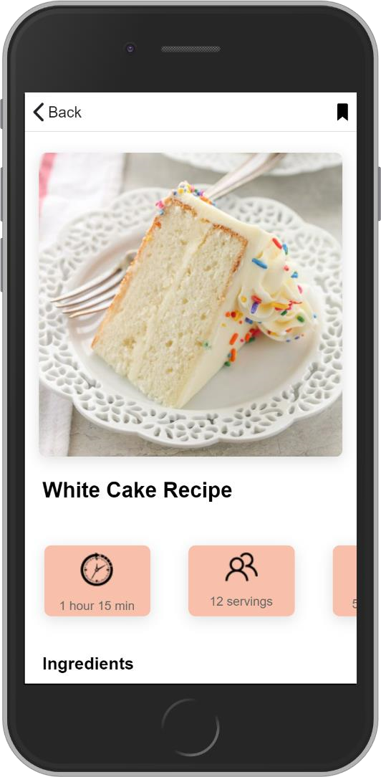
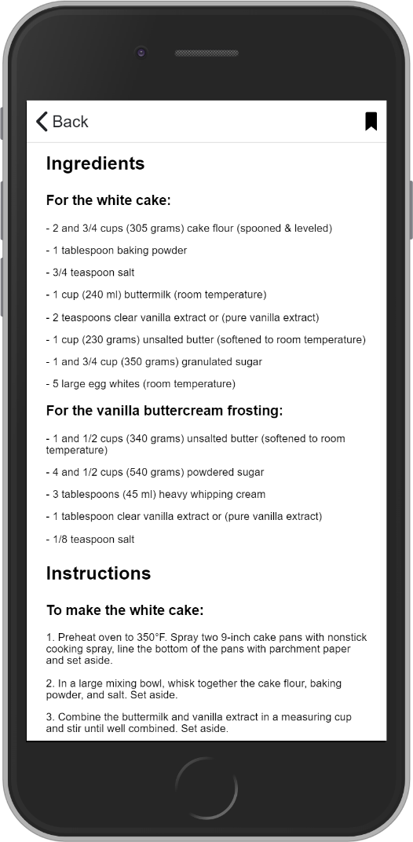
User-selected Page

Slide 17
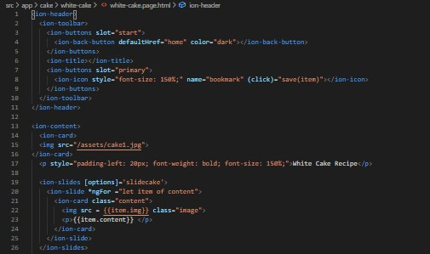

Slide 18
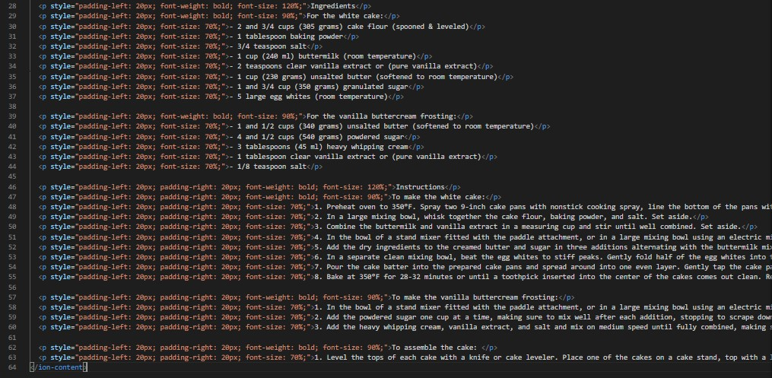
The content

Slide 19
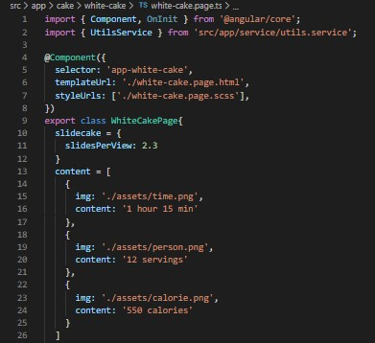

To display
time, portion, and calorie information

Slide 20

To display text
“You just saved this recipe”

Slide 21
THANK YOU!!!

