Slide 1
Google’s Word2vec
A tool for computing distributed representations of word vectors
3/23/2017

Slide 2
Introduction
What are word vectors?
We can encode words by weighting them across different dimensions
Ex.) In a small vocabulary: boy, girl, hen, rooster
Vector encoding [gender, is_chicken]
Boy: [1.0 , 0.0], hen: [0.0, 1.0]
Girl: [0.0, 0.0], rooster: [1.0, 1.0]

Slide 3
This allows for…
The following calculation
Vec(boy) = Vec(girl) + Vec(rooster) – Vec(hen)
[1.0, 0.0] = [0.0, 0.0] + [1.0, 1.0] – [0.0, 1.0]
Learning these representations can allow models to infer syntactic and semantic regularities within language

Slide 4
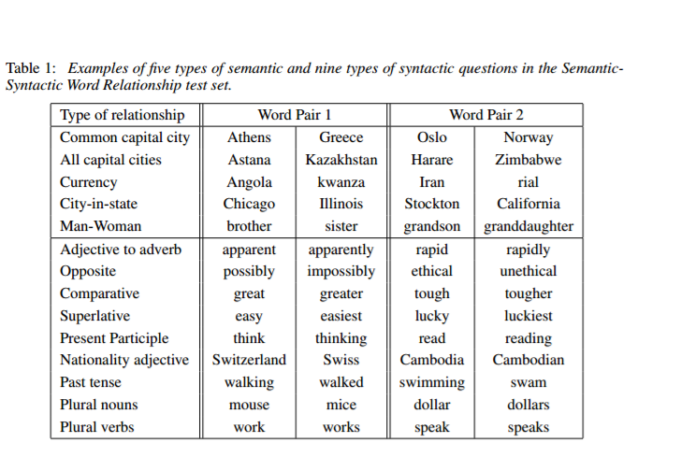
Types of Syntactic and Semantic Connections

Slide 5
Word2vec
Created at Google by a team of researchers led by Tomas Mikolov
Un-supervised learning algorithm which uses a large amount of text to create high dimensional representations of words
Structured as a neural network with 1 hidden layer
2 major architectures: CBOW and skip-gram

Slide 6
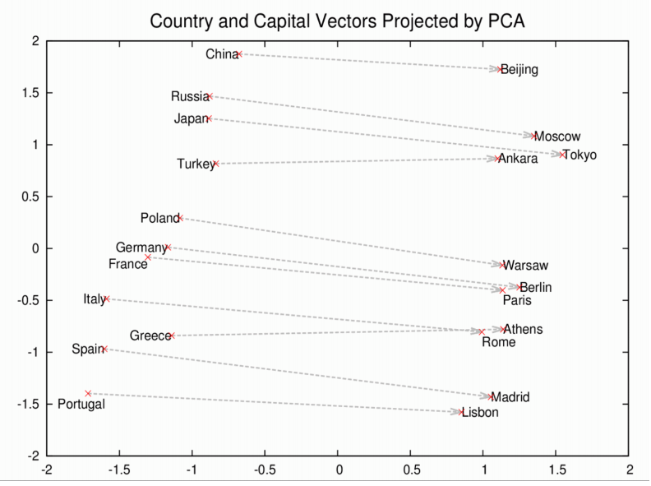
Interesting Results 1
Vec(Rome) – Vec(Italy) + Vec(China) = Vec(Beijing)

Slide 7
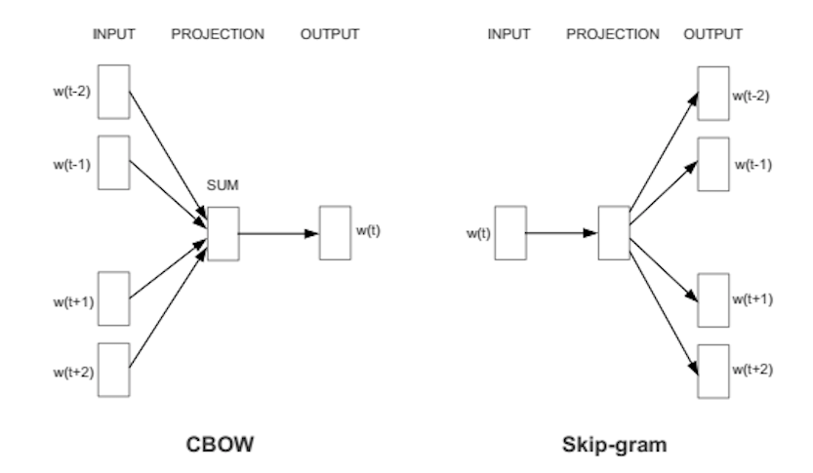
Continuous Skip-gram Model
Model predicts context from current word
Ex) “ice”
Predicted context words: “melting”, “winter”, “cold”

Slide 8
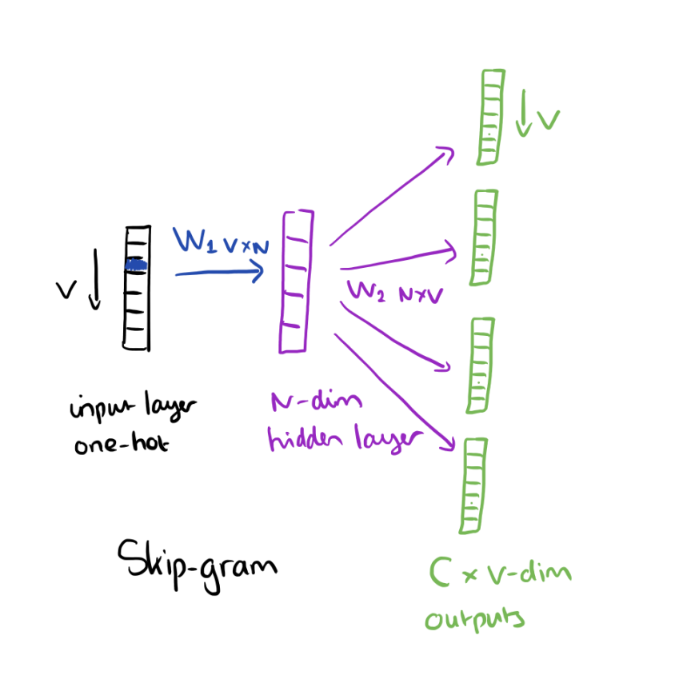
Skip-gram
If there are C context words at the output layer we output C multinomial distributions

Slide 9
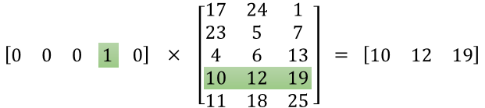
Insight
In the skip-gram model, the hidden layer is acting as a “look-up table” for the input word vector

Slide 10
Continuous Bag of Words (CBOW)
Model predicts the current word from context
Ex.) “children”, “__”, “in”, “a”, “school” ,“bus”
predict “ride”

Slide 11
CBOW
Each input word is encoded in “one-hot” 1xV vectors if V is the size of the vocabulary
The second weight matrix generates a score for each word, and softmax can be used to obtain the posterior distribution of words

Slide 12
NNLM and RNNLM
NNLM (Feedforward neural net language model)
Input, projection, hidden, and output layers
High computational complexity
RNNLM (Recurrent neural net language model)
Input, hidden and output layers
Hidden layer connects to itself with time-delay
High computational complexity

Slide 13
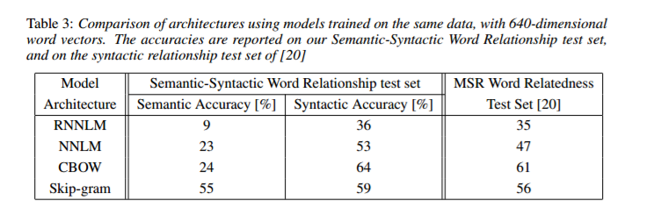
Results
Both CBOW and Skip-gram perform well compared to NNLM and RNNLM

Slide 14
Additional Results
architecture: skip-gram (slower, better for infrequent words) vs CBOW (fast)
the training algorithm: hierarchical softmax (better for infrequent words) vs negative sampling (better for frequent words, better with low dimensional vectors)

Slide 15
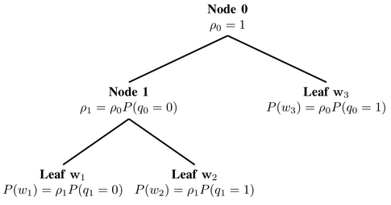
Optimization w/ Hierarchical Softmax
H-softmax replaces the flat softmax layer with a hierarchical layer that has words as leaves

Slide 16
H-softmax
Think of regular softmax as a tree of depth 1, with V leaf nodes
Computing the softmax probability of one word involves calculating the probabilities of all V
Structuring the softmax as a binary tree we only have to follow the path from the root to the leaf, considering at most log(V) nodes

Slide 17
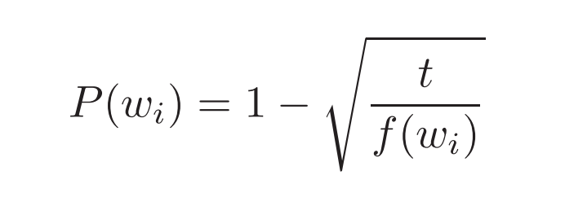
Optimization w/ Negative Sampling
Only update a sample of output words per iteration
Mikolov et al. uses the following procedure to counter the lesser knowledge given by words such as “in” and “the” compared to rarer words
Each word is discarded with the following probability, where f defines the frequency of the word

