Slide 1
Missing Data and potential fixes Yu-Sung Su Tsinghua University

Slide 2
Why care?

Slide 3
Why should you care about missing data?
Bias (even in randomized experiments)
Efficiency loss (particularly within subgroups)
Correct standard errors
May be interested in missing data mechanism (why are these people missing)

Slide 4
Example: Project Connect
Randomized trial targeting couples at high risk for HIV infection
Treatment arms received counseling sessions regarding ways to reduce risk of HIV infection focusing largely on safe sex practices; control arm just received educational materials
Outcomes reflecting risky behaviors were measured at 3 month and 12 month follow-up points

Slide 5
Example: Project Connect
Treatment effects estimates with standard errors in parentheses
Outcome is # unprotected sex acts at 12 months follow-up
 | Complete Cases | MI
Intervention Effect (log scale for outcome) | -0.36 (0.25) | -0.50* (.23)

Slide 6
Outline
Part 1: Missing data and simple solutions
Traditional solutions that throw away data
Traditional solutions that impute once
Regression imputation with noise
Part 2: Multiple Imputation
Overview
Assumptions
Models/Software
(MI using mi in R)

Slide 7
Methods that throw away data

Slide 8
Methods that throw away data
Complete cases
Complete variables
Weighting

Slide 9
Complete Cases
X₁ | X₂ | X₃ | X₄
0 | 3 | 8 | 2
0 | 4 | 9 | 3
0 | ? | 7 | 3
0 | ? | 6 | ?
1 | 5 | ? | ?
1 | 3 | ? | ?
1 | 4 | 9 | ?
X₁ | X₂ | X₃ | X₄
0 | 3 | 8 | 2
0 | 4 | 9 | 3

Slide 10
Complete cases (or listwise deletion)
Removes all observations from the dataset that have any missing values (Stata does automatically when you run an analysis)
At best is inefficient (yields higher standard errors) because of reduced sample size
At worst can cause severe bias
Reductions in sample size may preclude certain types of analyses, e.g. subgroup analyses

Slide 11
Complete case assumptions
The assumption needed for this to be a generally valid approach is that the data are Missing Completely at Random (MCAR). Formally we write as
p(R|X) = p(R)
where R is an indicator for nonresponse and X is all the variables in our dataset
Intuition 1: complete case sample is a random sample of the complete sample
Intuition 2: each person in the sample has an equal probability of having been dropped from the sample
This is generally not a plausible assumption. Usually, certain types of people are much more likely than others to have missing data.

Slide 12
More about complete cases
Actually, if the missingness is only on the outcome variable and if you fit the exact right model it shouldn’t matter if it’s fit on just a subset of the data (this is NOT true for missing predictor variables)
If model is not quite right or missingness is on predictors it’s better to fit on imputed dataset even if imputations formed under an imperfect model
When there are complicated missing data patterns the sample size can get reduced very quickly to a point when it will be difficult to use the remaining data to extrapolate to the rest of the original sample

Slide 13
Complete variables
X₁ | X₂ | X₃ | X₄
0 | 3 | 8 | 2
0 | 4 | 9 | 3
0 | ? | 7 | 3
0 | ? | 6 | ?
1 | 5 | ? | ?
1 | 3 | ? | ?
1 | 4 | 9 | ?
X₁
0
0
0
0
1
1
1

Slide 14
Complete variables
This throws out all variables that have any missing data
So full sample size is retained, but we may be left with only a few variables which aren’t of sufficient substantive interest
Makes it difficult to meet assumptions need for other types of (e.g. causal) analyses

Slide 15
Non-response weighting
Suppose only one variable has missing data
Build a model to predict whether a value is observed using observed values from the other variables
Use these predicted probabilities to create survey weights
Re-weight the complete case sample so that it is representative of the full sample once again
This becomes much more complicated when there is more than one variable with missing data
This has the potential to create crazy standard errors when probabilities get close to 1 or 0 (though one could create “stabilized weights”)

Slide 16
Non-response weighting
X₁ | X₂ | X₃ | X₄
0 | 1 | 7 | 3
0 | 1 | 7 | 3
0 | 1 | 7 | 3
0 | 1 | 7 | 3
1 | 8 | 2 | 1
1 | 8 | 2 | ?
1 | 8 | 2 | ?
1 | 8 | 2 | ?
1 | 8 | 2 | ?
0 | 1 | 7 | ?
X₁ | X₂ | X₃ | X₄ | Weight
0 | 1 | 7 | 3 | .125
0 | 1 | 7 | 3 | .125
0 | 1 | 7 | 3 | .125
0 | 1 | 7 | 3 | .125
1 | 8 | 2 | 1 | .5
Pr(missing|0,1,7)=1/5
Pr(missing|1,8,2)=4/5
e.g.
weight(0,1,7)=.20/(4*.20+1*.80)=.125

Slide 17
(overly simplistic) Summary of methods that throw away data
Method | Requires strong assumptions about missing data | Requires strong parametric assumptions | Increases standard errors | Leads to underestimates of s.e.’s | Complex to implement
Complete cases | YES (OR) YES |  | YES
Available cases |  | YES | YES
Weighting |  | YES | YES |  | YES

Slide 18
Single Imputation

Slide 19
Methods that keep all the data by imputing missing values (once)
Mean imputation
Last value carried forward
Dummy variables for missingness
Reports from other people
Regression imputation
Hotdecking

Slide 20
Mean imputation
Fills in all missing values for a given variable with the mean of the observed values for that variable
Can cause big problems, particularly in skewed data or data with e.g. big pile-ups at zero (like income data)
Underestimates variance for summaries of that variable
Skews summaries of that variable (so can affect measures of location as well)
Biases measures of association with other variables (correlation, regression, …)

Slide 21
Mean imputation
X₁ | X₂ | X₃ | X₄
0 | 3 | 8 | 2
0 | 4 | 9 | 3
0 | ? | 7 | 3
0 | ? | 6 | ?
1 | 5 | ? | ?
1 | 3 | ? | ?
1 | 4 | 9 | ?
X₁ | X₂ | X₃ | X₄
0 | 3 | 8 | 2
0 | 4 | 9 | 3
0 | 3.8 | 7 | 3
0 | 3.8 | 6 | 2.7
1 | 5 | 7.8 | 2.7
1 | 3 | 7.8 | 2.7
1 | 4 | 9 | 2.7

Slide 22
Illustration of mean imputation
First histogram is variable without missing data
Second histogram is variable
with missing data
Third histogram is variable
with mean imputation

Slide 23
Illustration of mean imputation
First scatter is variable, W, without missing data, and another variable, Y
First scatter is variable, W, with mean-imputed data, and another variable, Y
Correlation between variables W and Y is .92
Correlation between mean-imputed W and Y is .74

Slide 24
Last value carried forward
X_{pre} | X_{post}
3 | 8
4 | 9
2 | 7
7 | 6
5 | ?
3 | ?
4 | ?
X_{pre} | X_{post}
3 | 8
4 | 9
2 | 7
7 | 6
5 | 5
3 | 3
4 | 4

Slide 25
Last value carried forward
In studies with pre-test/post-test type measures (or the same questions asked over repeated time periods), missing post-test values are filled in with the pre-test value (or observed value from most recent time point in past)
This is often assumed to be conservative (that is, if biased, at least biased towards zero), but it can be quite anti-conservative!
Also will lead to underestimates of standard errors

Slide 26
Example of potential problem with last value carried forward
Consider a randomized experiment where the targeted sample is chosen specifically because they are observed to engage in risky behavior
Due to regression to the mean type effects we might expect a reduction in risky behavior even in the absence of the randomized experiment, therefore carrying the last value forward will result in values that look worse than they truly are
If we see differential rates of missing data across the treatment and control groups, this will results in biased treatment effect estimates that are anti-conservative

Slide 27
Last value carried forward: example
_{Treatment} | X_{pre} | X_{post}
0 | 20 | 12
0 | 18 | 12
0 | 16 | 10
0 | 21 | 14
1 | 19 | 11
1 | 15 | 9
1 | 22 | 14
1 | 20 | 12
_{Treatment} | X_{pre} | X_{post}
0 | 20 | 12
0 | 18 | 18
0 | 16 | 16
0 | 21 | 21
1 | 19 | 11
1 | 15 | 9
1 | 22 | 22
1 | 20 | 12

Slide 28
Conclusions from LVCF example
In this case even though there is no effect of the treatment, this missing data strategy would lead us to believe that there was a positive treatment effect
This is because the missing data rate is higher in the control group -- which is often the case
Thus this is an anti-conservative estimate!

Slide 29
Dummy variables for missingness
Fills in missing values with 0 (or the mean) and then includes new variables that are indicators for missingness for each variable with missing data
Used often by economists and other social scientists
Can easily cause bias because it forces the slopes of observed variables to be the same in both missing data groups
Adding an interaction between the missingness dummy and other variables can help with the bias -- leads to similar estimates as complete cases (see Jones, JASA, 1996) which is also problematic but generally less biased
This strategy is formally related to “pattern mixture models” (we won’t discuss today)

Slide 30
Dummy variables: example
Suppose we have data: y (outcome), treat (treatment variable), x (covariate) and we’re interested in the effect of the treatment on the outcome (n=1000)
The true model for the data is:
y = 5x + 0*treat + e
(there is no treatment effect)
Higher missing data rate for x among controls than treateds
Generating data according to this model with x and treat correlated, I estimated using the dummy variable method and got coefficient estimates of:
4.6 for the x-coefficient
2.0 for the coefficient on treatment (highly statistically significant!) thus leading one to believe there is a significant treatment effect when in fact none exists

Slide 31
Dummy variables example

Slide 32
Reports from other people
Suppose we are missing data regarding the fathers of children in a dataset
Why not fill these values in with mother’s report of the values?
At best will probably have measurement error (added noise) and misestimated standard errors due to single imputation
At worst could be systematically biased

Slide 33
Reports from other people
X₁ | X₂ | X₃
0 | 3 | 2
0 | 4 | 3
0 | 2 | 3
1 | 3 | ?
1 | 5 | ?
1 | 3 | ?
1 | 4 | ?
X₁ | X₂ | X₃
0 | 3 | 2
0 | 4 | 3
0 | 2 | 3
1 | 3 | 5
1 | 5 | ?
1 | 3 | ?
1 | 4 | ?
5

Slide 34
Reports from other people
Example of a discrepancy you might not expect: comparing reports of their marital status across members of a couple
| couple's marital
| status at 12 month
mother’s | father’s report
report | 0 no 1 yes | Total
--------------+----------------------+----------
1 married | 27 229 | 256
2 cohab | 981 48 | 1,029
3 nonresident | 1,022 9 | 1,031
--------------+----------------------+----------
Total | 2,030 286 | 2,316
Similar things in reports of number of sex acts and proportion of protected sex acts across members of the same couple in Project Connect data

Slide 35
Regression imputation
Suppose only one variable has missing data.
Within the complete case sample, build a model that predicts the values of that variable
Use this model with the fully observed variables within the cases with missing data to predict (impute) those values
This method becomes much more complicated when there are many variables with missing data
At best will underestimate standard errors
The “impute” command in Stata will perform these imputations one variable at a time

Slide 36
Regression imputation
X₁ | X₂ | X₃ | X₄
0 | 3 | 8 | 2
0 | 4 | 9 | 3
0 | 3 | 7 | 3
0 | 4 | 6 | ?
1 | 5 | 10 | ?
1 | 3 | 7 | ?
1 | 2 | 5 | ?
1 | 2 | 7 | 6
1 | 3 | 6 | 7
1 | 4 | 8 | 9
1 | 5 | 11 | 8
X₁ | X₂ | X₃ | X₄
0 | 3 | 8 | 2
0 | 4 | 9 | 3
0 | 3 | 7 | 3
0 | 4 | 6 | 4.5
1 | 5 | 10 | 8.7
1 | 3 | 7 | 7.25
1 | 2 | 5 | 6.75
1 | 2 | 7 | 6
1 | 3 | 6 | 7
1 | 4 | 8 | 9
1 | 5 | 11 | 8
| Coef. Std. Err.
--------+-----------------------
x1 | 4.6 .5291503
x2 | 1.4 .5291503
x3 | -.45 .3149074
_cons | 1.6 1.465151
For observation 5:
1.6 + 1*4.6 + 5*1.5 - 10*.45=8.7

Slide 37
Illustration of regression imputation
y | Coef. Std. Err.
x | 2.40121 .3060657
Root MSE = 4.15
y | Coef. Std. Err.
x | 2.195098 .2451244
Root MSE = 3.32

Slide 38
Hotdecking
Replaces missing values using other values found in the dataset
For each person with a missing value on variable Y, find another person who has all the same values (or close to the same values) on observed variables X₁, X₂, X₃…, and use that person’s Y value.
Avoids making modeling assumptions
Potentially ok in terms of bias but gets complicated if many variables have missing data and can be problematic if there is too much missing data
Sampling variability is accounted for but standard errors may be underestimated (depending on how hotdecking is done) if a model is used and the uncertainty regarding the model is not accounted for
Census has used this technique for years
Stata has a hotdeck command (have to download) that randomly samples within strata defined by fully observed categorical variables

Slide 39
Hotdecking
X₁ | X₂ | X₃ | X₄
0 | 3 | 8 | 2
0 | 4 | 9 | 3
1 | 2 | 7 | 3
0 | 4 | 6 | ?
1 | 5 | 3 | 1
0 | 3 | ? | 2
0 | 4 | 6 | 2
X₁ | X₂ | X₃ | X₄
0 | 3 | 8 | 2
0 | 4 | 9 | 3
1 | 2 | 7 | 3
0 | 4 | 6 | 2
1 | 5 | 3 | 1
0 | 3 | 8 | 2
0 | 4 | 6 | 2

Slide 40
Hotdecking
Hotdecking actually comes in many varieties.
I presented a form of “exact matching” algorithm.
But there are other ways to determine the “distance” between two observations.
Modeling of the probability of non-response given other variables can be used and then matching can take place using predicted probabilities (like propensity score matching).
Also predicted values for a missing value can be compared against the observed values to determine a match (predictive mean matching).

Slide 41
(overly simplistic) Summary of single imputation methods
Method | Requires strong assumptions about missing data | Requires strong parametric assumptions | Increases standard errors | Leads to underestimates of s.e.’s | Complex to implement
Mean imputation |  | YES |  | YES
LVCF |  | YES |  | YES
Dummy variables | YES | YES |  | YES
Reports from others |  | depends |  | YES
Regression imputation |  | YES |  | YES | YES
Hotdeck | depends | depends |  | depends | YES

Slide 42
If not these, then what?

Slide 43
First best: Bayesian Analyses
If performing a Bayesian analysis in which some of the variables have missing data, these missing values can be incorporated into the model as unknown parameters
Model fitting can be complicated (statistically/mathematically) as well as time- and computer-intensive
Generally can’t be performed using standard software, though there are free packages (BUGS, JAGS) that one can use
Multiple Imputation is an approximation to a fully Bayesian analysis

Slide 44
What should you be doing? (probably)
Single regression imputation with NOISE (simple cases of missing data)
Multiple imputation (an approximation to the fully Bayesian analysis)

Slide 45
Single regression imputation with noise

Slide 46
Regression imputation
Suppose only one variable has missing data.
Within the complete case sample, build a model that predicts the values of that variable
Use this model with the fully observed variables within the cases with missing data to predict (impute) those values
Then add “noise” by adding generating a normal random variable (e.g. using drawnorm in Stata) with the appropriate prediction standard error
Stata has a command that does (1) and (2)

Slide 47
Regression imputation with noise
X₁ | X₂ | X₃ | X₄
0 | 3 | 8 | 2
0 | 4 | 9 | 3
0 | 3 | 8 | 3
0 | 4 | 8 | ?
1 | 5 | 10 | ?
1 | 3 | 7 | ?
1 | 3 | 5 | ?
1 | 4 | 7 | 6
1 | 5 | 6 | 7
1 | 4 | 8 | 9
1 | 5 | 10 | 8
X₁ | X₂ | X₃ | X₄
0 | 3 | 8 | 2
0 | 4 | 9 | 3
0 | 3 | 8 | 3
0 | 4 | 8 | 2.1
1 | 5 | 10 | 8.3
1 | 3 | 7 | 7.1
1 | 3 | 5 | 7.9
1 | 4 | 7 | 6
1 | 5 | 6 | 7
1 | 4 | 8 | 9
1 | 5 | 10 | 8
| Coef. Std. Err.
--------+-----------------------
x1 | 5.186047 1.490309
x2 | -.0930233 .9467525
x3 | .4186047 .3983018
_cons | -.5116279 3.906608
For observation 5:
= -.51+ 1*5.2 - 5*.1 - 10*.42 + error
= 8.4 + N(0,1.05²) = 8.4-.1=8.3

Slide 48
Illustration of regression imputation with noise
y | Coef. Std. Err
x | 2.4012 .30607
Root MSE = 4.15
y | Coef. Std. Err
x | 2.1951 .24512
Root MSE = 3.32
y | Coef. Std. Err.
x | 2.374209 .327025
Root MSE = 4.43

Slide 49
Regression imputation with noise
Adds back in most of the variability that standard regression imputation removes
However, can be difficult to implement when there are complex patterns of missing data
(One option it to use an MI package but just have it impute once)

Slide 50
Regression imputation with noise: Stata
Use the regress and predict commands to get predictions
Use the predict command with option “stdf” to get the standard errors of predictions (save to a variable called e.g. std_pred)
(note the impute command in Stata gives you the standard error of the mean prediction not the forecast standard error)
Create a new variable, noise, by using the drawnorm command with option sds(a) where a=max(sqrt(std_pred)). [I have yet to find a way to generate a vector of normal random variables in Stata each from a different distribution -- e.g. each with a different s.d. -- but if you can do this with another software package that would be great]
Create a new variable that equals the prediction plus noise (make sure to only add noise for the imputed values!).

Slide 51
Comparison of stdp with stdf

Slide 52
Multiple Imputation

Slide 53
Multiple Imputation
What is it?
Description
What are its strengths and weaknesses
Assumptions?
How does it work
Generally
Software
Why should we trust it?

Slide 54
Multiple Imputation: What is it?
Uses observed data to impute missing values that reflect both sampling variability and model uncertainty
Creates several imputations for each missing value and thus creates several completed datasets
Compete data analyses can be performed on each dataset
Answers from each dataset are combined using standard rules

Slide 55
Multiple Imputation
X₁ | X₂ | X₃ | X₄
0 | 3 | 8 | 2
0 | 4 | 9 | 3
0 | 2 | 7 | 3
0 | 2 | 6 | 2
1 | 5 | 6 | 3
1 | 3 | 7 | 4
1 | 4 | 9 | 5
X₁ | X₂ | X₃ | X₄
0 | 3 | 8 | 2
0 | 4 | 9 | 3
0 | 3 | 7 | 3
0 | 2 | 6 | 3
1 | 5 | 6 | 1
1 | 3 | 5 | 3
1 | 4 | 9 | 4
X₁ | X₂ | X₃ | X₄
0 | 3 | 8 | 2
0 | 4 | 9 | 3
0 | ? | 7 | 3
0 | ? | 6 | ?
1 | 5 | ? | ?
1 | 3 | ? | ?
1 | 4 | 9 | ?
X₁ | X₂ | X₃ | X₄
0 | 3 | 8 | 2
0 | 4 | 9 | 3
0 | 2 | 7 | 3
0 | 1 | 6 | 2
1 | 5 | 5 | 2
1 | 3 | 8 | 2
1 | 4 | 9 | 4
X₁ | X₂ | X₃ | X₄
0 | 3 | 8 | 2
0 | 4 | 9 | 3
0 | 1 | 7 | 3
0 | 3 | 6 | 1
1 | 5 | 7 | 3
1 | 3 | 6 | 5
1 | 4 | 9 | 3

Slide 56
MI: strengths
Maintains entire dataset
Uses all available information
Relies on weaker (more plausible) assumptions about the missing data mechanism
Properly reflects two kinds of uncertainty about the missing values (so, confidence intervals have correct coverage properties)
Sampling uncertainty
Model uncertainty
Maintains relationships between variables
One set of imputed datasets can be used for many analyses (allowing for release, for example, of public use imputed datasets)

Slide 57
MI: weaknesses
Can be more complex to implement (though with current software this is becoming less and less of an issue)
May rely on stronger modeling assumptions than simpler methods

Slide 58
Assumptions about the missing data mechanism
Formally, if our data are missing at random then:
p(R|X) = p(R|X^{obs})
where X^{obs} denotes the portion of the data matrix that is observed.
Intuitively, this means that if two observations had the same values for all their observed covariates we would expect them to be equally likely to have missing values on the others.
Note that this is an untestable assumption and is distinct from decisions about how to predict missing values
(This is called an ignorable missing data mechanism (if the parameters of this model are distinct from the parameters of the sampling distribution of the data) because this allows us to avoid modeling the missing data mechanism -- it can be “ignored” -- when making inferences about the parameters of the sampling distribution)

Slide 59
Comparison to complete case assumptions
Recall that for complete cases the assumption about the missing data mechanism is:
p(R|X) = p(R)
Which says that the units with missing data are simply a random sample of all the units (all have equal probability of having missing data)

Slide 60
MI: non-ignorable missing data mechanisms?
In theory, MI can also handle “non-ignorable” missing data mechanisms such as:
p(R|X) = p(R|X^{obs},Z)
where X^{obs} denotes the portion of the data matrix that is observed, and Z denotes something partially or completely unobserved
Now we have to model the missing data mechanism explicitly
Current software does not accommodate such models

Slide 61
MI: typical parametric assumptions
We also have to specify a model for the data that guides how predictions are made. These vary across software packages but can be separately broadly into
Joint models (Multivariate Normal? Loglinear? General Location Model?)
Conditional models (Different model for each variable with missing data) (these algorithms called regression switching or chained equations)
Moreover, if fitting a Bayesian model: Need to fit a prior distribution for parameters (generally kept as non-informative as possible)

Slide 62
How does it work?

Slide 63
MI: How does it work?
Specify and fit a model for the complete data
Use this model to predict missing values
Repeat (1)-(2) M times to create M complete datasets
Perform your desired analysis in each dataset, then…

Slide 64
Combining estimates across datasets:
Given estimates Q₁…Q_{M} and their corresponding standard errors, s₁,…,s_{M}
point estimate: θ = 1/m ∑_{m} Q_{m}
variance: W + (1 + m⁻¹)B
where,
W=1/m ∑_{m} s_{m}²
B =1/(m-1) ∑_{m} (Q_{m}- θ)²

Slide 65
Says who?

Slide 66
MI Success Stories: NHANES simulation study
NHANES (National Health and Nutrition Examination Survey) III has produced 5 imputed datasets spanning approximately 30 variables
Pooled data from four NCHS examination surveys (n=31,847)
From this population, stratified samples (n=6000) were drawn (same sampling plan as NHANES)
Missing values imposed using an ignorable mechanism that mimicked NHANES missing data patterns
MI always did at least as well and generally did better than complete case analyses
When MI failed (departures from 95% coverage) it could generally be traced back to departures from the normality assumptions

Slide 67
More success?
For another similar example with BLS data see:
Raghunathan & Paulin (1998) “ Multiple Imputation of Income in the Consumer Expenditure Survey: Evaluation of Statistical Inference” in ASA Proceedings of the Business and Economic Statistics Section, pp. 1-10

Slide 68
Large-scale surveys now using MI
National Health and Nutrition Evaluation Survey (NHANES) National Center for Health Statistics
Fatal Accident Report System (FARS) Department of Transportation for the National Highway Traffic Safety Administration
Survey of Consumer Finances (SCF) Federal Reserve Bank
Others…

Slide 69
Software

Slide 70
(Some) MI Software
Joint models
Amelia (stand-alone, freeware, MVN, SIR)
Solas (stand-alone, $$$, propensity scores)
SAS: PROC MI, PROC MIANALYZE ($$, MVN)
Stata: mi ($$, MVN)
Splus: cat, norm, mix (Splus missing data library) ($$$, Bayesian, choice of loglinear, MVN, GLOM)
norm, pan (stand-alone, shareware)
Conditional models (chained equation imputation)
R: MICE, mi (free)
Stata: ICE ($$ for Stata, package if freeware)
SAS: IVEWARE ($$ for SAS, package is freeware)
For more info see www.multiple-imputation.com

Slide 71
Regression switching
Preferred MI algorithm
Primary Advantage
Don’t have to specify a joint distribution, just all of the conditionals, so can have very flexible functional form -- important for fitting big models and for interactions
Potential Disadvantage
May not correspond to a valid joint distribution (shorthand: may not work right): but simulation studies seem to indicate that this either doesn’t happen or doesn’t hurt results in practice)
Have to think a little harder to make sure the conditionals you specify make sense

Slide 72
First…
A quick preview of how quickly and easily we can impute and do MI analyses (here using ICE in Stata)
I’ve simulated data (n=200) from the following regression
Y_{i} = -10 + 4x_{i} + 10*treatment_{i}- 2*treat_{i}Xx_{i} + e_{i}
where e_{i} is distributed N(0,4²) and treatment was randomly assigned
The missing data mechanism depends only on x
Using just 4 commands (taking about 30 seconds) I generated 5 imputed datasets, and obtained combined regression estimates

Slide 73
Multiple imputation: simulated example (one imputed dataset displayed)
Observed and missing data
Observed and imputed data
yi | Coef. Std. Err. TRUTH
----------+-----------------------
treat | 12.46736 1.915802 10
x | 4.659715 .4054373 4
treat*x | -2.545544 .6174257 -2
_cons | -12.07608 1.288298 -10
yi | Coef. Std. Err.
---------+----------------------
treat | 9.363566 3.804913
x | 4.560679 .6278956
treat*x | -1.697624 1.051528
_cons | -11.68346 2.2934

Slide 74
Chained equations

Slide 75
Chained equations
The building block of this approach is the regression imputations with noise discussed previously
This method can easily handle complicated missing data patterns
This method can accommodate different types of data structures
This method accounts for model uncertainty in addition to sampling uncertainty

Slide 76
Chained equations: basic algorithm
Missing values are temporarily replaced with “starting values” generated as random draws from the empirical distribution of the variable
For each variable with missing data
Draw an imputed value for each given all other variables in the dataset (or a specified subset) using both observed and imputed (or starting) values. Think of this as regression imputation with noise though the model can be more general than linear regression.
Replace the starting value (or previously imputed value) with the imputed value from (a)
Cycle through step 2 C times (where C might equal 10)
To obtain a newly imputed dataset repeat steps (1)-(3) M times (where M might equal 5)

Slide 77
Chained equations. Step 1: starting values
X₁ | X₂ | X₃ | X₄
0 | 3 | 8 | 2
0 | 4 | 9 | 3
0 | 3 | ? | 3
0 | 4 | ? | ?
1 | 5 | 10 | ?
1 | ? | 7 | ?
1 | ? | 5 | ?
1 | ? | 7 | 6
1 | ? | 6 | 7
1 | 4 | 8 | 9
1 | 5 | ? | 8
X₁ | X₂ | X₃ | X₄
0 | 3 | 8 | 2
0 | 4 | 9 | 3
0 | 3 | 8 | 3
0 | 4 | 8 | 6
1 | 5 | 10 | 7
1 | 3 | 7 | 2
1 | 3 | 5 | 7
1 | 4 | 7 | 6
1 | 5 | 6 | 7
1 | 4 | 8 | 9
1 | 5 | 10 | 8
Missing values are temporarily replaced with “starting values” generated as random draws from the empirical distribution of the variable. For observation 6, value for X2 was replaced by a random draw from: 3,4,3,4,5,4,5

Slide 78
Regression switching. Step 2: Bayesian regression imputation
Drawing imputations is actually a bit more complicated than just adding noise to regression predictions
In simple terms, the idea is first to draw the regression coefficients from a distribution that reflects our uncertainty about them
Then we draw our imputations conditional on those coefficients just as we did in regression imputation with noise

Slide 79
Regression switching: Step 2, other flavors
If your data do not seem appropriate for linear regression other types of models can be used e.g. logistic regression, multinomial logit, ordered logit, etc (mi has most choices as we’ll see later)
Predictive mean matching: rather than drawing a new Y from it’s predictive distribution, another option is to find the observed Y in the dataset that most closely matches X_{mis}β and substitute that value for the missing value (can be thought of as a kind of hotdecking)

Slide 80
Regression switching. Step 2: imputation
Impute X₄⁽¹⁾ using X₁, X₂^{(s)}, X₃^{(s)}
Impute X₂ using X₁, X₃^{(s)}, X₄⁽¹⁾
X₁ | X₂ | X₃ | X₄
0 | 3 | 8 | 2
0 | 4 | 9 | 3
0 | 3 | 8 | 3
0 | 4 | 8 | ?
1 | 5 | 10 | ?
1 | 3 | 7 | ?
1 | 3 | 5 | ?
1 | 4 | 7 | 6
1 | 5 | 6 | 7
1 | 4 | 8 | 9
1 | 5 | 10 | 8
X₁ | X₂ | X₃ | X₄
0 | 3 | 8 | 2
0 | 4 | 9 | 3
0 | 3 | 8 | 3
0 | 4 | 8 | 4.2
1 | 5 | 10 | 9.1
1 | 3 | 7 | 6.7
1 | 3 | 5 | 7.2
1 | 4 | 7 | 6
1 | 5 | 6 | 7
1 | 4 | 8 | 9
1 | 5 | 10 | 8
X₁ | X₂ | X₃ | X₄
0 | 3 | 8 | 2
0 | 4 | 9 | 3
0 | 3 | 8 | 3
0 | 4 | 8 | 4.2
1 | 5 | 10 | 9.1
1 | ? | 7 | 6.7
1 | ? | 5 | 7.2
1 | ? | 7 | 6
1 | ? | 6 | 7
1 | 4 | 8 | 9
1 | 5 | 10 | 8
X₁ | X₂ | X₃ | X₄
0 | 3 | 8 | 2
0 | 4 | 9 | 3
0 | 3 | 8 | 3
0 | 4 | 8 | 4.2
1 | 5 | 10 | 9.1
1 | 5.1 | 7 | 6.7
1 | 4.2 | 5 | 7.2
1 | 5.5 | 7 | 6
1 | 3.9 | 6 | 7
1 | 4 | 8 | 9
1 | 5 | 10 | 8

Slide 81
Multiple Imputation
X₁ | X₂ | X₃ | X₄
0 | 3 | 8 | 2
0 | 4 | 9 | 3
0 | 3 | 8 | 3
0 | 4 | 8 | 2
1 | 5 | 10 | 12
1 | 5 | 7 | 9
1 | 4 | 5 | 8
1 | 4 | 7 | 10
1 | 3 | 6 | 7
1 | 4 | 8 | 9
1 | 5 | ? | 8
X₁ | X₂ | X₃ | X₄
0 | 3 | 8 | 2
0 | 4 | 9 | 3
0 | 3 | 7 | 3
0 | 4 | 8 | 1
1 | 5 | 10 | 9
1 | 4 | 7 | 9
1 | 5 | 5 | 8
1 | 5 | 7 | 6
1 | 3 | 6 | 7
1 | 4 | 8 | 9
1 | 5 | ? | 8
X₁ | X₂ | X₃ | X₄
0 | 3 | 8 | 2
0 | 4 | 9 | 3
0 | 3 | ? | 3
0 | 4 | ? | ?
1 | 5 | 10 | ?
1 | ? | 7 | ?
1 | ? | 5 | ?
1 | ? | 7 | 6
1 | ? | 6 | 7
1 | 4 | 8 | 9
1 | 5 | ? | 8
X₁ | X₂ | X₃ | X₄
0 | 3 | 8 | 2
0 | 4 | 9 | 3
0 | 3 | 7 | 3
0 | 9 | 8 | 2
1 | 5 | 10 | 10
1 | 5 | 7 | 9
1 | 4 | 5 | 8
1 | 5 | 7 | 6
1 | 3 | 6 | 7
1 | 4 | 8 | 9
1 | 5 | ? | 8
X₁ | X₂ | X₃ | X₄
0 | 3 | 8 | 2
0 | 4 | 9 | 3
0 | 3 | 8 | 3
0 | 4 | 9 | 3
1 | 5 | 9 | 11
1 | 4 | 7 | 9
1 | 4 | 5 | 9
1 | 5 | 7 | 6
1 | 4 | 6 | 7
1 | 4 | 8 | 9
1 | 5 | ? | 8

Slide 82
Combining estimates across datasets:
Given estimates Q₁…Q_{M} and their corresponding standard errors, s₁,…,s_{M}
point estimate: θ = 1/m ∑_{m} Q_{m}
variance: W + (1 + m⁻¹)B
where,
W=1/m ∑_{m} s_{m}²
B =1/(m-1) ∑_{m} (Q_{m}- θ)²

Slide 83
Estimates from each
X₁ | X₂ | X₃ | X₄
0 | 3 | 8 | 2
0 | 4 | 9 | 3
0 | 3 | 8 | 3
0 | 4 | 8 | 4
1 | 5 | 10 | 12
1 | 5 | 7 | 11
1 | 4 | 5 | 9
1 | 4 | 7 | 10
1 | 3 | 6 | 7
1 | 4 | 8 | 9
1 | 5 | ? | 8
X₁ | X₂ | X₃ | X₄
0 | 3 | 8 | 2
0 | 4 | 9 | 3
0 | 3 | 7 | 3
0 | 4 | 8 | 1
1 | 5 | 10 | 7
1 | 4 | 7 | 8
1 | 5 | 5 | 6
1 | 5 | 7 | 6
1 | 3 | 6 | 7
1 | 4 | 8 | 9
1 | 5 | ? | 8
X₁ | X₂ | X₃ | X₄
0 | 3 | 8 | 2
0 | 4 | 9 | 3
0 | 3 | 7 | 3
0 | 9 | 8 | 2
1 | 5 | 10 | 10
1 | 5 | 7 | 9
1 | 4 | 5 | 8
1 | 5 | 7 | 6
1 | 3 | 6 | 7
1 | 4 | 8 | 9
1 | 5 | ? | 8
X₁ | X₂ | X₃ | X₄
0 | 3 | 8 | 2
0 | 4 | 9 | 3
0 | 3 | 8 | 3
0 | 4 | 9 | 3
1 | 5 | 9 | 11
1 | 4 | 7 | 9
1 | 4 | 5 | 9
1 | 5 | 7 | 6
1 | 4 | 6 | 7
1 | 4 | 8 | 9
1 | 5 | ? | 8

Slide 84
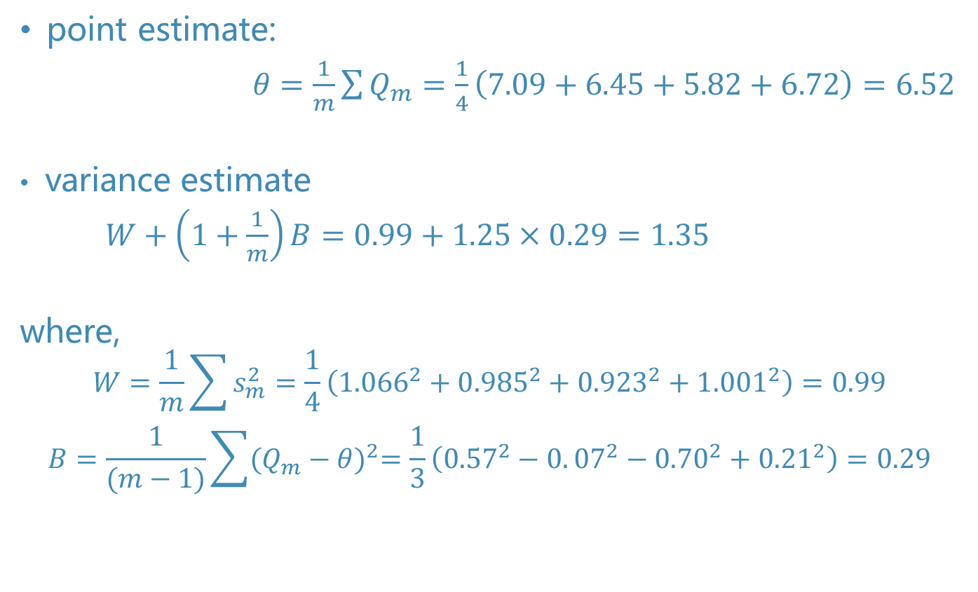
Example: inference for the mean of X₄
point estimate:
$θ=\frac{1}{m}\sum{Q_{m}}=\frac{1}{4}\left(7.09+6.45+5.82+6.72\right)=6.52$
variance estimate
$W+\left(1+\frac{1}{m}\right)B=0.99+1.25×0.29=1.35$
where,
$$W=\frac{1}{m}\sum{s_{m}^{2}=\frac{1}{4}\left({1.066}^{2}+{0.985}^{2}+{0.923}^{2}+{1.001}^{2}\right)=0.99}$$
$$B=\frac{1}{(m−1)}\sum{{(Q_{m}−θ)}^{2}=\frac{1}{3}\left({0.57}^{2}−0.{07}^{2}−{0.70}^{2}+{0.21}^{2}\right)=0.29}$$

Slide 85
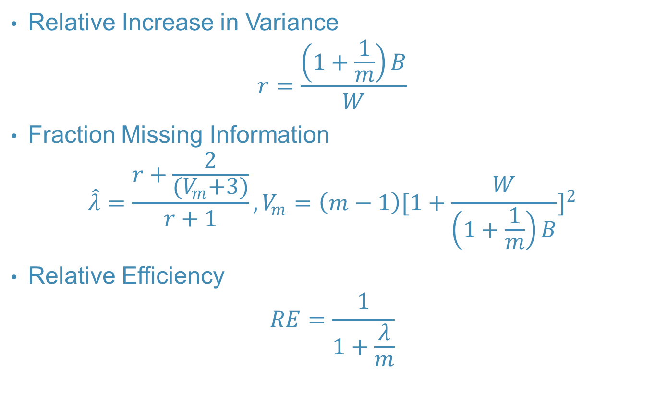
Three Indicators of Imputation Effectiveness
Relative Increase in Variance
$$r=\frac{\left(1+\frac{1}{m}\right)B}{W}$$
Fraction Missing Information
$$\hat{λ}=\frac{r+\frac{2}{{(V}_{m}+3)}}{r+1}, V_{m}=\left(m−1\right){[1+\frac{W}{\left(1+\frac{1}{m}\right)B}]}^{2}$$
Relative Efficiency
$$RE=\frac{1}{1+\frac{λ}{m}}$$

Slide 86
Three Indicators of Imputation Effectiveness
相对增加方差（Relative Increase in Variance）
由于缺失值导致的研究变量上增加的方差
目标：在不同次的插补之后，相对增加方差维持稳定地低
缺失信息比例（Fraction Missing Information）
由于缺失值导致的总体参数的信息缺失比例
目标：在不同次的插补之后，缺失信息比例维持稳定地低
相对效率（Relative Efficiency）
缺失信息比例和插补次数组成的函数
目标：在不同次的插补之后，相对效率维持稳定地高

Slide 87
STATA MI
mi set flong //定义插补库的存储类型
mi register imputed var1 var2 var3 // 注册要被插补的变量
mi register regular var4 var5 var6 // 注册那些不被插补的变量
mi impute mvn var1 var2 var3 = var4 var5 var6, add(20)// 定义插补模型，插补的次数
mi xeq 0 1 5 10 20: summarize x1 // 描述X1变量被插补0,1,5,10,20次的结果
mi estimate, vart : reg yvar var1 var2 var3 var4 var5 var6

Slide 88
STATA MI

Slide 89
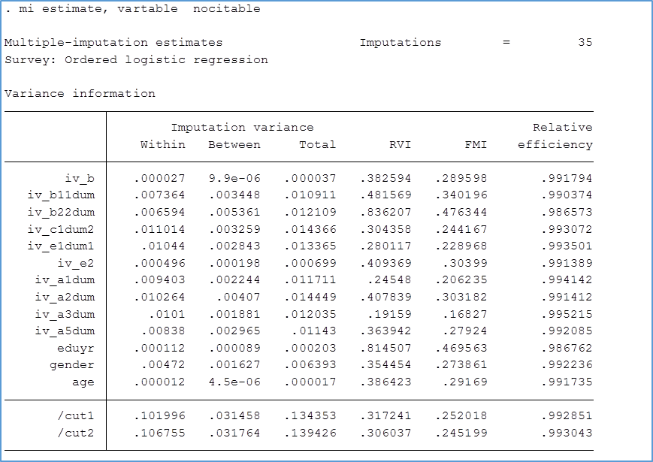
STATA MI

Slide 90
Wrapping up
简单插补缺失值的方法往往会造成一些问题。
多重插补只要运用得当，可以避免使用其他插补方法所隐含大胆的假设。
虽然有学者非常不认可这种无中生有的方法。
插补的目的不是找到我们无法观测到缺失值的“真值”。
差不得目的是为了更好的估计模型的参数。
多重插补容许了这些参数的变异（组内和组间）。当我们使用合并法则，我们平均掉了缺失值的不确定率，而不是接受它们。

Slide 91
Wrapping up
目的不是给缺失值补个理想值，而是获得有效的统计推断
为此，
变量之间的关系应该是稳定的
无回答的处理过程中，不能代入偏差
处理过程中，利用信息的程度要高
插补必须是建立在缺失数据的预测分布的基础之上
插补值必须从预测分布中抽取
必须提供一种把插补值考虑在内的抽样估计误差的计算方法
完全回答的变量必须包含在内
必须给予需要插补变量的辅助信息
要避免超越数据取值的过分外推

Slide 92
Wrapping up
Simplistic solutions to missing data often cause problems
MI is a solution that, when implemented properly, can avoid some of the heroic assumptions implicitly made by other strategies
Some people feel very uncomfortable with “making up data”
However the goal is not to find the “true” value that represents what we should have observed
The goal is to use the imputations to better estimate model parameters
The multiple imputations allow for variation in these estimates. When we use the combining rules we “average over” our uncertainty about the missing data (rather than accepting them as the truth)

Slide 93
Regression switching. Step 2: Bayesian regression imputation
Drawing imputations is actually a bit more complicated than just adding noise to regression predictions.
Y is the variable we want to impute
Y_{mis} is the vector of missing values
Y_{obs} is the vector of observed values.
X, X_{mis,} X_{obs} are defined similarly for the matrix of predictors
If Y is modelled using linear regression with conventional uniform priors, we draw Y from its posterior predictive distribution:

Slide 94
Posterior predictive distribution

