Slide 1
Understanding Machine Learning Through Textiles
Yuhan Shao, Mel Mark, Neha Nishikant, Tara Lakdawala

Slide 2
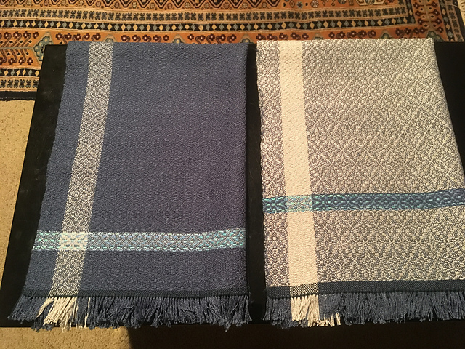
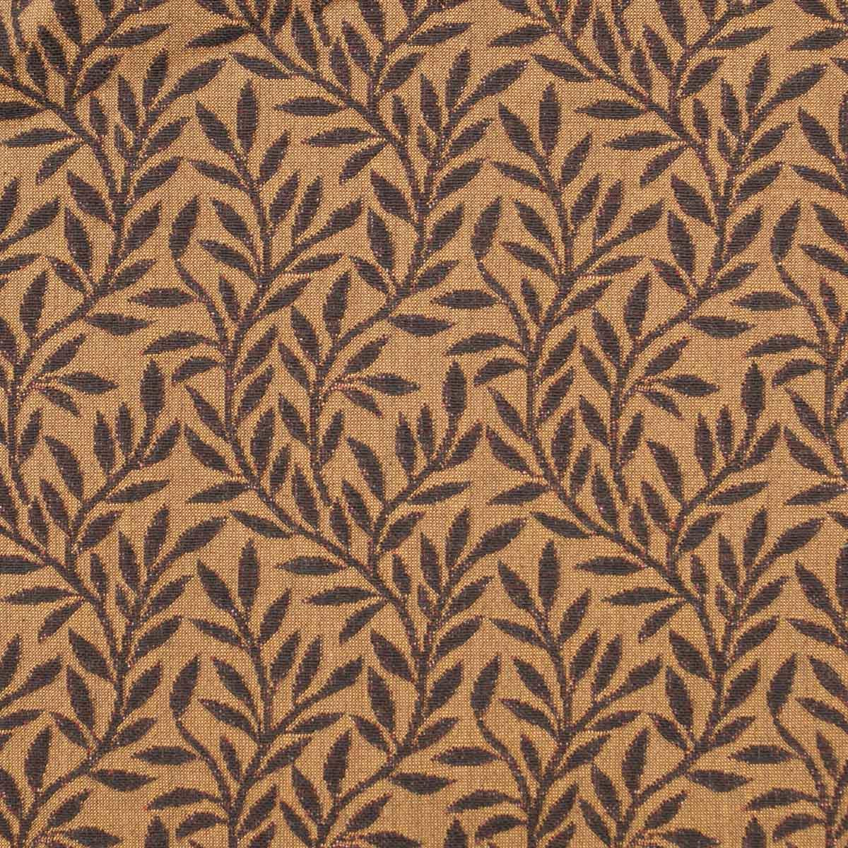
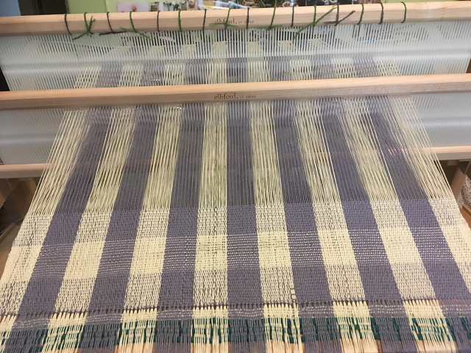
Big Ideas
What is machine learning?
How do we understand patterns?
Where does automation fit in?
Image source: Carolyn Rosé
Notes:
YUHAN: What were our goals/what did we try to answer in this workshop?
Coming into this workshop, none of us had any experience with textiles, and now we are able to describe machine learning methods and how it fits in with patterns and textiles.

Slide 3
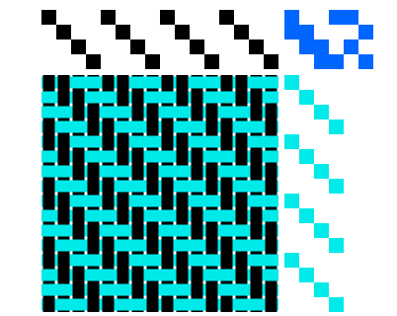
Weaving
Oldest method of textile production
Fundamentally represented in binaries
Image source: Lea Albaugh
Notes:
MEL: Weaving is one of oldest forms of textile production in human history, dating back as early as the paleolithic era.
We are looking at it as a composite of matrices fundamentally represented as binaries (over=1, under=0)
Weaving drafts are essentially 2D neural networks
CLICK PICTURE

Slide 4
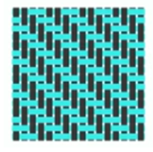
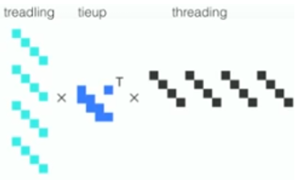
Machine Learning
Finding meaningful patterns in data
Patterns can interact and it can be difficult to differentiate
Textile Decomposition (Matrix Factorization)
Image source: Lea Albaugh
Notes:
TARA: Machine learning aims to find meaningful patterns in data. But how do we understand this using textiles?
Patterns interact, creating indistinguishable data; but can a machine learn how to do this? Researchers can use matrix factorization to deconstruct convoluted patterns.

Slide 5
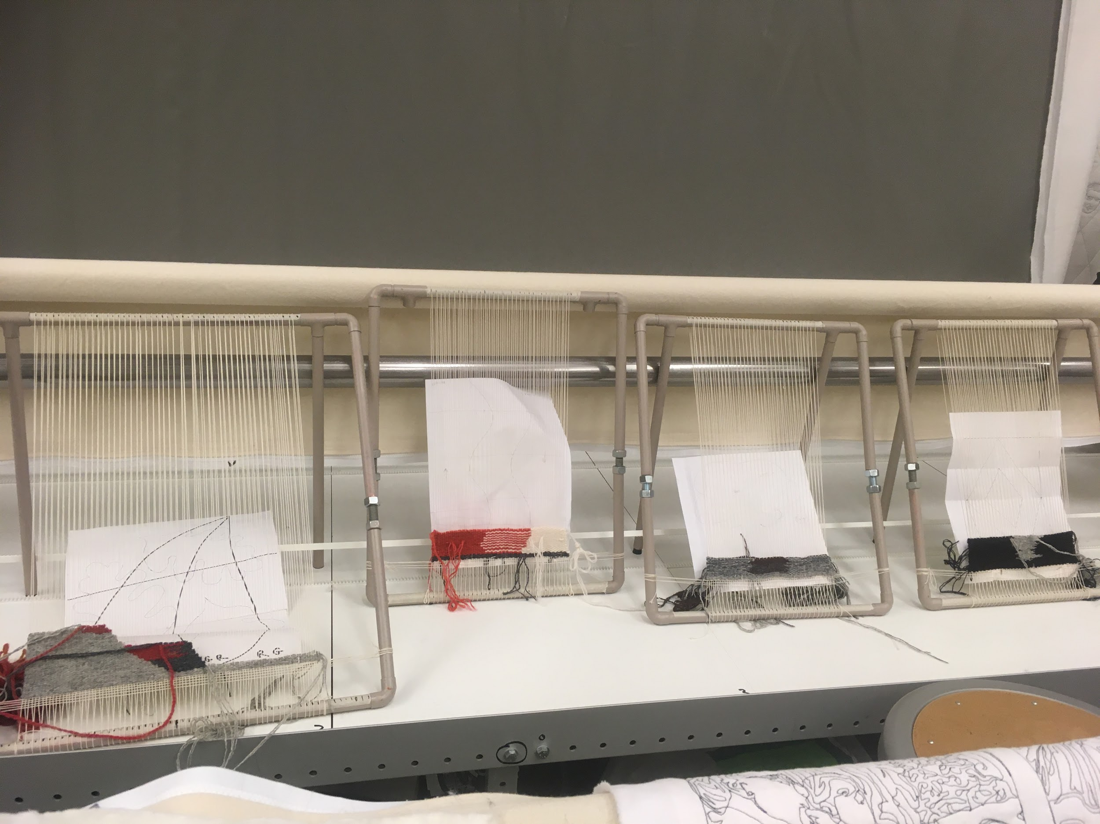
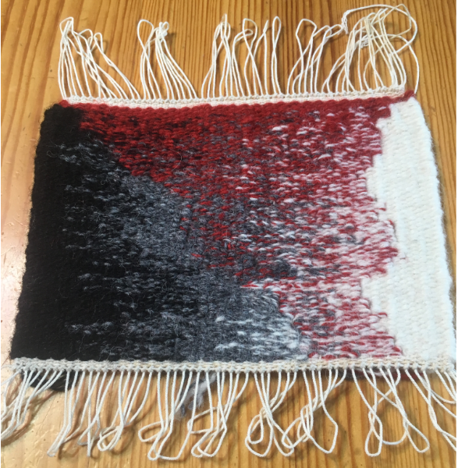
Visualizing pattern interference with pipe looms
Image source: Carolyn Rosé
Notes:
Yuhan: Our goal was to create some level of pattern interference which would allow us to better visualize challenges in machine learning.
This weekend, we drew out our pattern interference designs, fumbled with yarn, and ultimately began weaving our textiles with pipe looms.

Slide 6
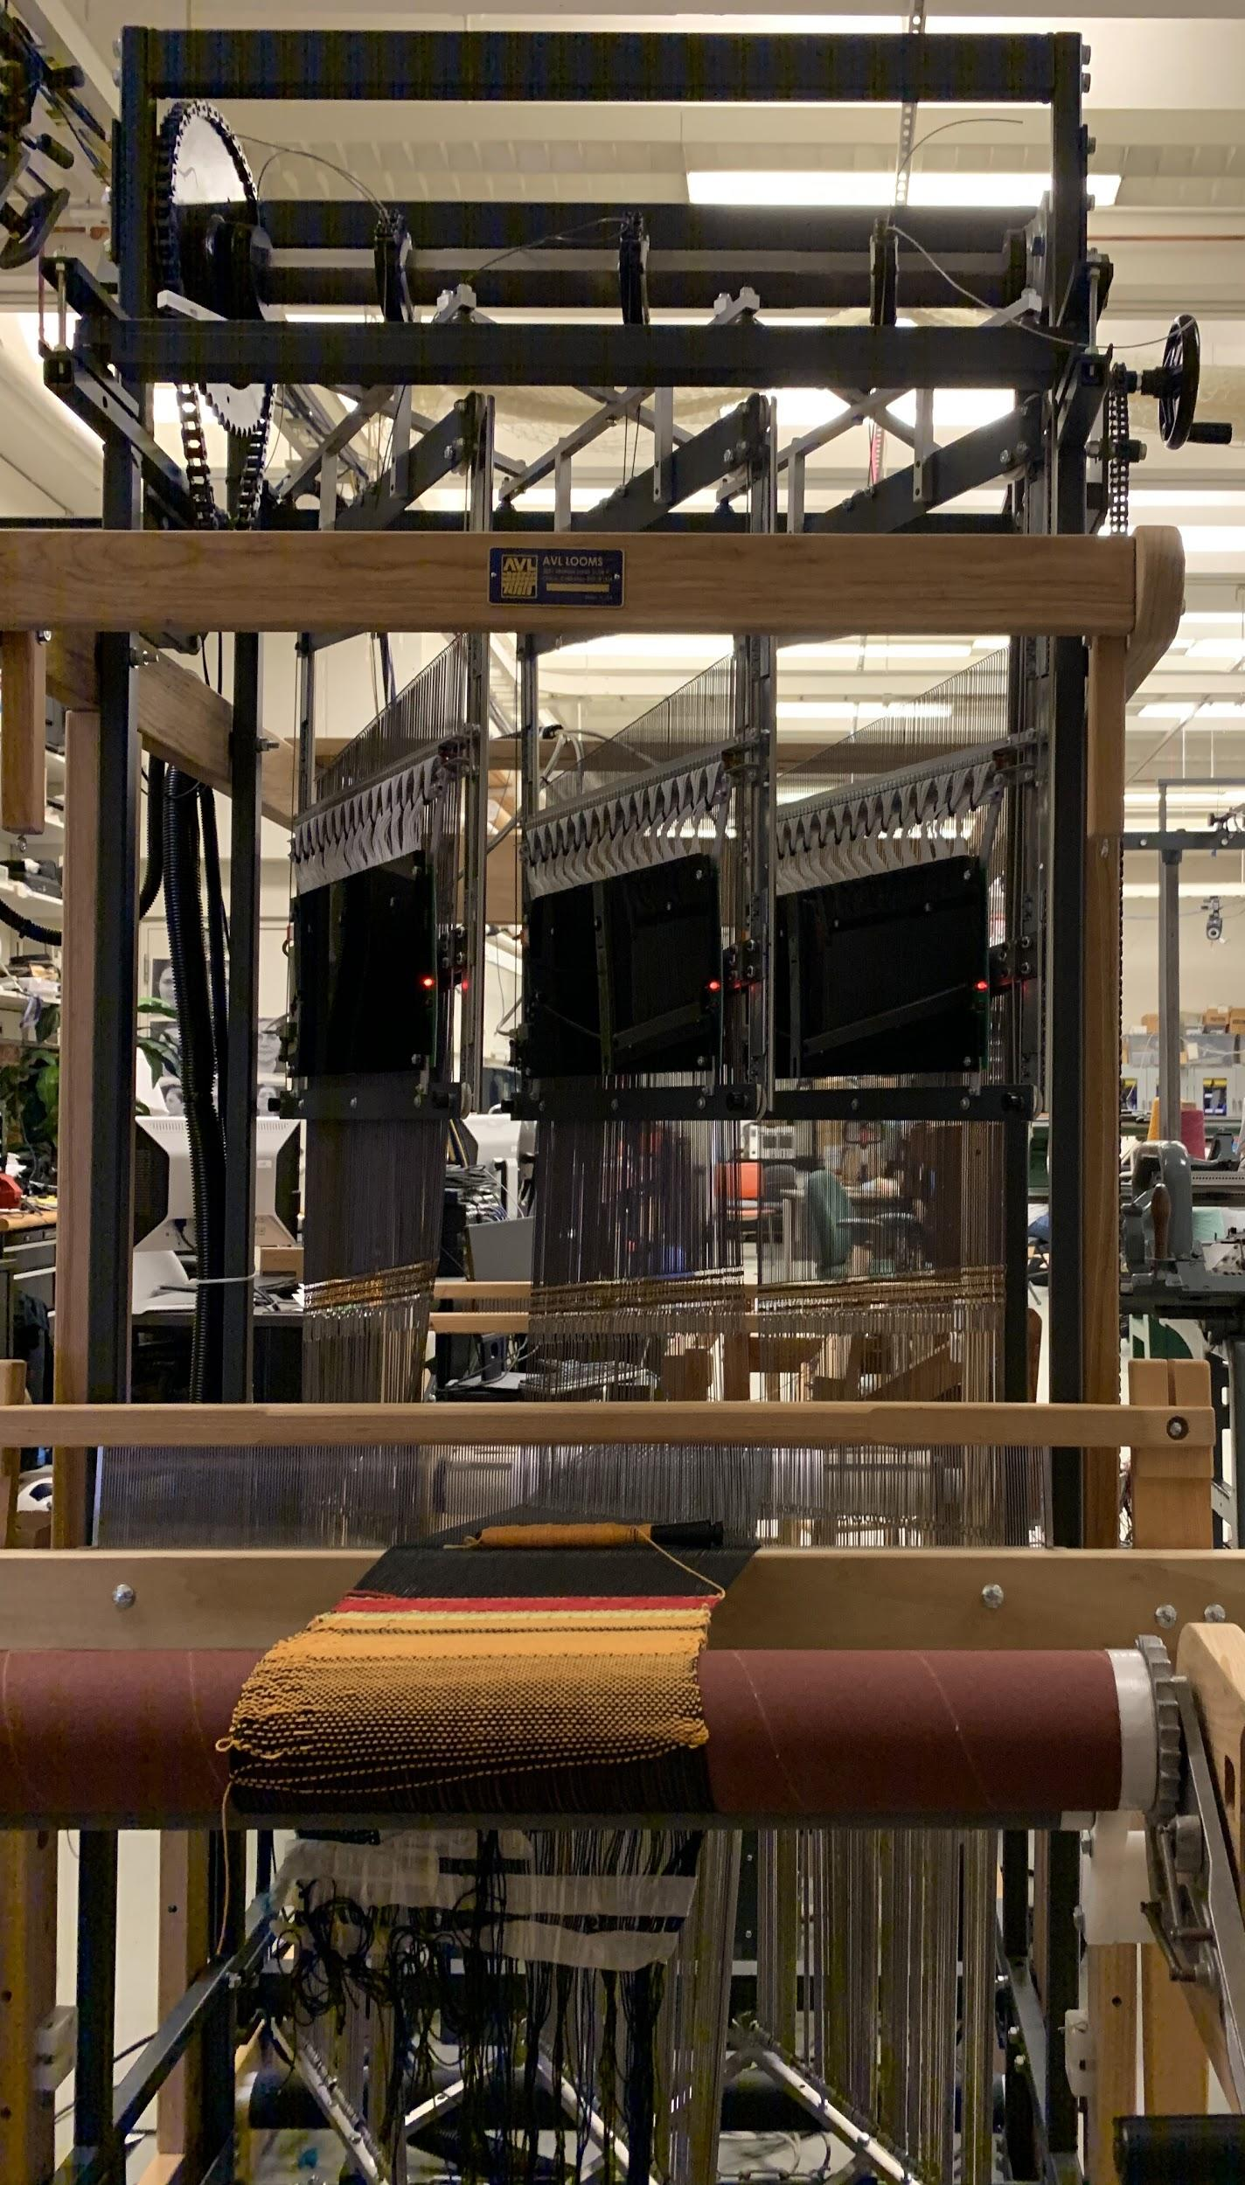
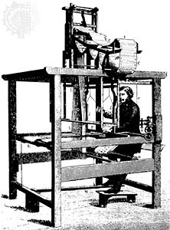
The Future & Automation: Jacquard Looms
Invented in 1801 originally used punch cards
One of the first programmable machines was a Jacquard Loom
Image source: Britannica, Mel Mark
Notes:
MEL: Current innovations in weaving are just a blip in the expansive history of textiles, so where do we go from here?

Slide 7

Open Questions
How do we determine the way a woven textile was created?
How do we know for certain if a fabric was knit, crocheted, or woven?
Can we use sustainable materials to manufacture durable textiles?
How can we produce textiles, from production to consumption, for minimal negative environmental impact?
Image source: FlatIcon
Notes:
TARA et all: Questions we still have...

Slide 8
Thanks for Watching!

