Slide 1
An Introduction to Elliptic Curve Cryptography

Slide 2
What is Elliptic Curve Cryptography
elliptic curve cryptography(ECC) is a form of public key cryptography
it is based on the somewhat esoteric topic of elliptic curve combined with modular arithmetic
some implementations use the same principles as the earlier public key cryptosystems

Slide 3

GRAPH OF ECC
b = 1, a =2,1,0,-1,-2,-3
y² = x³ + ax + b(4a³ + 27b² ≠ 0)

Slide 4
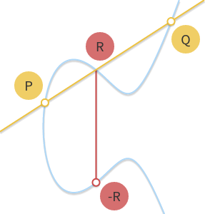
Geometric addition

Slide 5
Geometric addition

Slide 6
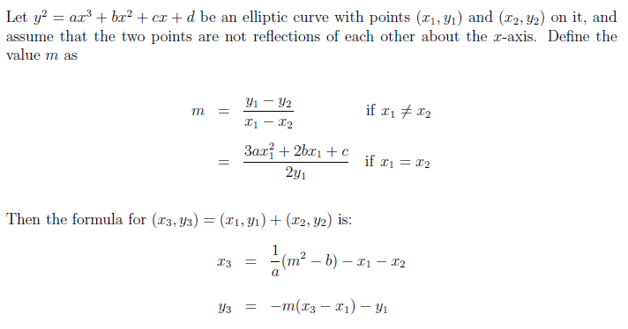
Geometric addition

Slide 7
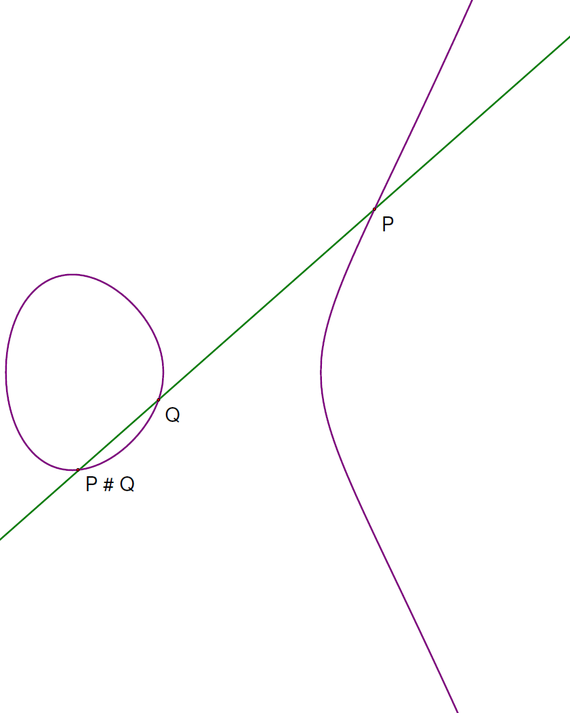
Geometric substraction

Slide 8

Mod p($Ϝ_{p}$)
y² = x³ + ax + b(mod p)(4a³ + 27b² ≠ 0)
P is a prime:
Mod works nice with arithmetic.
If p is a prime, we use the numbers {0, 1, 2, …, p-1}, and we can add, subtract, multiply, and divide.
So we can do elliptic curves on the integers mod p.
Properties:
Each nonzero point in our set can generate a cyclic group
Can find n s.t. nP = 0, so we can have (n+1)P = P

Slide 9
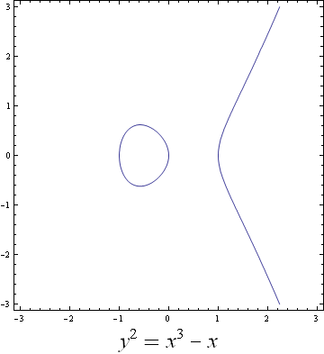
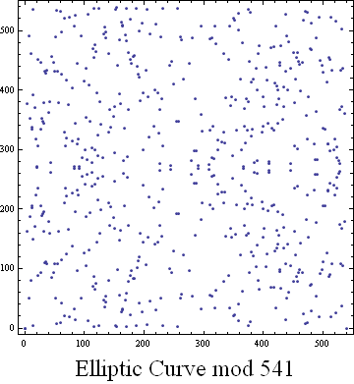
Elliptic Curve mod p

Slide 10
KEY EXCHANGE
Alice and Bob want to agree on a key k.
Shared objects(public for everyone):
an elliptic curve
a large prime p (about 35 digits will do)
a point B on the curve
Alice:
secretly picks a large number p_{A} (about 20 digits will do).
Bob:
secretly picks a large number p_{B}.
Key:
Alice computes Q_{A} = p_{A}B. Bob computes Q_{B} = p_{B}B. They exchange the points Q_{A} and Q_{B}.
Alice computes p_{A}Q_{B} = p_{A}p_{B}B. Bob computes p_{B}Q_{A} = p_{B}p_{A}B. Both use the x value of p_{A}p_{B}B for the key k.

Slide 11
EXAMPLE
Let’s use y² = x³ – x with p = 541, B = (10, 80).
Alice picks p_{A} = 20. Bob picks p_{B} = 103.
Q_{A} = 20 (10, 80) = (519, 241).
Q_{B} = 103 (10, 80) = (85, 345).
When Alice gets Q_{B}, she finds 20Q_{B} = (353, 158).
When Bob gets Q_{A}, he finds 103Q_{A} = (353, 158).
They both use K = 353 for their key.

Slide 12
Is it secure?
Eve knows the elliptic curve, the prime p, the original point B, and the points Q_{A} = p_{A}B and Q_{B} = p_{B}B.
To break, Eve needs to find p_{A} or p_{A}. To get either value, Eve needs to solve the ECDLP.
No one knows how to do this in a reasonable length of time.

Slide 13
附录
https://andrea.corbellini.name/2015/05/17/elliptic-curve-cryptography-a-gentle-introduction/
http://www.360doc.com/content/16/0714/11/7531335_575408041.shtml
https://www.wolframalpha.com/input/?i=plot+x%5E3+-+3x+%2B+2%3Dy%5E2
https://hgarrereyn.gitbooks.io/th3g3ntl3man-ctf-writeups/content/2017/picoCTF_2017/problems/cryptography/ECC2/ECC2.html

