Slide 1

http://xyzcmd.syhpoon.name/

Slide 2
Main features:
* Tight integration with python run–time system — most of the settings
can be changed "on the fly" via management console.
* Powerful configuration system - define own actions, aliases,
internal commands, key bindings.
* Extensible plug-in system - even core functionality implemented
mainly using plug–ins, keeping base system small and clean.
* Events & hooks subsystem - a flexible way of reacting on certain
system events.
* Customizable look-n-feel - every widget component look can
be changed using skins.
* Unicode support

Slide 3
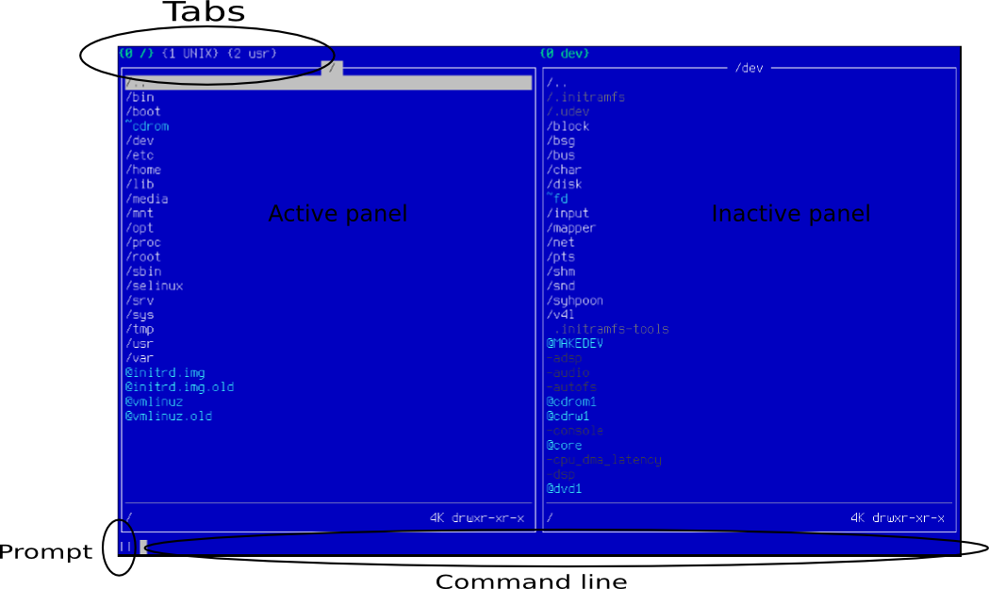

Slide 4
Skins
Skin is the way to customize look'n'feel of XYZCommander.
Customizable elements are:
* Elements of filesystem based on fsrule description:
* All user interface widgets
XYZCommander comes with 5 standard skins:

Slide 5
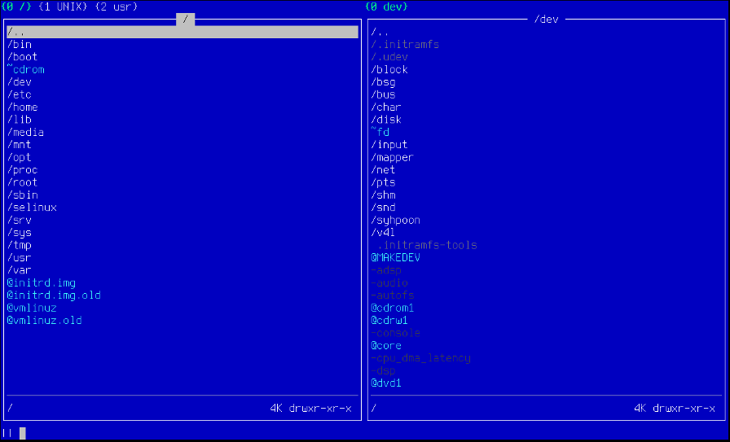
Seablue (default)

Slide 6
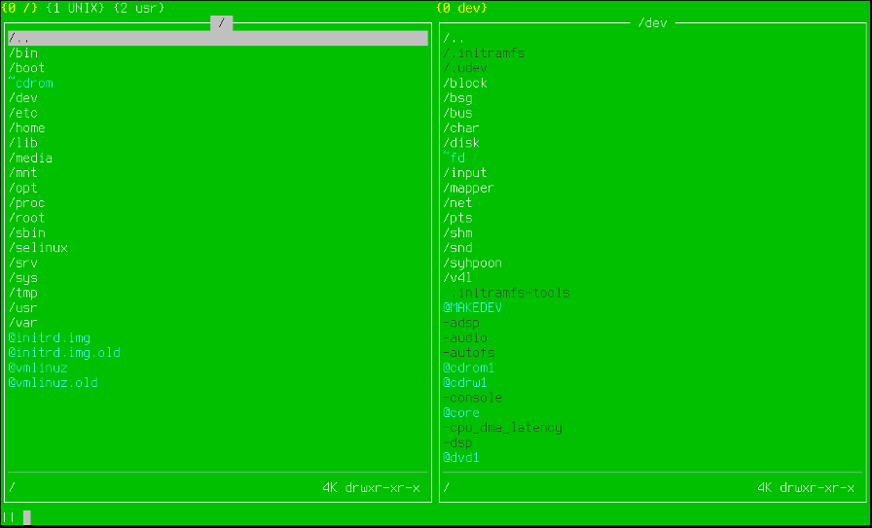
grass

Slide 7
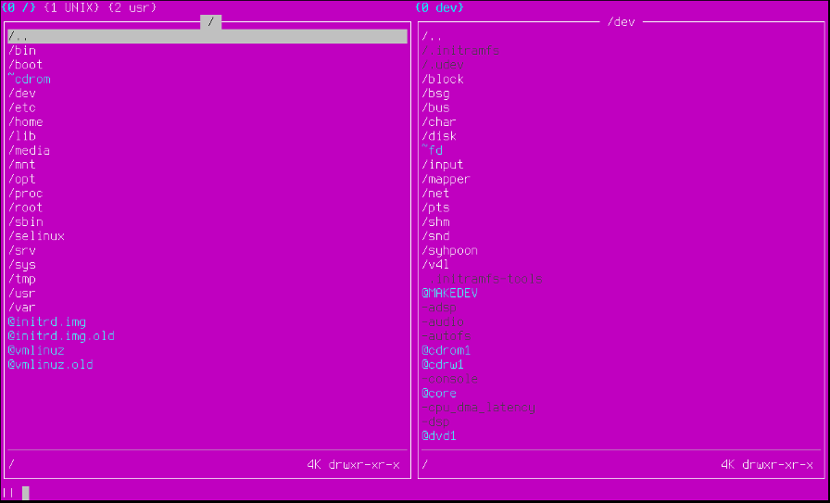
glamour

Slide 8
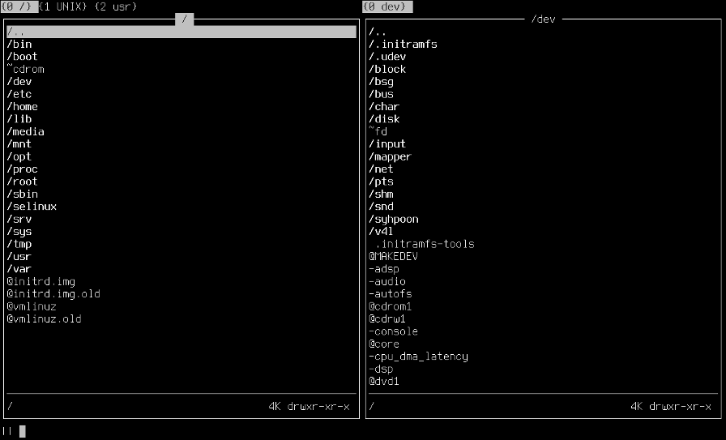
monochrome

Slide 9
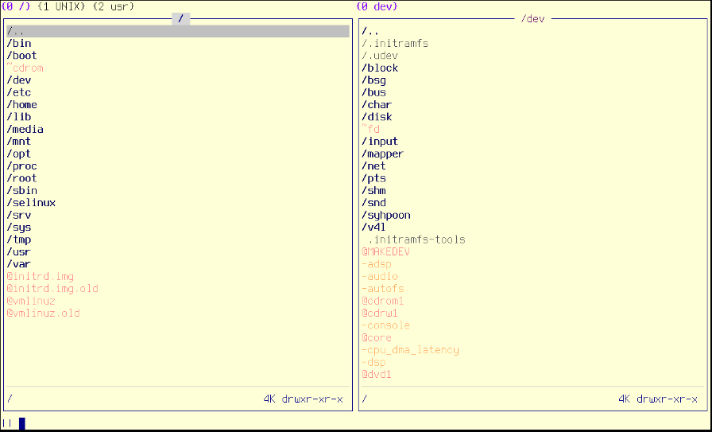
Lighty (256 high colors mode)

Slide 10
It is very easy to create your own skin theme!
Check the manual chapter for details:
http://xyzcmd.syhpoon.name/static/doc/user-manual/skins.html

Slide 11
FSRules
FSRules is a tiny DSL, widely-used in XYZCommander for describing filesystem objects.
FSRules are used for:
* Describing objects in skins
* Describing objects for custom actions
* Tagging files in panel
* More ...

Slide 12
Some FSRules examples

Slide 13
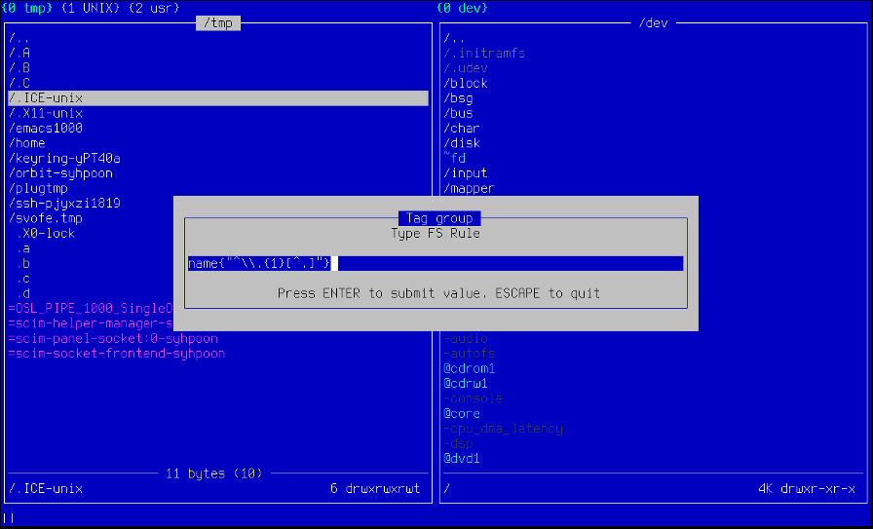
Tag all hidden files in current directory

Slide 14
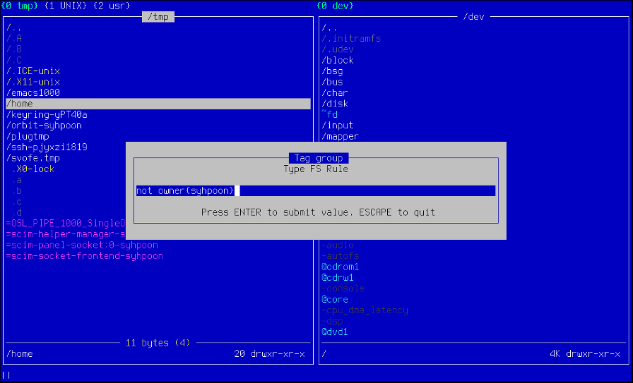
Tag all files not owned by user syhpoon

Slide 15
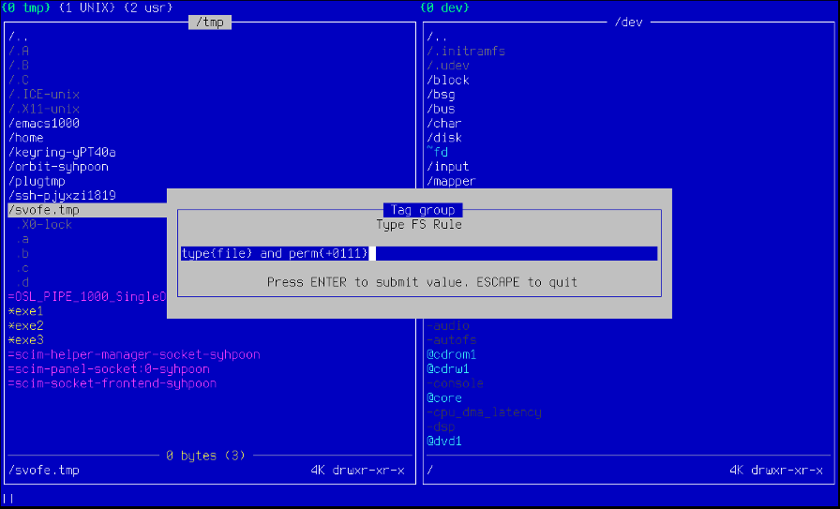
Tag all files with execution bit set

Slide 16
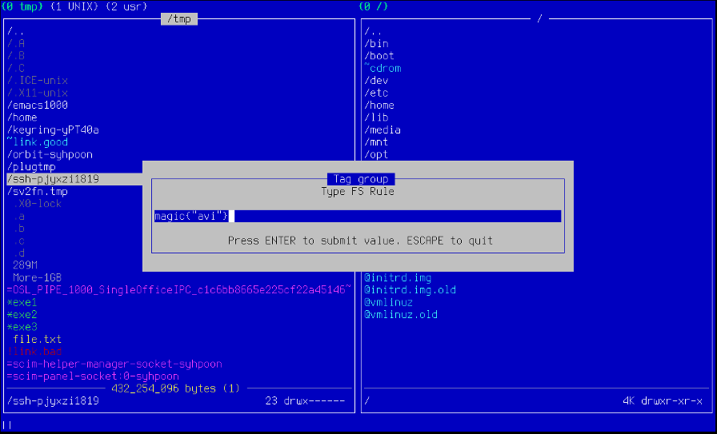
Tag those files which according to magic db match as avi movies.

Slide 17
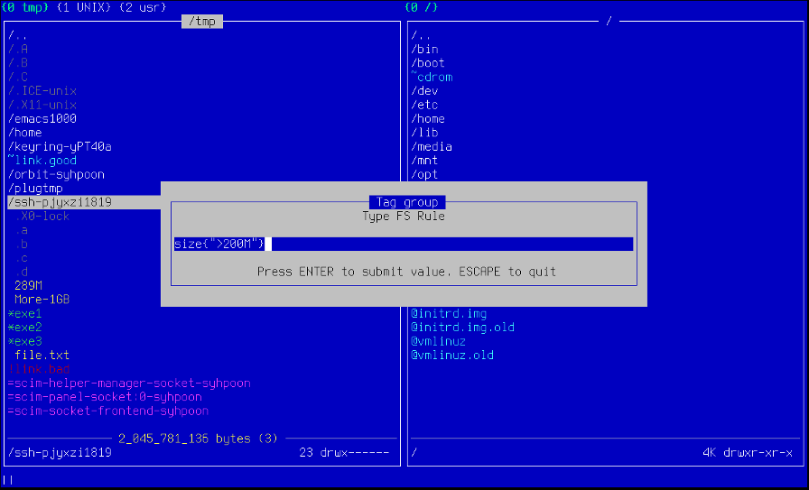
Tag all files with size exceeding 200 megabytes

Slide 18
More rule actions and description how to create your own FSRule are available in XYZCommander user manual:
http://xyzcmd.syhpoon.name/static/doc/user-manual/fs_rules.html

