Slide 1
Course Syllabus
Text Book:
B. A. Forouzan, “TCP/IP Protocol Suite”, 4th ed., McGraw-Hill, 2010
Instructor
張軒彬, hpchang@cs.nchu.edu.tw
Office Number: 917
TA
吳宜芬, emma62042@gmail.com
Office Number: 1001
All slides are available in i-learning

Slide 2
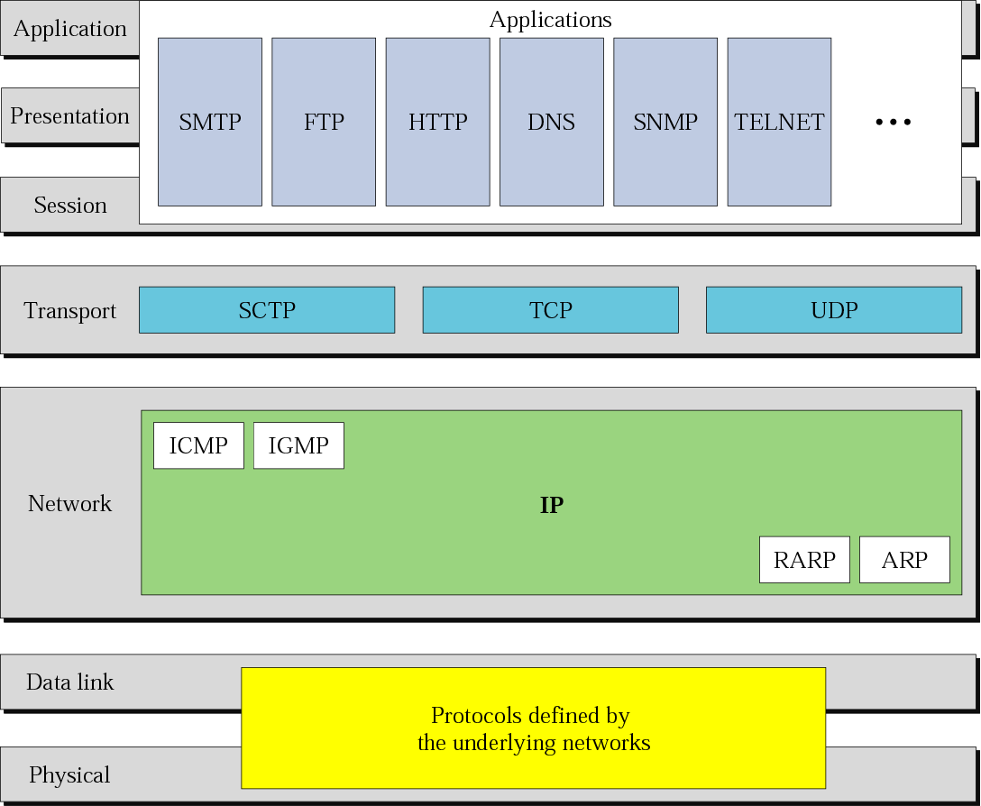
Figure 2-15
TCP/IP and OSI Model
The McGraw-Hill Companies, Inc., 2000

Slide 3
Outline
Introduction and Underlying Technologies
Chapter 1: Introduction
Chapter 2: The OSI Model and the TCP/IP Protocol Suite
Chapter 3: Underlying Technologies
Network Layer
Chapter 4: Introduction to Network Layer
Chapter 5: IPv4 Addressing
Chapter 6: Delivery and Forwarding of IP Packets
Chapter 7: Internet Protocol Version 4 (IPv4)
Chapter 8: Address Resolution Protocol (ARP)

Slide 4
Outline (Cont.)
Chapter 9: Internet Control Message Protocol Version 4 (ICMPv4)
Chapter 10: Mobile IP
Chapter 11: Unicast Routing Protocols (RIP, OSPF, and BGP)
Chapter 12: Multicasting and Multicast Routing Protocols
Transport Layer
Chapter 13: Introduction to the Transport Layer
Chapter 14: User Datagram Protocol (UDP)
Chapter 15: Transmission Control Protocol (TCP)
Chapter 16: Stream Control Transmission Protocol (SCTP)

Slide 5
Outline (Cont.)
Application Layer
Chapter 17: Introduction to the Application Layer
Chapter 18: Host Configuration (DHCP)
Chapter 19: Domain Name System (DNS)
Chapter 20: Remote Login: TELNET and SSH
Chapter 21: File Transfer: FTP and TFTP
Chapter 22: World Wide Web and HTTP
Chapter 23: Electronic Mail: SMTP, POP, IMAP, and MIME
Chapter 24: Network Management: SNMP
Chapter 25: Multimedia

Slide 6
Outline (Cont.)
Next Generation
Chapter 26: IPv6 Addressing
Chapter 27: IPv6 Protocol
Chapter 28: ICMPv6
Security
Chapter 29: Cryptography and Network Security
Chapter 30: Internet Security

Slide 7
Requirements
Three exams (75%)
Programming homework (25%)
UDP and TCP socket programming
Client-server program
By multi-thread programming
Packet capture and analysis
By raw socket
Ping implementation
By raw socket

