Slide 1
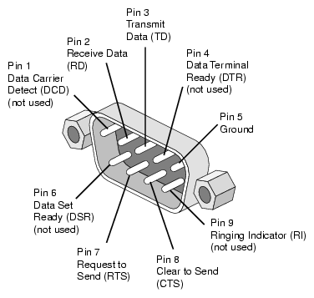
EECS 373
Design of Microprocessor-Based Systems
Prabal Dutta
University of Michigan
  Guest Lecturer
  Pat Pannuto
Lecture 10: Serial buses
Oct 6, 2011

Slide 2
Announcements
Homework #1
  Due now

Slide 3
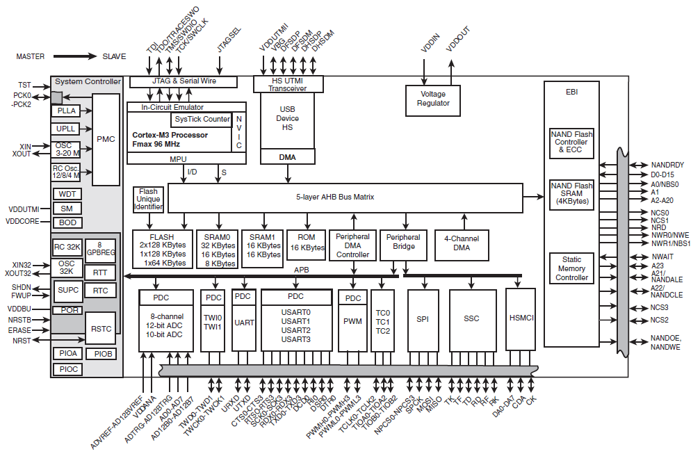
Serial buses attach to the processor
via the APB (which is bridged to the AHB)
Atmel SAM3U
CPU High-Speed Bus Low-Speed Bus
The CPU is a tiny part of the picture!

Slide 4
Outline
Minute quiz
Announcements
UART
SPI
I2C

Slide 5
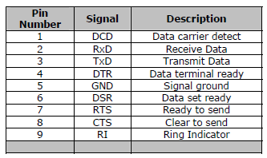
DB9 pinout of a DTE
DTE vs DCE
Pinout of a DCE?
Common ground?
Noise effects?

Slide 6
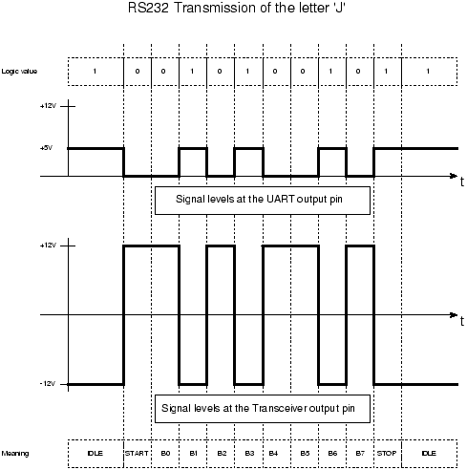
RS-232 transmission example
How do peers agree on timing?

Slide 7
Outline
Minute quiz
Announcements
UART
SPI
I2C

Slide 8
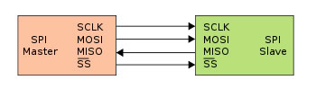
Serial Peripheral Interface
What is it?
Basic SPI
Capabilities
Protocol
Pros and Cons
Uses
Serial Peripheral Interface
http://upload.wikimedia.org/wikipedia/commons/thumb/e/ed/
SPI_single_slave.svg/350px-SPI_single_slave.svg.png

Slide 9
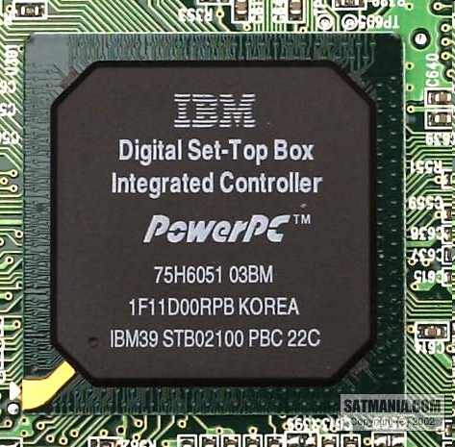
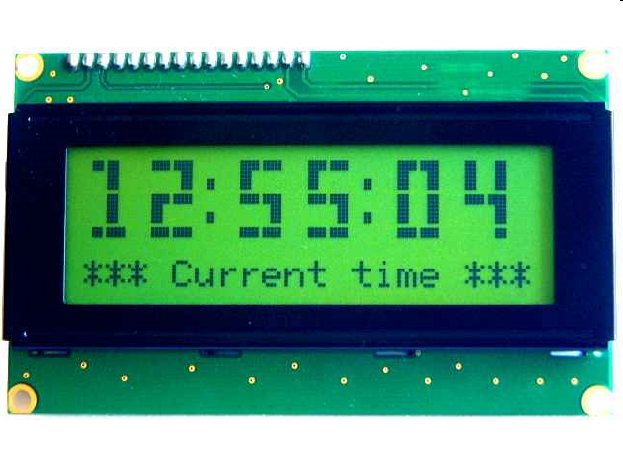
What is SPI?
Serial bus protocol
Fast, easy to use, and simple
Very widely used
Not “standardized”

Slide 10
SPI Basics
A 4-wire communications bus
Typically communicate across short distances
Supports
  Single master
  Multiple slaves
Synchronized
  Communications are “clocked”

Slide 11
SPI Capabilities
Always full-duplex
  Communicates in both directions simultaneously
  Transmitted (or received) data may not be meaningful
Multiple Mbps transmission speeds
  0-50 MHz clock speeds not uncommon
Transfer data in 4 to 16 bit characters
Supports multiple slaves

Slide 12
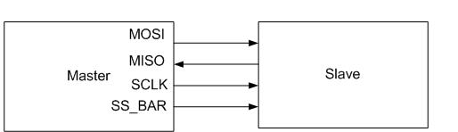
SPI bus wiring
Bus wires
  Master-Out, Slave-In (MOSI)
  Master-In, Slave-Out (MISO)
  System Clock (SCLK)
  Slave Select/Chip Select (SS1#, …, SS#n or CS1, …, CSn)
Master asserts slave/chip select line
Master generates clock signal

Slide 13
SPI signal functions
MOSI – carries data out of master to slave
MISO – carries data out of slave to master
  Both MOSI and MISO are active during every transmission
SCLK – produced by master to synchronize transfers
SS# (or CS) – unique line to select each slave chip

Slide 14
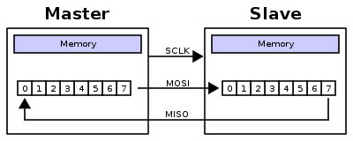
SPI uses a “shift register” model of communications
Master shifts out data to Slave, and shifts in data from Slave
http://upload.wikimedia.org/wikipedia/commons/thumb/b/bb/SPI_8-bit_circular_transfer.svg/400px-SPI_8-bit_circular_transfer.svg.png

Slide 15
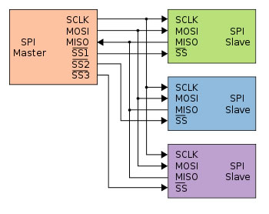
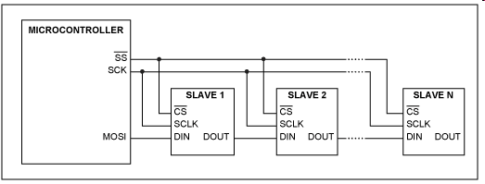
Two bus configuration models
Some wires have been renamed
Master and multiple daisy-chained slaves
http://www.maxim-ic.com/appnotes.cfm/an_pk/3947
Master and multiple independent slaves
http://upload.wikimedia.org/wikipedia/commons/thumb/f/fc/SPI_three_slaves.svg/350px-SPI_three_slaves.svg.png

Slide 16
SPI clocking: there is no “standard way”
Four clocking “modes”
  Two phases
  Two polarities
Master and selected slave must be in the same mode
During transfers with slaves A and B, Master must
  Configure clock to Slave A’s clock mode
  Select Slave A
  Do transfer
  Deselect Slave A
  Configure clock to Slave B’s clock mode
  Select Slave B
  Do transfer
  Deselect Slave B
Master reconfigures clock mode on-the-fly!

Slide 17
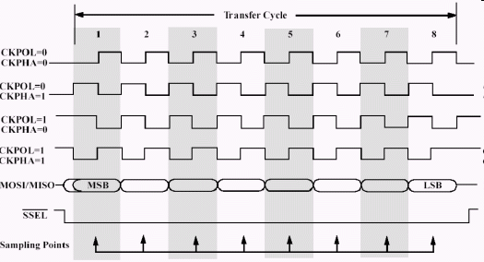
SPI timing diagram
Timing Diagram – Showing Clock polarities and phases
http://www.maxim-ic.com.cn/images/appnotes/3078/3078Fig02.gif

Slide 18
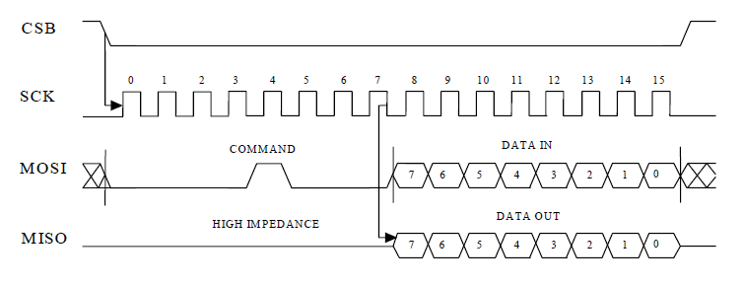
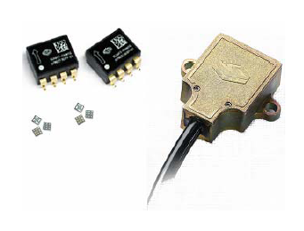

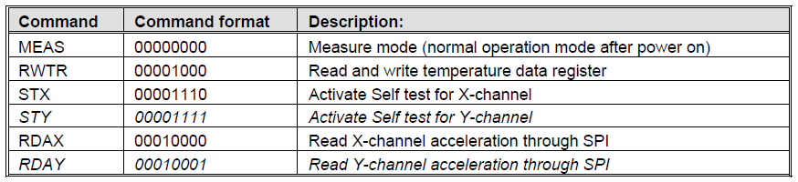
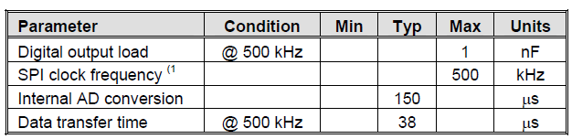
SPI example: decode what’s happening

Slide 19
SPI tradeoffs: the pros and cons
Pros
  Fast for point-to-point connections
  Easily allows streaming/constant data inflow
  No addressing in protocol, so it’s simple to implement
  Broadly supported
Cons
  Slave select/chip select makes multiple slaves more complex
  No acknowledgement (can’t tell if clocking in garbage)
  No inherent arbitration
  No flow control (must know slave speed)

Slide 20
SPI is used everywhere!
Peripherals
  LCDs
  Sensors
  Radios
  Lots of other chips
Microcontrollers
  Almost all MCUs have SPI masters
  Some have SPI slaves

Slide 21
Outline
Minute quiz
Announcements
UART
SPI
I2C

Slide 22
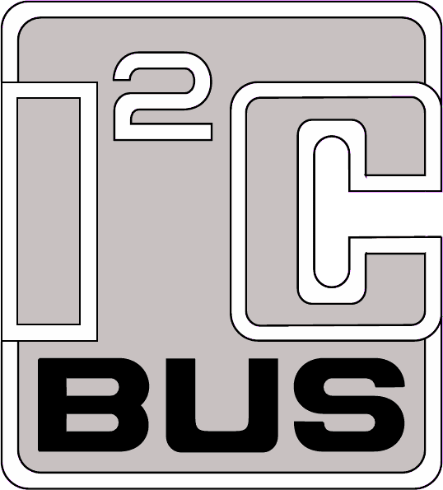
I2C bus
Inter-Integrated Circuit
Pronounced “eye-squared-see”
Sometimes called “eye-two-see”
Two wire serial bus specification
Invented by Philips in the early 1980s
  The division is now NXP
  Was a patented protocol, but patent has now expired

Slide 23
I2C uses
Originally used by Philips inside television sets
Now a very common peripheral bus standard
Intended for use in embedded systems
  Philips, National, Xicor, Siemens, … all use
Also used in PCs
  RTC
  Temperature sensors
  Variant is the SMBus (system management bus)

Slide 24
I2C wiring
Two lines
  SDA (serial data)
  SCL (serial clock)
Open collector design
  Simple interfacing in for multi-voltage
  Supports bus arbitration

Slide 25
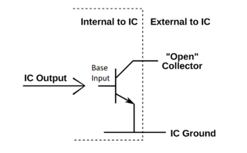
Open Collector
If IC Output is...
  Not Driven (OFF)
    The transistor is off and looks like a short circuit
  Driven (ON)
    The transistor is on, and the bus line is tied (pulled) to ground
Example Open Collector Circuit
Author: Yan bellavance http://en.wikipedia.org/wiki/File:OpencollectorV3.png

Slide 26
Building an I2C Bus
If no device is driving the bus...
  They all look like short circuits
  Bus voltage is V_{dd}
If any device is driving the bus...
  Current flows V_{dd} through R_{Pullup}
  Bus voltage is 0 V
V_{dd}
(3.3~5V)
R_{Pullup}
(10~100 kΩ)

Slide 27
I2C details
Two-wire serial protocol with addressing capability
Speeds up to 3.4 Mbps
  Discussion: what limits I2C to such small speeds?
Multi-master, Multi-slave
  Uses bus arbitration
  More on this later...

Slide 28
I2C clock
Not a “traditional” clock
Normally is kept “high” using a pull-up
Pulsed by the master during data transmission
  Master could be either the transmitter or receiver
Slave device can hold clock low if needs more time
  Allows for flow control

Slide 29
I2C transaction
Transmitter/receiver differs from master/slave
  Master initiates transactions
  Slave responds
Transmitter sets data on SDA line, slave ACKs
  For a read, slave is transmitter
  For a write, master is transmitter

Slide 30
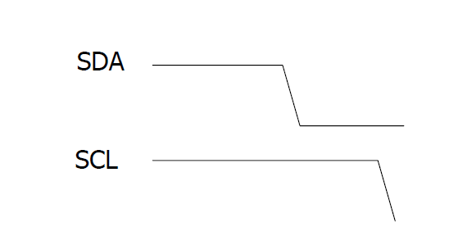
I2C start condition
Master pulls SDA low while SCL is high
Normal SDA changes only happen when SCL is low

Slide 31
I2C address transmission
Data is always sampled on the rising clock edge
Address is 7 bits
An 8-th bit indicated read or write
  High for read
  Low for write
Addresses assigned by Philips/NXP
  For a fee
  Was covered by patent

Slide 32
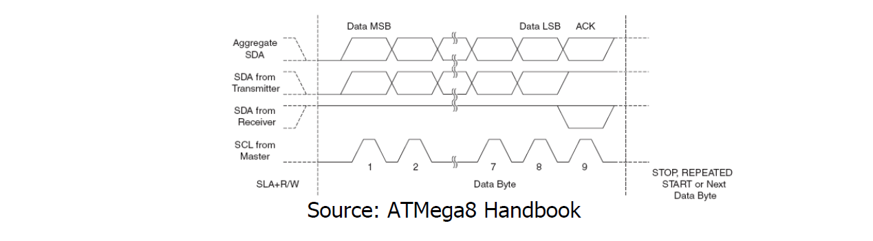
I2C data transmission
Transmitted just like address (8 bits)
For a write, master transmits, slave acknowledges
For a read, slave transmits, master acknowledges
Transmission continues
  Subsequent bytes sent
  Continue until master creates stop condition

Slide 33
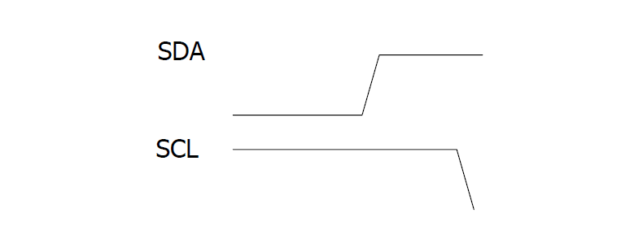
I2C stop condition
Master pulls SDA high while SCL is high
Also used to abort transactions

Slide 34
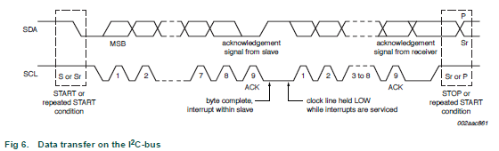
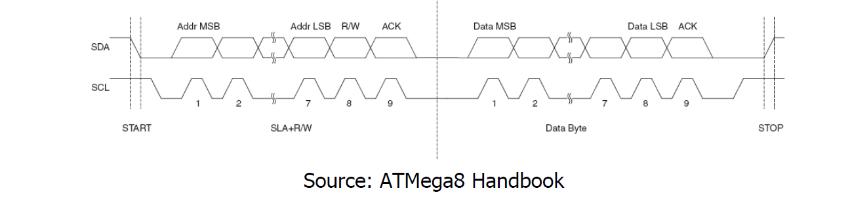
I2C bus transactions: data transfer

Slide 35
Multi-Master Arbitration
(Bus Contention)
What does it mean to be multi-master?
How do we actually make that work?
What other features does this allow?
  Clock stretching
  Repeated start

Slide 36
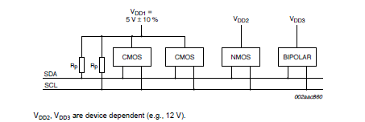
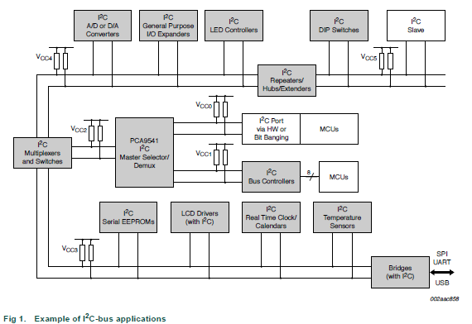
I2C Scales...
I2C
Standardizes peripheral classes
SCK, SDA
Philips/NXP

Slide 37
Questions?
Comments?
Discussion?

Slide 38
SPI summary
SPI – a 4-wire serial bus (but not official “standard”)
  MOSI, MISO, SS/CS, and SCLK signals
Full-duplex operation
One master
Multiple slaves
Best for point-to-point data transfers
Easily supported
Broadly used

Slide 39
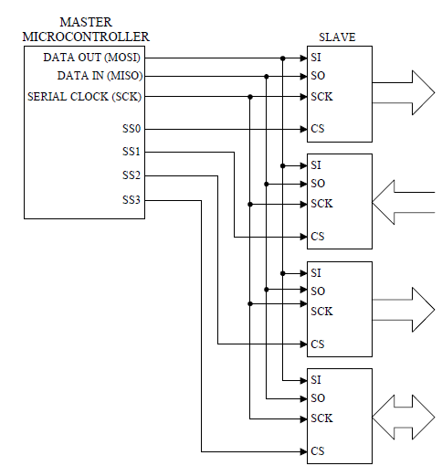
SPI bus architecture
Shared bus
SCK
MOSI
MISO
Chip selects

Slide 40
SPI bus architecture
Compact shared bus
SCK
MOSI
MISO
Chip selects

Slide 41
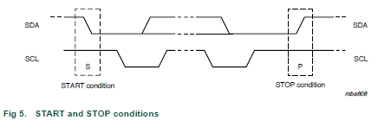
I2C bus transactions: start and stop conditions

Slide 42
I2C bus transactions: data transfer

