Slide 1
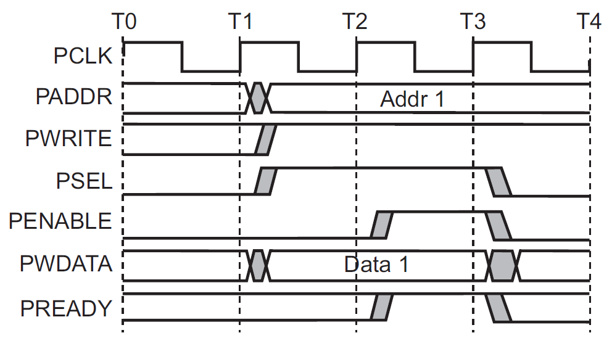
EECS 373
Design of Microprocessor-Based Systems
Prabal Dutta
University of Michigan
Lecture 5: Memory and Peripheral Busses
September 18, 2012

Slide 2

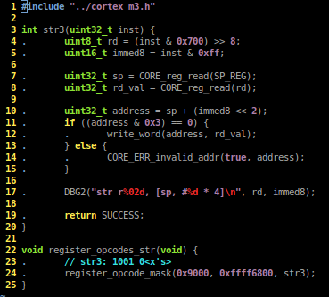
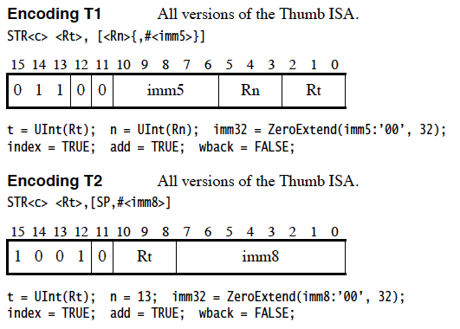
Aside: writing an architectural simulator

Slide 3
Outline
Minute quiz
Announcements
Memory and Memory-Mapped I/O
Bus Architectures
ARM APB
ARM AHB-Lite

Slide 4
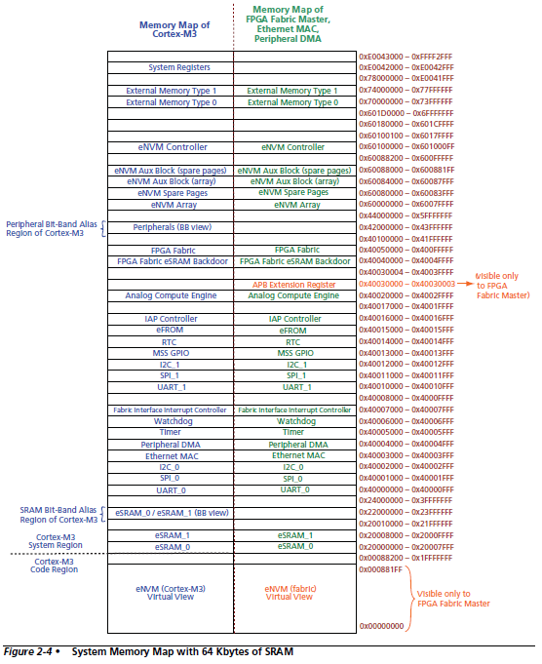
System
Memory
Map
Notes:
Condition codes are simply a way of testing the ALU status flags.

Slide 5
Accessing memory locations from C
Memory has an address and value
Can equate a pointer to desired address
Can set/get de-referenced value to change memory
#define SYSREG_SOFT_RST_CR 0xE0042030
uint32_t *reg = (uint32_t *)(SYSREG_SOFT_RST_CR);
main () {
*reg |= 0x00004000; // Reset GPIO hardware
*reg &= ~(0x00004000);
}

Slide 6
Some useful C keywords
const
  Makes variable value or pointer parameter unmodifiable
  const foo = 32;
register
  Tells compiler to locate variables in a CPU register if possible
  register int x;
static
  Preserve variable value after its scope ends
  Does not go on the stack
  static int x;
volatile
  Opposite of const
  Can be changed in the background
  volatile int I;

Slide 7
Outline
Minute quiz
Announcements
Memory and Memory-Mapped I/O
Bus Architectures
ARM APB
ARM AHB-Lite

Slide 8
What happens when this “instruction” executes?
#include <stdio.h>
#include <inttypes.h>
#define REG_FOO 0x40000140
main () {
uint32_t *reg = (uint32_t *)(REG_FOO);
*reg += 3;
printf(“0x%x\n”, *reg); // Prints out new value
}

Slide 9
“*reg += 3” is turned into a ld, add, str sequence
Load instruction
  A bus read operation commences
  The CPU drives the address “reg” onto the address bus
  The CPU indicated a read operation is in process (e.g. R/W#)
  Some “handshaking” occurs
  The target drives the contents of “reg” onto the data lines
  The contents of “reg” is loaded into a CPU register (e.g. r0)
Add instruction
  An immediate add (e.g. add r0, #3) adds three to this value
Store instruction
  A bus write operation commences
  The CPU drives the address “reg” onto the address bus
  The CPU indicated a write operation is in process (e.g. R/W#)
  Some “handshaking” occurs
  The CPU drives the contents of “r0” onto the data lines
  The target stores the data value into address “reg”

Slide 10
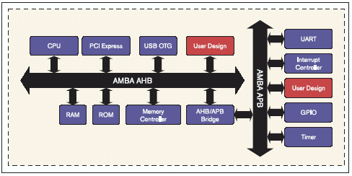


Details of the bus “handshaking” depend on the particular memory/peripherals involved
SoC memory/peripherals
  AMBA AHB/APB
NAND Flash
  Open NAND Flash Interface (ONFI)
DDR SDRAM
  JEDEC JESD79, JESD79-2F, etc.

Slide 11
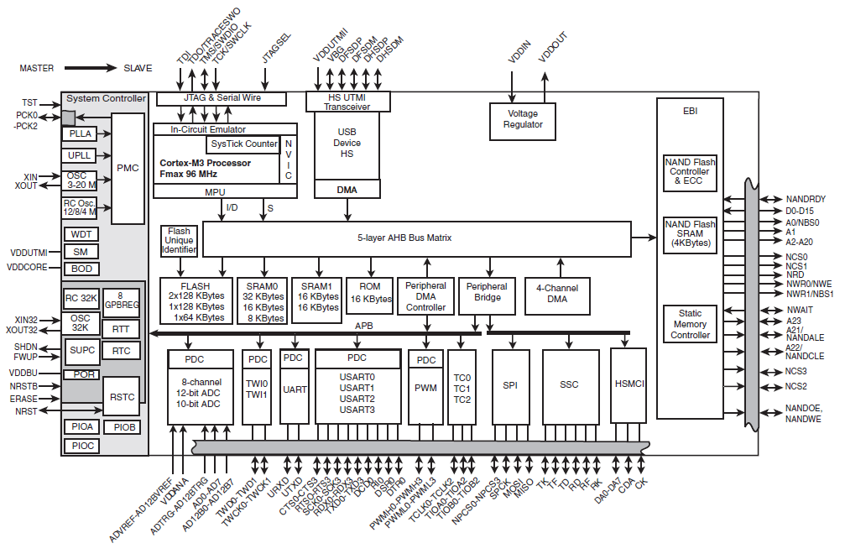
Modern embedded systems have multiple busses
Atmel SAM3U
Expanded
373 focus
Historical
373 focus

Slide 12
Why have so many busses?
Many designs considerations
  Master vs Slave
  Internal vs External
  Bridged vs Flat
  Memory vs Peripheral
  Synchronous vs Asynchronous
  High-speed vs low-speed
  Serial vs Parallel
  Single master vs multi master
  Single layer vs multi layer
  Multiplexed A/D vs demultiplexed A/D
Discussion: what are some of the tradeoffs?

Slide 13
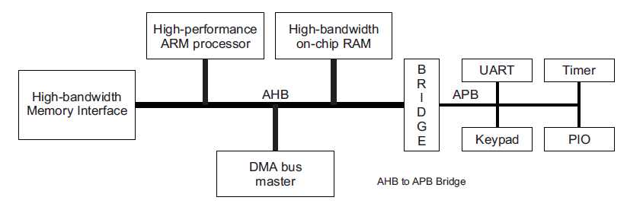
Advanced Microcontroller Bus Architecture (AMBA)
- Advanced High-performance Bus (AHB)
- Advanced Peripheral Bus (APB)
AHB
APB
High performance
Pipelined operation
Burst transfers
Multiple bus masters
Split transactions
Low power
Latched address/control
Simple interface
Suitable of many peripherals

Slide 14
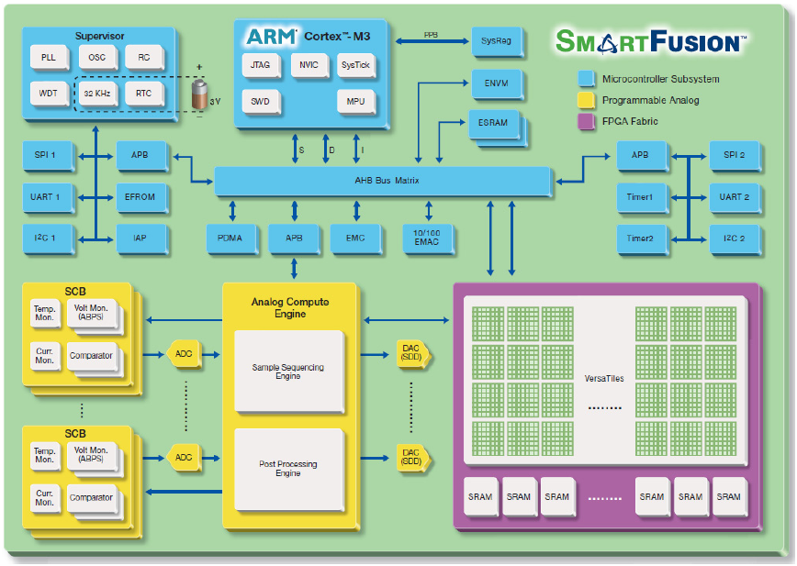
Actel SmartFusion system/bus architecture

Slide 15
Outline
Minute quiz
Announcements
Memory and Memory-Mapped I/O
Bus Architectures
ARM AHB-Lite
ARM APB

Slide 16
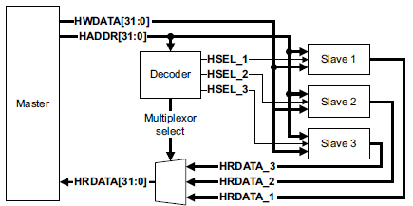
AHB-Lite supports single bus master and provides high-bandwidth operation
Burst transfers
Single clock-edge operation
Non-tri-state implementation
Configurable bus width

Slide 17
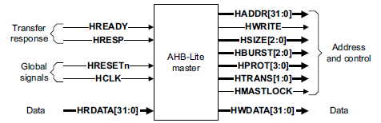
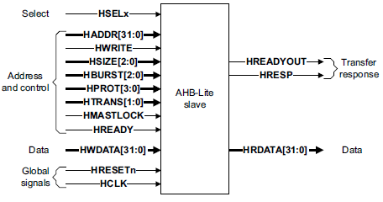
AHB-Lite bus master/slave interface
Global signals
  HCLK
  HRESETn
Master out/slave in
  HADDR (address)
  HWDATA (write data)
  Control
    HWRITE
    HSIZE
    HBURST
    HPROT
    HTRANS
    HMASTLOCK
Slave out/master in
  HRDATA (read data)
  HREADY
  HRESP

Slide 18
AHB-Lite signal definitions
Global signals
  HCLK: the bus clock source (rising-edge triggered)
  HRESETn: the bus (and system) reset signal (active low)
Master out/slave in
  HADDR[31:0]: the 32-bit system address bus
  HWDATA[31:0]: the system write data bus
  Control
    HWRITE: indicates transfer direction (Write=1, Read=0)
    HSIZE[2:0]: indicates size of transfer (byte, halfword, or word)
    HBURST[2:0]: indicates single or burst transfer (1, 4, 8, 16 beats)
    HPROT[3:0]: provides protection information (e.g. I or D; user or handler)
    HTRANS: indicates current transfer type (e.g. idle, busy, nonseq, seq)
    HMASTLOCK: indicates a locked (atomic) transfer sequence
Slave out/master in
  HRDATA[31:0]: the slave read data bus
  HREADY: indicates previous transfer is complete
  HRESP: the transfer response (OKAY=0, ERROR=1)

Slide 19
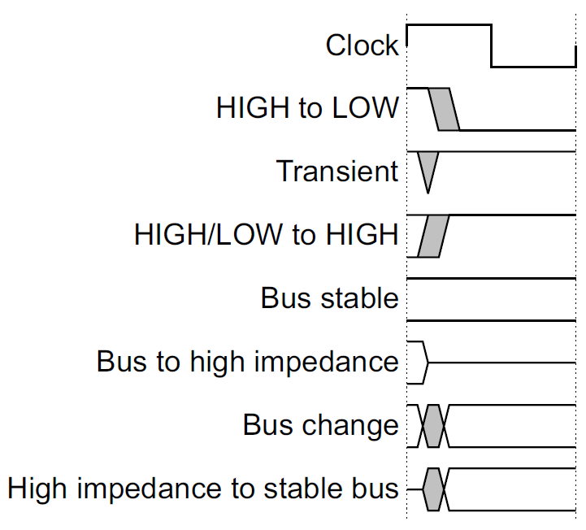
Key to timing diagram conventions
Timing diagrams
  Clock
  Stable values
  Transitions
  High-impedance
Signal conventions
  Lower case ‘n’ denote active low (e.g. RESETn)
  Prefix ‘H’ denotes AHB
  Prefix ‘P’ denotes APB

Slide 20
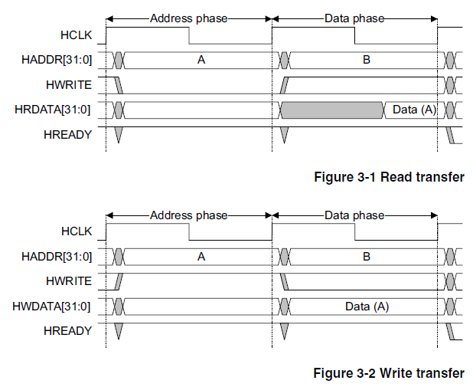
Basic read and write transfers with no wait states
Pipelined
Address
& Data
Transfer

Slide 21
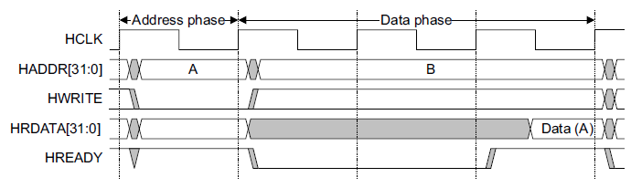
Read transfer with two wait states
Two wait states
added by slave
by asserting
HREADY low
Valid data
produced

Slide 22
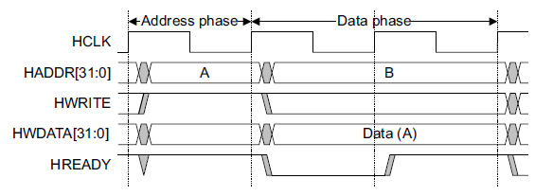
Write transfer with one wait state
One wait state
added by slave
by asserting
HREADY low
Valid data
held stable

Slide 23
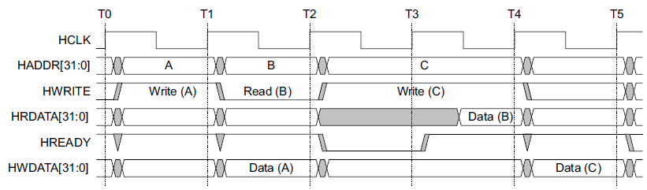
Wait states extend the address phase of next transfer
Address stage of
the next transfer
is also extended
One wait state
added by slave
by asserting
HREADY low

Slide 24
Transfers can be of four types (HTRANS[1:0])
IDLE (b00)
  No data transfer is required
  Slave must OKAY w/o waiting
  Slave must ignore IDLE
BUSY (b01)
  Insert idle cycles in a burst
  Burst will continue afterward
  Address/control reflects next transfer in burst
  Slave must OKAY w/o waiting
  Slave must ignore BUSY
NONSEQ (b10)
  Indicates single transfer or first transfer of a burst
  Address/control unrelated to prior transfers
SEQ (b11)
  Remaining transfers in a burst
  Addr = prior addr + transfer size

Slide 25
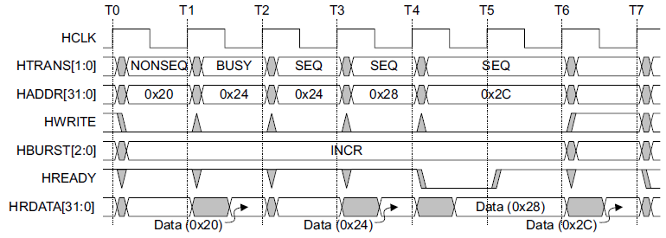
A four beat burst with master busy and slave wait
Master busy
indicated by
HTRANS[1:0]
One wait state
added by slave
by asserting
HREADY low

Slide 26
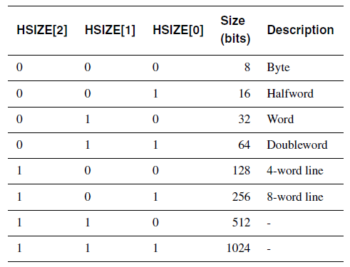
Controlling the size (width) of a transfer
HSIZE[2:0] encodes the size
The cannot exceed the data bus width (e.g. 32-bits)
HSIZE + HBURST is determines wrapping boundary for wrapping bursts
HSIZE must remain constant throughout a burst transfer

Slide 27
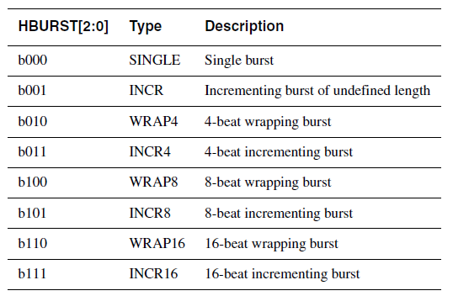
Controlling the burst beats (length) of a transfer
Burst of 1, 4, 8, 16, and undef
HBURST[2:0] encodes the type
Incremental burst
Wrapping bursts
  4 beats x 4-byte words wrapping
  Wraps at 16 byte boundary
  E.g. 0x34, 0x38, 0x3c, 0x30,…
Bursts must not cross 1KB address boundaries

Slide 28
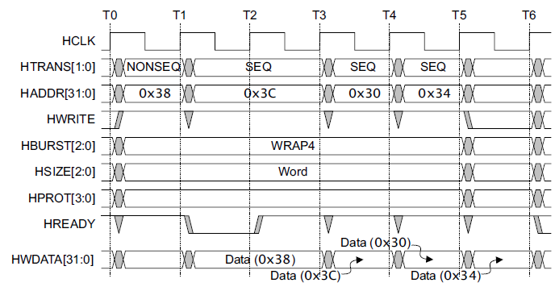
A four beat wrapping burst (WRAP4)

Slide 29
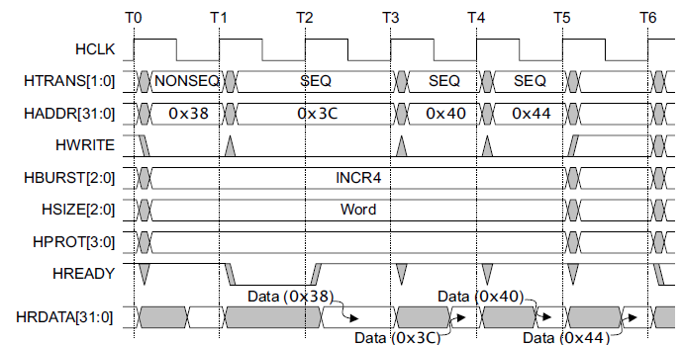
A four beat incrementing burst (INCR4)

Slide 30
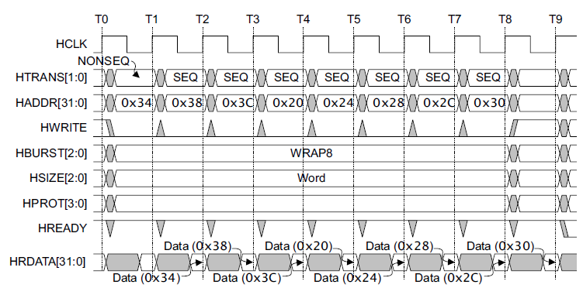
An eight beat wrapping burst (WRAP8)

Slide 31
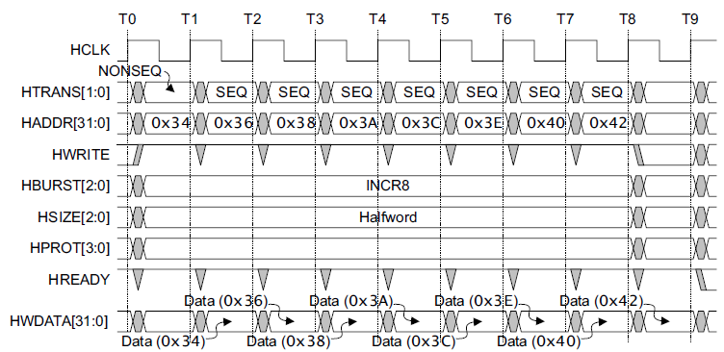
An eight beat incrementing burst
(INCR8) using half-word transfers

Slide 32
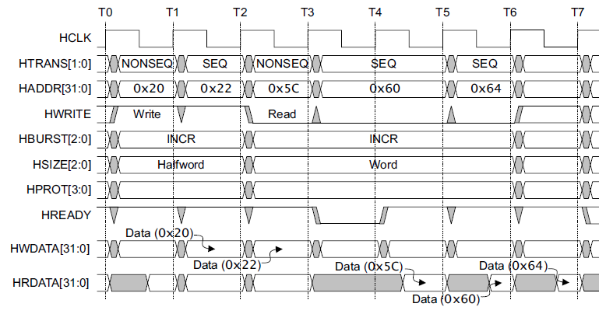
An undefined length incrementing burst (INCR)

Slide 33
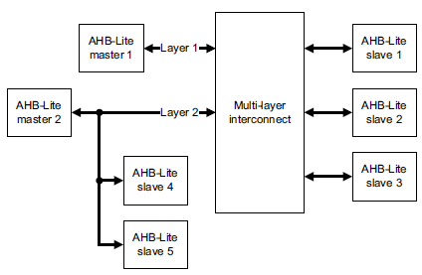
Multi-master AHB-Lite requires a multi-layer interconnect
AHB-Lite is single-master
Multi-master operation
  Must isolate masters
  Each master assigned to layer
  Interconnect arbitrates slave accesses
Full crossbar switch often unneeded
  Slaves 1, 2, 3 are shared
  Slaves 4, 5 are local to Master 1

Slide 34
Outline
Minute quiz
Announcements
Memory and Memory-Mapped I/O
Bus Architectures
ARM AHB-Lite
ARM APB

Slide 35
APB is simpler interface than AHB-Lite and provides high-bandwidth operation
Low-cost
Low-power
Low-complexity
Low-bandwidth
Non pipelined
Ideal for peripherals

Slide 36
APB signal definitions
PCLK: the bus clock source (rising-edge triggered)
PRESETn: the bus (and typically system) reset signal (active low)
PADDR: the APB address bus (can be up to 32-bits wide)
PSELx: the select line for each slave device
PENABLE: indicates the 2nd and subsequent cycles of an APB xfer
PWRITE: indicates transfer direction (Write=H, Read=L)
PWDATA: the write data bus (can be up to 32-bits wide)
PREADY: used to extend a transfer
PRDATA: the read data bus (can be up to 32-bits wide)
PSLVERR: indicates a transfer error (OKAY=L, ERROR=H)

Slide 37
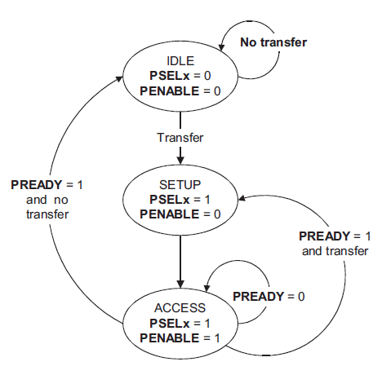
APB state machine
IDLE
  Default APB state
SETUP
  When transfer required
  PSELx is asserted
  Only one cycle
ACCESS
  PENABLE is asserted
  Addr, write, select, and write data remain stable
  Stay if PREADY = L
  Goto IDLE if PREADY = H and no more data
  Goto SETUP is PREADY = H and more data pending

Slide 38
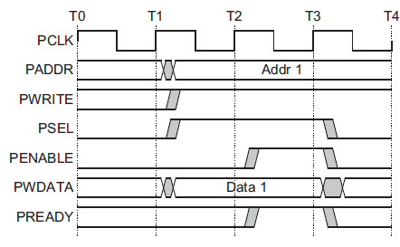
A write transfer with no wait states
Setup phase begins
with this rising edge
Setup
Phase
Access
Phase

Slide 39
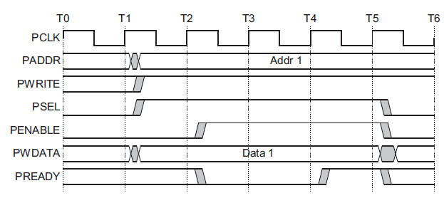
A write transfer with wait states
Setup phase begins
with this rising edge
Setup
Phase
Wait
State
Wait
State
Access
Phase

Slide 40
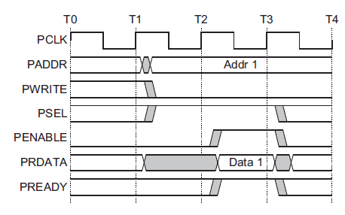
A read transfer with no wait states
Setup phase begins
with this rising edge
Setup
Phase
Access
Phase

Slide 41
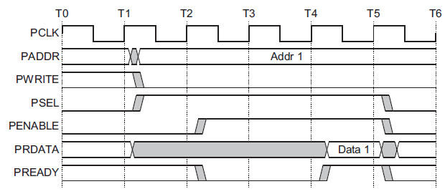
A read transfer with wait states
Setup phase begins
with this rising edge
Setup
Phase
Wait
State
Wait
State
Access
Phase

Slide 42
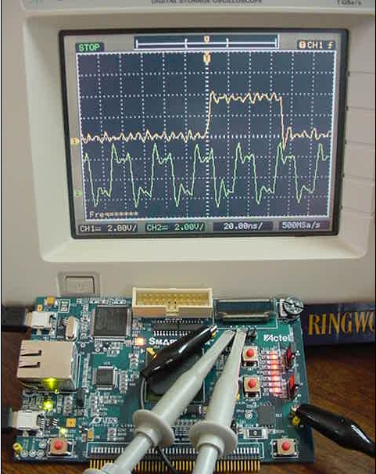
This week: creating a memory-mapped peripheral that lives on the AMBA APB

Slide 43
Questions?
Comments?
Discussion?

