Slide 1
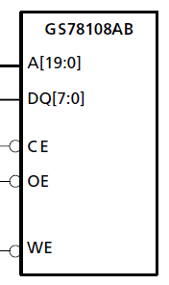
EECS 373
Design of Microprocessor-Based Systems
Prabal Dutta
University of Michigan
Lecture 6: Memory-Mapped Peripherals
September 20, 2012

Slide 2
Announcements
HW1 coming out soon
Catch up from last time

Slide 3
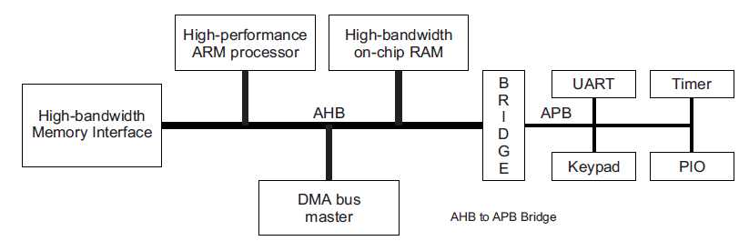
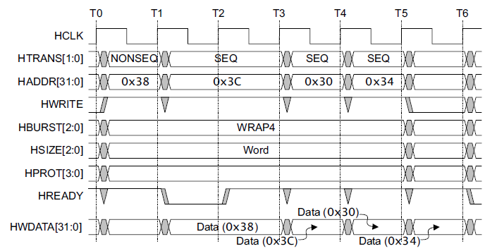
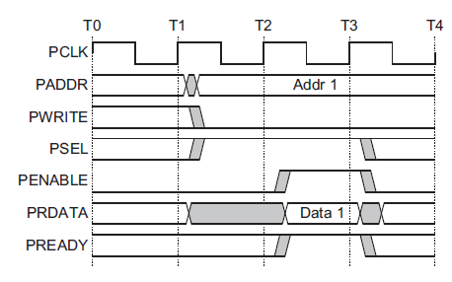
Advanced Microcontroller Bus Architecture (AMBA)
- Advanced High-performance Bus (AHB)
- Advanced Peripheral Bus (APB)
AHB
APB

Slide 4
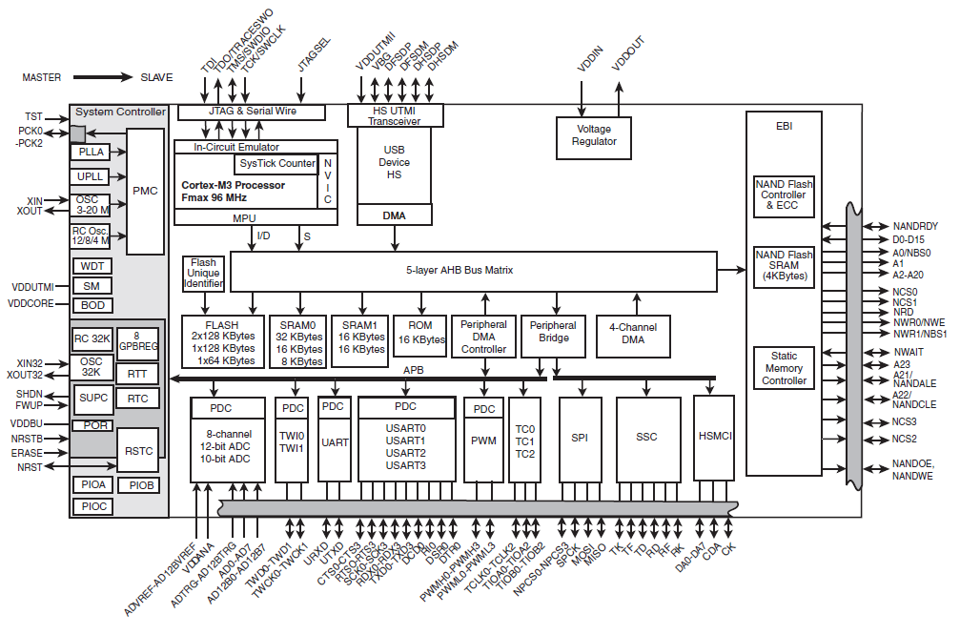
Internal and external busses are accessed in very different ways!
Atmel SAM3U
Accessed
logically
w/ VHDL
& Verilog
Accessed
physically
w/ wires

Slide 5
Why not just export the AHB-Lite or APB off-chip?

Slide 6
Outline
Minute quiz
Announcements
Asynchronous Memory
External Memory Controller
Open Discussions

Slide 7
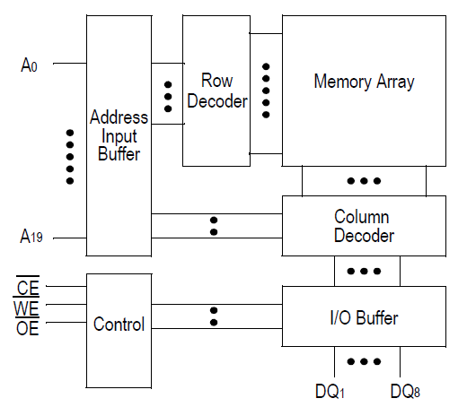
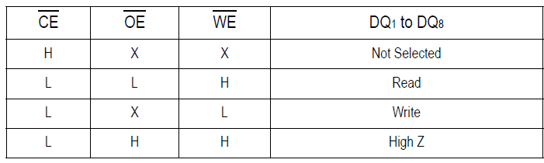
An SRAM chip and its asynchronous parallel interface
A: 20-bit address bus
DQ: 8-bit data bus
CE#: chip enable
WE#: write enable
OE#: output enable

Slide 8
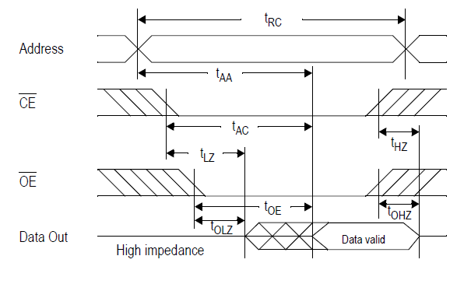
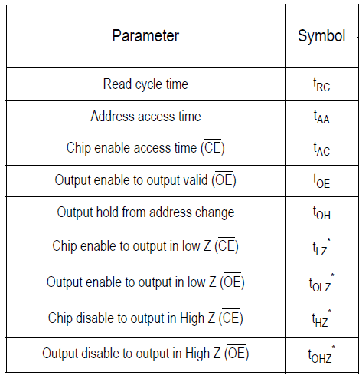
GS78108 read cycle…has no clock

Slide 9
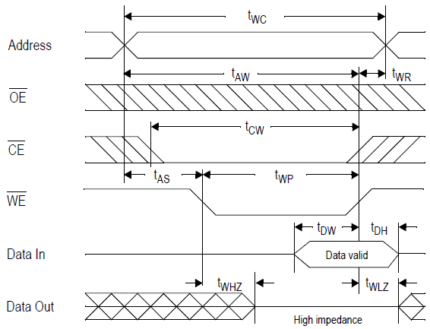
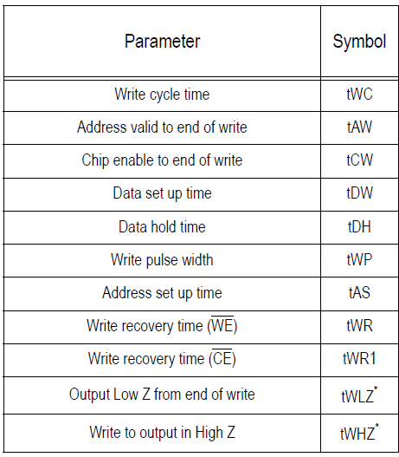
GS78108 WE#-controlled write cycle

Slide 10
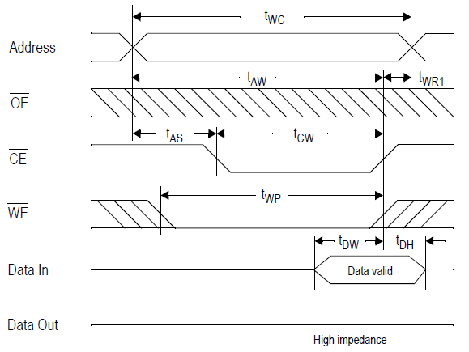
GS78108 CE#-controlled write cycle

Slide 11
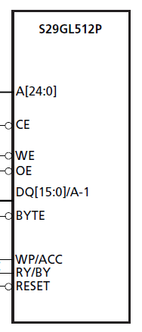
An asynchronous NOR flash memory
(that does not have a clock input line)
A: 25-bit address bus
DQ: A 16-bit data bus
CE#: chip enable
WE#: write enable
OE#: output enable
BYTE: 8-bit or 16-bit mode
WP#/ACC: write protect
RY/BY#: ready/busy
RESET#: clear internal status

Slide 12
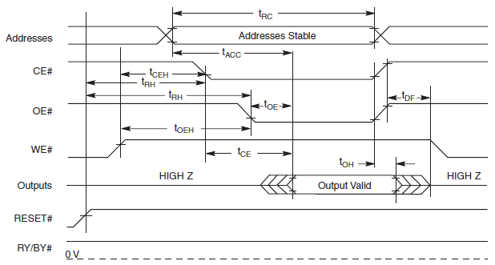
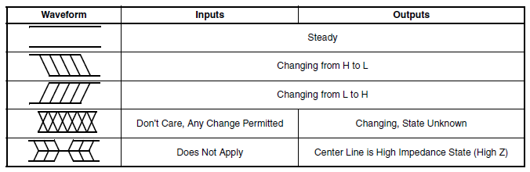
S29GL512P read cycle

Slide 13
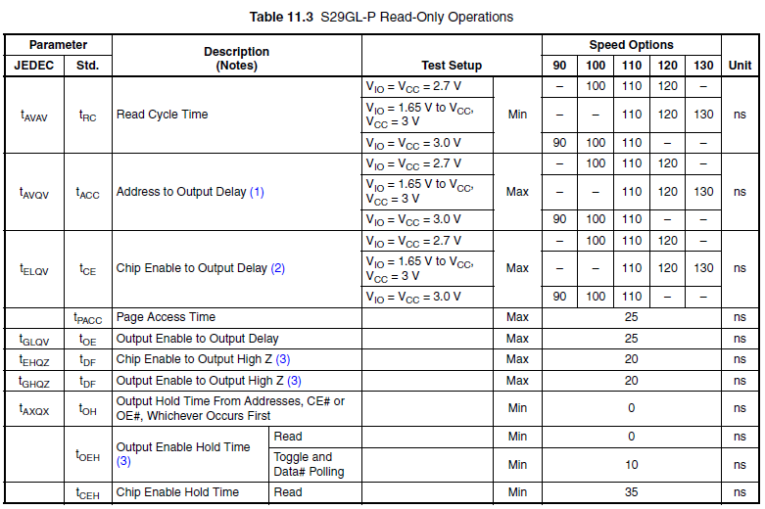

S29GL512P read cycle timing

Slide 14
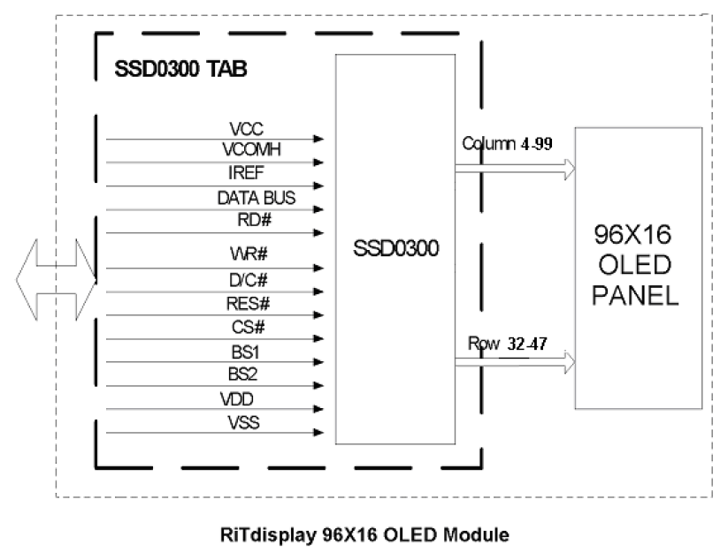
LCD controller (PMO13701) exports both a parallel and a serial interface
8-bit parallel interface
D: 8-bit data bus
BS1/BS2: Ifc mode select
CS#: chip select
RD#: read data
WR#: write data
RES#: hardware reset
D/C#: Slave address bit

Slide 15
Outline
Minute quiz
Announcements
Asynchronous Memory
External Memory Controller
Open Discussions

Slide 16
Accessing external parallel devices
AHB and APB are wide, de-multiplexed internal busses
External busses tradeoff pin-count, performance, …
  ISA
  VESA
  AGP
  PCI
  VME
  IDE
  CF
MCUs often integrate external memory controllers
  Often tailored to specific peripheral class
  EMCs ease memory/peripheral interfacing

Slide 17
External Memory Controller on SmartFusion
Provide glueless interface to external devices
Asynchronous and Synchronous memories supported
EMC is mapped into system address space
  0x70000000 to 0x77FFFFFF
Offers
  2 chip select lines (CS)
  8-bit or 16-bit shared data bus
  Write enable generation
  Translates 32-bit AHB transfers into half-word and byte txns
  Automatic translation of misaligned addresses

Slide 18
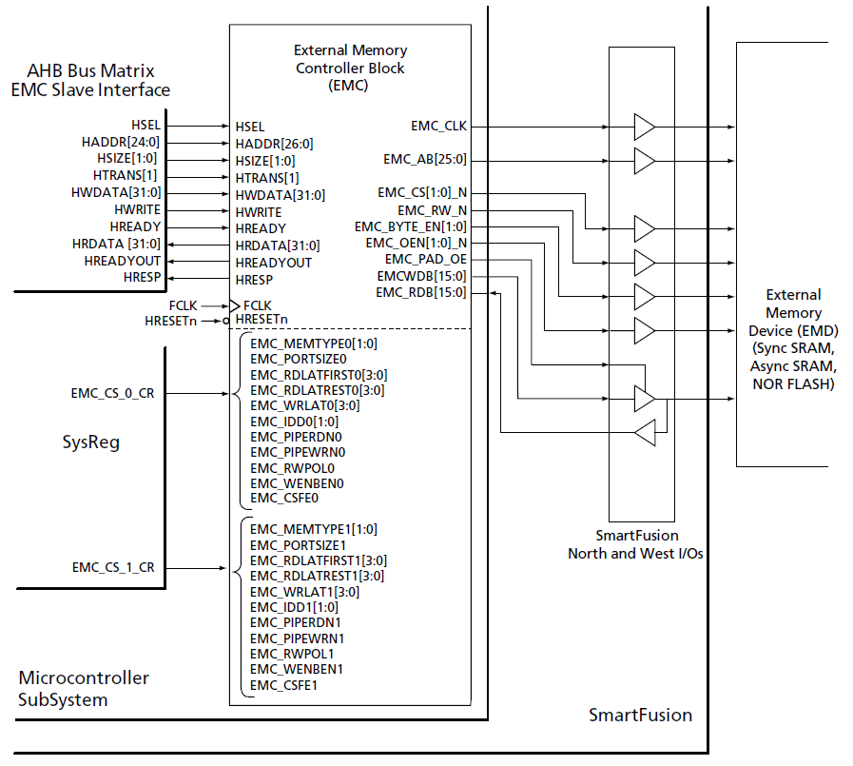
SmartFusion’s External Memory Controller

Slide 19
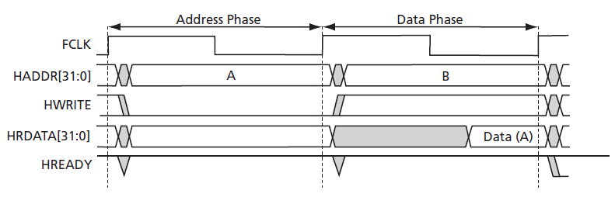
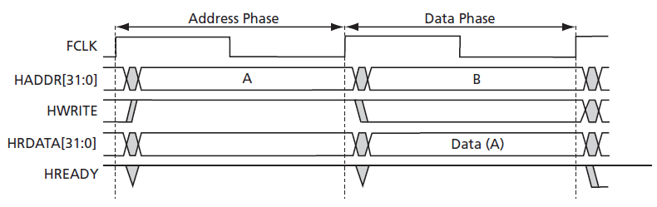
AHB read/write transfers

Slide 20
EMC operation
EMC accepts single AHB transactions
  Reading external memory devices (EMD)
  Writing EMD
EMC reformats single AHB transactions into EMD format
EMC may use multiple CLK cycles to complete access
  Recall AHB transfers complete in two cycles
EMC cannot complete EMD R/W in only two cycles
User must configure EMC to include wait states

Slide 21
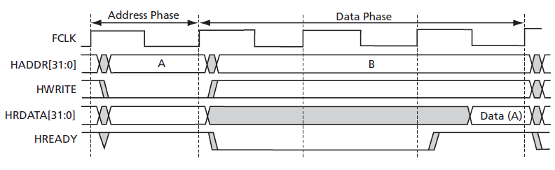
AHB read transfer with two wait states

Slide 22
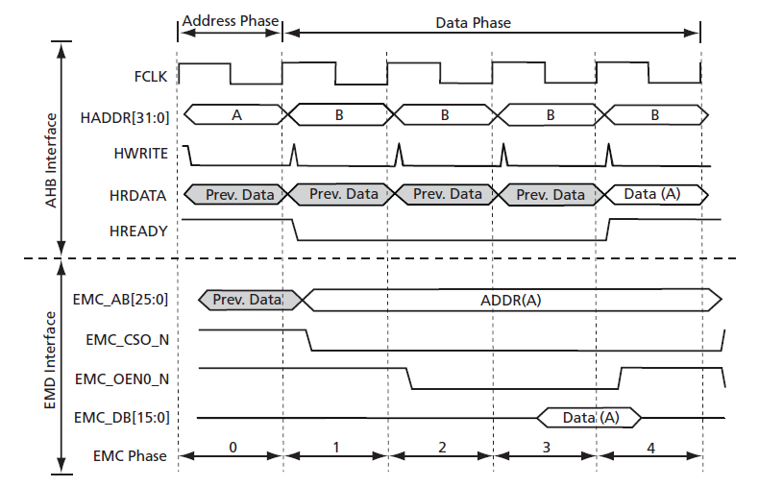
EMC operation continued
EMC uses extra cycles to complete EMD transaction
AHB address phase is one cycle (wait states are in data)
EMC requires one cycle to output EMD address
EMD requires two cycles to fetch the data
EMC requires one additional cycle to transfer data to AHB
A total of three wait states on AHB tranfers

Slide 23
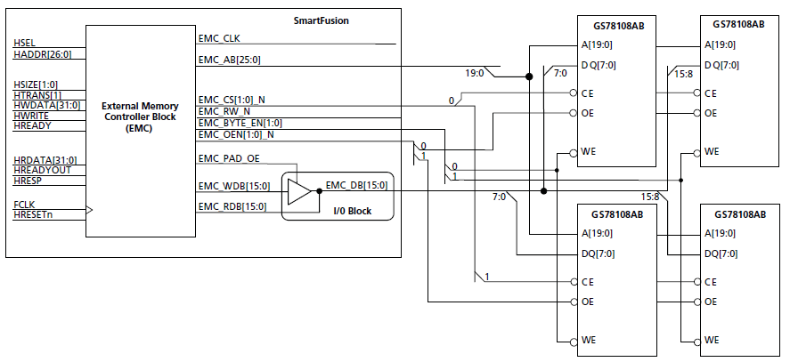
Using the EMC to attach four GS78108’s
Four asynchronous SRAMs
Byte enables used a write enables

Slide 24
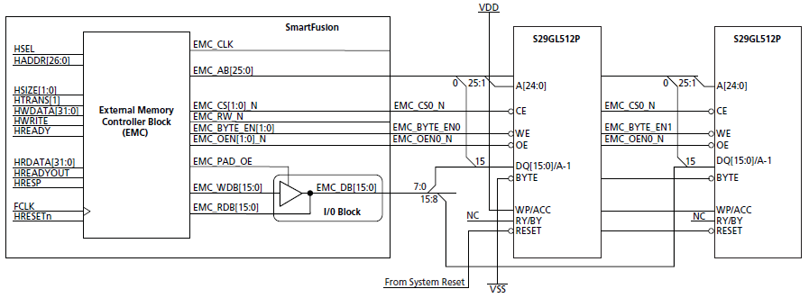
Using the EMC to attach two S29GL512’s
Two byte-mode NOR flash devices
Byte enables used as write enables

Slide 25
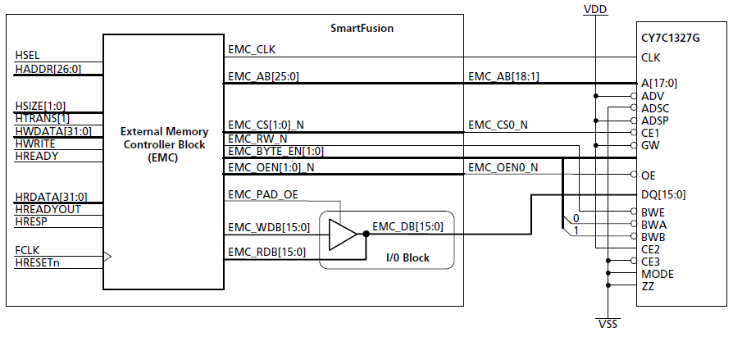
Using the EMC to interface with a synchronous SRAM

Slide 26
Outline
Minute quiz
Announcements
Asynchronous Memory
External Memory Controller
Open Discussions

Slide 27
Questions?
Comments?
Discussion?

