Slide 1

Elastic MapReduce
Overview
How does it works
Cost
Group 5 & 9

Slide 2
Elastic MapReduce
Account with AWS
Need to know about S3 Bucket
Need to know about EC2 Instance
Familiar with Hadoop

Slide 3

What is Elastic MapReduce

Slide 4
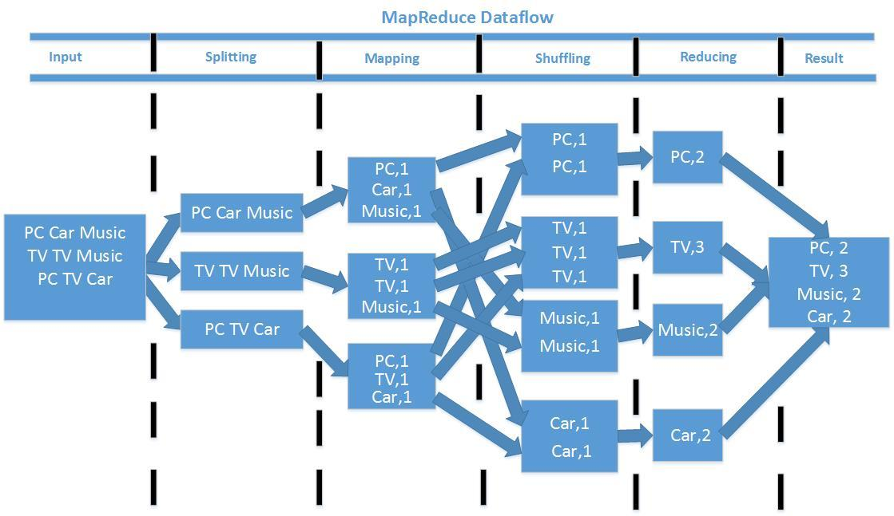

Slide 5

Hadoop
An open source software framework that enables the distributed processing of large data sets across clusters servers.
Designed to scale up from a single server to thousands of machines, with a very high degree of fault tolerance
Scalable Flexible
Fault tolerant Cost effective

Slide 6
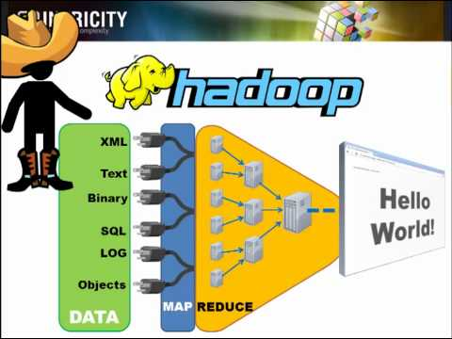

Slide 7

S3 Bucket
simple web services interface
store and retrieve any amount of data, at any time, from anywhere on the web.
developer access to the highly scalable, reliable, fast, inexpensive data storage

Slide 8
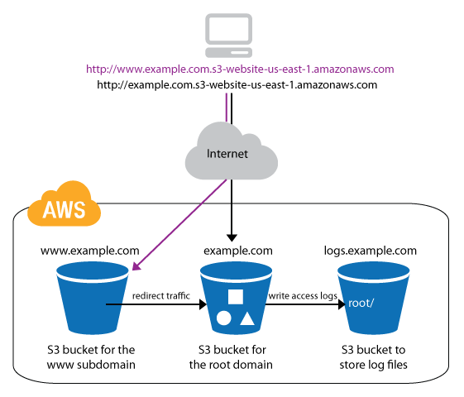
S3 Bucket

Slide 9
EC2 Instance
Elastic Compute Cloud (EC2)
Resizable compute capacity in the cloud.
web-scale cloud computing easier for developers. to obtain and configure capacity with minimal friction.
reduces the time required to obtain and boot new server instances to minutes.
quickly scale capacity as per computing requirements change.

Slide 10
Word length Counting
Wordcount for specific wordlength
Map-Function: calculate length for every Word
Return WordLength:WordList (3:[the,and,...])
Reduce-Function: count the words per wordlength
Result: Amount of words for specific wordlength

Slide 11
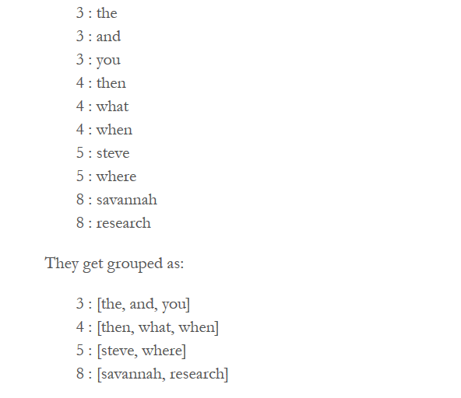
Result

Slide 12
Cost
Hardware : m1.large 6 instance
EC2 Price $0.190 per Hour
Elastic MapReduce Price $0.044 per Hour
Estimated cost ($0.190 + $0.044 ) * 6 = $ 1.404 / hour
Amazon S3 costs $668 per month to store 10 TB of data in S3
Hidden cost
applicable taxes and duties
Partial hours are rounded up
Amazon SimpleDB is also billed separately. (Only applies if you enable debugging for your cluster)
Additional charge for the MapR M5 and M7 distributions

Slide 13
Group 9 - description of the task
Used Google Books dataset
One tuple is:
n-gram - The actual n-gram
year - The year for this aggregation
occurrences - The number of times this n-gram appeared in this year
e.g. Hello 2000 30
World 2000 20
Aim: 2000 50 → Words occurrences per year

Slide 14
Costs
Job uses 6 instance hours
EC2 instance type: m1.medium
Amazon EC2 Price: $0.095 per Hour x 6
Amazon Elastic MapReduce Price: $0.022 per Hour x 6
Except as otherwise noted, prices are exclusive of applicable taxes and duties, including VAT and applicable sales tax.
Charging starts from the time the cluster begins processing until it is terminated. Partial hours are rounded up.
Currently it costs $668 per month to store 10 TB of data in S3 with reduced redundancy. The more data you store, the lower the monthly price per GB.

