Slide 1
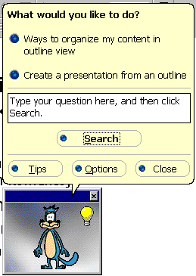
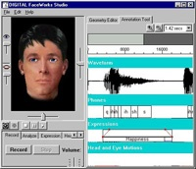

What is an Intelligent Agent ?
Based on Tutorials:
Monique Calisti, Roope Raisamo, Franco Guidi Polanko, Jeffrey S. Rosenschein, Vagan Terziyan and others

Slide 2





Ability to Exist to be Autonomous, Reactive, Goal-Oriented, etc.
- are the basic abilities of an Intelligent Agent

Slide 3


References
Basic Literature:
Software Agents, Edited by Jeff M. Bradshaw. AAAI Press/The MIT Press.
Agent Technology, Edited by N. Jennings and M. Wooldridge, Springer.
The Design of Intelligent Agents, Jorg P. Muller, Springer.
Heterogeneous Agent Systems, V.S. Subrahmanian, P. Bonatti et al., The MIT Press.
Papers‘ collections: ICMAS, Autonomous Agents (AA), AAAI, IJCAI.
Links:
- www.fipa.org
- www.agentlink.org
- www.umbc.edu
- www.agentcities.org

Slide 4
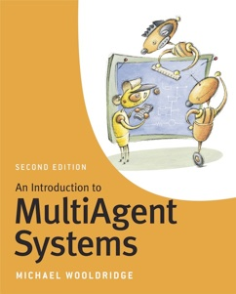

Fresh Recommended Literature
Details and handouts available in: http://www.cs.ox.ac.uk/people/michael.wooldridge/pubs/imas/IMAS2e.html

Slide 5


Fresh Recommended Literature
Handouts available in: http://www.the-mas-book.info/index-lecture-slides.html

Slide 6
Some fundamentals on Game Theory, Decision Making, Uncertainty, Utility, etc.
Neumann, John von & Morgenstern, Oskar (1944). Theory of Games and Economic Behavior. Princeton, NJ: Princeton University Press.
Fishburn, Peter C. (1970). Utility Theory for Decision Making. Huntington, NY: Robert E. Krieger.
Gilboa, Itzhak (2009). Theory of Decision under Uncertainty. Cambridge: Cambridge University Press.

Slide 7
What agents are ?

Slide 8
What is an agent?
“An over-used term” (Patti Maes, MIT Labs, 1996)
“Agent” can be considered as a theoretical concept from AI.
Many different definitions exist in the literature…..

Slide 9
Agent Definition (1)
An agent is an entity which is:
  Situated in some environment.
  Autonomous, in the sense that it can act without direct intervention from humans or other software processes, and controls over its own actions and internal state.
  Flexible which means:
    Responsive (reactive): agents should perceive their environment and respond to changes that occur in it;
    Proactive: agents should not simply act in response to their environment, they should be able to exhibit opportunistic, goal-directed behavior and take the initiative when appropriate;
    Social: agents should be able to interact with humans or other artificial agents
“A Roadmap of agent research and development”,
N. Jennings, K. Sycara, M. Wooldridge (1998)

Slide 10
Agent Definition (2)
American Heritage Dictionary:
  agent -
  ” … one that acts or has the power or authority to act… or represent another”

Slide 11
Does this means that
… an agent carries out a task in favor of someone who has delegated it ?
To avoid tedious description of tasks we sometimes prefer our agents to be able to infer (predict, guess) our goals ...
… so the agents should have some knowledge of task domain and their user.

Slide 12

Agent Definition (3)
"An agent is anything that can be viewed as perceiving its environment through sensors and acting upon that environment through effectors."
Russell & Norvig

Slide 13

Agent Definition (4)
"Autonomous agents are computational systems that inhabit some complex dynamic environment, sense and act autonomously in this environment, and by doing so realize a set of goals or tasks for which they are designed."
Pattie Maes

Slide 14

Agent Definition (5)
“Intelligent agents continuously perform three functions: perception of dynamic conditions in the environment; action to affect conditions in the environment; and reasoning to interpret perceptions, solve problems, draw inferences, and determine actions.”
Barbara Hayes-Roth

Slide 15
What is an Agent?
ENVIRONMENT
Events
Behavior

Slide 16
Agents & Environments
The agent takes sensory input from its environment, and produces as output actions that affect it.
sensor
input
action
output
Agent
Environment

Slide 17
Internal and External Environment of an Agent
Balance !
External Environment:
user, other humans, other agents,
applications, information sources,
their relationships,
platforms, servers, networks, etc.
Internal Environment:
architecture, goals, abilities, sensors,
effectors, profile, knowledge,
beliefs, etc.

Slide 18




What “Balance” means?
For example a balance would mean: …
… for a human – possibility to complete the personal mission statement;
… for an agent – possibility to complete its design objectives.

Slide 19
Agent Definition (6) [Terziyan, 1993, 2007]
Intelligent Agent is an entity that is able to keep continuously balance between its internal and external environments in such a way that in the case of unbalance agent can:
change external environment to be in balance with the internal one ... OR
change internal environment to be in balance with the external one … OR
find out and move to another place within the external environment where balance occurs without any changes … OR
closely communicate with one or more other agents (human or artificial) to be able to create a community, which internal environment will be able to be in balance with the external one … OR
configure sensors by filtering the set of acquired features from the external environment to achieve balance between the internal environment and the deliberately distorted pattern of the external one. I.e. “if you are not able either to change the environment or adapt yourself to it, then just try not to notice things, which make you unhappy”

Slide 20
Agent Definition (6) [Terziyan, 1993]
The above means that an agent:
is goal-oriented, because it should have at least one goal - to keep continuously balance between its internal and external environments ;
is creative because of the ability to change external environment;
is adaptive because of the ability to change internal environment;
is mobile because of the ability to move to another place;
is social because of the ability to communicate to create a community;
is self-configurable because of the ability to protect “mental health” by sensing only a “suitable” part of the environment.

Slide 21
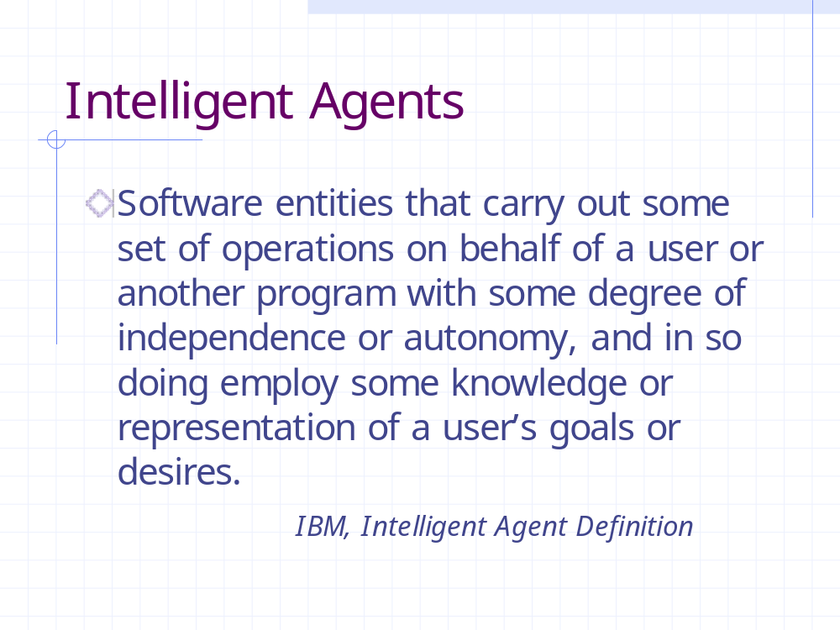
Agent Definition (7) [IBM]

Slide 22
Agent Definition (8)
[FIPA: (Foundation for Intelligent
Physical Agents), www.fipa.org ]
An agent is a computational process that implements the autonomous, communicating functionality of an application.

Slide 23
Agent Definition (9)
[Wikipedia: (The free Encyclopedia), http://www.wikipedia.org ]
In computer science, an intelligent agent (IA) is a software agent that exhibits some form of artificial intelligence that assists the user and will act on their behalf, in performing non-repetitive computer-related tasks. While the working of software agents used for operator assistance or data mining (sometimes referred to as bots) is often based on fixed pre-programmed rules, "intelligent" here implies the ability to adapt and learn.

Slide 24
Three groups of agents [Etzioni and Daniel S. Weld, 1995]
Backseat driver: helps the user during some task (e.g., Microsoft Office Assistant);
Taxi driver: knows where to go when you tell the destination;
Concierge: know where to go, when and why.

Slide 25
Agent classification according to Franklin and Graesser
Autonomous Agents
Biological Agents
Robotic Agents
Computational Agents
Artificial Life
Agents
Software Agents
Task-Specific Agents
Entertainment Agents
Viruses

Slide 26
Examples of agents
Control systems
  e.g. Thermostat
Software daemons
  e.g. Mail client
But… are they known as Intelligent Agents?
N

Slide 27


What is “intelligence”?

Slide 28
What intelligent agents are ?
“An intelligent agent is one that is capable of flexible autonomous action in order to meet its design objectives, where flexible means three things:
  reactivity: agents are able to perceive their environment, and respond in a timely fashion to changes that occur in it in order to satisfy its design objectives;
  pro-activeness: intelligent agents are able to exhibit goal-directed behavior by taking the initiative in order to satisfy its design objectives;
  social ability: intelligent agents are capable of interacting with other agents (and possibly humans) in order to satisfy its design objectives”;
Wooldridge & Jennings

Slide 29
Features of intelligent agents
reactive
autonomous
goal-oriented
temporally continuous
communicative
learning
mobile
flexible
character
responds to changes in the environment
control over its own actions
does not simply act in response to the environment
is a continuously running process
communicates with other agents, perhaps including people
changes its behaviour based on its previous experience
able to transport itself from one machine to another
actions are not scripted
believable personality and emotional state

Slide 30
Agent Characterisation
An agent is responsible for satisfying specific goals. There can be different types of goals such as achieving a specific status (defined either exactly or approximately), keeping certain status, optimizing a given function (e.g., utility), etc.
The state of an agent includes state of its internal environment + state of knowledge and beliefs about its external environment.
knowledge
beliefs
Goal1
Goal2

Slide 31
Goal I (achieving exactly defined status)
Initial State
Goal

Slide 32
Goal II (achieving constrained status)
Goal
Constraint:
“The smallest in on top”
Initial State
OR

Slide 33
Goal III (continuously keeping instable status)
Initial State
Goal

Slide 34



Goal IV (maximizing utility)
Goal:
The basket filled with mushrooms that can be sold for maximum possible price
Initial State

Slide 35
Situatedness
An agent is situated in an environment, that consists of the objects and other agents it is possible to interact with.
An agent has an identity that distinguishes it from the other agents of its environment.
environment
James Bond

Slide 36
Situated in an environment, which can be:
Accessible/partially accessible/inaccessible
(with respect to the agent’s precepts);
Deterministic/nondeterministic
(current state can or not fully determine the next one);
Static/dynamic
(with respect to time).

Slide 37
Agents & Environments
In complex environments:
  An agent do not have complete control over its environment, it just have partial control
  Partial control means that an agent can influence the environment with its actions
  An action performed by an agent may fail to have the desired effect.
Conclusion: environments are non-deterministic, and agents must be prepared for the possibility of failure.

Slide 38


Agents & Environments
Effectoric capability: agent’s ability to modify its environment.
Actions have pre-conditions
Key problem for an agent: deciding which of its actions it should perform in order to best satisfy its design objectives.

Slide 39
Agents & Environments
Agent’s environment states characterized by a set:
S={ s1,s2,…}
Effectoric capability of the Agent characterized by a set of actions:
A={ a1,a2,…}
sensor
input
Agent
action
output
Environment

Slide 40
Standard agents
A Standard agent decides what action to perform on the basis of his history (experiences).
A Standard agent can be viewed as function
action: S* → A
S* is the set of sequences of elements of S (states).

Slide 41
Environments
Environments can be modeled as function
env: S x A → P(S)
where P(S) is the power set of S (the set of all subsets of S) ;
This function takes the current state of the environment s∈S and an action a∈A (performed by the agent), and maps them to a set of environment states env(s,a).
Deterministic environment: all the sets in the range of env are singletons (contain 1 instance).
Non-deterministic environment: otherwise.

Slide 42
History
History represents the interaction between an agent and its environment. A history is a sequence:
Where:
s₀ is the initial state of the environment
a_{u} is the u’th action that the agent choose to perform
s_{u} is the u’th environment state
a₀
a₁
a₂
a_{u-1}
a_{u}
h:s₀ s₁ s₂ … s_{u}

Slide 43

Purely reactive agents
A purely reactive agent decides what to do without reference to its history (no references to the past).
It can be represented by a function
action: S → A
Example: thermostat
Environment states: temperature OK; too cold
heater off if s = temperature OK
action(s) =
heater on otherwise

Slide 44
Perception
see and action functions:
Agent
see
action
Environment

Slide 45
Perception
Perception is the result of the function
see: S → P
where
  P is a (non-empty) set of percepts (perceptual inputs).
Then, the action becomes:
action: P* → A
which maps sequences of percepts to actions

Slide 46
Perception ability
Non-existent
perceptual ability
Omniscient
MIN
MAX
| E | = 1
| E | = | S |
where
E: is the set of different perceived states
Two different states s₁∈ S and s₂ ∈ S (with s₁ ≠ s₂) are indistinguishable if see( s₁ ) = see( s₂ )

Slide 47
Perception ability
Example:
x = “The room temperature is OK”
y = “There is no war at this moment”
then:
S={ (x,y), (x,¬y), (¬x,y), (¬x, ¬ y)}
s1 s2 s3 s4
but for the thermostat:
p1 if s=s1 or s=s2
see(s) =
p2 if s=s3 or s=s4

Slide 48
Agents with state
see, next and action functions
Agent
see
action
next
state
Environment

Slide 49
Agents with state
The same perception function:
see: S → P
The action-selection function is now:
action: I → A
where
I: set of all internal states of the agent
An additional function is introduced:
next: I x P → I

Slide 50
Agents with state
Behavior:
  The agent starts in some internal initial state i₀
  Then observes its environment state s
  The internal state of the agent is updated with next(i₀,see(s))
  The action selected by the agent becomes action(next(i₀,see(s))), and it is performed
  The agent repeats the cycle observing the environment

Slide 51
Unbalance in Agent Systems
Not accessible (hidden)
part of External
Environment
Unbalance
Balance
Accessible (observed)
part of External
Environment
Internal Environment

Slide 52

Objects & Agents
sayHelloToThePeople()
Object
say Hello to the people
“Hello People!”
Classes control its states
Agents control its states and behaviors
“Objects do it for free; agents do it for money”

Slide 53

Agent’s Activity
Agents actions can be:
  direct, i.e., they affect properties of objects in the environment;
  - communicative / indirect, i.e., send messages with the aim of affecting mental attitudes of other agents;
- planning, i.e. making decisions about future actions.
Messages have a wel-defined semantics, they embed a content expressed in a given content language and containing terms whose meaning is defined in a given ontology.
I inform you that in Lausanne
it is raining
Mm it’s raining..
I got the message!
understood
inform

Slide 54
Classes of agents
Logic-based agents
Reactive agents
Belief-desire-intention agents
Layered architectures

Slide 55
Logic-based architectures
“Traditional” approach to build artificial intelligent systems:
  Logical formulas: symbolic
  representation of its
  environment and desired
  behavior.
  Logical deduction or
  theorem proving: syntactical
  manipulation of this
  representation.
and
grasp(x)
Kill(Marco, Caesar)
or
Pressure( tank1, 220)

Slide 56
Logic-based architectures: example
A cleaning robot
In(x,y) agent is at (x,y)
Dirt(x,y) there is a dirt at (x,y)
Facing(d) the agent is facing direction d
∀x,y (¬ Dirt(x,y)) – goal
Actions:
  change_direction
  move_one_step
  suck

Slide 57
Logic-based architectures: example
What to do ?

Slide 58
Logic-based architectures: example
start
// finding corner
continue while fail { do move_one_step}
do change_direction
continue while fail {do move_one_step}
do change_direction
finding corner //
// cleaning
continue {
remember In(x,y) to Mem
do change_direction
continue while fail {
if Dirt(In(x,y)) then suck
do move_one_step }
do change_direction
do change_direction
do change_direction
continue while fail {
if Dirt(In(x,y)) then suck
do move_one_step }
if In(x,y) equal Mem then stop
}
cleaning //
Solution
What is stopping criterion ?!

Slide 59
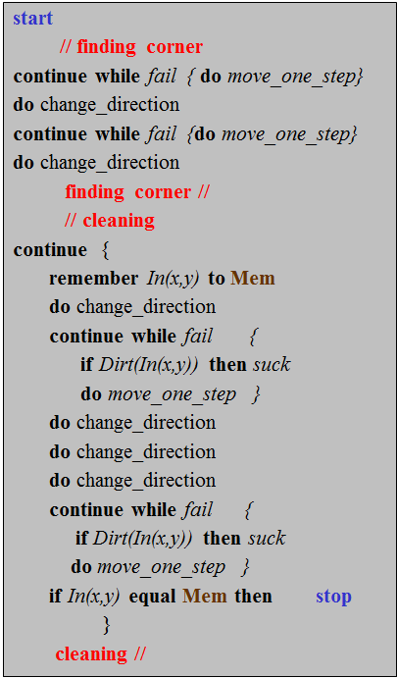
Logic-based architectures: example
is that intelligent?
How to make our agent capable to “invent” (derive) such a solution (plan) autonomously by itself ?!

Slide 60
Logic-based architectures: example
Looks like previous solution will not work here. What to do ?

Slide 61
Logic-based architectures: example
What to do now??
4
1
2
3
4
3
5
5
1
Restriction: a flat has a tree-like structure of rectangle rooms !
2

Slide 62
ATTENSION: Course Assignment !
To get 5 ECTS and the grade for the TIES-453 course you are expected to write 5-10 pages of a free text ASSIGNMENT describing how you see a possible approach to the problem, example of which is shown on the picture: (requirements to the agent architecture and capabilities (as economic as possible); view on agent’s strategy (or/and plan) to reach the goal of cleaning free shape environments); conclusions

Slide 63
Assignment: Format, Submission and Deadlines
Format: Word (or PDF) document;
Deadline - 15 March of this year (24:00);
Files with the assignment should be sent by e-mail to Vagan Terziyan (vagan@jyu.fi);
Notification of evaluation - until 30 March;
You will get 5 credits for the course;
Your course grade will be given based on originality and quality of this assignment;
The quality of the solution will be considered much higher if you will be able to provide it in the context of the Open World Assumption and agent capability to create a plan!

Slide 64
Logic-based architectures: example
What to do now??
4
1
2
3
4
3
5
5
1
2

Slide 65
Logic-based architectures: example
What now???

Slide 66
Logic-based architectures: example
or now … ??!

Slide 67

Logic-based architectures: example
To get 2 ECTS more in addition to 5 ECTS and get altogether 7 ECTS for the TIES-453 course you are expected to write extra 2-5 pages within your ASSIGNMENT describing how you see a possible approach to the problem, example of which is shown on the picture: (requirements to the agent architecture and capabilities (as economic as possible); view on agents’ collaborative strategy (or/and plan) to reach the goal of collaborating cleaning free shape environments); conclusions.
IMPORTANT ! This option of 2 extra credits is applied only to those who registered only to this TIES-453 course and not registered to TIES-454 course

Slide 68
Logic-based architectures: example
or now … ??!

Slide 69






Logic-based architectures: example
Open
World
Assumption
Now … ???!!!!!!
Everything may change:
  Room configuration;
  Objects and their locations
  Own capabilities, etc.
  Own goal!
f(t)
When you will be capable to design such a system, this means that you have learned more than everything you need from the course “Design of Agent-Based Systems”
f (t)

Slide 70

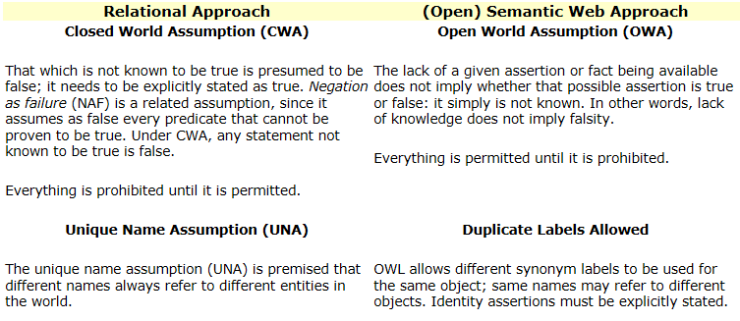
The Open World Assumption (1)
The Open World Assumption (OWA): a lack of information does not imply the missing information to be false.
http://www.mkbergman.com/852/

Slide 71
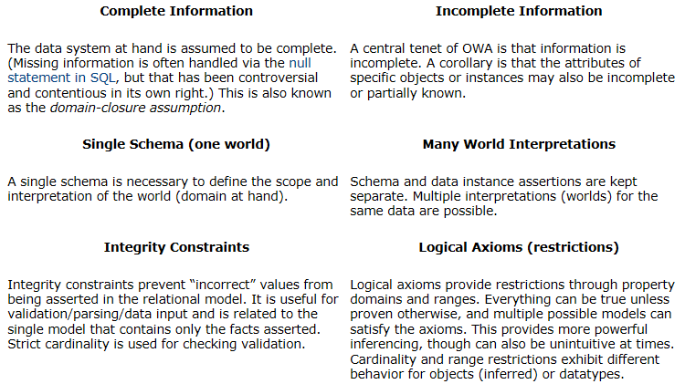
The Open World Assumption (2)
http://www.mkbergman.com/852/

Slide 72
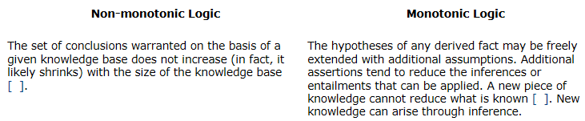
The Open World Assumption (3)
*
*
* The logic or inference system of classical model theory is monotonic. That is, it has the behavior that if S entails E then (S + T) entails E. In other words, adding information to some prior conditions or assertions cannot invalidate a valid entailment. The basic intuition of model-theoretic semantics is that asserting a statement makes a claim about the world: it is another way of saying that the world is, in fact, so arranged as to be an interpretation which makes the statement true.
In comparison, a non-monotonic logic system may include default reasoning, where one assumes a ‘normal’ general truth unless it is contradicted by more particular information (birds normally fly, but penguins don’t fly); negation-by-failure, commonly assumed in logic programming systems, where one concludes, from a failure to prove a proposition, that the proposition is false; and implicit closed-world assumptions, often assumed in database applications, where one concludes from a lack of information about an entity in some corpus that the information is false (e.g., that if someone is not listed in an employee database, that he or she is not an employee.)
http://www.mkbergman.com/852/

Slide 73
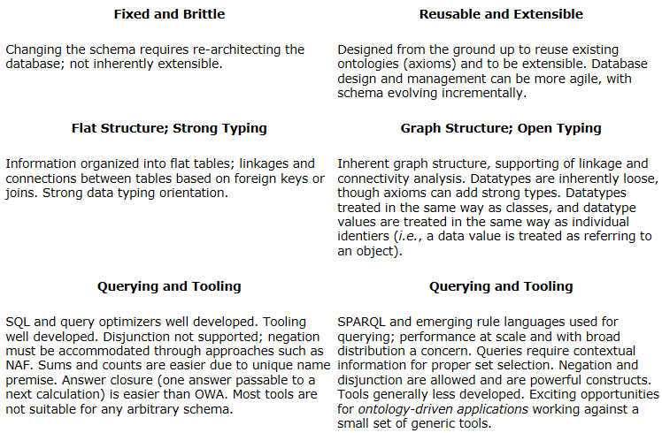
The Open World Assumption (4)
http://www.mkbergman.com/852/

Slide 74
Characteristics of OWA-based knowledge systems(1)
Knowledge is never complete — gaining and using knowledge is a process, and is never complete. A completeness assumption around knowledge is by definition inappropriate;
Knowledge is found in structured, semi-structured and unstructured forms — structured databases represent only a portion of structured information in the enterprise (spreadsheets and other non-relational data-stores provide the remainder). Further, general estimates are that 80% of information available to enterprises reside in documents, with a growing importance to metadata, Web pages, markup documents and other semi-structured sources. A proper data model for knowledge representation should be equally applicable to these various information forms; the open semantic language of RDF is specifically designed for this purpose;
Knowledge can be found anywhere — the open world assumption does not imply open information only. However, it is also just as true that relevant information about customers, products, competitors, the environment or virtually any knowledge-based topic can also not be gained via internal information alone. The emergence of the Internet and the universal availability and access to mountains of public and shared information demands its thoughtful incorporation into KM systems. This requirement, in turn, demands OWA data models;
Knowledge structure evolves with the incorporation of more information — our ability to describe and understand the world or our problems at hand requires inspection, description and definition. Birdwatchers, botanists and experts in all domains know well how inspection and study of specific domains leads to more discerning understanding and “seeing” of that domain. Before learning, everything is just a shade of green or a herb, shrub or tree to the incipient botanist; eventually, she learns how to discern entire families and individual plant species, all accompanied by a rich domain language. This truth of how increased knowledge leads to more structure and more vocabulary needs to be explicitly reflected in our KM systems;
http://www.mkbergman.com/852/

Slide 75
Characteristics of OWA-based knowledge systems(2)
Knowledge is contextual — the importance or meaning of given information changes by perspective and context. Further, exactly the same information may be used differently or given different importance depending on circumstance. Still further, what is important to describe (the “attributes”) about certain information also varies by context and perspective. Large knowledge management initiatives that attempt to use the relational model and single perspectives or schema to capture this information are doomed in one of two ways: either they fail to capture the relevant perspectives of some users; or they take forever and massive dollars and effort to embrace all relevant stakeholders’ contexts;
Knowledge should be coherent — (i.e., internally logically consistent). Because of the power of OWA logics in inferencing and entailments, whatever “world” is chosen for a given knowledge representation should be coherent. Various fantasies, even though not real, can be made believable and compelling by virtue of their coherence;
Knowledge is about connections — knowledge makes the connections between disparate pieces of relevant information. As these relationships accrete, the knowledge base grows. Again, RDF and the open world approach are essentially connective in nature. New connections and relationships tend to break brittle relational models, and …;
Knowledge is about its users defining its structure and use — since knowledge is a state of understanding by practitioners and experts in a given domain, it is also important that those very same users be active in its gathering, organization (structure) and use. Data models that allow more direct involvement and authoring and modification by users — as is inherently the case with RDF and OWA approaches — bring the knowledge process closer to hand. Besides this ability to manipulate the model directly, there are also the immediacy advantages of incremental changes, tests and tweaks of the OWA model. The schema consensus and delays from single-world views inherent to CWA remove this immediacy, and often result in delays of months or years before knowledge structures can actually be used and tested.
http://www.mkbergman.com/852/

Slide 76
Characteristics of OWA-based knowledge systems(3)
Domains can be analyzed and inspected incrementally;
Schema can be incomplete and developed and refined incrementally;
The data and the structures within these open world frameworks can be used and expressed in a piecemeal or incomplete manner;
We can readily combine data with partial characterizations with other data having complete characterizations;
Systems built with open world frameworks are flexible and robust; as new information or structure is gained, it can be incorporated without negating the information already resident, and …;
Open world systems can readily bridge or embrace closed world subsystems.
http://www.mkbergman.com/852/

Slide 77
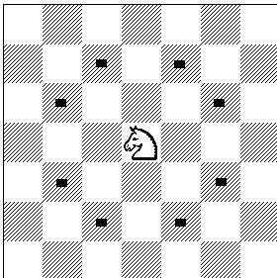

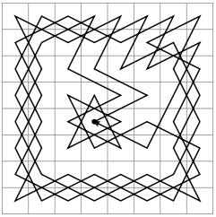
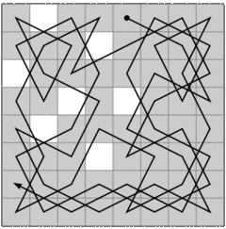
Knight’s Tour Problem

Slide 78
Reactive architectures
  situation → action

Slide 79
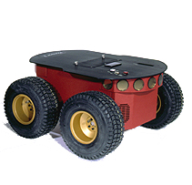
Reactive architectures: example
A mobile robot that avoids obstacles
ActionGoTo (x,y): moves to position (x,y)
ActionAvoidFront(z): turn left or right if there is an obstacle in a distance less than z units.

Slide 80
Belief-Desire-Intention (BDI) architectures
They have their Roots in understanding practical reasoning.
It involves two processes:
  Deliberation: deciding which goals we want to achieve.
  Means-ends reasoning: deciding how we are going to achieve these goals.

Slide 81
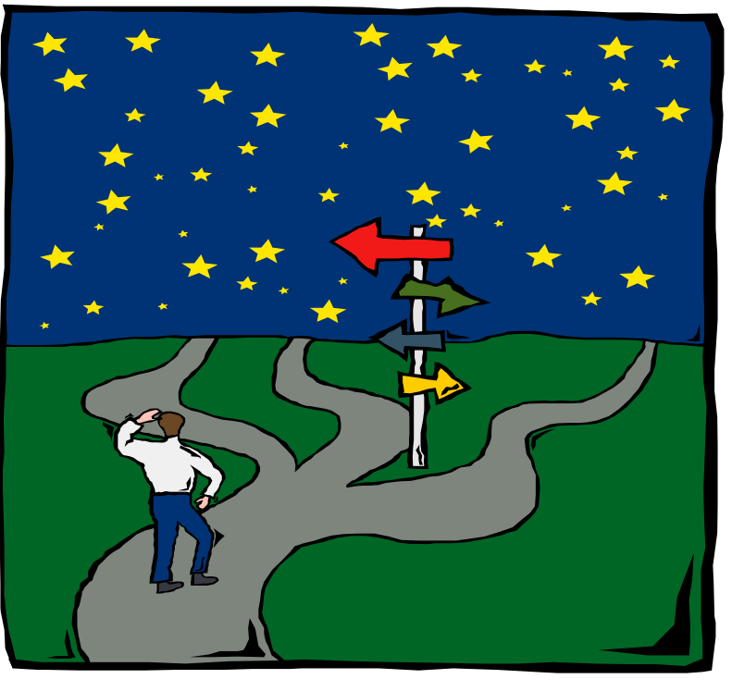
BDI architectures
First: try to understand what options are available.
Then: choose between them, and commit to some.
Intentions influence beliefs upon which future reasoning is based
These chosen options become intentions, which then determine the agent’s actions.

Slide 82
BDI architectures: reconsideration of intentions
Example (taken from Cisneros et al.)
P
Time t = 0
Desire: Kill the alien
Intention: Reach point P
Belief: The alien is at P

Slide 83
BDI architectures: reconsideration of intentions
Q
P
Time t = 1
Desire: Kill the alien
Intention: Kill the alien
Belief: The alien is at P
Wrong!

Slide 84
BDI Architecture (Wikipedia) - 1
Beliefs: Beliefs represent the informational state of the agent, in other words its beliefs about the world (including itself and other agents). Beliefs can also include inference rules, allowing forward chaining to lead to new beliefs. Using the term belief rather than knowledge recognizes that what an agent believes may not necessarily be true (and in fact may change in the future).
Desires: Desires represent the motivational state of the agent. They represent objectives or situations that the agent would like to accomplish or bring about. Examples of desires might be: find the best price, go to the party or become rich.
  Goals: A goal is a desire that has been adopted for active pursuit by the agent. Usage of the term goals adds the further restriction that the set of active desires must be consistent. For example, one should not have concurrent goals to go to a party and to stay at home even though they could both be desirable.

Slide 85
BDI Architecture (Wikipedia) - 2
Intentions: Intentions represent the deliberative state of the agent – what the agent has chosen to do. Intentions are desires to which the agent has to some extent committed. In implemented systems, this means the agent has begun executing a plan.
  Plans: Plans are sequences of actions (recipes or knowledge areas) that an agent can perform to achieve one or more of its intentions. Plans may include other plans: my plan to go for a drive may include a plan to find my car keys.
  Events: These are triggers for reactive activity by the agent. An event may update beliefs, trigger plans or modify goals. Events may be generated externally and received by sensors or integrated systems. Additionally, events may be generated internally to trigger decoupled updates or plans of activity.

Slide 86
Layered architectures
To satisfy the requirement of integrating a reactive and a proactive behavior.
Two types of control flow:
  Horizontal layering: software layers are each directly connected to the sensory input and action output.
  Vertical layering: sensory input and action output are each dealt with by at most one layer each.

Slide 87
Layered architectures: horizontal layering
Advantage: conceptual simplicity (to implement n behaviors we implement n layers)
Problem: a mediator function is required to ensure the coherence of the overall behavior
Layer n
…
perceptual
input
action
output
Layer 2
Layer 1

Slide 88
Layered architectures: vertical layering
Subdivided into:
action output
Two pass architecture
Layer n
Layer n
…
…
Layer 2
Layer 2
Layer 1
Layer 1
perceptual input
perceptual
input
action
output
One pass architecture

Slide 89
Layered architectures: INTERRAP
Proposed by Jörg Müller
Cooperation layer
Social knowledge
Plan layer
Planning knowledge
Behavior layer
World model
World interface
sensor input
action output

Slide 90

Multi-Agent Systems (MAS) Main idea
Cooperative working environment comprising synergistic software components can cope with complex problems.

Slide 91

Cooperation
Three main approaches:
  Cooperative interaction
  Contract-based co-operation
  Negotiated cooperation

Slide 92
Rationality
Principle of social rationality by Hogg et al.:
“Within an agent-based society, if a socially rational agent can perform an action so that agents’ join benefit is greater than their joint loss then it may select that action.”
EU(a) = f( IU(a), SU(a) )
where:
  EU(a): expected utility
  of action a
  IU(a): individual utility
  SU(a): social utility

Slide 93
Agent platform
A platform is a place which provides services to an Agent
  Services: Communications, Resource Access, Migration, Security, Contact Address Management, Persistence, Storage, Creation etc.
  Middleware
    Fat AOM (Agent Oriented Middleware): lots of services and lightweight agents
    Thin AOM: few services and very capable agents

Slide 94
Mobile Agent
The Mobile Agent is the entity that moves between platforms
  Includes the state and the code where appropriate
  Includes the responsibilities and the social role if appropriate (I.e. the agent does not usually become a new agent just because it moved.)

Slide 95
Conclusions
The concept of agent is associated with many different kinds of software and hardware systems. Still, we found that there are similarities in many different definitions of agents.
  Unfortunately, still, the meaning of the word “agent” depends heavily on who is speaking.

Slide 96
Conclusions
There is no consensus on what an agent is, but several key concepts are fundamental to this paradigm. We have seen:
  The main characteristics upon which our agent definition relies
  Several types of software agents
  In what an agent differs from other software paradigms
Agents as natural trend
Agents because of market reasons

Slide 97
Discussion
Who is legally responsible for the actions or agents?
How many tasks and which tasks the users want to delegate to agents?
How much can we trust in agents?
How to protect ourselves of erroneously working agents?

