Slide 1
MIS 382N - Advanced Machine Learning
Google Analytics Customer Revenue Prediction
Team 11: Sharon Liu, Yingjia Shang, Jiaxi Wang, Leyang Xu

Slide 2
Agenda
Project Goals
Exploratory Data Analysis
Data Preprocessing
Modeling & Future Plans
Project Goals
Data Preprocessing
Exploratory Data Analysis
Modeling & Future Plans

Slide 3
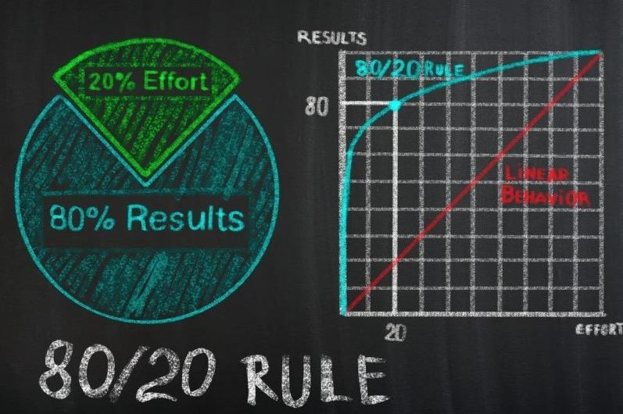
Problem Statement
80/20 (Pareto’s) rule:
A small percentage of customers produce the majority of the revenue
Project Goals
Data Preprocessing
Exploratory Data Analysis
Modeling & Future Plans

Slide 4
Problem Statement
Marketing Strategies
Customer Revenue Prediction
Optimize Value Creation
Establish Competitive Advantages
How much revenue a single visit is likely to generate at the store in a certain timeframe?
Predictive Modeling
Project Goals
Project Goals
Data Preprocessing
Exploratory Data Analysis
Modeling & Future Plans

Slide 5
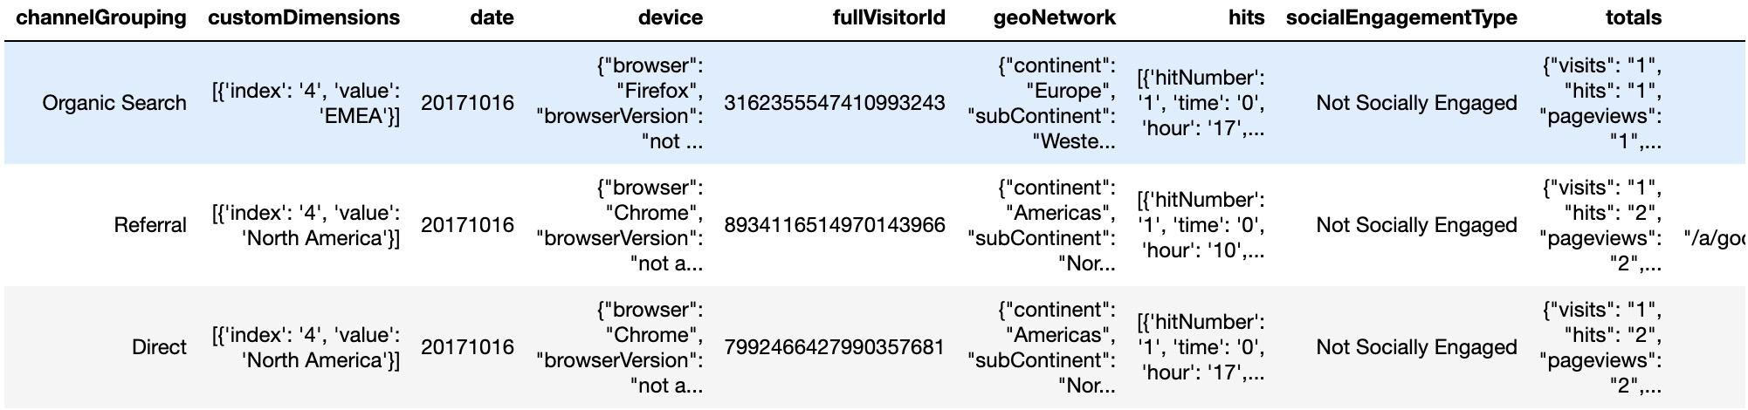
Data Description
Our dataset is already separated into training and test set.
Training set: 1.7 million rows & 13 columns
transaction records occur in the time period between year 2016 and 2018
Test set: 0.4 million rows & 12 columns
transaction records occur between 12/1/2018 and 1/31/2019
Each row represented one visit to the GStore with information about purchasing activities.
Data types: numeric, strings, JSON, date, etc.
Notes:
The famous 80/20 (Pareto’s) rule tells us that a small percentage of customers produce the majority of the revenue. So in order to make more profits, companies need to adopt "smarter" marketing strategies to focus more on the revenue-generating customers. Customer revenue prediction is therefore an essential part of a company’s promotion strategies to optimize value creation and establish competitive advantages. For our project, we are given various types of customer information at a Google Merchandise store (short as GStore), and we want to build a model to predict how much money they will spend at the store in a certain timeframe (12/1/2018 - 1/31/2019). For convenience, we take the natural log of sum of transactions per user.
Let's take a look at our data. Our dataset is already separated into training and test set.
Training set contains 1.7 million rows and 13 columns
Test set contains 0.4 million rows and 12 columns
All training set transaction records occur in the time period between year 2016 and 2018
All test set transaction records occur between 12/1/2018 and 1/31/2019
Each row represented one visit to the GStore with information about purchasing activities.
Data types include numeric, strings, JSON, date, etc.
We have a snapshot of our data frame down below, and on the next slide we have more details about column information. Data fields include Visitor ID, Visit ID, Channel used, date, device information, geography, social engagement, timestamps, and totals which includes some high level aggregate values.
Our data is not ready for modeling immediately. Before that, we need to do some preprocessing steps.
Firstly, we need to extract and flatten 4 JSON columns, which extends to 60 columns in total
Secondly, we check for null values and drop 11 columns with > 60% null values; for the rest of the columns with NAs, we filled them in with in 0 or 1 so it doesn’t create a tighter concentration around the mean.
Then, we noticed that there are several columns with constant values, so we decided to remove them as well as some other columns that we determined not helpful for prediction.
Last but not least, we converted certain columns into correct data type, especially those from JSON columns. For example, date column that we extracted from a JSON column requires a specific format.

Slide 6
Data Fields (before Pre-Processing)
Column Name | Column Description
fullVisitorId | Unique identifier of each user
channelGrouping | Channel used to come to store
date | Date visited
device | The specifications for the device used
geoNetwork | Geography information of the user
SocialEngagamentType | Social engagement level category
totals | High-level aggregate of the purchase
trafficSource | Purchase session’s web traffic
visitId | An identifier for this purchase session
Project Goals
Data Preprocessing
Exploratory Data Analysis
Modeling & Future Plans

Slide 7
Data Preprocessing
Flatten JSON columns
Dealing with NAs
Drop Columns
Change Data Type
Read and flatten 4 JSON Columns - extend to 60 columns in total
Remove columns with constant values and columns don’t help prediction
Convert some columns (eg. Date) into correct data type
Drop 11 columns with more than 60% NAs; Fill other columns with 0 or 1
Project Goals
Data Preprocessing
Exploratory Data Analysis
Modeling & Future Plans

Slide 8
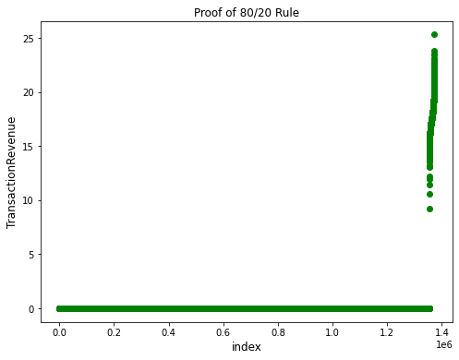
Exploratory Data Analysis
Project Goals
Data Preprocessing
Exploratory Data Analysis
Modeling & Future Plans

Slide 9
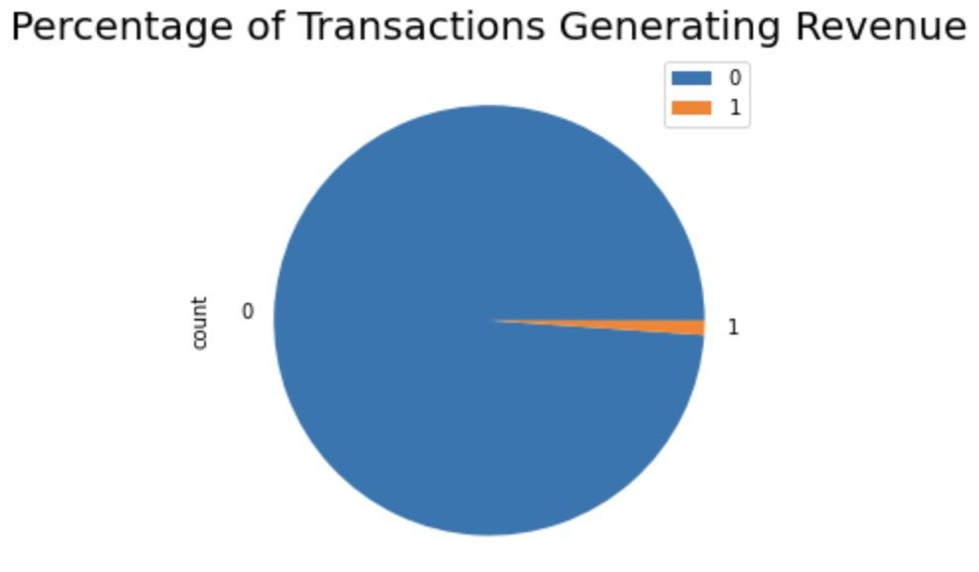
Exploratory Data Analysis
Project Goals
Data Preprocessing
Exploratory Data Analysis
Exploratory Data Analysis
Modeling & Future Plans
Notes:
created a new column - whether this store visit generated a transaction or not

Slide 10
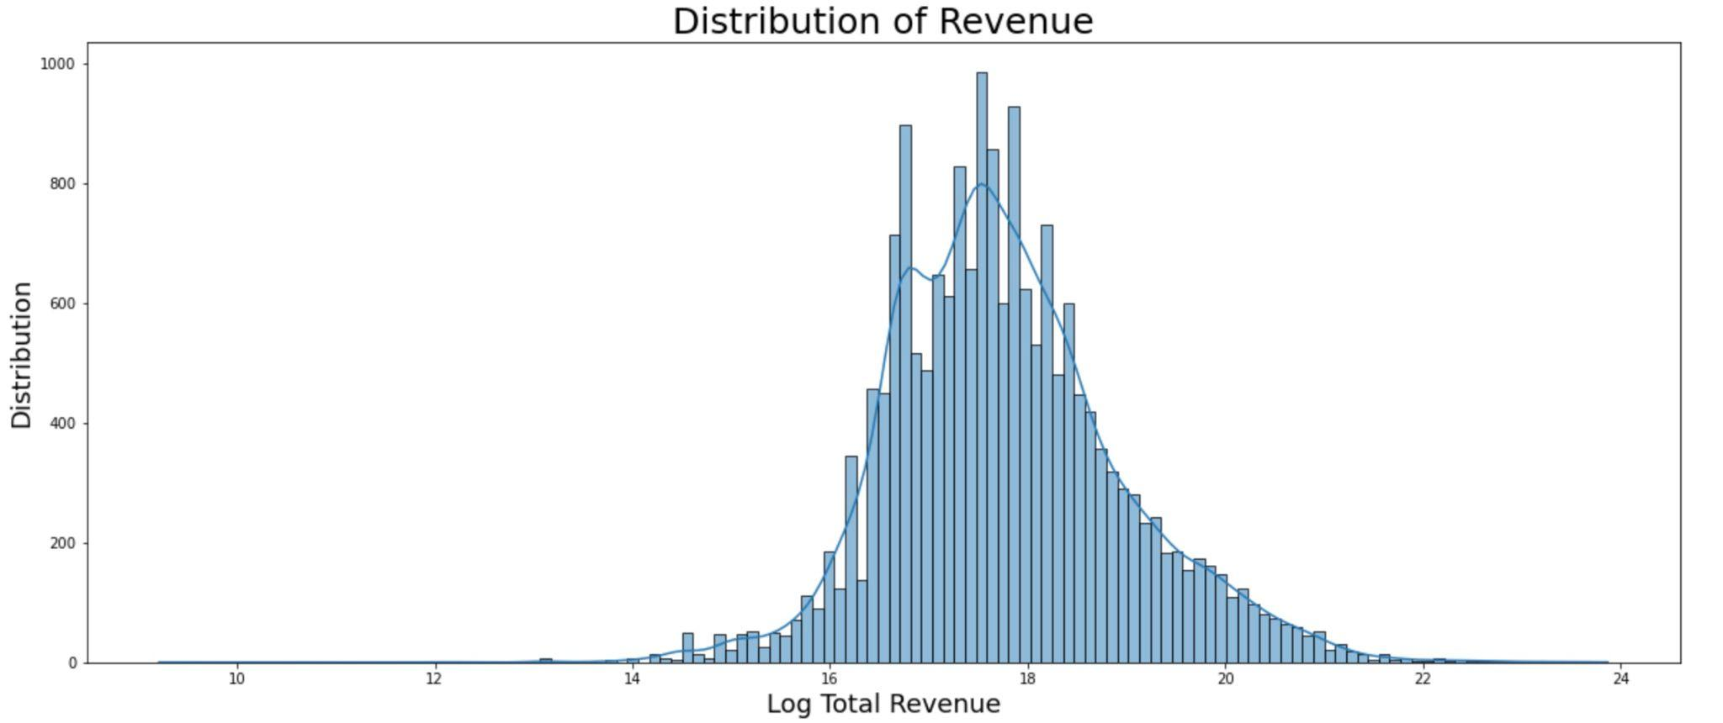
Exploratory Data Analysis
Project Goals
Data Preprocessing
Exploratory Data Analysis
Modeling & Future Plans

Slide 11
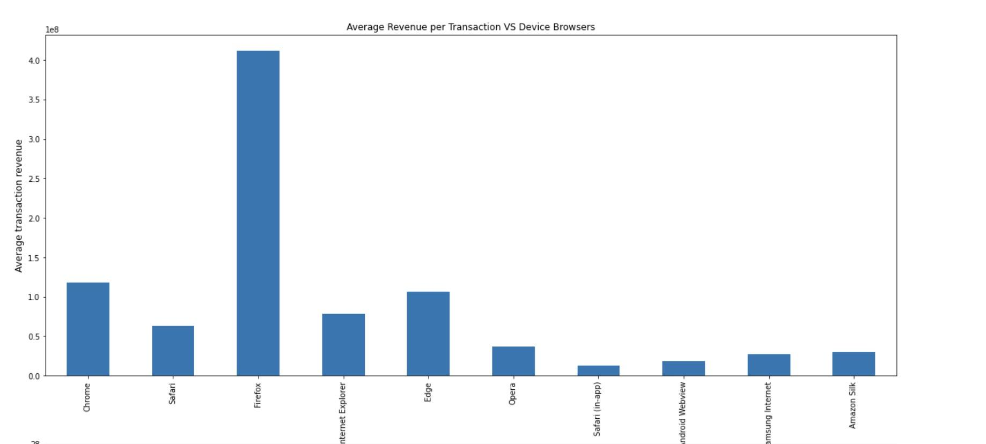
EDA - Revenue vs Device Browser
Project Goals
Data Preprocessing
Exploratory Data Analysis
Exploratory Data Analysis
Modeling & Future Plans

Slide 12
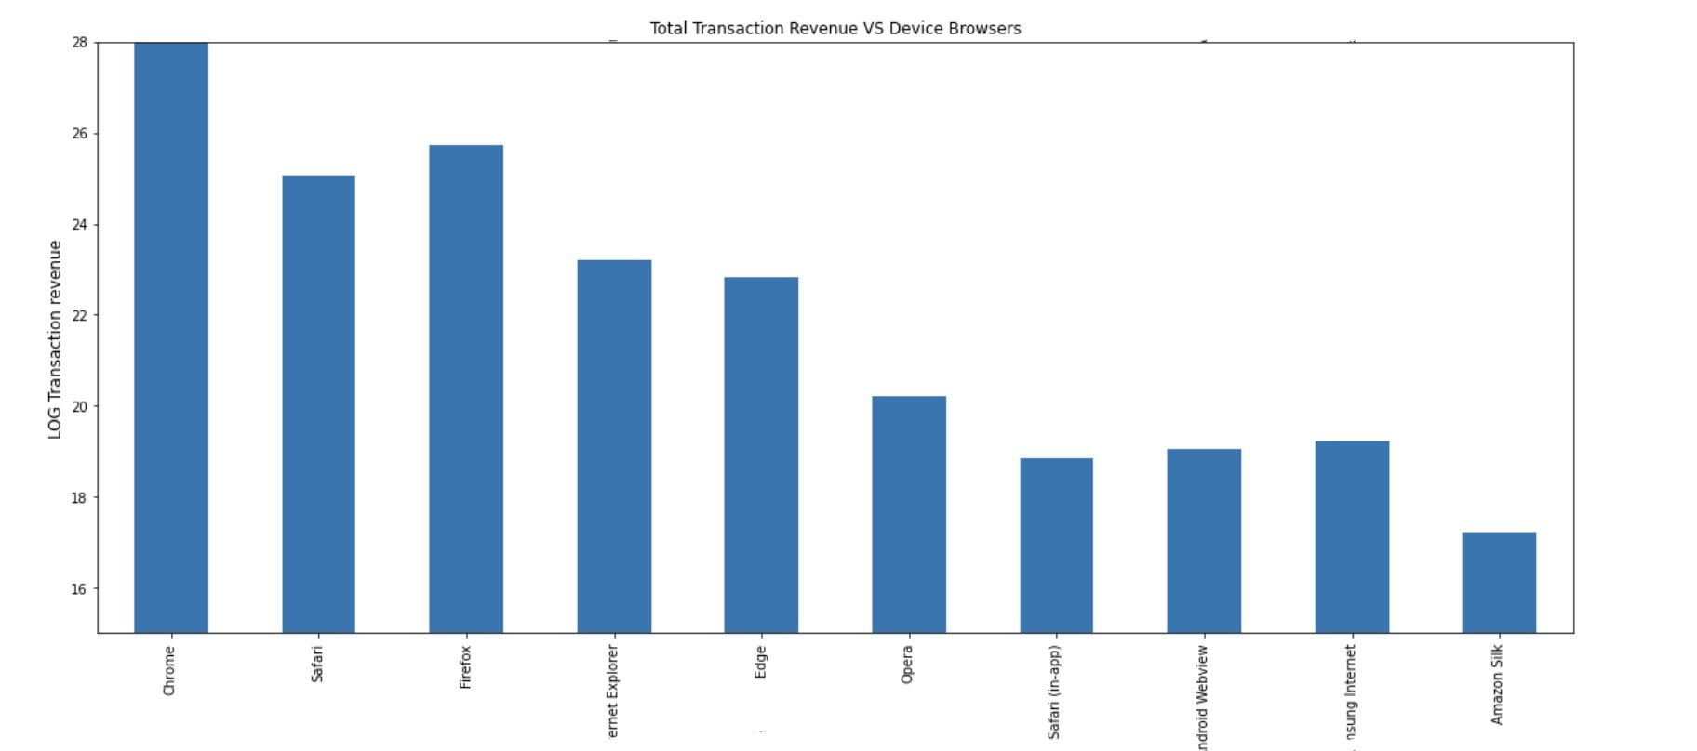
EDA - Revenue vs Device Browser
Project Goals
Data Preprocessing
Exploratory Data Analysis
Exploratory Data Analysis
Modeling & Future Plans

Slide 13
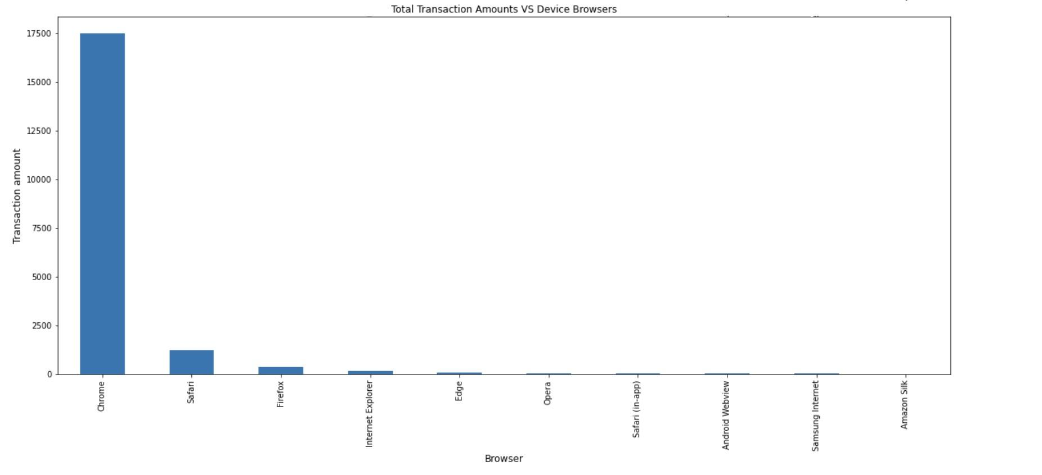
EDA - Revenue vs Device Browser
From the above 3 graphs:
Chrome generates highest transaction revenue with most transactions
Firefox generates highest avg rev per transaction
Project Goals
Data Preprocessing
Exploratory Data Analysis
Exploratory Data Analysis
Modeling & Future Plans
Notes:
We also have huge amount of information about the users’ browsers and devices. generally there seems to have strong relationship between the mean revenue and them (Fig. 3): visitors using chrome (which is the most popular browser) and firefox contributes to higher mean revenue, and visitors using Mac have more power on purchasing compared to those using Windows. What’s more, most of the revenue came from desktop devices, though mobile device occupied a quarter of all visits. (我们只做了browser的比较？）

Slide 14
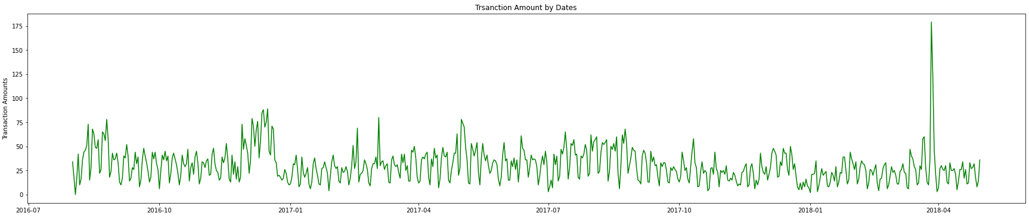
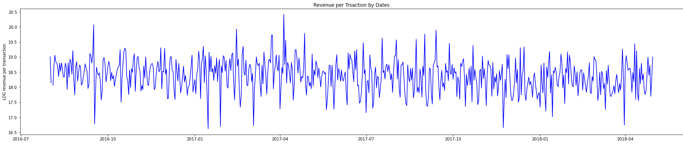
EDA - Trsanction Amount by Dates
Project Goals
Data Preprocessing
Exploratory Data Analysis
Exploratory Data Analysis
Modeling & Future Plans

Slide 15
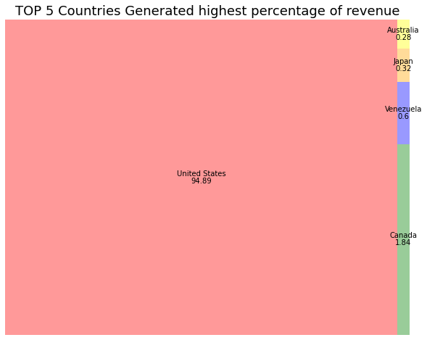
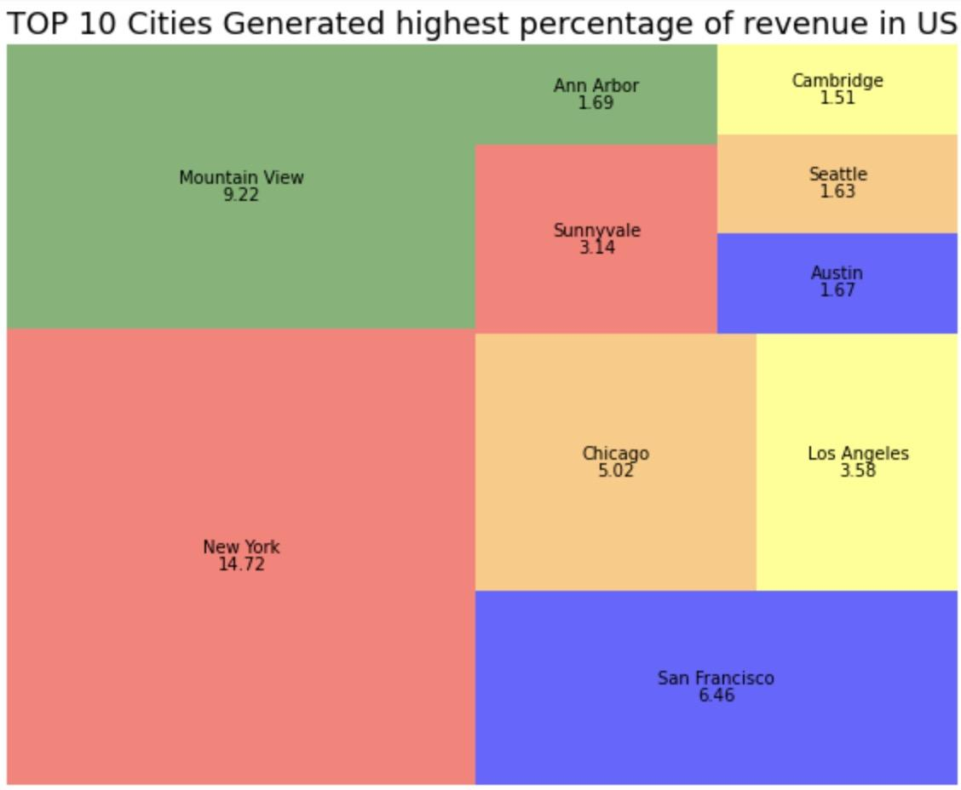
Exploratory Data Analysis
US generated most revenue transactions among all countries
Project Goals
Data Preprocessing
Exploratory Data Analysis
Modeling & Future Plans
Notes:
We can divide all visitors by their country information(Fig. 4). It shows that revenue came from all continents, with US having the highest total amount. Also, most of the hits came from US, showing the main market of Google Store is actually US rather than the whole world. Therefore the information of country might be useful in prediction revenue, but we are not sure about it.

Slide 16
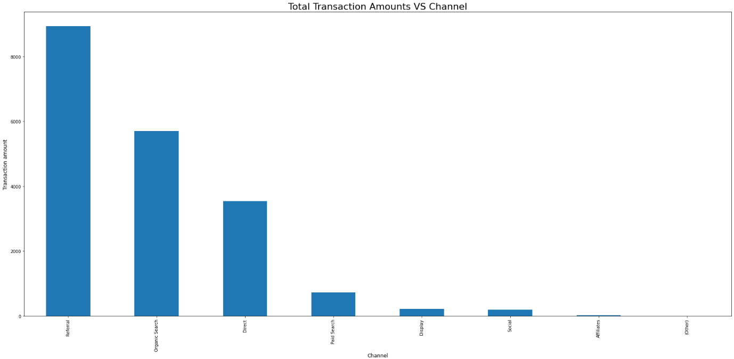
EDA - Revenue vs Channel Groups
Project Goals
Data Preprocessing
Exploratory Data Analysis
Modeling & Future Plans

Slide 17
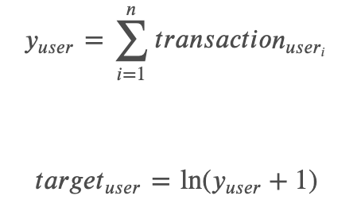

Model Preparation
Encoding categorical features
Drop columns highly correlated with target (totals.transactions)
Split train dataset to train and validation data based on time
Visits happened before 2017/12/31 -> Train
Visits happened after 2017/12/31 -> Validation
Adjust test dataset features to match train dataset
Ready to use data: 22 columns
Project Goals
Data Preprocessing
Exploratory Data Analysis
Modeling & Future Plans

Slide 18

Modelling
Linear Regression (Ridge regression)
Random Forest Regression
LGBMRegressor
XGBRegressor
Ensamble (LGBMRegressor + XGBRegressor)
Multi Layer Neural Network Architecture
Project Goals
Data Preprocessing
Exploratory Data Analysis
Modeling & Future Plans

Slide 19
Model Comparison
Ridge Regression
Random Forest
LGBM
XGBM
RF+LGBM+XGBM
LSTM
Train-MSE
NA
2.801
2.410
2.456
2.415
2.451
Test-MSE
3.521
2.813
3.039
3.095
3.026
3.062
Time
57 s
659s
<5s
8s
~600s
~650s
Project Goals
Data Preprocessing
Exploratory Data Analysis
Modeling & Future Plans

Slide 20
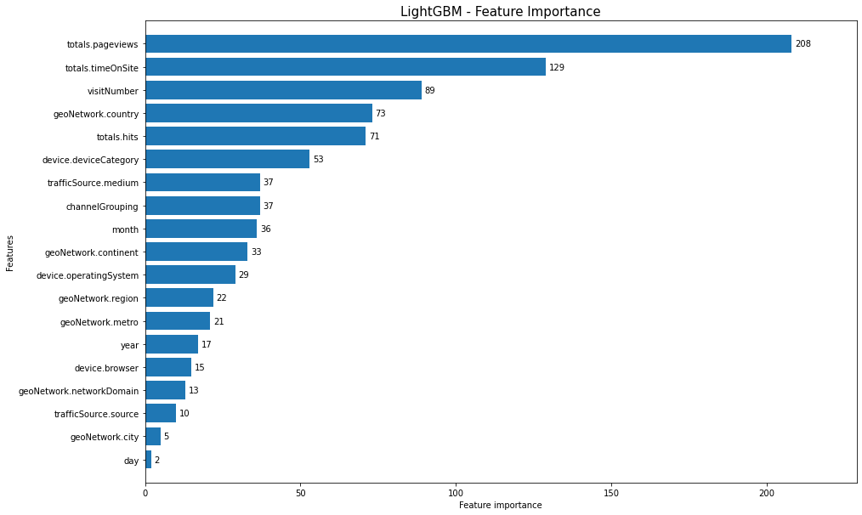
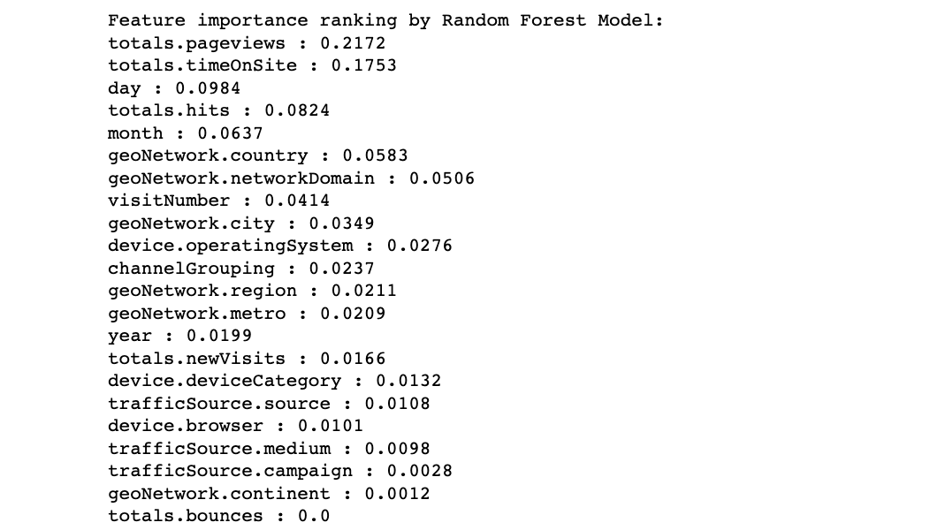
Feature Importance Comparison
Hyperparameter tuning using GridSearch to find best parameters:
Learning rate: 0.05
# of estimators: 50
# of iterations: 150
Project Goals
Data Preprocessing
Exploratory Data Analysis
Modeling & Future Plans

Slide 21
Next Steps
Re-fit the models after implementing feature selection
Try implementing different neural networks and to obtain result with better prediction accuracy
Try improve model performance by parameter tuning
Combine best performing models to run ensemble learning algorithms
Take consideration of relationships between visits (same visitor_id)
group by visitor_id or other customer information
Project Goals
Data Preprocessing
Exploratory Data Analysis
Modeling & Future Plans
Modeling & Future Plans
Notes:
So far, we assumed that all visits are independent and not considering relationships between visitors. In reality, a customer might explore what he or she wants to buy on the phone but then order the items by using a laptop. We can group people by their visitor_id or other information and takes these visits as one visit (or one transaction)
From blog:
Using the mixed model we can predict the log revenue with an average error of about 1, considering zero revenue visits behavior and non-zero ones are highly separative.
However, it is still hard to specifically tell how much money they will spend, since we know nothing about what they are looking for. Google now provides a new version of the data set, which contains what items visitors look through and how long they stay at each page.
On the other hand, in this study we assumed that all visits are independent and not considering relationships between visitors. For example, one might explore what he wanted to buy on his smartphone but then order by using his desktop. We can group people by their visit start time, visitor id and other information, and then consider these visits as one visit. That may help to build better predicting model.
Finally, people always wish to get prediction on what people will do rather than what they are doing. We can do further study on using existed data to predict the revenue that one customer will made in the future months. In this way Google can draft different advertising price to better serve the customers and merchants, which makes a win-win business.

Slide 22
Thank you for Listening!
Any Questions?
Project Goals
Data Preprocessing
Exploratory Data Analysis
Modeling & Future Plans

