Slide 1
Computational Fluid Dynamics
Week 2
Parallel Computing Lab.
Mechanical Engineering
Hanyang University

Slide 2

PARTIAL DIFFERNTIAL EQUATION
ODE | PDE
$$u(x)$$ | $$u(x,y,z)$$
LINEAR
PARTIAL DIFFERNTIAL EQUATION
NON-LINEAR

Slide 3

PARTIAL DIFFERNTIAL EQUATION
2nd order quasi-linear PDE
$$A\frac{∂^{2}φ}{∂x^{2}}+B\frac{∂^{2}φ}{∂x∂y}+C\frac{∂^{2}φ}{∂y^{2}}+D\frac{∂φ}{∂x}+E\frac{∂φ}{∂y}+Fφ=G$$
Elliptic eqn | Parabolic eqn | Hyperbolic eqn

Slide 4
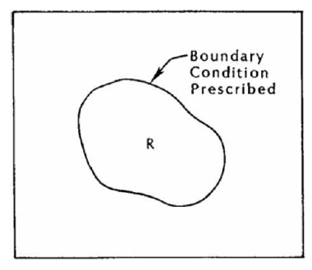
ELLIPTIC EQUATION
Laplace’s equation
Solution to Laplace equation is harmonic function
Steady state

Slide 5
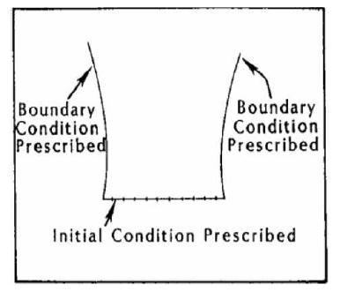
PARABOLIC EQUATION
Unsteady heat equation

Slide 6
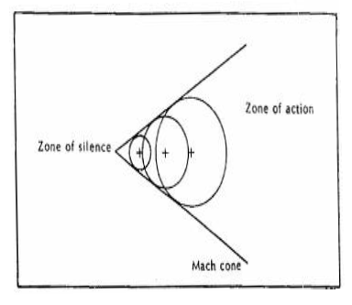
HYPERBOLIC EQUATION
Second-order wave equation

Slide 7
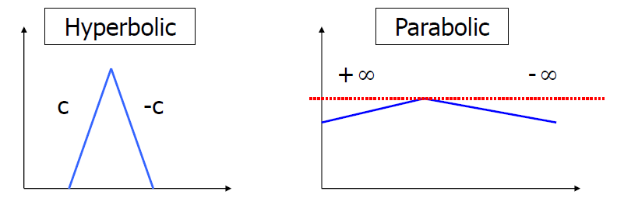
PARTIAL DIFFERNTIAL EQUATIONS
 | Hyperbolic | Parabolic | Elliptic
Type of problem | Evolution | Evolution | Equilibrium
Characteristic | Real |  | No real

Slide 8
HW #2
Steady state, Incompressible Navier-Stokes eqn이 선형인지 비선형인지. 그 이유도 같이.
Steady state, Incompressible Navier-Stokes eqn이 세가지 편미분 방정식 중 어디에 속하는지 조사.
※ 과제 및 코드 주소 : github.com/Yusmos/Yusmos

