Slide 1
Computational Fluid Dynamics
Week 3
Parallel Computing Lab.
Mechanical Engineering
Hanyang University

Slide 2
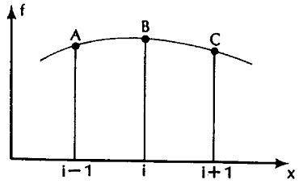


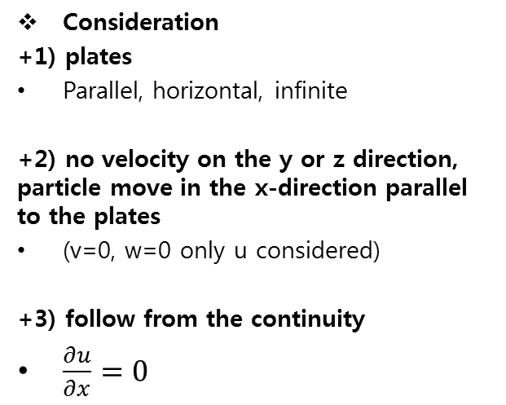



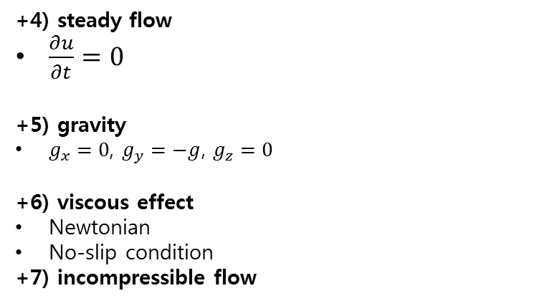

FINITE DIFFERENCE
Taylor Series
Forward difference
$$\frac{∂f}{∂x}=\frac{f_{i+1}−f_{i}}{Δx}+O\left(Δx\right)$$
$$\frac{∂^{2}f}{∂x^{2}}=\frac{f_{i+2}−2f_{i+1}+f_{i}}{{\left(Δx\right)}^{2}}+O\left(Δx\right)$$
Backward difference
$$\frac{∂f}{∂x}=\frac{f_{i}−f_{i−1}}{Δx}+O\left(Δx\right)$$
Taylor series expansion
$$\frac{∂^{2}f}{∂x^{2}}=\frac{f_{i−2}−2f_{i−1}+f_{i}}{{\left(Δx\right)}^{2}}+O\left(Δx\right)$$
$$f\left(x+Δx\right)=f\left(x\right)+\left(Δx\right)\frac{∂f}{∂x}+\frac{{\left(Δx\right)}^{2}}{2!}\frac{∂^{2}f}{∂x^{2}}+\frac{{\left(Δx\right)}^{3}}{3!}\frac{∂^{3}f}{∂x^{3}}+…$$
$$\frac{∂f}{∂x}=\frac{\left.f(x+Δx)−f(x\right)}{Δx}−\frac{\left(Δx\right)}{2!}\frac{∂^{2}f}{∂x^{2}}−\frac{{\left(Δx\right)}^{2}}{3!}\frac{∂^{3}f}{∂x^{3}}−...$$
Central difference
$$\frac{∂f}{∂x}=\frac{f_{i+1}−f_{i−1}}{2Δx}+O\left(Δx^{2}\right)$$
$$\frac{∂f}{∂x}=\frac{\left.f(x+Δx)−f(x\right)}{Δx}+O\left(Δx\right)$$
$$\frac{∂^{2}f}{∂x^{2}}=\frac{f_{i+1}−2f_{i}+f_{i−1}}{{\left(Δx\right)}^{2}}+O{\left(Δx\right)}^{2}$$
$${\frac{∂f}{∂x}|}_{i}=\frac{f_{i+1}−f_{i}}{Δx}+O(Δx)$$

Slide 3




PARABOLIC EQUATION – DIFFUSION EQUATION
Diffusion equation
$$\frac{∂u}{∂t}=ν\frac{∂^{2}u}{∂y^{2}}$$
FTCS - Explicit
$$\frac{∂u}{∂t}=\frac{u_{i}^{n+1}−u_{i}^{n}}{Δt}$$
$$ν\frac{∂^{2}u}{∂y^{2}}=ν\frac{u_{i+1}^{n}−2u_{i}^{n}+u_{i−1}^{n}}{{\left(Δy\right)}^{2}}$$
$$\frac{u_{i}^{n+1}−u_{i}^{n}}{Δt}=ν\frac{u_{i+1}^{n}−2u_{i}^{n}+u_{i−1}^{n}}{{\left(Δy\right)}^{2}}$$
$$d=\frac{νΔt}{{(Δy)}^{2}}$$
$$u_{i}^{n+1}=du_{i+1}^{n}+\left(1−2d\right)u_{i}^{n}+du_{i−1}^{n}$$
$($Forward Time)
$($Central Space)
(diffusion number)

Slide 4



PARABOLIC EQUATION – DIFFUSION EQUATION
Diffusion equation
$$\frac{∂u}{∂t}=ν\frac{∂^{2}u}{∂y^{2}}$$
FTCS – Implicit
$$\frac{∂u}{∂t}=\frac{u_{i}^{n+1}−u_{i}^{n}}{Δt}$$
$$ν\frac{∂^{2}u}{∂y^{2}}=ν\frac{u_{i+1}^{n+1}−2u_{i}^{n+1}+u_{i−1}^{n+1}}{{\left(Δy\right)}^{2}}$$
$$\frac{u_{i}^{n+1}−u_{i}^{n}}{Δt}=ν\frac{u_{i+1}^{n+1}−2u_{i}^{n+1}+u_{i−1}^{n+1}}{{\left(Δy\right)}^{2}}$$
$$d=\frac{νΔt}{{(Δy)}^{2}}$$
$$\left(1+2d\right)u_{i}^{n+1}−d(u_{i+1}^{n+1}+u_{i−1}^{n+1})=u_{i}^{n}$$
$($Forward Time)
$($Central Space)
(diffusion number)

Slide 5
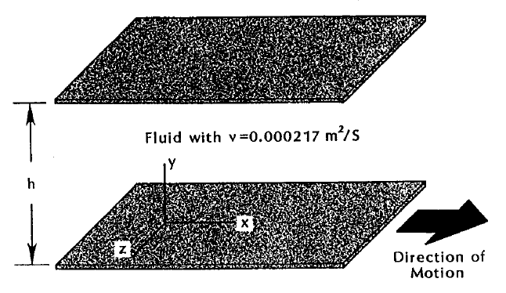

APPLICATION
$$\frac{∂u}{∂t}=ν\frac{∂^{2}u}{∂y^{2}}$$
$$∆t=0.000001s$$
$$∆y=0.001m$$
$$U_{0}=40m/s$$
$$d=\frac{ν∆t}{{∆y}^{2}}=ν$$

Slide 6

FTCS – Explicit
$ν=0.5m^{2}/s$
$d=\left(\frac{ν∆y}{{∆y}^{2}}\right)=0.5$
Stable

Slide 7
FTCS – Implicit
$ν=0.5m^{2}/s$
$d=\left(\frac{ν∆y}{{∆y}^{2}}\right)=0.5$
Stable

Slide 8

FTCS – Explicit
$ν=0.502m^{2}/s$
$d=\left(\frac{ν∆y}{{∆y}^{2}}\right)=0.502$
Unstable

Slide 9

FTCS – Implicit
$ν=0.502m^{2}/s$
$d=\left(\frac{ν∆y}{{∆y}^{2}}\right)=0.502$
Stable

Slide 10
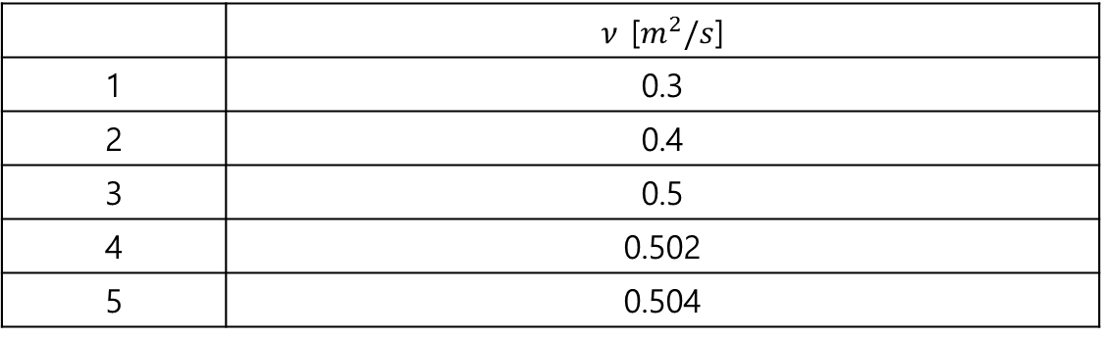

H/W #3
$$\frac{∂u}{∂t}=ν\frac{∂^{2}u}{∂y^{2}}$$
위 식을 차분할 수 있는 여러가지 방법들을 조사해볼 것
아래 표 각각의 Case에 대하여 FTCS와 Lassonen(FTCS – implicit)을 이용한 각각의 결과를 plot하고 고찰할 것
 | $ν$ [$m^{2}/s$]
1 | 0.3
2 | 0.4
3 | 0.5
4 | 0.502
5 | 0.504

