Slide 1
Computational Fluid Dynamics
Week 5
Parallel Computing Lab.
Mechanical Engineering
Hanyang University

Slide 2

HYPERBOLIC EQUATIONS(LINEAR PROBLEM)
$$\frac{∂u}{∂t}=−a\frac{∂u}{∂x} a=250[\frac{m}{s}]$$
Initial Condition
$\left\{\begin{matrix}u\left(x,0\right)=0.0 & 0≤x≤50 \\ u\left(x,0\right)=100\sin\left[π\frac{x−50}{60}\right] & 50≤x≤110 \\ u\left(x,0\right)=0.0 & 110≤x≤400\end{matrix}\right.$
Boundary Condition
$at x=0, u\left(0,t\right)=0$
$at x=L, u\left(L,t\right)=0$
CFL Condition
$c=a\frac{Δt}{Δx}$
Compute Condition
(1) $∆x=5.0, ∆t=0.02 →c=1$
(2) $∆x=5.0, ∆t=0.01 →c=0.5$
(3) $∆x=5.0, ∆t=0.005 →c=0.25$

Slide 3
HYPERBOLIC PDE - First upwind
C=1
C=0.25
$\frac{u_{i}^{n+1}−u_{i}^{n}}{∆t}=−a\frac{u_{i}^{n}−u_{i−1}^{n}}{∆x}$

Slide 4
HYPERBOLIC PDE – The Lax method
C=1
C=0.25
$\frac{u_{i}^{n+1}−\frac{1}{2}\left(u_{i+1}^{n}+u_{i−1}^{n}\right)}{∆t}=−a\frac{u_{i+1}^{n}−u_{i−1}^{n}}{2∆x}$

Slide 5
HYPERBOLIC PDE – The Lax Wendroff
C=1
C=0.25
$u_{i}^{n+1}=u_{i}^{n}−a∆t\left[\frac{u_{i+1}^{n}−u_{i−1}^{n}}{2∆x}\right]+\frac{1}{2}a^{2}{\left(∆t\right)}^{2}\left[\frac{u_{i+1}^{n}−2u_{i}^{n}+u_{i−1}^{n}}{{\left(∆x\right)}^{2}}\right]$

Slide 6
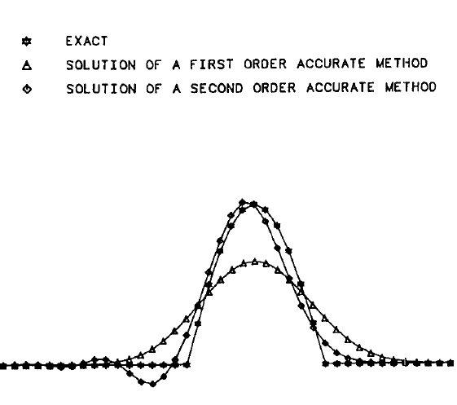
ERROR ANALYSIS
Odd number order
: dissipation error
Even number order
: dispersion error

Slide 7

HYPERBOLIC EQUATIONS(NON-LINEAR PROBLEM)
$$\frac{∂u}{∂t}=−u\frac{∂u}{∂x}$$
Initial Condition
$\left\{\begin{matrix}u\left(x,0\right)=1.0 & 0≤x≤2.0 \\ u\left(x,0\right)=0.0 & 2.0≤x≤4.0\end{matrix}\right.$
CFL Condition
$c=\left|u_{max}\frac{Δt}{Δx}\right|$
Compute Condition
(1) $∆x=0.1, ∆t=0.1 →c=1$
(2) $∆x=0.1, ∆t=0.05 →c=0.5$

Slide 8
HYPERBOLIC PDE – Explicit 1st Upwind
C=1
C=0.5
$\frac{u_{i}^{n+1}−u_{i}^{n}}{∆t}=−\frac{E_{i}^{n}−E_{i−1}^{n}}{∆x}, E=\frac{u^{2}}{2}$

Slide 9
HYPERBOLIC PDE - The Lax method
C=1
C=0.5
$\frac{u_{i}^{n+1}−u_{i}^{n}}{∆t}=−\frac{E_{i+1}^{n}−E_{i−1}^{n}}{2∆x},$

Slide 10
HYPERBOLIC PDE - The Lax-Wendroff
$u_{i}^{n+1}=u_{i}^{n}−\frac{Δt}{2Δx}\left(E_{i+1}^{n}−E_{i−1}^{n}\right)+{\left(\frac{Δt}{2Δx}\right)}^{2}\left[\left(u_{i+1}^{n}+u_{i}^{n}\right)\left(E_{i+1}^{n}−E_{i}^{n}\right)−\left(E_{i}^{n}−E_{i−1}^{n}\right)\left(u_{i+1}^{n}+u_{i−1}^{n}\right)\right]$
C=1
C=0.5

Slide 11
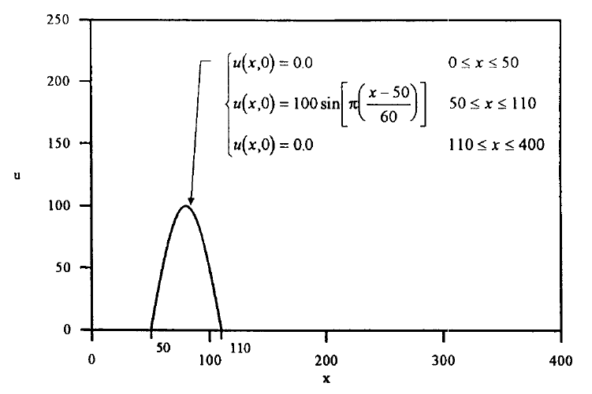

H/W #5
$$\frac{∂u}{∂t}=−a\frac{∂u}{∂x} a=250$$
Initial Condition
$\left\{\begin{matrix}u\left(x,0\right)=0.0 & 0≤x≤50 \\ u\left(x,0\right)=100\sin\left[π\frac{x−50}{60}\right] & 50≤x≤110 \\ u\left(x,0\right)=0.0 & 110≤x≤400\end{matrix}\right.$
Boundary Condition
$at x=0, u\left(0,t\right)=0$
$at x=L, u\left(L,t\right)=0$
CFL Condition
$c=a\frac{Δt}{Δx}$
Compute Condition
(1) $∆x=5.0, ∆t=0.02 →c=1$
(2) $∆x=5.0, ∆t=0.01 →c=0.5$
(3) $∆x=5.0, ∆t=0.005 →c=0.25$

