Slide 1
Computational Fluid Dynamics
Week 6
Parallel Computing Lab.
Mechanical Engineering
Hanyang University

Slide 2

INCOMPRESSIBLE N-S EQUATION
$ω−ψ$ function formulation

Slide 3
INCOMPRESSIBLE N-S EQUATION
Advantage
Velocity field
Pressure do not appear
Disadvantage
Only 2-dimensional
Boundary condition for vorticity

Slide 4
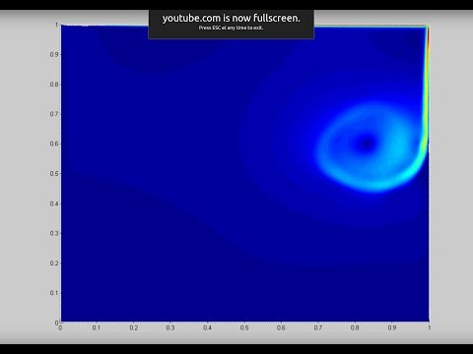
APPLICATION(CAVITY FLOW - FDM)

Slide 5
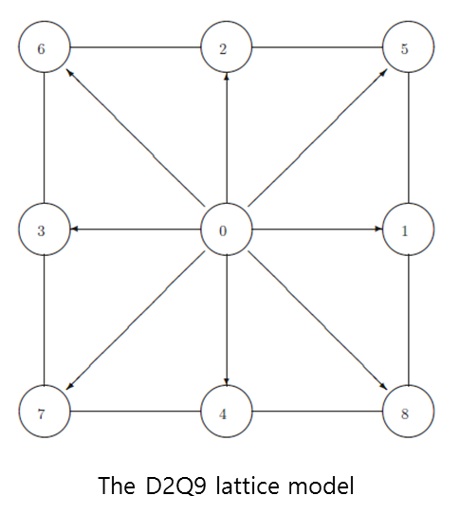
LATTICE BOLTZMANN METHOD(LBM)
Distribution function
streaming
collision
streaming
collision

Slide 6
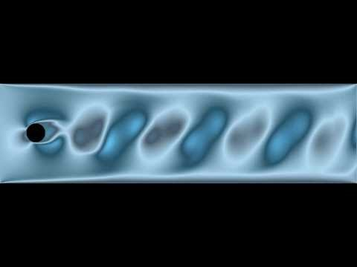
APPLICATION(CIRCULAR CYLINDER - LBM)

