Slide 1

CISB5123 TEXT ANALYTICS
OSCAR GROUP
Project Part 1
Data Collection & Preprocessing
Aisyah Azreena
IS01082893
Nurul Atiqah
IS01082926
PROJECT MEMBERS
Nur Syakila
IS01082922
Emier Imran
SN01083227
Athysya Roslan
IS01082956

Slide 2

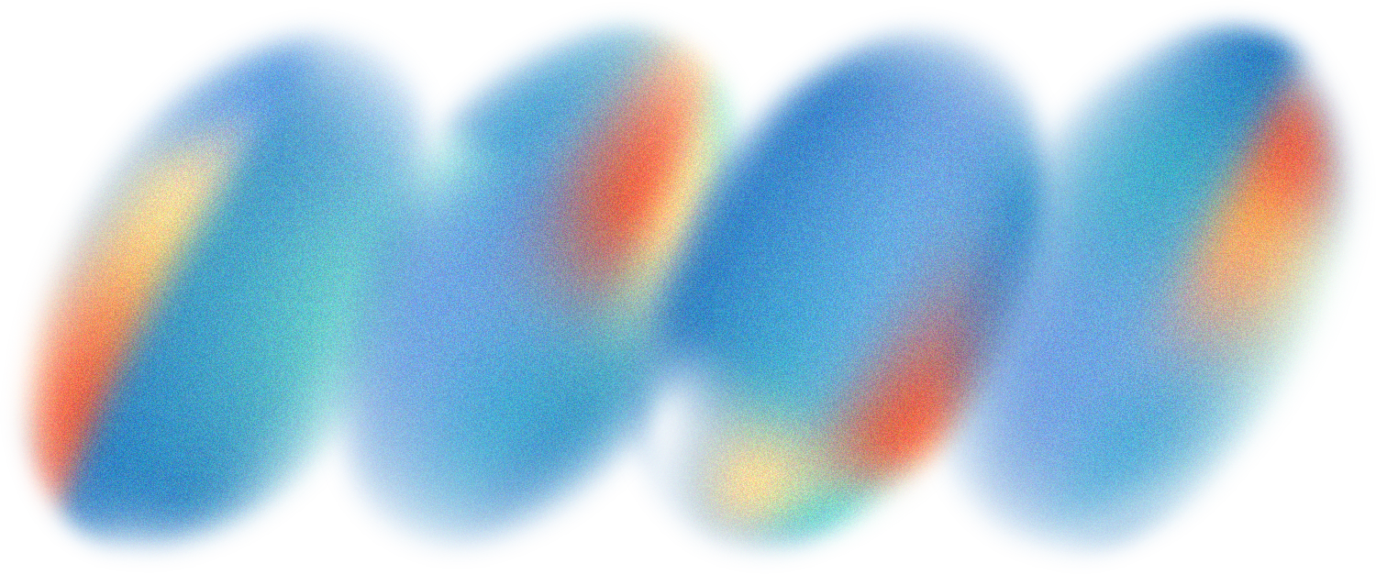
CISB5123 TEXT ANALYTICS
OSCAR GROUP
PROJECT SCOPE
Problem Statement :
Insights :
Data Source :
Ethical
Consideration :
to understand public sentiment toward Oscar-winning movies the last decade. This could help identify patterns in how critically acclaimed movies are received by general audiences.
Sentiment polarity for each movie
Compare sentiment trends across years
Spot sentiment shifts between critics and public review
public data but still consider user anonymity
avoid collecting personally identifiable info
respect IMDb's scraping rules
IMDb

Slide 3
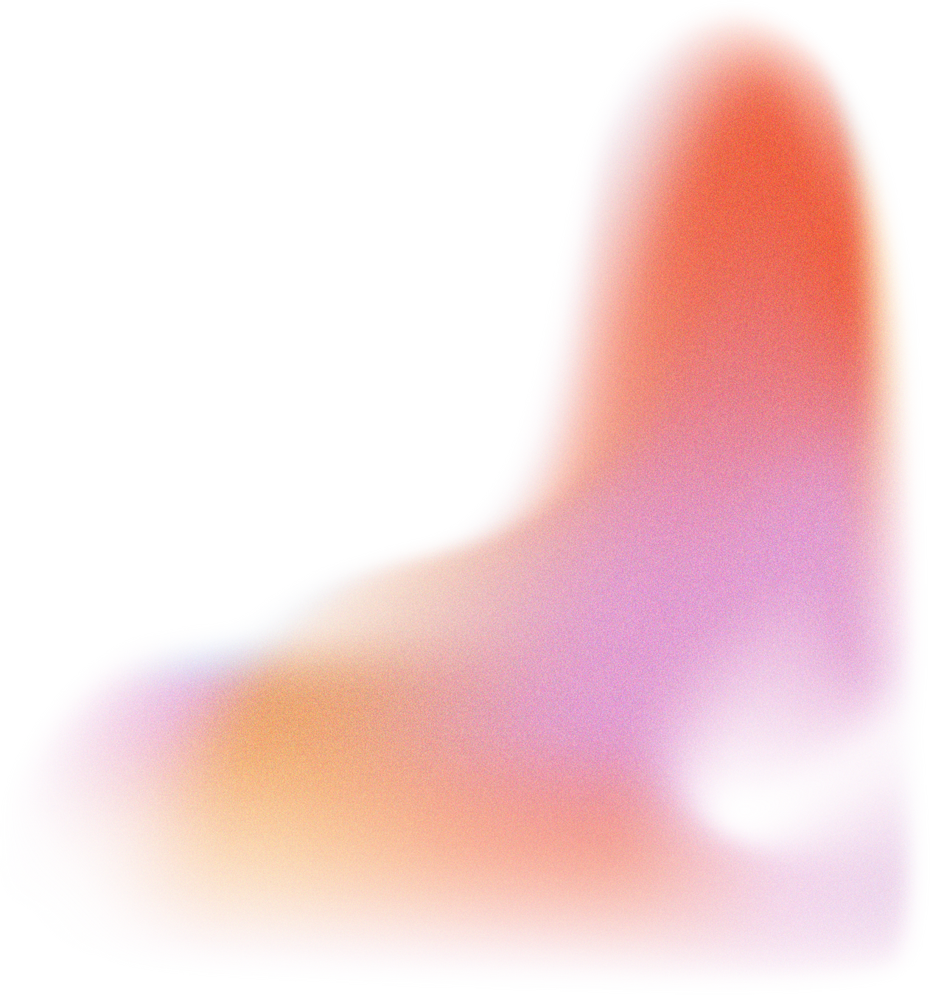

CISB5123 TEXT ANALYTICS
OSCAR GROUP
Data Insight
The data from this project is taken from a source named IMDb (Internet Movie Database).
It provides details regarding films, television shows, and video games.
In this project, reviews of Oscar-winning movies from 2015–2024 are scraped and analyzed to understand public sentiment
Among the 10 movies included are Oppenheimer, CODA, Poor Things, and several others
A total of 100 reviews are scraped for each movie

Slide 4
CISB5123 TEXT ANALYTICS
OSCAR GROUP
Pre - Processing Technique
Text Pre-processing Process
Unitize &
Tokenize
Standardize &
Cleanse
Stop Word
Removal
Stem &
Lemmatize
Sample Doc:
A review from the movie Oppenheimer 2023 :
I'm still collecting my thoughts after experiencing this film, Cillian Murphy might as well start clearing a space on his mantle for the Best Actor Oscar.This film is a masterclass in weaving narratives and different time periods while exploring the profound depths of a man whose actions altered the world's trajectory forever, for better or worse. Nolan brings us into the complexities of Oppenheimer, and all the moral conflicts stirring within him.Murphy's portrayal is so riveting that the long run-time became an afterthought. Robert Downey Jr also offers a great performance and Nolan's push and pull with how he uses sound design throughout is the cherry on top.Some viewers might need a brief refresher on WWII and Cold War history, but any film lover should be happy to willingly lose themselves in this film for hours on end.

Slide 5
CISB5123 TEXT ANALYTICS
Pre - Processing Technique
OSCAR GROUP
Text Pre-processing Process
Unitize &
Tokenize
Tokenized Documents:
[I'm] [still] [collecting] [my] [thoughts] [after] [experiencing] [this] [film] [,] [Cillian] [Murphy] [might] [as] [well] [start] [clearing] [a] [space] [on] [his] [mantle] [for] [the] [Best] [Actor] [Oscar] [.] [This] [film] [is] [a] [masterclass] [in] [weaving] [narratives] [and] [different] [time] [periods] [while] [exploring] [the] [profound] [depths] [of] [a] [man] [whose] [actions] [altered] [the] [world's] [trajectory] [forever] [,] [for] [better] [or] [worse] [.] [Nolan] [brings] [us] [into] [the] [complexities] [of] [Oppenheimer] [,] [and] [all] [the] [moral] [conflicts] [stirring] [within] [him] [.] [Murphy's] [portrayal] [is] [so] [riveting] [that] [the] [long] [run-time] [became] [an] [afterthought] [.] [Robert] [Downey] [Jr] [also] [offers] [a] [great] [performance] [and] [Nolan's] [push] [and] [pull] [with] [how] [he] [uses] [sound] [design] [throughout] [is] [the] [cherry] [on] [top] [.] [Some] [viewers] [might] [need] [a] [brief] [refresher] [on] [WWII] [and] [Cold] [War] [history] [,] [but] [any] [film] [lover] [should] [be] [happy] [to] [willingly] [lose] [themselves] [in] [this] [film] [for] [hours] [on] [end] [.]

Slide 6
CISB5123 TEXT ANALYTICS
Pre - Processing Technique
OSCAR GROUP
Text Pre-processing Process
Unitize &
Tokenize
Standardize &
Cleanse
During the standardize and cleanse process, the text is converted to lowercase, and URLs, HTML tags, contractions, punctuation, numbers, and emojis are removed. Slang words are also replaced with their formal equivalents, and spelling corrections are applied.
Standardize & Cleansed Document :
i am still collecting my thoughts after experiencing this film million murphy might as well start clearing a space on his mantle for the best actor oscar this film is a masterclass in weaving narratives and different time periods while exploring the profound depths of a man whose actions altered the worlds trajectory forever for better or worse nolan brings us into the complexities of oppenheimer and all the moral conflicts stirring within him murphys portrayal is so riveting that the long runtime became an afterthought robert downed jr also offers a great performance and nolan push and pull with how he uses sound design throughout is the cherry on topsome viewers might need a brief refresher on wwii and cold war history but any film lover should be happy to willingly lose themselves in this film for hours on end

Slide 7
CISB5123 TEXT ANALYTICS
Pre - Processing Technique
OSCAR GROUP
Text Pre-processing Process
Unitize &
Tokenize
Standardize &
Cleanse
Stop Word
Removal
Documents after stop word removal :
still collecting thoughts experiencing film million murphy might well start clearing space mantle best actor oscar this film masterclass weaving narratives different time periods exploring profound depths man whose actions altered worlds trajectory forever better worse nolan brings us complexities oppenheimer moral conflicts stirring within him murphys portrayal riveting long runtime became afterthought robert downed jr also offers great performance nolan push pull uses sound design throughout cherry topsome viewers might need brief refresher wwii cold war history film lover happy willingly lose film hours end

Slide 8
CISB5123 TEXT ANALYTICS
Pre - Processing Technique
OSCAR GROUP
Text Pre-processing Process
Unitize &
Tokenize
Standardize &
Cleanse
Stop Word
Removal
Stem &
Lemmatize
Stemming:
still collect thought experienc film million murphi might well start clear space mantl best actor oscarthi film masterclass weav narr differ time period explor profound depth man whose action alter world trajectori forev better wors nolan bring us complex oppenheim moral conflict stir within himmurphi portray rivet long runtim becam afterthought robert down jr also offer great perform nolan push pull use sound design throughout cherri topsom viewer might need brief refresh wwii cold war histori film lover happi willingli lose film hour end
Lemmatizing:
still collect thought experience film million murphy might well start clear space mantle best actor oscar this film masterclass weave narrative different time period explore profound depths man whose action alter world trajectory forever good bad nolan brings u complexity oppenheimer moral conflict stir within him murphys portrayal rivet long runtime become afterthought robert down jr also offer great performance nolan push pull use sound design throughout cherry top some viewer might need brief refresher wwii cold war history film lover happy willingly lose film hour end

Slide 9
CISB5123 TEXT ANALYTICS
OSCAR GROUP
Thank you

