Slide 1
Autoencoder
Soyeon Kim
Mar. 10th, 2020

Slide 2
Contents
Definition
What is autoencoder?
Types
Undercomplete autoencoder
Stacked(deep) autoencoder
Denoising autoencoder
Sparse autoencoder
Variational autoencoder
Denoising autoencoder
Code
Result

Slide 3
What is autoencoder?
Simply copies inputs to the output
Type of artificial neural network
Unsupervised learning
Encoder(recognition network) and decoder(generative network)
Dimensionality reduction
Ignore signal noise
Input data
Output data
encoder
decoder

Slide 4
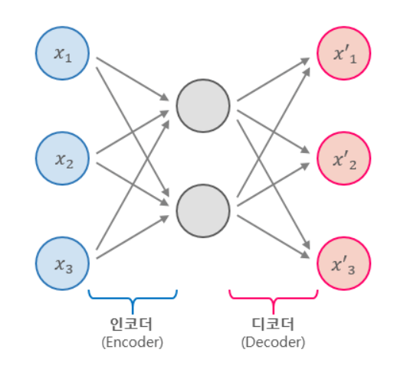
Undercomplete autoencoder
Hidden layer has lower dimension than input data
Learning the key feature of the input data (ignore the unimportant parts)
Input (3 dimension)
Output
2 dimension
Reference (image) – https://excelsior-cjh.tistory.com/187

Slide 5
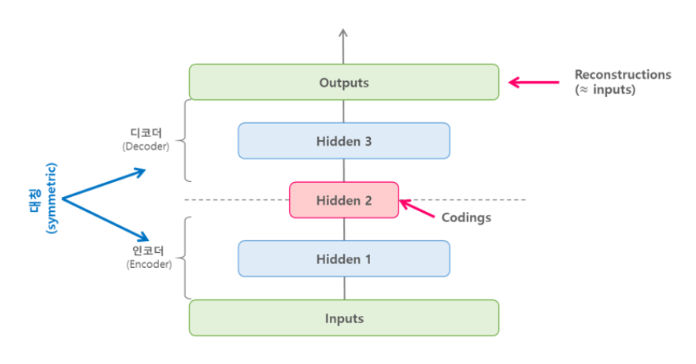
Stacked(deep) autoencoder
Has several hidden layer
Symmetric
Reference (image) – https://excelsior-cjh.tistory.com/187

Slide 6
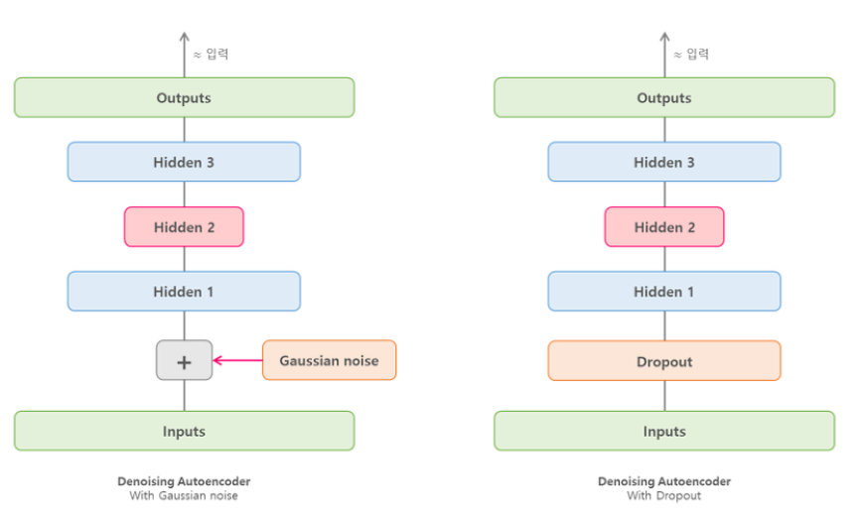
Denoising autoencoder
Add noise to input and reconstruct denoised original input
Gaussian noise, dropout
Reference (image) – https://excelsior-cjh.tistory.com/187

Slide 7
Sparse autoencoder
Using sparsity
Add appropriate terms to the loss function → Reduce activated neuron in coding layer

Slide 8
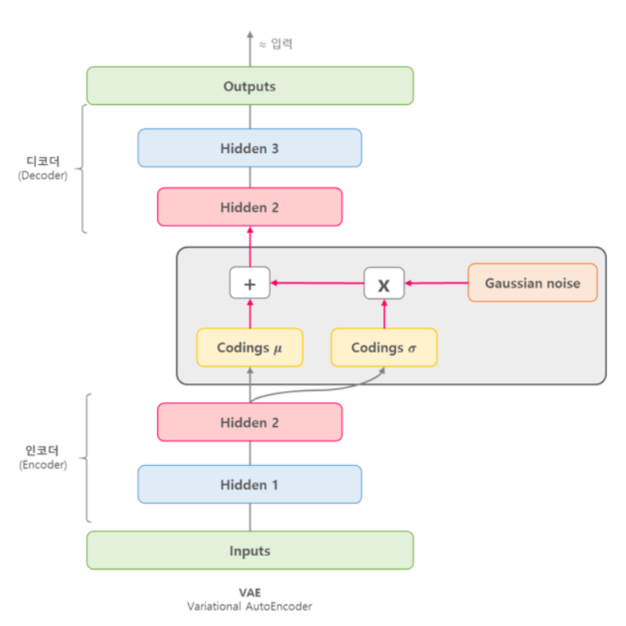
Variational autoencoder
Probabilistic autoencoder
Generative autoencoder
Reference (image) – https://excelsior-cjh.tistory.com/187

Slide 9
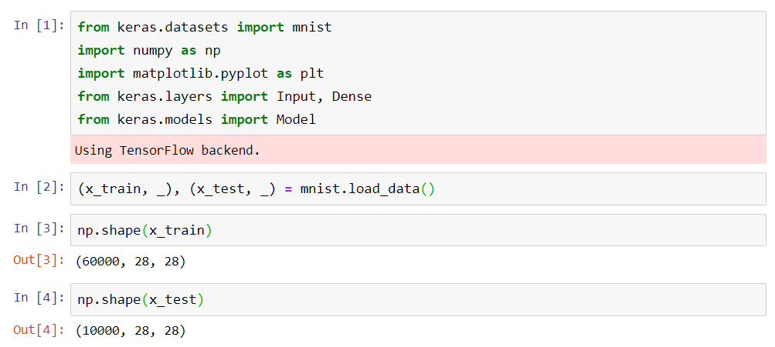
Denoising autoencoder – Code

Slide 10
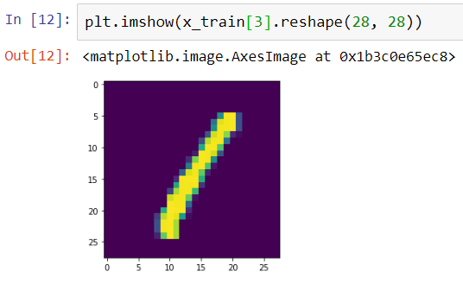
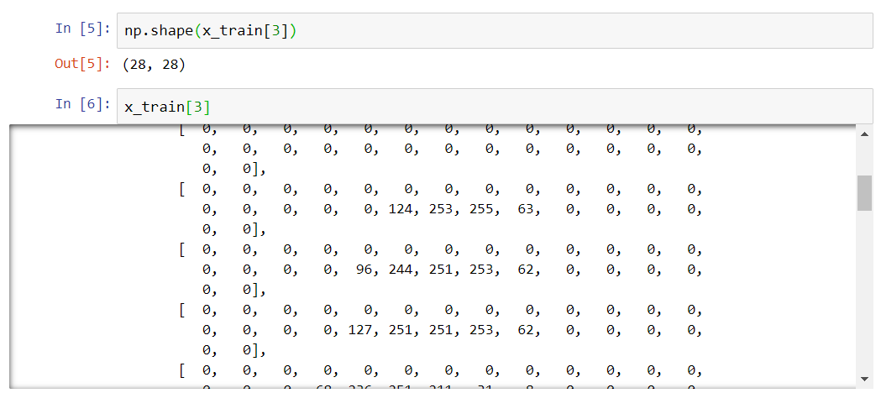
Denoising autoencoder – Code

Slide 11
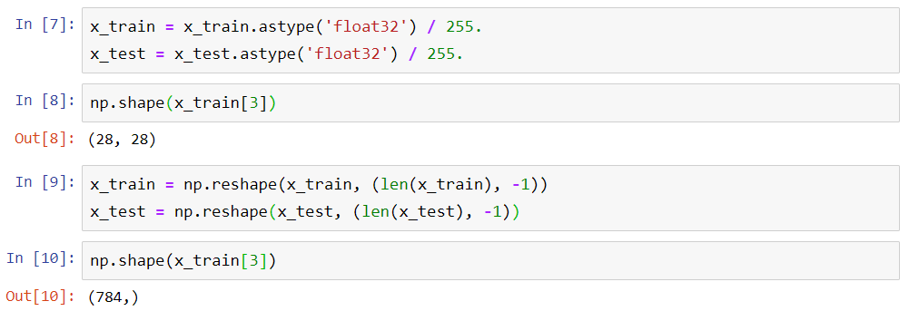
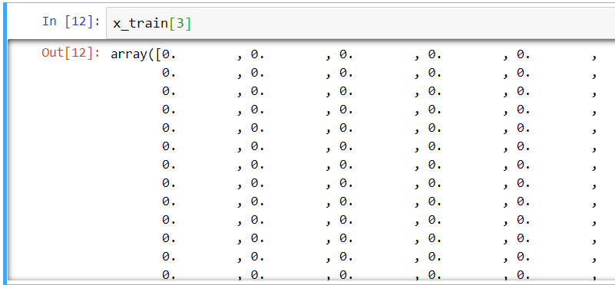
Denoising autoencoder – Code

Slide 12
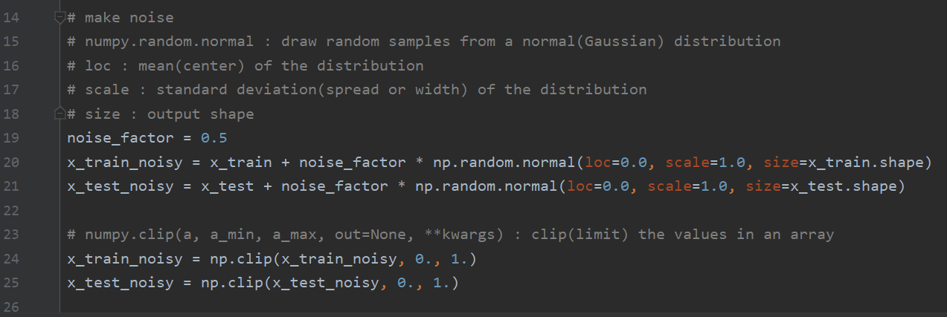
Denoising autoencoder – Code

Slide 13
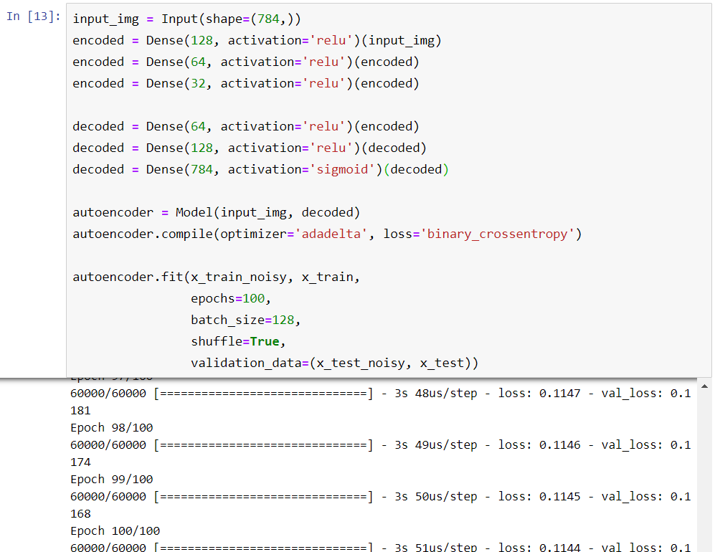
Denoising autoencoder – Code

Slide 14
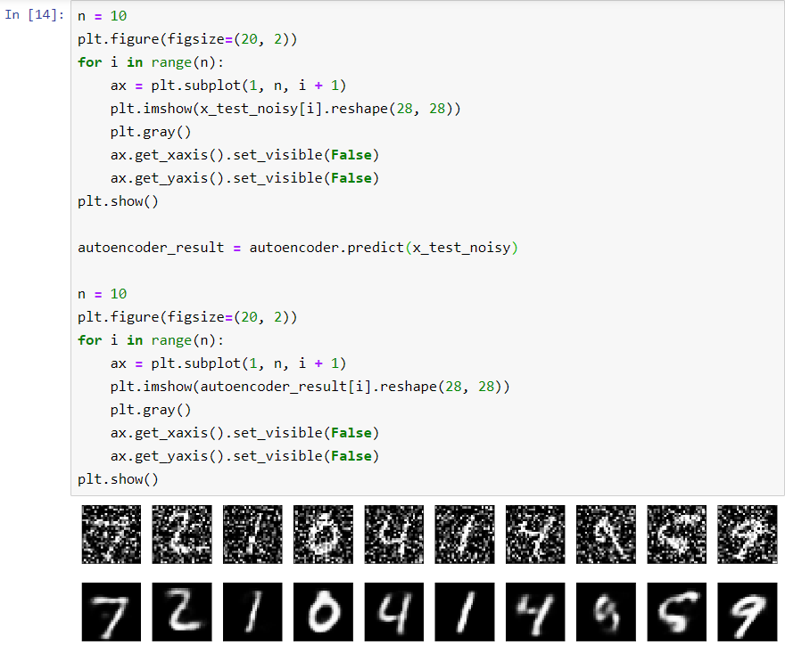
Denoising autoencoder – Code

Slide 15














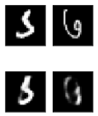
Denoising autoencoder – Result
Epochs = 100
Input : original data
Sequence : Original data → Autoencoder result

Slide 16
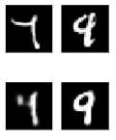

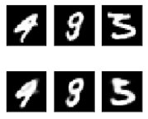

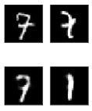







Denoising autoencoder – Result
Epochs = 100
Input : original data
Sequence : Original data → Autoencoder result

Slide 17
















Denoising autoencoder – Result
Epochs = 100
Input : original data
Sequence : Original data → Autoencoder result

Slide 18
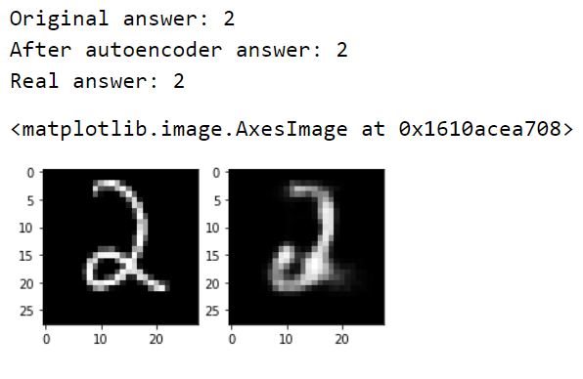
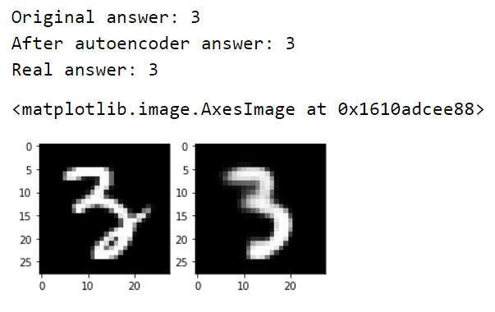
Denoising autoencoder – Result
Epochs = 100
Input : original data
Sequence : Original data → Autoencoder result

Slide 19
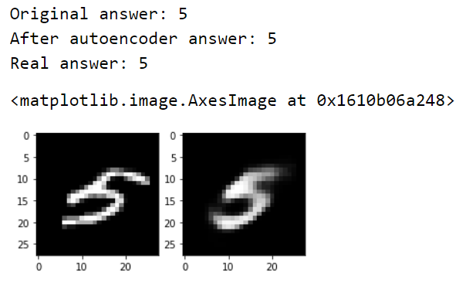
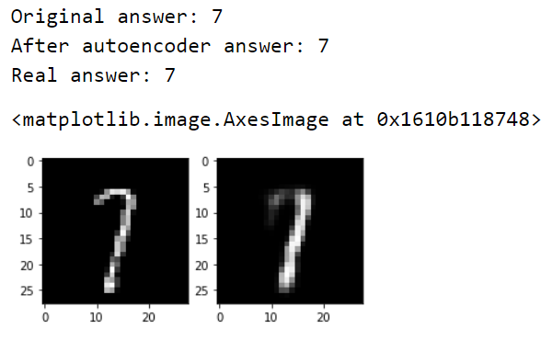
Denoising autoencoder – Result
Epochs = 100
Input : original data
Sequence : Original data → Autoencoder result

Slide 20
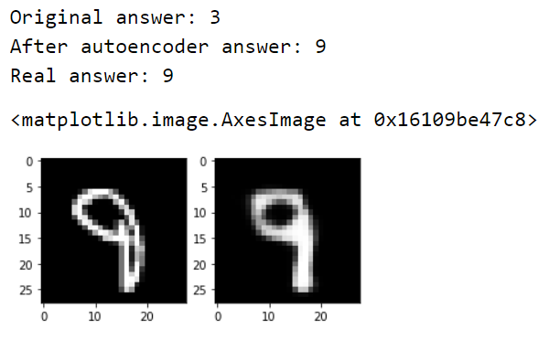
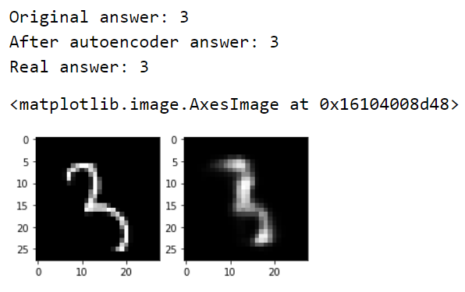
Denoising autoencoder – Result
Epochs = 100
Input : original data
Sequence : Original data → Autoencoder result

Slide 21
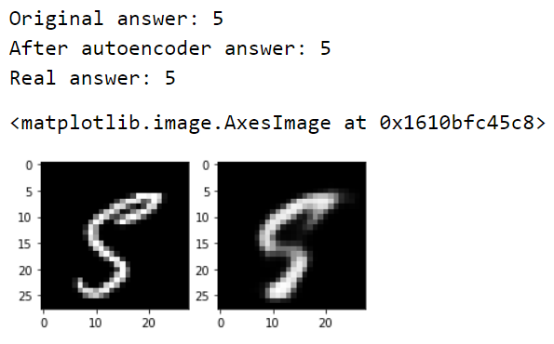
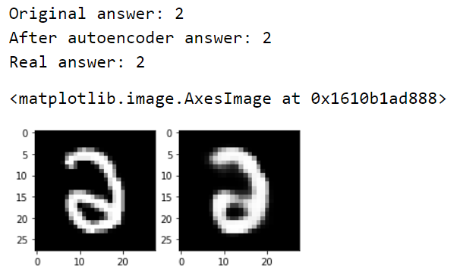
Denoising autoencoder – Result
Epochs = 100
Input : original data
Sequence : Original data → Autoencoder result

Slide 22
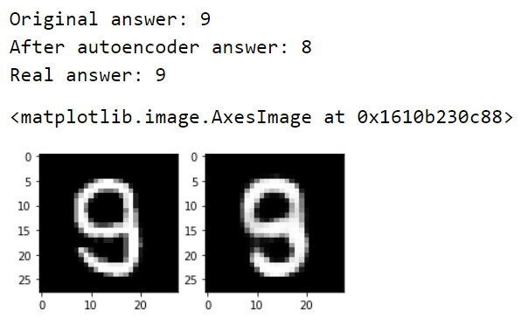
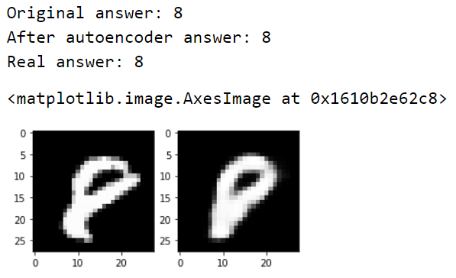
Denoising autoencoder – Result
Epochs = 100
Input : original data
Sequence : Original data → Autoencoder result

Slide 23
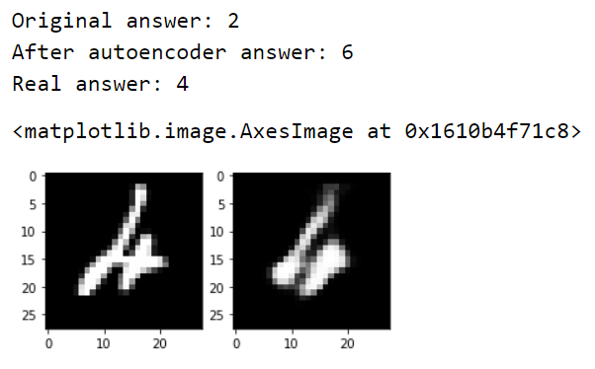
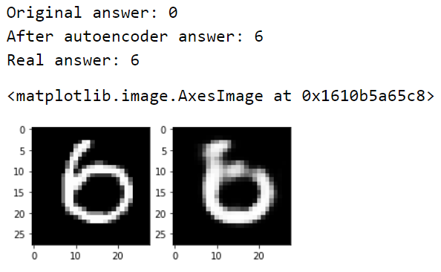
Denoising autoencoder – Result
Epochs = 100
Input : original data
Sequence : Original data → Autoencoder result

Slide 24
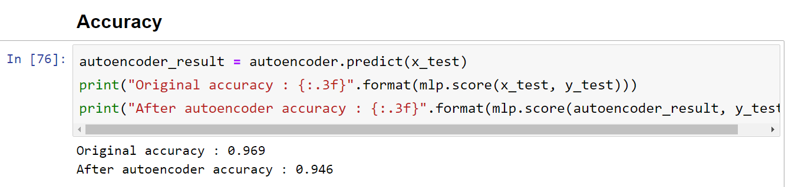
Denoising autoencoder – Result
Epochs = 100
(All test dataset)

Slide 25
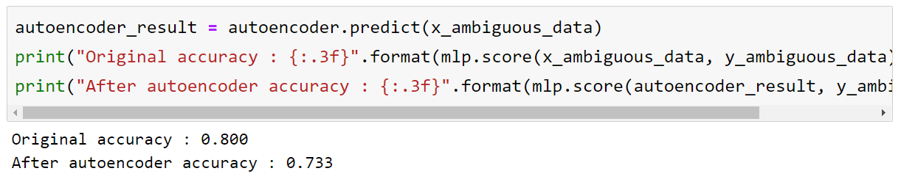
Denoising autoencoder – Result
Epochs = 100
(Small amount ambiguous data)

