Slide 1
ADZD PROJECT

Slide 2
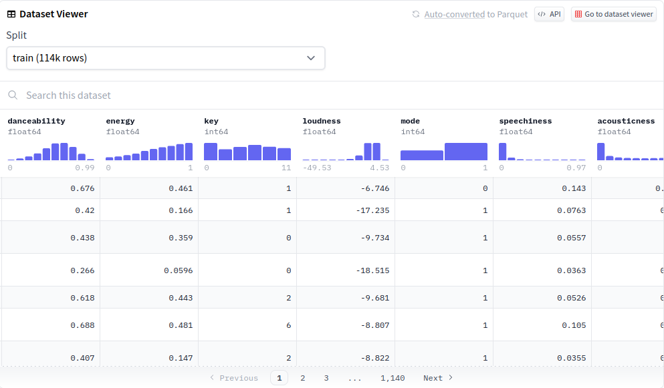
Dataset
https://huggingface.co/datasets/maharshipandya/spotify-tracks-dataset
114,000 songs with the same features

Slide 3
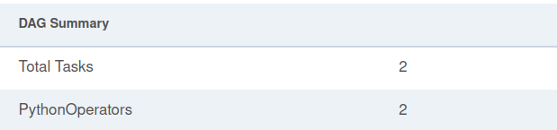
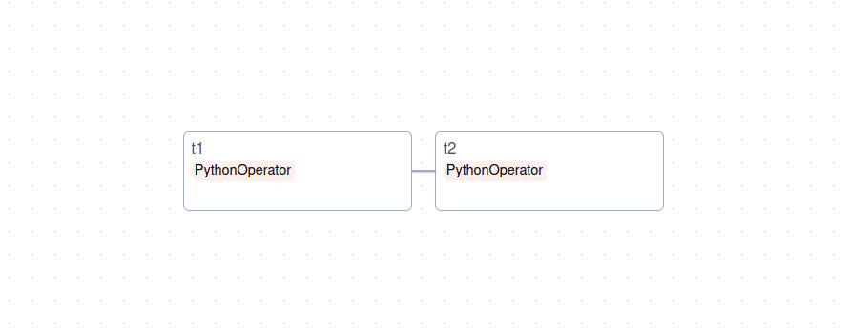
Version Simple
The DAG has two tasks – T1 carries out all the calculations, whereas T2 is an ending function

Slide 4
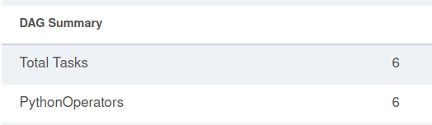
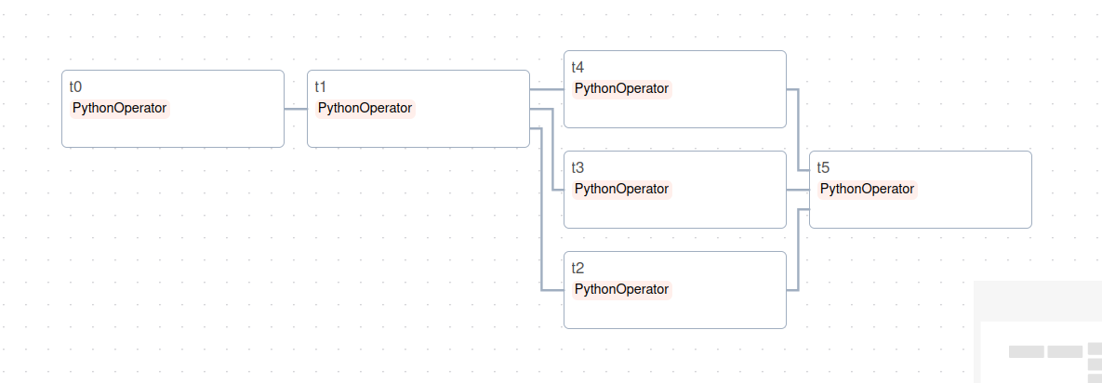
Version Concurrent
T1 from the previous DAG has been separated into several tasks (that are subtasks of T1)

Slide 5

Experiment Result
The simple experiment was carries out faster than the one that included concurrent tasks. This might be because the time consumption is largely due to accessing the database, rather than the calculations.
We see several ways to resolve this:
- aquire / create a much bigger dataset
- add significantly more calculations to the tasks
- find a faster way of string and accessing data

Slide 6

Thank you

