Slide 1
ADZD PROJECT

Slide 2
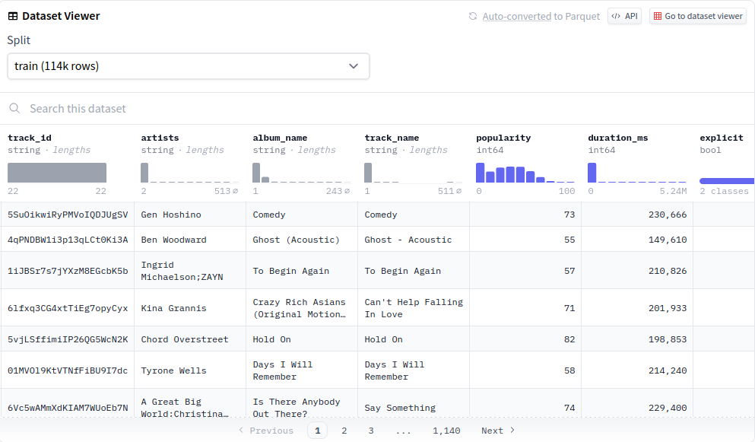
Dataset 1
https://www.kaggle.com/datasets/joebeachcapital/30000-spotify-songs/
30,000 songs with their features, eg. genre, artist, loudness

Slide 3
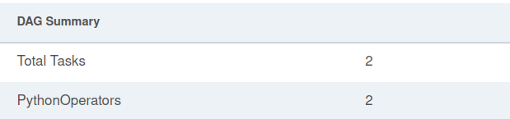
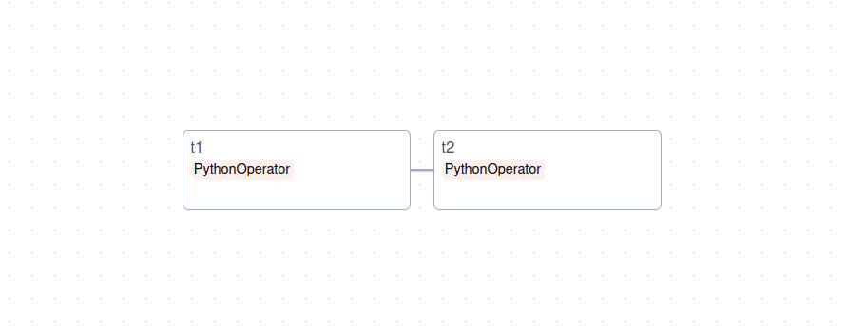
Version Simple
The DAG has two tasks – T1 carries out the calculations, whereas T2 is an ending function

Slide 5
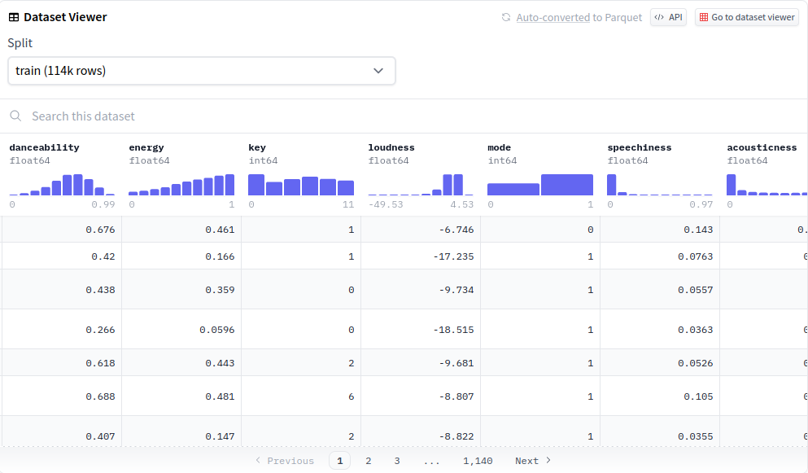
Dataset 2
https://huggingface.co/datasets/maharshipandya/spotify-tracks-dataset
114,000 songs with the same features

Slide 6
Version Simple

Slide 7

Thank you
CC by SA, Risyad Rais

