Slide 1

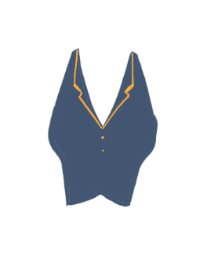

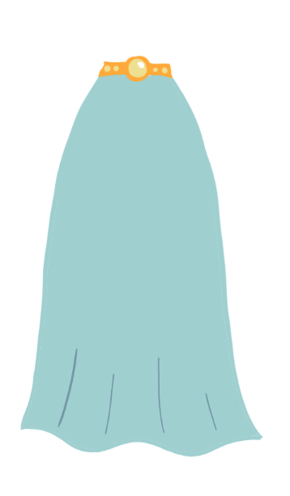
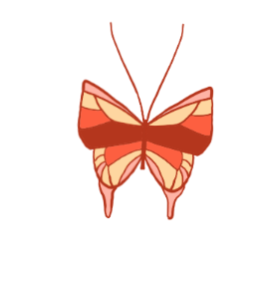

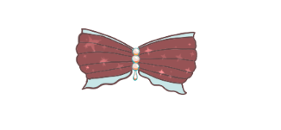
dressUpGame.java
Syl Kailey, Elise Hedlund, Laura Anker
Notes:
everyone

Slide 2
Proposal Motivation
A lot of girls’ first introduction to computer games are dress-up flash games like ours
We wanted to implement the techniques we’ve learned this semester to make a similar game
Additional features: Networking
Our project is distinct from most other dress-up games because it requires users to work together to complete the game
Notes:
elise

Slide 3

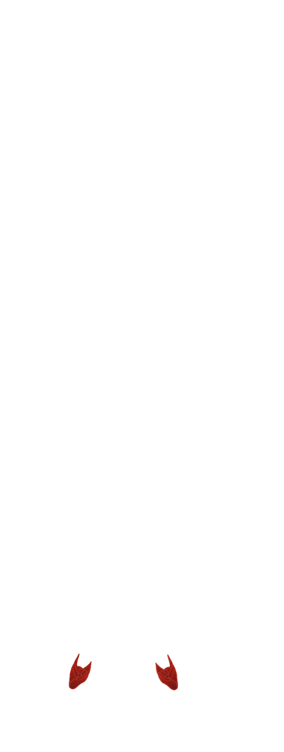
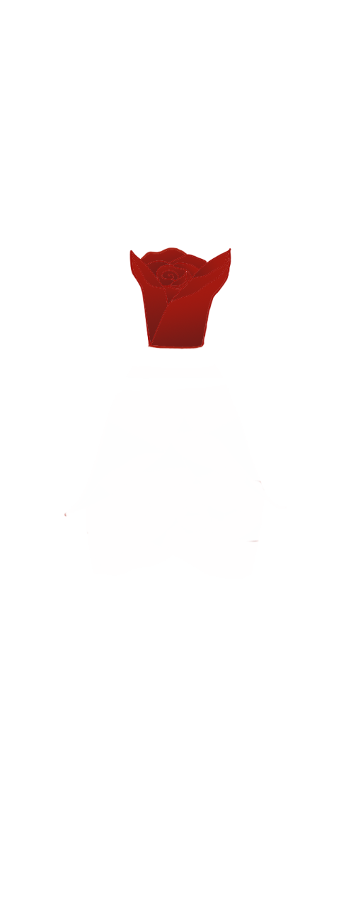
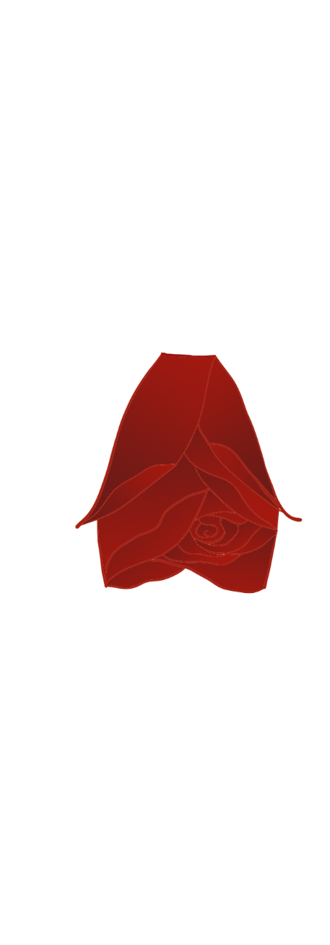
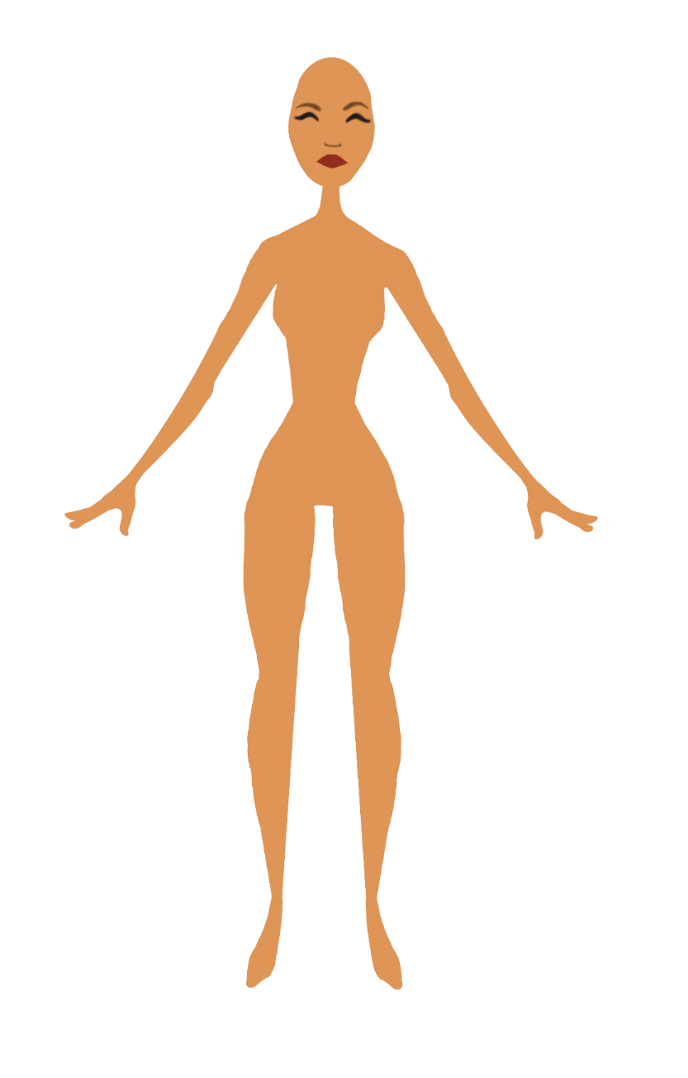
Game Plan
Two people join a server and each pick 3 tops, bottoms, and shoes
Based on their choices, our algorithm selects a final outfit they will both like
Both people can see the outfit, and customize the final look using hair, skin tone, and background
Notes:
elise

Slide 4
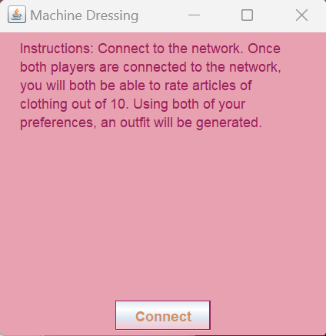
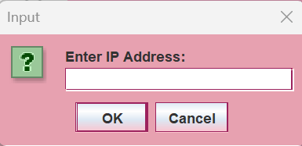

Start Page
Notes:
elise
Created a theme to create a fun vibe

Slide 5
Connecting to Server
After importing the port number, the user is connected to the server
The program waits until two players are connected before showing either the screens to pick their outfits
Notes:
elise

Slide 6
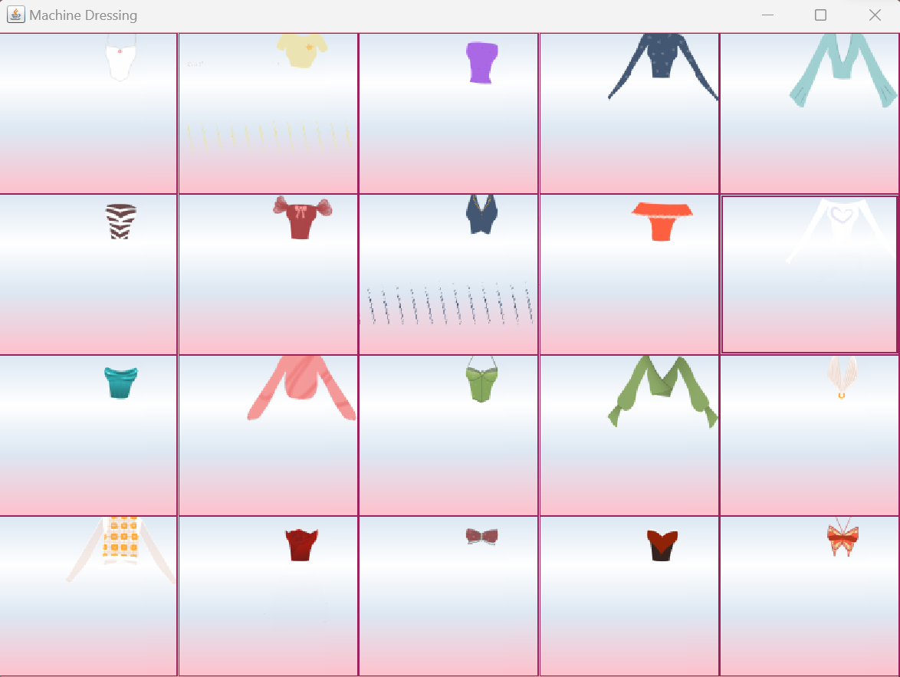
Picking Clothing Items
Notes:
laura
All clothing items drawn for the game
Once you pick 3, you are automatically moved to the next GUI, except when you finish shoes, which waits for the other player if they’re not done

Slide 7
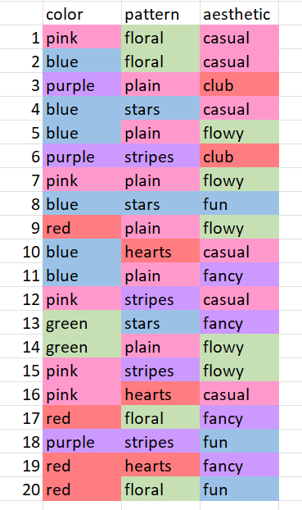
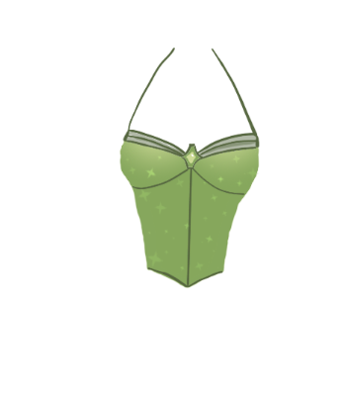

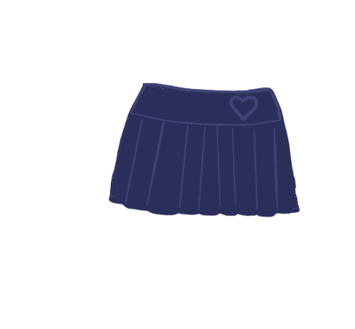
Deciding Final Outfit
Each clothing element belongs to a complete outfit
Outfits contain the attributes color, pattern, and aesthetic
Based on the attributes from the 6 outfits belonging to the clothing the players picked, it decides on the outfit that most closely matches the preferences of both players
18
13
10
Notes:
Laura
Didn’t want to just create a mishmash of pieces that didn’t match for the final look. It would also be a little boring, cause you’d just get exactly what you picked
Goal with organizing outfits was avoiding the same combination of patterns, colors, and aesthetics, so that you could get every outfit if you picked different combinations
Gets colors, patterns, and aesthetics from what each person picked, then finds any common attribute between both of them. If they share a color/pattern/aesthetic then it saves that one, otherwise it will pick the top one of each of them. It then looks through all outfits to find ones that have the colors/patterns/aesthetic. Then if any outfit has all three, that’s the outfit. Otherwise it picks one that contains two attributes or if nothing in common(super unlikely) it just picks an outfit at random that one of them liked.
Accounts for ranking of attributes more than frequency

Slide 8
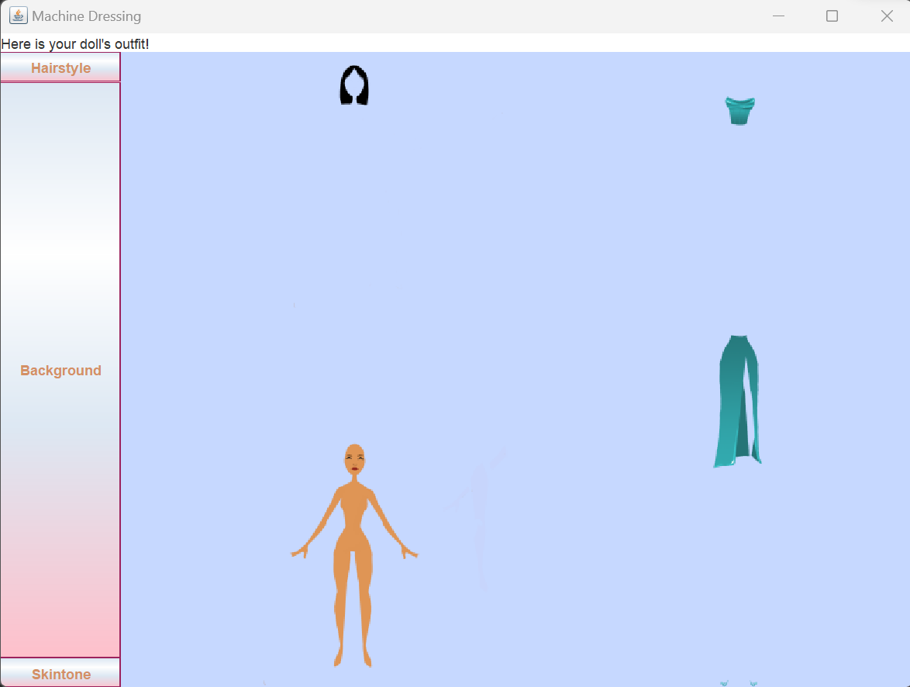
Final Outfit
Both players have a new GUI pop up with the shirt, bottoms, and shoes that the algorithm selected based on the combination of their choices displayed
Players can personalize by changing the background color, as well as the hair type and doll skin tone
Notes:
Laura

Slide 9
Demonstration
Notes:
syl

Slide 10
Potential Further Development
Display clothing on a doll (according to original game plan)
Possible for more than two players to play together
More customization options
Detailed backgrounds
Accessories
More outfits
Size and ability inclusivity
Add traits for individual clothing items, rather than just outfits, to make for a better final outfit selection
Drag and drop clothes
Add animations/interactions with final doll
Better GUIs
Notes:
syl

Slide 11
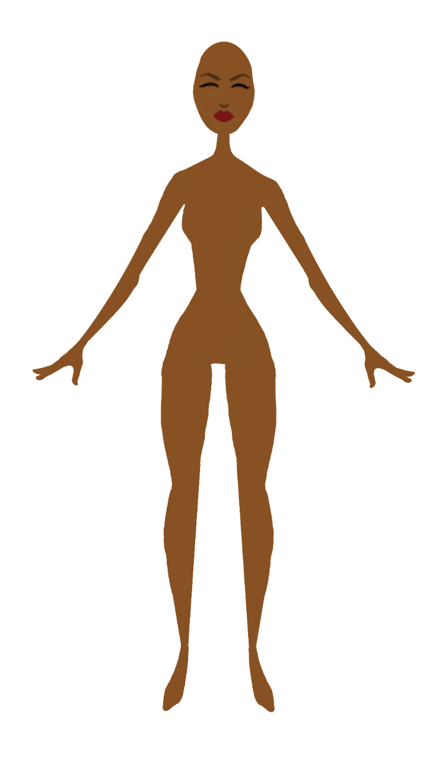
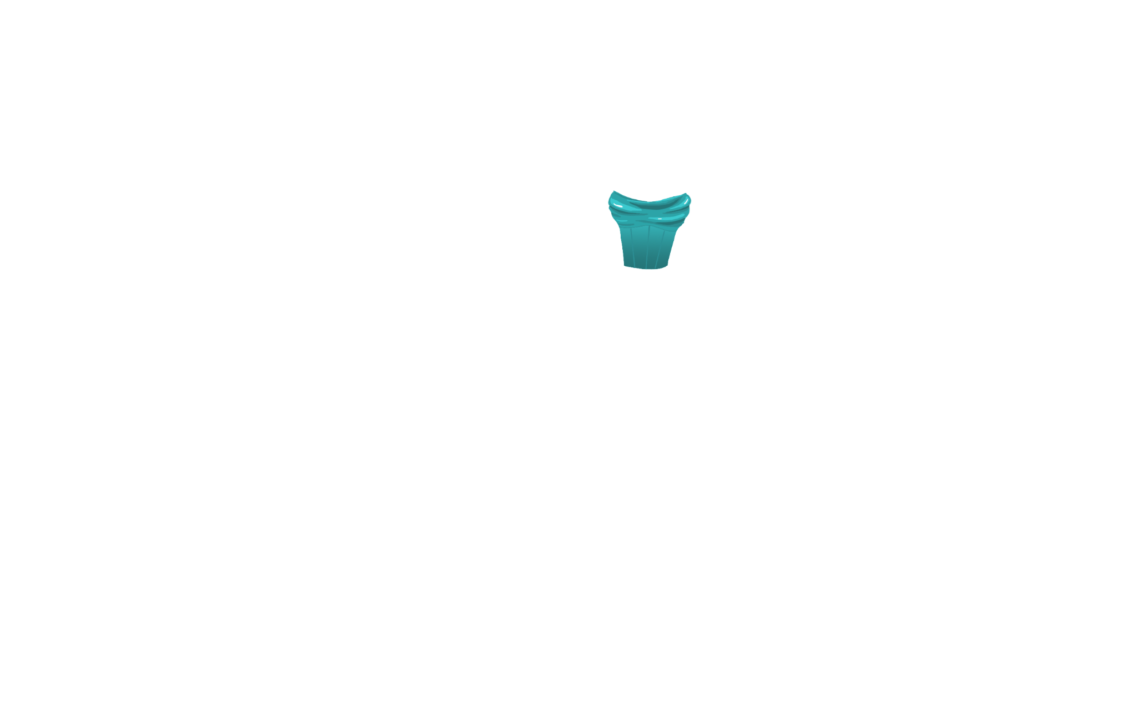

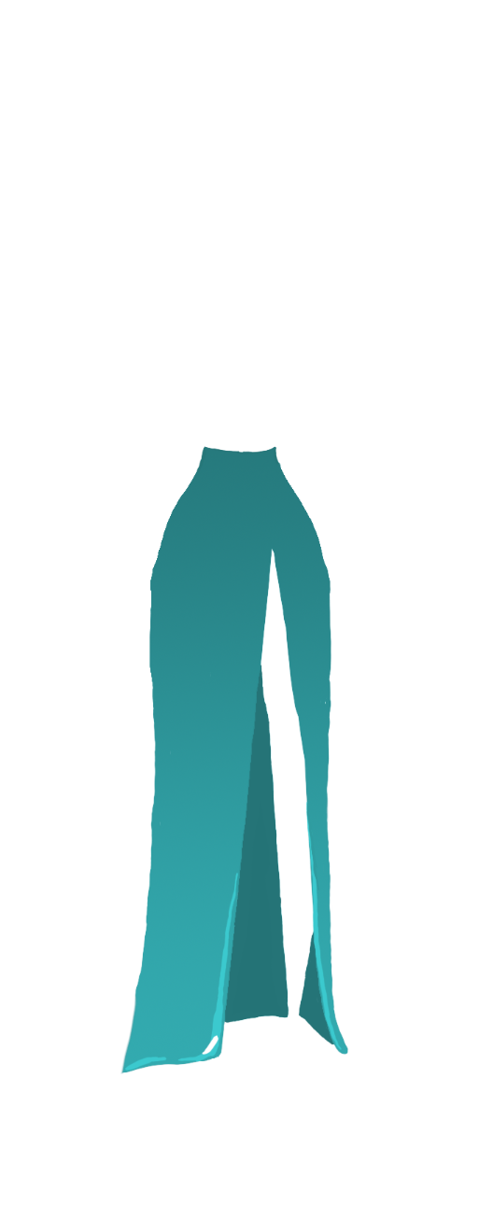
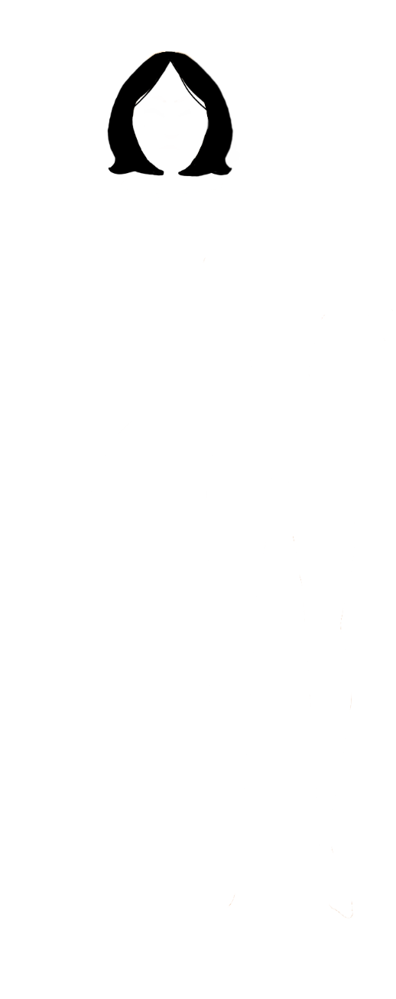
Questions?
?
Notes:
syl/everyone

