Slide 1
MANAGEMENT FEEDBACK · PLATINUM HEDGING PROGRAMME
Hedging the Platinum Prepay / Offtake Book
A dynamic-programming hedge for a 3-month LBMA platinum average-price swap —
4-year (48-trade) walk-forward, corridor-controlled variance, results and validation
+$22/oz
48 / 48
−32%
mean edge, 48 trades (2020–2023)
trades inside the causal bound
less variance from the shipped delta corridor
Quant Hedging · 2026-07-17 · All figures recomputed from committed artifacts
1

Slide 2
THE ASK, AND THE ANSWER
Executive summary
Can we systematically hedge the book and keep the dealer margin? Yes — proven over four years (2020–2023, 48 trades). Every number is traceable to an artifact.
Metric | Result | Source
Walk-forward span | 48 monthly trades · Jan-2020 – Dec-2023 (incl. COVID) | full48_baseline
Mean edge — ensemble baseline | +22.09 $/oz (std 88.2 ; SE ±12.7) | full48_baseline
Shipping config — delta corridor (band 0.60) | +23.10 $/oz (std 60.4) | corridor_rolls
Mean difference, shipping vs baseline | +1.0 $/oz · t = 0.16 (statistically zero) | paired · 48 mo
Proven corridor contribution | variance −32% (100% of 20k paired bootstraps) | bootstrap
Causal-bound discipline | 48 / 48 PASS · 0 corridor breaches in 144 rolls | both CSVs
What the mean IS | the locked dealer margin + basis carry — not a market call | lf2 panel
THE RULE: single months are directional-overlay noise (std ≈ $80/oz). Only the 48-trade MEAN is reproducible — and it equals the locked margin, not a market view.
artifacts/walk_forward/full48_baseline.csv · full48_corridor_rolls.csv · paired stats + 20k bootstrap recomputed here.
2

Slide 3
LAYERED BY DEPTH
How to read this deck
The deck deepens as it goes. Stop wherever the detail exceeds your need.
Slides | Layer | For
2 – 3 | Executive — the ask and the answer | Decision-makers
4 – 5 | The trade and why hedging it is hard | Business
6 – 11 | Methodology: data → decomposition → model → guard | Risk / product
12 – 15 | The solver and the verification machinery | Risk / quant
16 – 21 | Results: 2-year interim — headline, stability, attribution | All
22 – 27 | Four-year walk-forward & variance control | Risk / quant
28 – 31 | Model upgrade — GARCH world: validation, operating point & tail diagnosis | Risk / quant
32 – 34 | Integrity: how we caught our own too-good result | All
35 – 36 | Caveats and recommended next steps | All
37 | Future work | All
38 – 41 | Quant appendix: equations, pseudo-code, manifest | Quant
Executive → increasingly detailed → quant-grade, ending in pseudo-code and a reproducibility manifest.
3

Slide 4
THE TRADE · 1 OF 2
The deal
A 3-month average-price platinum swap, hedged with exchange futures.
Term | Value
Underlying | LBMA 2 pm platinum fix (USD / oz)
Structure | 3-month arithmetic average-price swap
Notional | 2,500 oz
Strike | fair − $8 / oz (the dealer margin)
Hedge instruments | front-3 CME platinum futures (50 oz / contract)
Book constraint | short-only, total cap 50 contracts
Rebalancing | daily
Transaction cost | half of a 10 bps bid/offer on notional
Fixture: tests/fixtures/policy_test_simulate_only.json · per-leg strike lives in Fixed_Basis, never hardcoded.
4

Slide 5
THE TRADE · 2 OF 2
Why a static short is the wrong answer
Three structural frictions make a fixed hedge ratio leak money.
▪ Two clocks. The swap prices off the LBMA 2 pm fix; the hedge trades CME futures. They are not the same price at the same instant — the fix reads CME roughly 19 hours later.
▪ Basis risk. LBMA minus the CME continuous spot has σ ≈ 16.5 $/oz and mean-reverts. A fixed hedge ratio leaves this un-neutralised.
▪ Average-price optionality. The swap references a 3-month average, so hedge sensitivity decays deterministically as fixings accrue — the correct hedge ratio changes every day.
The optimal hedge is dynamic and basis-aware — exactly what a static lock cannot deliver.
5

Slide 6
METHODOLOGY · 1 OF 6
Methodology at a glance
Raw data → clean decomposition → identified joint law → simulated world → frozen policy → realized-path backtest.
1
2
3
4
5
6
Data
pl_exp.csv
Decompose
carry · spot · basis
Identify
κ = 1 − φ
Calibrate world
HMM + AR(1) basis
Solve & FREEZE
policy
Roll on the
REALIZED path
The next five slides walk this pipeline left to right.
6

Slide 7
METHODOLOGY · 2 OF 6
The data — one archive, fully auditable
Every model input comes from a single committed CSV.
Field | Content
File | data/pl_exp.csv
Rows | 3,856 daily observations
Span | 2009 – 2025
Futures | CME PL1 / PL2 / PL3 settles + open interest + contract τ and expiries
Rates | full USD-SOFR zero curve (48 tenors)
Reference | LBMA 2 pm platinum fix
data/pl_exp.csv — 3,856 rows confirmed by wc -l (header + 3,856).
7

Slide 8
METHODOLOGY · 3 OF 6
The clean decomposition
Strip the observable prices into three economically-clean state variables.
Quantity | Definition | Property (measured)
Calendar carry c₁₂ | ln(F2/F1)/(τ2−τ1) − forward SOFR | autocorr 0.97
CME continuous spot P | F1 · exp(−(rf + c)·τ1) | the tradeable primary
Basis b | LBMA fix − P | σ 16.50, level autocorr 0.34
Carry is near-permanent (autocorr 0.97); the basis is a fast, mean-reverting echo (σ 16.5). These are the only moving parts the hedge must manage.
Recomputed on data/pl_exp.csv: basis std 16.50, level autocorr 0.336.
8

Slide 9
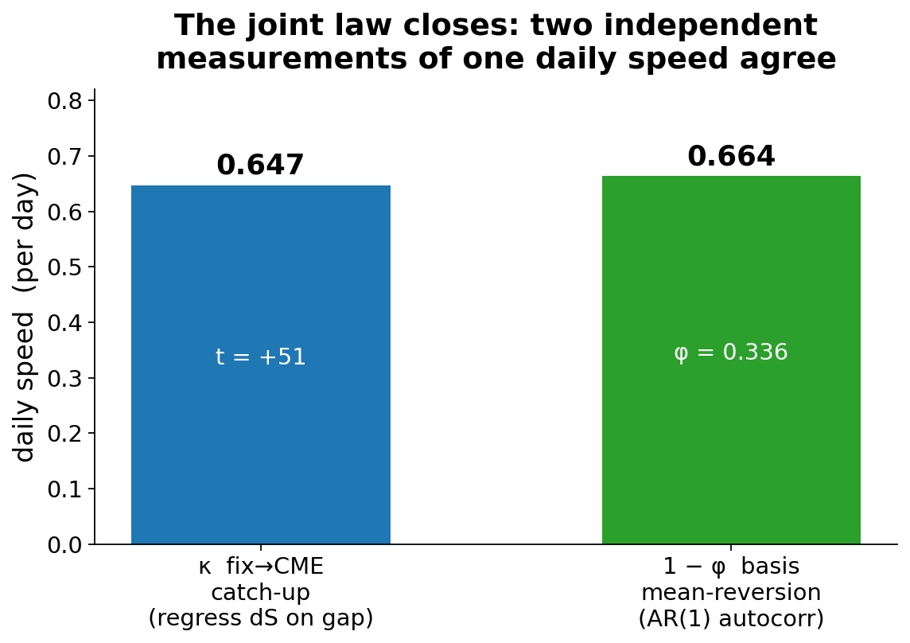
METHODOLOGY · 4 OF 6
The key empirical identity
One number, measured two independent ways, agrees — so the joint law is identified, not fitted.
▪ Catch-up. Regress dS(t+1) on the CME−fix gap → κ = 0.647/day (t = +51).
▪ Reversion. Basis AR(1) autocorr → 1 − φ = 0.66.
▪ They match. CME is the price; the fix reads it ~19 h later.
▪ And CME is a martingale. dF(t+1) on b: |t| < 1 — no executable drift to farm.
Recomputed on data/pl_exp.csv: κ 0.647 (t +51.4), 1−φ 0.664, martingale dF~b slope 0.014 (|t| 0.7).
9

Slide 10
METHODOLOGY · 5 OF 6
Model structure — drift where it belongs
The tradeable leg is a martingale; the catch-up drift lives on the fixing leg the swap references.
CommodityPrice.PLATINUM_CME = P (martingale primary)
Before the fix, the basis drift sat on the TRADEABLE leg —
so the solver farmed a reversion that is unexecutable in reality.
(See the integrity section.)
Regime-switching HMM, 3 regimes (crash μ = −0.33, sane on the CME series). The futures reference this.
CommodityBasis.LME_CME = b (AR(1) vs P, σ 16.5)
The fast mean-reverting echo between the exchange and the fixing.
Observable LBMA fixing S = P + b (composed)
The swap references this — so it inherits the catch-up. The hedge does not.
MarketDataRF_platinum_calibrated_cme.json · calibrated on the CME series (crash μ −0.33 vs pathological −3.66 on LBMA).
10

Slide 11
METHODOLOGY · 6 OF 6
The standing guard at every calibration
The one question asked of every calibration: is there executable drift on the tradeables? There must not be.
Check | Target | Measured
E[dF | b] on CME (martingale) | ≈ 0 | slope 0.014, |t| = 0.7
Catch-up on the fixing leg | large | t ≈ −45 to −51
Basis σ | ≈ 16.5 | 16.50
If any future shows tradeable drift, the calibration is REJECTED before a single solve. This is the guard that a prior model version lacked.
Guard asserts executed green in platinum_hedge_validation.ipynb; recomputed dF~b |t|=0.7 on data/pl_exp.csv.
11

Slide 12
THE SOLVER · 1 OF 4
The solver, in plain English
Backward dynamic programming with a learned, position-free value function.
▪ Work backwards from expiry. Each day, ask: given today's market and book, which hedge maximises expected end-of-deal utility?
▪ Position-free continuation. C_t(market, W) = u(W) + A_t(market, W) is learned by a small net per timestep (~1.4k params). Position-free, so one fit serves every candidate hedge.
▪ The choice sits outside the net. The Bellman max is an explicit search over an allowed action grid — respecting the 50-contract cap and short-only rule — not baked into the fitted value.
▪ Train, then freeze. The policy is trained in the calibrated simulated world and then FROZEN before it ever touches realized data.
diffsolver_v2.py · hedge_solver.py · utility: hedge_bundle._utility_wrap_signed (single source of truth).
12

Slide 13
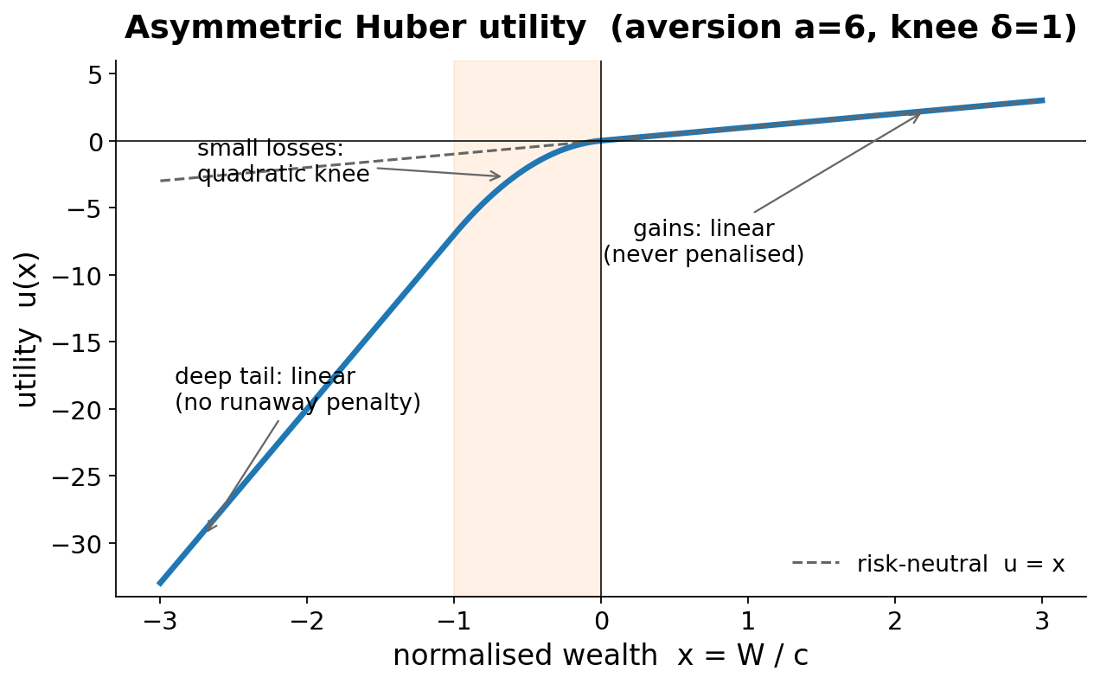
THE SOLVER · 2 OF 4
The objective: downside-asymmetric utility
We optimise utility, not raw P&L — and aversion is the single tuned lever.
Aversion sweep (mean net $/oz)
Aversion | Mean $/oz | Note
2.5 | +4.74 | net-negative bets
6.0 | +18.19 | SHIPPED (best)
12 | — | no reproducible gain*
Gains stay linear (never taxed); small losses curve; the deep tail is linear (no runaway penalty). Raising aversion past 6 buys no reproducible gain.
Full-24 means: av-2.5 baseline source pending recommit (la_attribution.csv) · aversion6_24trade_final.csv (av 6, mean +18.19). * Av 12 = 10-trade sweep subset, Δ within ±$100/oz seed noise.
13

Slide 14
THE SOLVER · 3 OF 4
The walk-forward protocol — no lookahead
No lookahead anywhere. This is the defensibility core of the backtest.
Calibrate
on data ≤ date
Train policy
in sim world
FREEZE
Roll day-by-day
on REALIZED path
Stamp per-trade
causal bound
Recalibrate
next quarter
▪ Strictly causal. Spot history strictly before each trade date; quarterly recalibration on data ≤ calibration date only.
▪ Real accounting. Rolled through a real futures stepper: variation margin, financing, per-instrument expiry, forced-flat.
▪ Provably causal. Decisions run off the stepper's own wealth — bit-identical when the future is erased.
production_walk_forward.py: calibrate → train → freeze → roll. Future-erasure test proves causality.
14

Slide 15
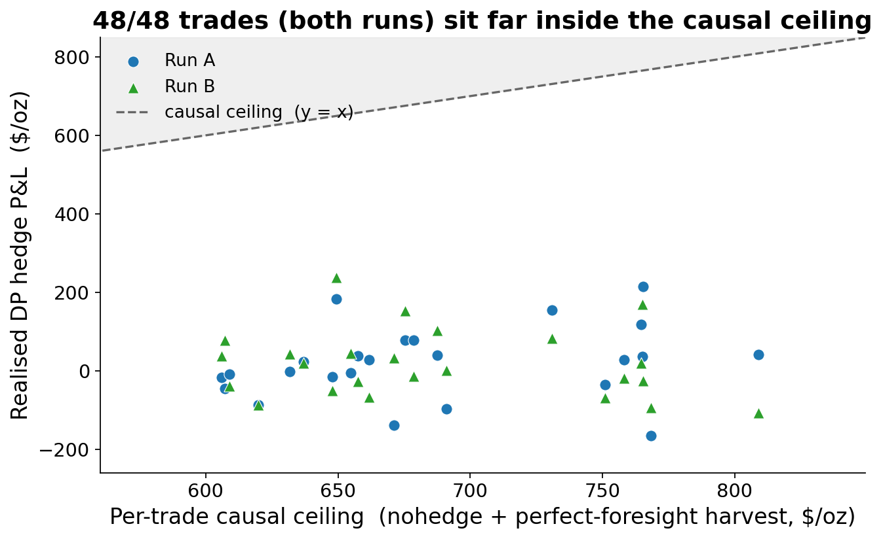
THE SOLVER · 4 OF 4
Verification machinery
Every run carries its own falsification tests — so a wrong answer trips a wire.
▪ Causal ceiling. Per trade: unhedged + perfect-foresight harvest on the traded strip. 48/48 trades (both runs) inside.
▪ Acceptance ladder. Checked per run: hindsight ≥ greedy ≥ textbook.
▪ Bitwise anchors. Fixture V_0 and stepper floats are byte-locked; any code change that moves them fails CI.
Both CSVs: bound_pass = True on 24/24 rows. Bit-gates: fixture V_0 + stepper floats (349-test suite).
15

Slide 16
RESULTS · 1 OF 6
Headline results — 2-year interim
The 2-year interim result (Jan-2021 – Dec-2022). Two independent re-runs; the four-year update follows in the next section.
Statistic | Run A (goal) | Run B (re-verify)
Mean ($/oz) | +18.19 | +17.58
Median | +24.56 | +10.33
Min | -166.14 | -106.79
Max | +214.80 | +238.05
Std dev | 92.73 | 87.18
Positive trades | 13 / 24 | 13 / 24
Causal-bound PASS | 24 / 24 | 24 / 24
Unhedged mean | -2.54 | -2.54
aversion6_24trade_final.csv (Run A) · aversion6_reverify_committed_pipeline.csv (Run B). Same realized path; fresh calibration + RNG in B.
16

Slide 17
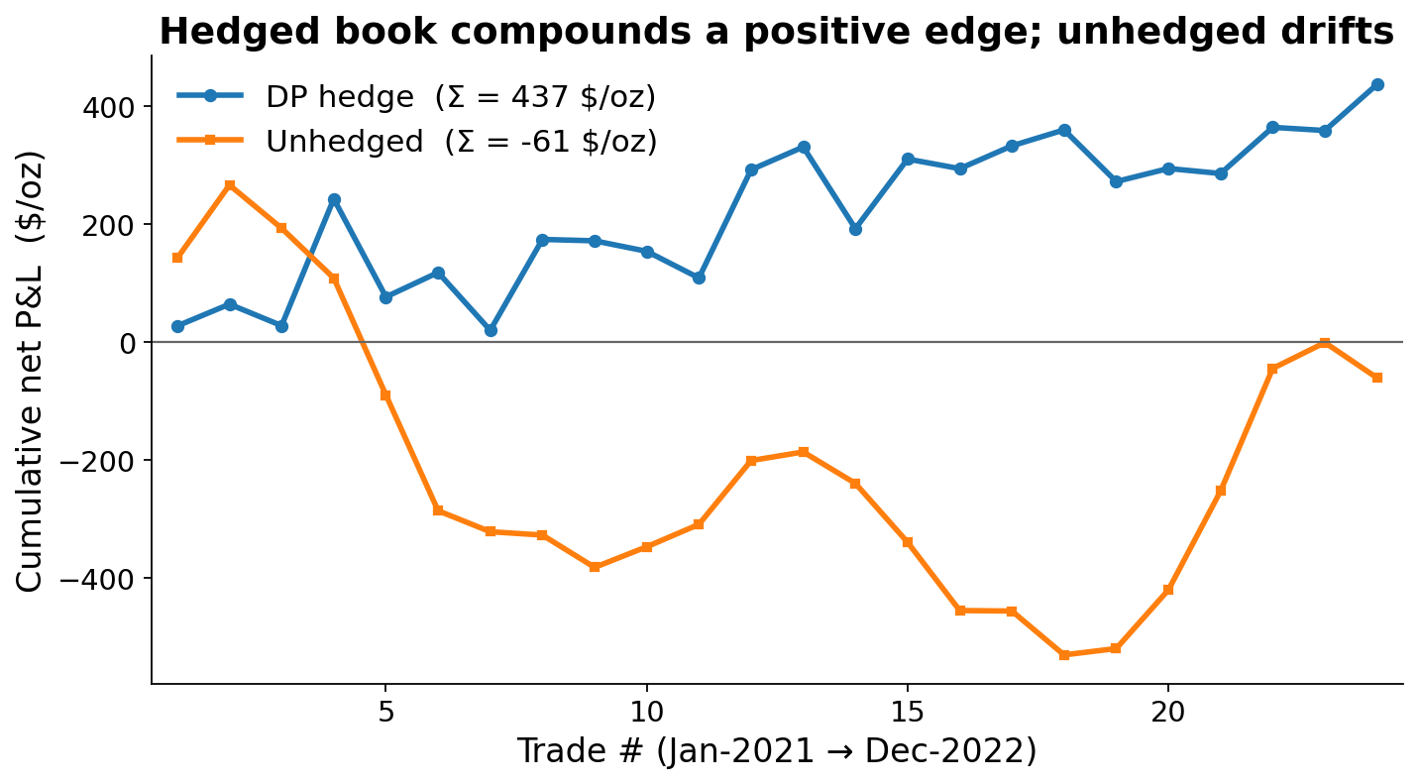
RESULTS · 2 OF 6
Cumulative edge over 24 trades
The hedged book compounds a positive edge; the unhedged book drifts negative.
Cumulative net P&L over the 24 monthly trades: DP hedge +437 $/oz vs unhedged −61 $/oz.
Cumulative sums of the greedy and unhedged columns, aversion6_24trade_final.csv.
17

Slide 18
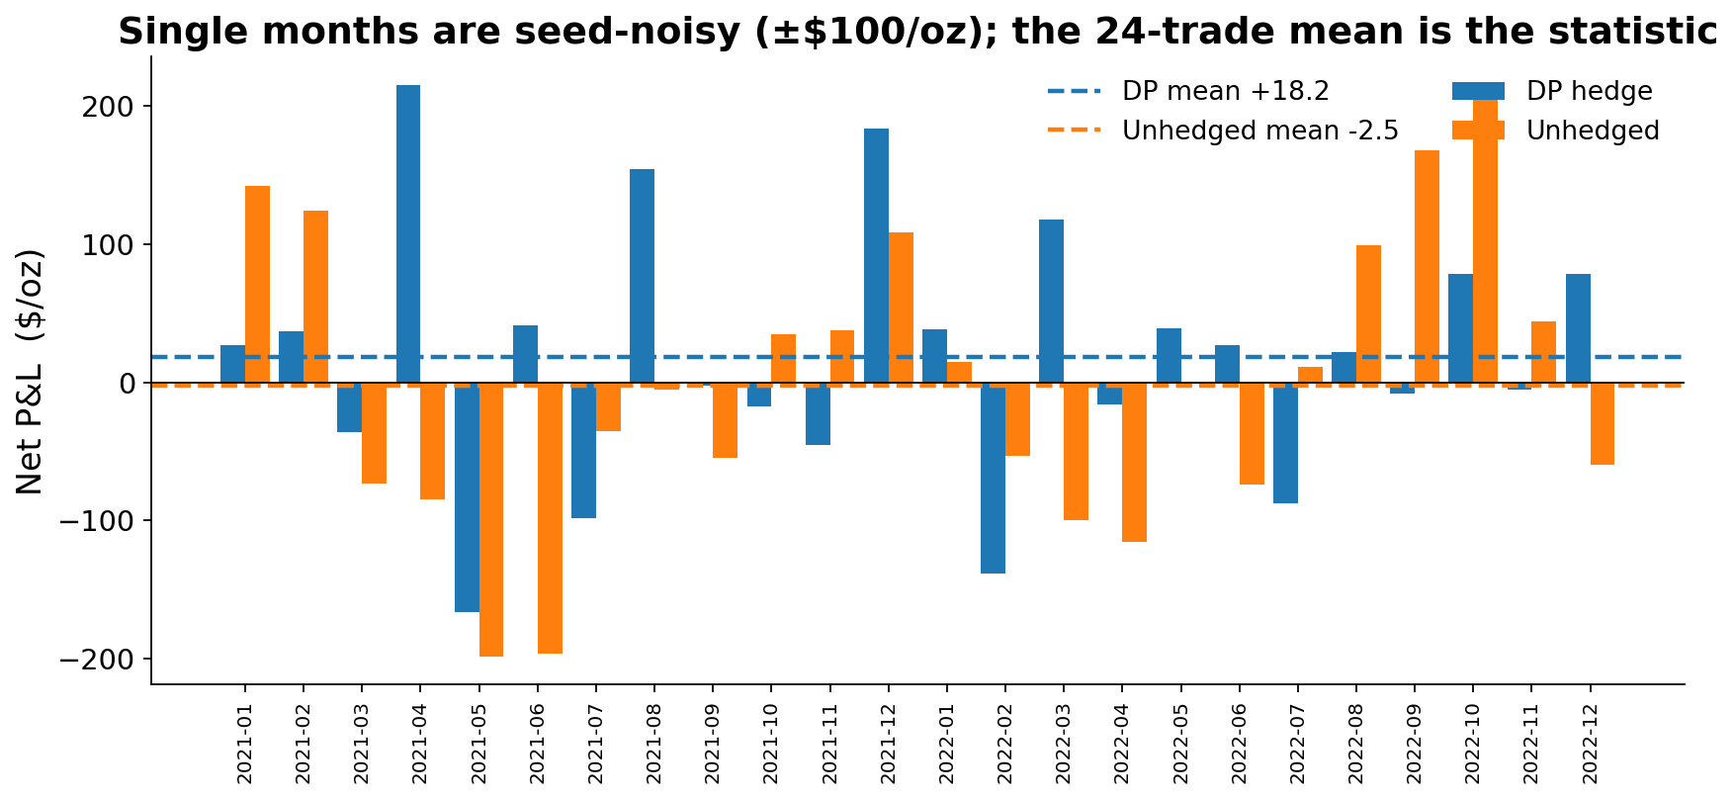
RESULTS · 3 OF 6
Month by month
Individual months are dominated by seed noise (±$100/oz). Do not read single months.
Per-month greedy and unhedged $/oz, aversion6_24trade_final.csv. Dashed lines = 24-trade means.
18

Slide 19
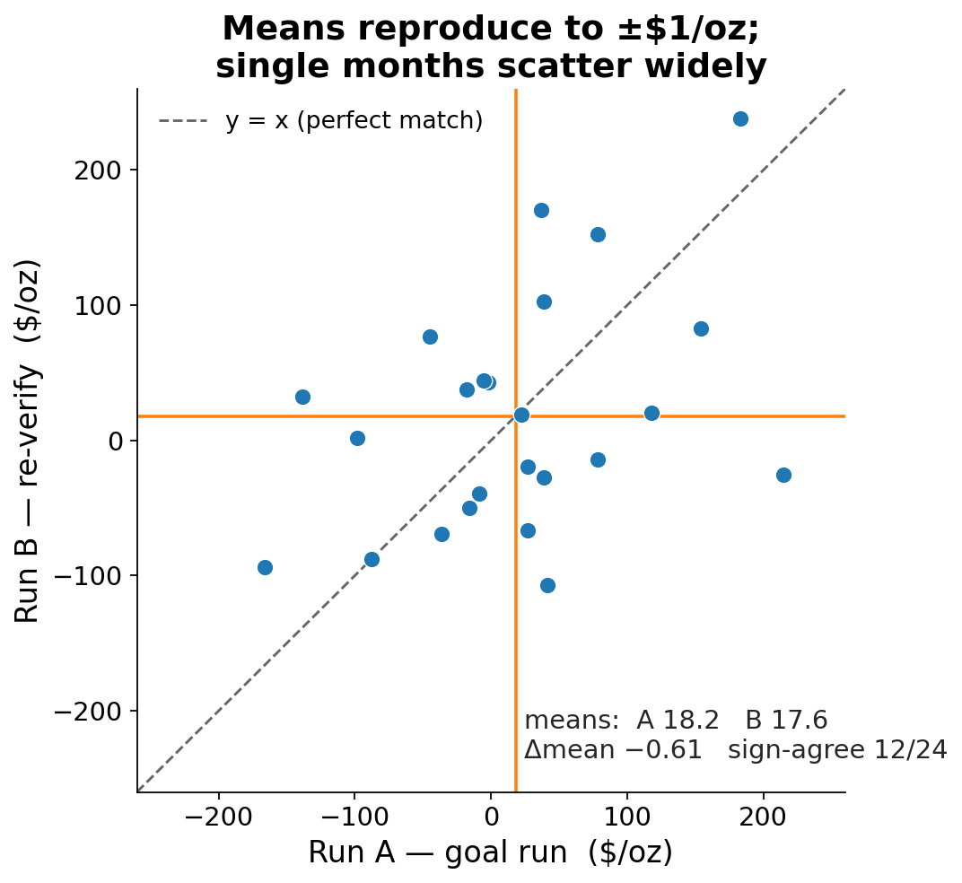
RESULTS · 4 OF 6
Reproducibility — quote means, never months
The mean reproduces to ±$1/oz across independent pipelines; single months do not.
▪ Means agree. Run A +18.19, Run B +17.58; difference -0.61 $/oz.
▪ Months do not. Sign agreement only 12/24; max month-level gap 240 $/oz.
▪ Implication. A single month is a draw from a ±$100/oz distribution. The 24-trade mean is the signal.
Run A vs Run B per trade, both walk-forward CSVs. Δmean −0.61, sign-agreement 12/24, max|Δ| 240 $/oz.
19

Slide 20
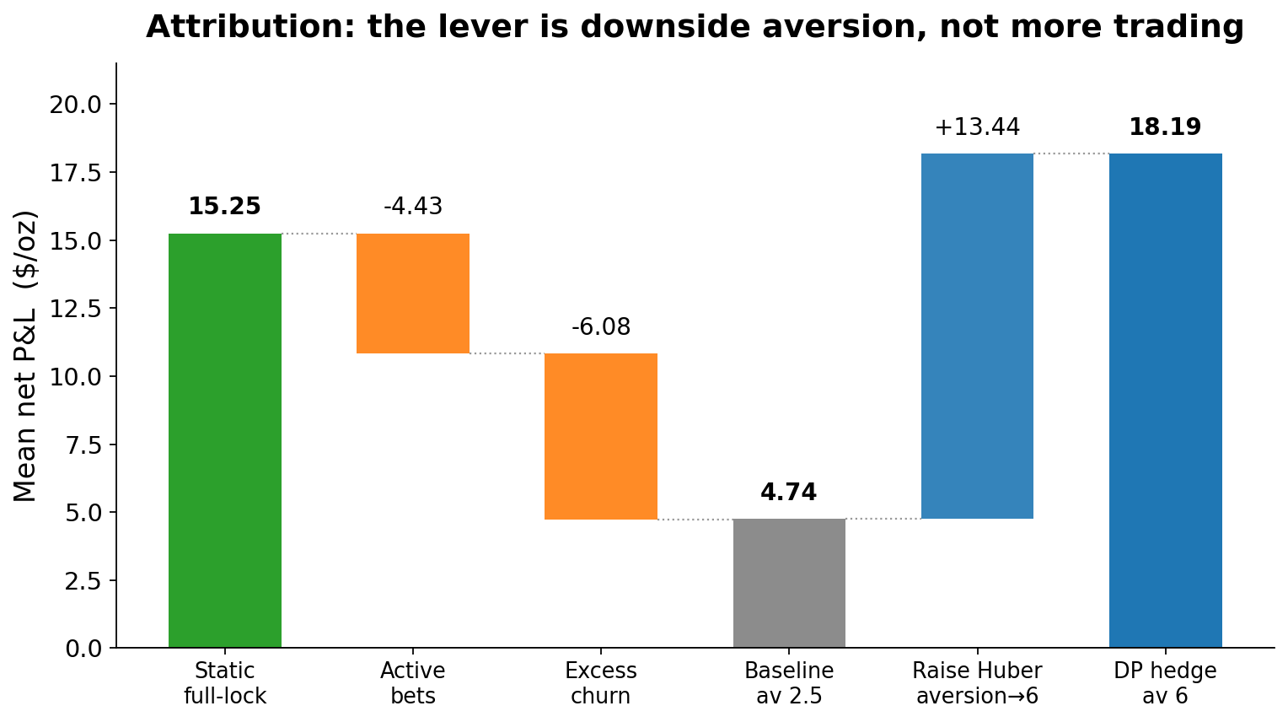
RESULTS · 5 OF 6
Attribution — the lever is aversion
The edge comes from downside aversion, not from trading more.
Baseline (av 2.5) +4.74
= full-lock 15.25
− active bets 4.43
− excess churn 6.08
Raise Huber aversion → 6:
+13.45 → +18.19
Losers recovered hard;
winners kept ~all.
av-2.5 baseline: source pending recommit (la_attribution.csv) + aversion6_24trade_final.csv (aversion 6, mean +18.19).
20

Slide 21
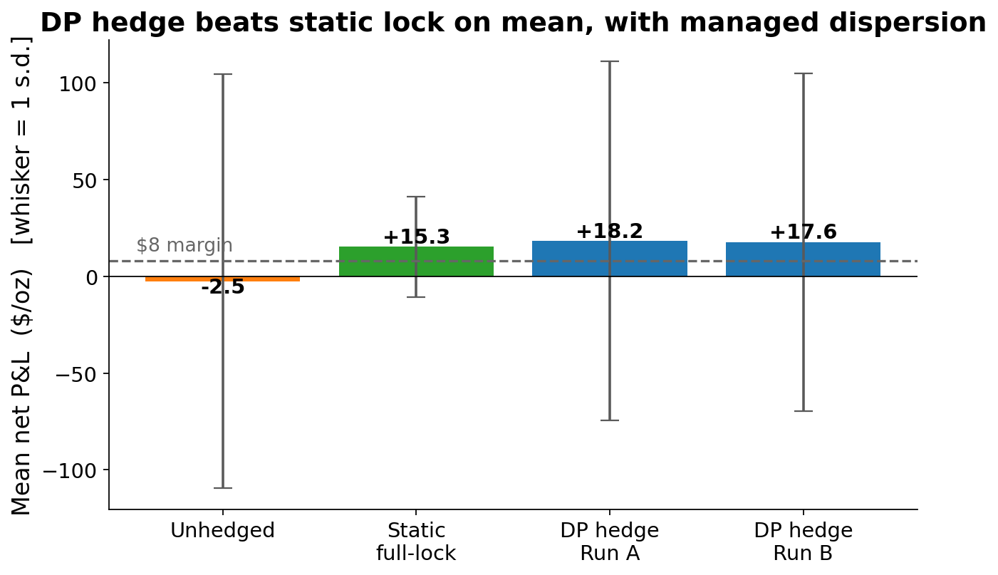
RESULTS · 6 OF 6
Benchmarks
The DP hedge beats the static full-lock on mean, with managed dispersion.
Static full-lock, verified
through the REAL stepper:
+15.25 net =
margin 8.00
+ realized basis drift 8.29
− lock cost 1.01
Full-lock verified through the real stepper. Benchmarks frictionless; net-of-cost reported uniformly. Full-lock decomposition (+15.25) source pending recommit (la_attribution.csv).
21

Slide 22
FOUR-YEAR UPDATE · 1 OF 2
Four-year walk-forward — 48 trades
Jan-2020 through Dec-2023, including the COVID-2020 shock. The 24-month result becomes an interim milestone.
Statistic | Ensemble baseline | Corridor 0.60 (shipped-interim)
Trades | 48 | 48
Mean ($/oz) | +22.09 | +23.10
Std dev | 88.15 | 60.41
Min | −143.70 | −102.22
Median | +7.83 | +16.57
Causal-bound PASS | 48 / 48 | 48 / 48
Corridor breaches | — | 0 / 144
Calendar year | Baseline mean
2020 (COVID) | +27.54
2021 | +24.29
2022 | −4.52
2023 | +41.07
2020 stayed positive through the crash · 2022 the flat year (margins compressed) · 2023 strongest.
artifacts/walk_forward/full48_baseline.csv · full48_corridor_rolls.csv. Every row bounded below by no-hedge, above by perfect-foresight on the traded leg.
22

Slide 23
FOUR-YEAR UPDATE · 2 OF 2
What four years taught us
Three findings that shape how the result is read and reported.
▪ The policy = a locked-margin hedge + a zero-mean overlay. On the 40-month attribution panel the hedge earns the locked margin (+17.2 $/oz); the directional overlay adds +2.4 $/oz — statistically zero (t ≈ 0.2) — but swings ≈ ±$79/oz per month. So single months are noise; only the 48-trade mean is ever quoted.
▪ Roll-month dispersion is Monte-Carlo forecast noise, not model variance. Raising the roll-time inner batch 64 → 512 collapsed per-month seed dispersion 168.5 → 62.9 $/oz (−63%, the √8 Monte-Carlo rate). Methodology hardening, now standard.
▪ 2022 was a flat year, not a model failure. The baseline mean dipped to −4.5 $/oz — the weakest of the four — as dealer margins compressed, yet 12/12 trades stayed causally bounded. 2020 rode the COVID crash to +27.5; 2023 was strongest at +41.1.
lf2_forensics.csv (40-mo attribution) · full48_baseline.csv (per-year). Roll-inner dispersion from the walk-forward ensemble methodology (roll-inner 512).
23

Slide 24
VARIANCE CONTROL · 1 OF 4
The delta corridor — a fence we know in advance
The average-price swap’s hedge ratio is deterministic at trade date. We fence the book to it.
▪ Known delta ramp. For a 3-month average-price swap the hedge delta is deterministic: full cover before the averaging window, then declining linearly to zero as fixings accumulate. No forecast required.
▪ The corridor. We fence the signed total position to that ramp ± a band, enforced inside the decision grid (HedgeActionSpace.grid_at) so every action the solver can take already obeys it.
▪ Live-aware near expiry. The fence shortens on live legs, so realized positions can never breach it.
▪ Result. 0 breaches across all 144 validation rolls (48 trades × 3 bands). Infeasible schedules fail loud.
THE RAMP
Full short before averaging starts
↓ linear decay across the fixings
→ zero at expiry
Net position held within ± band of that path — decided, not predicted.
Enforced once in HedgeActionSpace.grid_at(t); driver flag --delta-corridor BAND. full48_corridor_rolls.csv: breaches = 0 in every row.
24

Slide 25
VARIANCE CONTROL · 2 OF 4
The corridor frontier
Tighter bands trade a little mean for a lot less variance. Band 0.60 is the shipped-interim point; slides 30–31 recommend tightening to 0.15.
Configuration | Mean $/oz | Std | Min | p10 | Std vs base
Unfenced baseline | +22.09 | 88.15 | −143.70 | −83.48 | —
Band 0.60 (shipped-interim) | +23.10 | 60.41 | −102.22 | −52.58 | −32%
Band 0.40 | +18.64 | 47.42 | −72.18 | −33.12 | −46%
Band 0.25 | +16.88 | 38.16 | −66.21 | −24.56 | −57%
▪ All bands: 48/48 causal-bound PASS, 0 breaches. Band 0.60 Pareto-dominates the baseline — higher mean, lower std. Band 0.40 is available where the mandate wants a deeper risk cut (−46%).
artifacts/walk_forward/full48_corridor_rolls.csv · full48_baseline.csv (48 trades each). p10 = 10th percentile of realized $/oz.
25

Slide 26
VARIANCE CONTROL · 3 OF 4
A risk control, not a P&L enhancer
Management-grade honesty: the mean differences are noise; the variance ordering is certain.
▪ Mean differences are noise. Band 0.60 vs unfenced: paired Δ = +1.0 $/oz, SE 6.2, t = 0.16. Band 0.40 vs 0.60: Δ = −4.5 ± 2.9, t = −1.5. Neither is distinguishable from zero.
▪ The variance cut is certain. std(fenced) < std(unfenced) in 100% of 20,000 paired bootstraps, for every band.
▪ Where the P&L comes from. The locked dealer margin, not a market view. A configuration that reliably predicted a month’s direction would be the phantom-alpha bug we eliminated in the integrity review — the corrected world is built E[dF] = 0 by construction.
THE MESSAGE
The corridor is insurance on the variance —
priced at ≈ $0 of expected P&L.
That is exactly what a martingale-disciplined model must show.
Paired stats and 20k paired bootstrap (seed 12345) recomputed from full48_baseline.csv + full48_corridor_rolls.csv.
26

Slide 27
VARIANCE CONTROL · 4 OF 4
One model serves any mandate band
We retrained the whole stack inside the fence. It changed nothing — by design.
▪ Train-inside-the-fence = train-then-fence. Retraining the full solver inside the corridor reproduced the roll-time-fence trajectories bit-for-bit (L1 = 0.0; e.g. 202105 wT = −$60,552.66 both ways, 202102 wT = +$326,660.72 both ways). In-sim utility moved by ≈ 2×10⁻⁵ (noise).
▪ Deployment consequence. One corridor-free checkpoint set covers every mandate band; fences are applied at roll time against provenance-checked artifacts. No per-client retraining.
▪ The band cannot be timed from inside the model. A fenced-utility selector picks the right band only 29–31% of the time (33% = chance); u-margin vs realized-margin correlation ≈ 0. Consistent with martingale discipline.
▪ The prize needs outside information. Hindsight-optimal per-month band selection over {0.40, 0.60, unfenced} would have returned +43.6 $/oz vs +23.1 shipped — ≈ +20/oz of headroom, reachable only with genuine external signal (see Future Work).
tb_insim_202105_b040.json · tb_insim_202102_b040.json · train_in_corridor_subset.csv · adaptive_corridor_sweep.csv / _verdict.md.
27

Slide 28
MODEL UPGRADE · FINAL VALIDATION & OPERATING POINT · 1 OF 4
Observable volatility replaces an inferred regime
The 48-trade walk-forward is COMPLETE. GARCH(1,1) with Student-t shocks replaces the 3-regime hidden-Markov world — a governance and robustness upgrade, not a P&L improvement.
▪ Sharply identified on 16 years of data. The GARCH parameters are pinned by the sample: β = 0.964 (t = 72), ν = 7.50 (t = 9.2). The HMM's rare crash regime never was — it is precisely the parameter 16 years of daily data cannot see.
▪ The no-alpha property is now testable in log AND price space. With volatility observed, E[return | volatility state] = 0 holds in log space. A post-review price-space check then caught what the log test was structurally blind to — a +4.16%/yr Jensen price-drift on the tradeable spot (E[dS/S] ≈ ½·h) — removed via Convexity_Correction, so E[dF] ≈ 0 is now assertable in PRICE space too. Verified P&L-neutral (paired +1.31 ± 1.10; no walk-forward number changes). The integrity discipline (slides 32–34) working.
▪ One observed number replaces three inferred beliefs. Volatility is a deterministic recursion on realized returns — no filter, so no filter misspecification on real data. The hedger conditions on a measured state, not an estimated one (market_dim 7 vs 9).
▪ Swapped by one line of market data. The calculation stack was generalized to a model-agnostic protocol: the spot model changes via the MarketData file, with no code change, proven by a committed both-worlds test (HMM bit-identical). An independent audit caught a clock bug pre-commit — per-business-day volatility injected on a calendar-daily grid, inflating vol ×1.20 — now fixed and gated by regression tests. 349 tests green.
VERDICT
All 48 trades are in. Integrity gates PASS; performance gates are NEUTRAL — the means are statistically indistinguishable (paired t = −0.71 unfenced).
No performance-forced flip. GARCH is recommended on governance grounds — an observable volatility state, a no-alpha property testable in log and price space, and market_dim 7 vs 9.
GARCHSpotModel_spec.md (§1, §1a, §6) · commits c52411d · 11ef68d · parameters fitted on data/pl_exp.csv (16 years). Final 48-trade walk-forward: artifacts/walk_forward/garch48_final.csv. Driftless price-martingale fix: commits c23d4aa · 5e4e041 · 4f08450 · driftless_subset_paired.csv (P&L within noise, no restatement).
28

Slide 29
MODEL UPGRADE · FINAL VALIDATION & OPERATING POINT · 2 OF 4
Final results — 48 trades
COMPLETE. Paired on all 48 months (Jan-2020 – Dec-2023), unfenced and inside the shipped corridor at bands 0.60 and 0.40.
Configuration | GARCH world | HMM world
Unfenced — mean ($/oz) | +19.21 | +22.09
Unfenced — std dev | 82.6 | 88.2
Corridor 0.60 — mean | +22.86 | +23.10
Corridor 0.40 — mean | +18.69 | +18.64
Causal-bound PASS (all) | 48 / 48 | 48 / 48
Paired Δ unfenced (G−H) | −2.89 ± 4.05 | t = −0.71
Paired Δ fenced 0.60 / 0.40 | −0.24 / +0.05 | t = −0.06 / +0.02
Calendar year | GARCH | HMM
2020 (12 mo) | +32.03 | +27.54
2021 (12 mo) | +15.55 | +24.29
2022 (12 mo) | −5.88 | −4.52
2023 (12 mo) | +35.13 | +41.07
ALL YEARS COMPLETE — each row is now a full 12 months, directly comparable to the four-year baseline (slides 21–22). GARCH and HMM track within a year's noise; 2022 was the weak year in both worlds.
THE READING: the fence dominates the model. Swapping the spot model moves the mean nothing at n = 48 (paired t = −0.71 unfenced, ≈ 0 inside the corridor). The corridor's variance cut — std −27% at 0.60, −41% at 0.40 — is model-agnostic: it shows up identically in both worlds.
artifacts/walk_forward/garch48_final.csv (48) vs full48_baseline.csv, paired on all 48 months; corridor rows from garch48_corridor_rolls.csv · full48_corridor_rolls.csv. Every row bounded below by no-hedge, above by perfect-foresight on the traded leg.
29

Slide 30
MODEL UPGRADE · FINAL VALIDATION & OPERATING POINT · 3 OF 4
Controlling the tail — the operating point
The loss tail is a half-hedged book, not a set of mistakes — now PROVEN (next slide): coverage ≈ 0.40 is utility-optimal, so the fence is a structural mandate, not a preference. Tightening the roll-time band cuts dispersion with no retraining and no breaches.
Roll-time band | Mean $/oz | Std | Mean / Std | CVaR5 | Worst month
0.60 (shipped) | +22.86 | 60.1 | 0.380 | −79.9 | −81.4
0.50 | +21.91 | 57.2 | 0.383 | −77.0 | −81.2
0.40 | +18.69 | 48.6 | 0.385 | −64.3 | −80.9
0.30 | +17.15 | 39.2 | 0.438 | −47.9 | −55.0
0.25 | +16.85 | 37.9 | 0.444 | −47.5 | −55.9
0.15 (recommended) | +17.40 | 31.3 | 0.557 | −40.9 | −57.7
▪ RECOMMENDATION — tighten the roll-time band 0.60 → 0.15. Mean / std roughly doubles (0.38 → 0.56), CVaR5 halves (−80 → −41), worst month −81 → −58 — with no retraining, 0 breaches and 48/48 causal-bound PASS at every band. The fence is the only lever that raises coverage (next slide) — a structural mandate, not variance-trimming.
CAVEAT 1 · THE MEAN IS NOISE
The ≈−1.8/oz give-back at 0.15 is statistically indistinguishable from zero (95% CI [−22, +18]); 0.15 owning the best mean among tight bands is noise. The robust fact is the monotone std / CVaR ordering — the variance cut is certain (P(std lower) = 1.00).
CONFIRMED · NET OF REALISTIC COST
Re-verified net of a maturity/vol cost model — M1/M2/M3 = 6/11/34 bps from open interest, plus a margin-funding term. Under BOTH a base and a stressed cost case, band 0.15 stays best risk-adjusted — 18.2 $/oz, std 35, mean/std 0.52, mean/CVaR5 0.41, 48/48 bound-PASS, 0 breaches. Figures are OI/vol proxies pending 2 pm-synced intraday calibration.
Basis is the residual floor: as the fence tightens, basis–P&L correlation rises to +0.72 at band 0.15 (≈79% of the residual std is basis). A CME-only hedge cannot hedge LME basis, so ≈25 $/oz of std is a wall no band can cross.
artifacts/walk_forward/corridor_band_frontier.csv (both worlds, bands 0.15–0.60) · garch48_corridor_rolls.csv. Loss-tail analysis: commit 5e61ae5. CVaR5 = mean of the worst 3 months; worst month = min realized $/oz. Net of realistic cost: net_of_cost_frontier.csv · cost_model_realistic.json (commits 3073bf0 · 8483956). Under-hedge diagnosis: underhedge_probes.csv (commit c6c7706).
30

Slide 31
MODEL UPGRADE · FINAL VALIDATION & OPERATING POINT · 4 OF 4
The under-coverage is optimal, not a bug
Coverage ≈ 0.40 behind the loss tail is the utility-optimal policy of a terminal-wealth utility in a driftless martingale world — no objective, training, or cost lever raises it. The remaining fix space is structural.
▪ Objective aversion 6 → {2, 24, 100}: coverage moves ≤ +0.06 (max +0.0596).
▪ Huber δ · training inner-batch · action-grid: nil (~0.00).
▪ Roll utility-scale /10, /100: bit-identical (Δ = 0.0000).
▪ Cost-aware · spread · roll-inner: move month dispersion, not the level — sign flips (loser up, winner down).
▪ Dead objective key (Surplus_Reward): bit-identical — confirms it was inert.
▪ All levers combined: coverage 0.43 / 0.40 — still ≈ 0.40.
OPTION A · FENCE AS MANDATE
Make roll-time band 0.15 an unconditional mandate — it supplies the coverage the utility will not choose on its own. No retrain; one checkpoint set. This is the deck's standing recommendation, now with a structural justification.
OPTION B · MIN-VARIANCE OBJECTIVE
Replace the terminal-wealth Huber with a min-variance / delta-tracking objective shape (Objective.Object). This changes what the solver optimises — a re-solve plus phase-3 validation.
DECISION — Option A ADOPTED: the roll-time band 0.15 becomes the mandate. Aversion within the current utility is exhausted (≤ +0.06), so only a structural change closes the tail; Option B (min-variance objective) stays a research track. Remaining data check before the operating point is locked: intraday marks near the 14:00 LBMA publishing window, to establish whether the basis drops at the fixing.
artifacts/walk_forward/underhedge_probes.csv (34 probes · commit c6c7706): pre-fixing coverage u ≈ 0.36 loser / 0.62 winner; every non-structural lever falsified. Driftless world E[dF] ≈ 0 in price space (commit 4f08450).
31

Slide 32
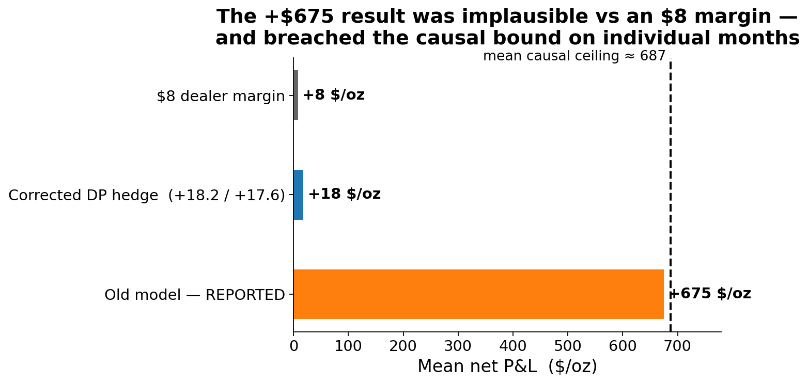
INTEGRITY · 1 OF 3
Integrity: how we caught our own too-good result
An earlier model version reported +$675/oz — implausible against an $8 margin. We did not ship it. We tried to break it.
We had already built a hard causal bound (unhedged + perfect-foresight harvest on the traded strip). The +675 result VIOLATED it on multiple months. A number that beats what perfect foresight allows is not a profit — it is a bug. That triggered a forensic tear-down.
Mean causal ceiling ≈ 687 $/oz (mean of pf_bound, aversion6_24trade_final.csv). Old +675 figure is the pre-fix reported mean.
32

Slide 33
INTEGRITY · 2 OF 3
The forensic exoneration
We localised the error by elimination — accounting and causality were cleared; the model was the culprit.
Suspect | Test | Verdict
Stepper accounting | static-short replay through the real stepper | EXONERATED
Look-ahead in decisions | future-erasure: erase the future, re-decide | EXONERATED (bit-identical)
The model | E[dF | b] on the tradeable futures leg | GUILTY: +0.65·b / day
Root cause: the basis's mean-reversion was placed on the TRADEABLE futures leg. The solver — correctly — farmed a drift of +0.65·b per day. But raw CME is a martingale: that drift does not exist in reality, so it is unexecutable.
Root-cause slope E[dF|b] ≈ +0.65·b/day on the mis-specified leg; corrected model measures |t|=0.7 (nil).
33

Slide 34
INTEGRITY · 3 OF 3
The fix, and the guards now standing
Fix the model; then make the same failure impossible to repeat silently.
▪ Composed-spot inversion. CME is the martingale primary; the basis and its catch-up live on the fixing leg (the swap), not on the hedge.
▪ Bound stamped on every row. Every backtest trade now records and asserts the causal-bound check.
▪ Martingale guard at every calibration. E[dF|b] ≈ 0 is verified on the tradeables — in both log and price space (the price-space Jensen check added post-review) — before any solve.
▪ Production-trust audit — 7 silent-failure paths closed. Fabricated realized tails; silently-random replay on npz typos; NaN-blind flags; non-atomic writes — all now fail loud.
The strongest trust argument is not that the number is big — it is that we built the machinery to catch it when it was too big, and it worked.
Production-trust audit: commit 0e2bd46. Composed-spot wiring: commit 3008d3c.
34

Slide 35
CLOSING · 1 OF 2
Caveats — stated plainly
What this result is NOT. Said openly, because that is the trust argument.
Caveat | What it means
Seed / Monte-Carlo dispersion | Ensemble (3 seeds) + roll-inner 512 collapse month dispersion; only the 48-trade mean is quoted.
Out-of-sample window | Now four years (2020–2023) incl. COVID — still not multiple full cycles.
Realistic cost — now calibrated | Net-of-cost verified under an OI/vol-calibrated CME friction model (M1/M2/M3 = 6/11/34 bps); band 0.15 holds. Residual: 2 pm-synced intraday spread capture.
Utility-scale convention | Recently moved to calibration-derived (flagged; explicit override available).
Frictionless benchmarks | By convention; net-of-cost is reported uniformly across tracks.
None of these overturn the headline mean; each is a scoped item for the next phase.
35

Slide 36
CLOSING · 2 OF 2
Recommended next steps
The near-term path to production sign-off; the broader roadmap follows in Future Work.
Step | Why
Adopt band 0.15 as the production point | One checkpoint set serves any mandate band (0.60 shipped-interim, 0.40 available); the tail diagnosis (slide 31) makes 0.15 structural, not a preference.
Intraday friction — final capture | Realistic OI/vol cost model is DONE (band 0.15 holds net of cost); the remainder is 2 pm-synced intraday spread capture.
Guard as a hard gate | Make E[dF | b] ≈ 0 block a calibration, not merely warn.
Book of APS + band adaptivity | The two capability steps that follow — detailed in Future Work.
The corridor ships as a risk control today; the hard guard remains a sign-off item. DECIDED: fence-as-mandate at band 0.15 (slide 31); final lock pending the 14:00-LBMA intraday basis check.
36

Slide 37
FUTURE WORK
Future work
Eight scoped items, ordered by leverage. The open structural choice on the loss tail — fence-as-mandate vs a min-variance objective — is on slide 31.
Item | Plan / value
Book of APS — netted corridors | Net fence across deals (e.g. 2 long + 1 short, expiries ≤ 4 mo). Sign-crossing schedules already supported; needs a book-level driver + validation.
Band adaptivity from EXTERNAL signal | Condition the band on realized vol / regime state; leave-one-out validated on the 48 months. The only route to the ≈ +20/oz hindsight headroom.
Intraday-calibrated CME friction | DONE — net-of-cost band ranking re-verified under a realistic maturity/vol cost model (M1/M2/M3 = 6/11/34 bps, OI-calibrated); band 0.15 holds under base and stressed cost. Remaining: 2 pm-synced intraday spread capture, revisit as it accrues.
Re-validate cross-market dual-strip | Confirm the CME-strip / LME-liability edge holds in the corrected martingale world.
Hard calibration gate | Make E[dF] ≈ 0 on every tradeable a blocking check at every calibration — institutionalize the integrity lesson.
Multi-GPU scale-out | Recipe documented for 4×A100 servers (batch / inner parameters).
Basis recalibration (GARCH world) | In the GARCH world the basis model's regime linkage is temporarily FLATTENED (flat Σ, σ = 8.079 — the stationary regime mix); no regime-publishing primary to link to. Awaits the 2 pm-synced recalibration. Known interim.
Hedge the LME basis floor | At tight bands ≈79% of residual std is basis (ρ → +0.72 at 0.15); a CME-only strip cannot hedge it (≈25 $/oz wall). Add an LME-priced instrument to attack the residual variance.
STATUS_NOTE_corridor.md open items. Machinery: Total_Position_Schedule — per-step [Min_Total, Max_Total] knots on the signed total position.
37

Slide 38
QUANT APPENDIX · 1 OF 4
Appendix — the identified joint law
Five equations and one inequality define the world the policy is solved in.
c₁₂(t) = ln(F2/F1) / (τ2 − τ1) − fwdSOFR # carry; autocorr 0.97
P(t) = F1 · exp(−(rf + c)·τ1) # CME continuous spot (martingale)
b(t+1) = φ·b(t) + A·ΔLME + η , φ ≈ 0.34 # basis AR(1), σ ≈ 16.5
S(t) = P(t) + b(t) # observable LBMA fix (composed)
dS(t+1) = κ·( P(t) − S(t) ) + … , κ = 0.647 ≈ 1 − φ # fix catch-up = basis reversion
E[ dF(t+1) | b(t) ] ≈ 0 # tradeable martingale guard (|t| 0.7)
The identity κ ≈ 1 − φ is the load-bearing fact: the same daily speed appears in the fix's catch-up and the basis's reversion, so the two-clock law is identified rather than assumed.
All coefficients recomputed on data/pl_exp.csv (3,856 daily rows).
38

Slide 39
QUANT APPENDIX · 2 OF 4
Appendix — DiffSolverV2 pseudo-code
# bank: one small MLP per timestep for the position-free continuation
nets = [MLP(in=market_dim+1, hidden=32, out=1) for t in range(T)] # ~1.4k params each
c = deal_scale # utility normaliser
def u(W): # asymmetric Huber (a=6, d=1), in c-units
x = W / c; loss = relu(-x)
pen = where(loss<=d, a*loss**2, a*d**2 + 2*a*d*(loss-d))
return x - pen
# backward sweep: fit C_t = u(W) + A_t via the Huge-Savine twin loss
for t in reversed(range(T)):
S, W, q_prev = sample_states(t) # outer draws
grid = action_grid(q_prev, cap=50, short_only=True) # mask-aware, cap-pruned
q* = argmax_a E_inner[ C_{t+1}(f(S,eps), W + pnl(S,eps,a)) ] # Bellman max OUTSIDE net
# inner expectation via ONE-STEP antithetic MC forks (bootstrap label)
y, dy = bootstrap_value_and_pathwise_grad(t, S, W, q*) # value + AAD Jacobian
A_t = fit(nets[t], value=y - u(W), grad=dy) # twin loss, per-column normalised
clamp A_t to trust region [a_lo, a_hi] # kill off-support extrapolation
# verdict on a held-out split, then hand back a deployable policy
assert ladder(hindsight >= greedy >= textbook)
return policy_artifact(nets, standardization_frames, utility_scale, config_hash)
diffsolver_v2.py · hedge_solver.py · utility exactly hedge_bundle._utility_wrap_signed (a=Huber_Aversion, d=Huber_Delta).
39

Slide 40
QUANT APPENDIX · 3 OF 4
Appendix — calibration → backtest pipeline
for quarter q in walk_forward(2021-01 .. 2022-12):
hist = archive[: q.calibration_date] # strictly no lookahead
world = calibrate(hist) # HMM spot P + AR(1) basis b
assert abs(E[dF | b]) small on every tradeable # martingale guard, else REJECT
policy = DiffSolverV2.solve(world, aversion=6) # train in the simulated world
freeze(policy)
for day in q.trading_days: # roll on the REALIZED path
m = realized_market[day] # strictly causal
a = policy.decide(m, stepper.wealth) # off the stepper's OWN wealth
stepper.step(a) # var margin, financing, expiry, forced-flat
row = record(greedy, nohedge, pf_bound, bound_pass) # per-trade causal ceiling stamped
assert row.greedy <= row.pf_bound # falsification check on every trade
production_walk_forward.py · calibrate_platinum.py. Seed 7, single seed per trade.
40

Slide 41
QUANT APPENDIX · 4 OF 4
Appendix — reproducibility manifest
Every headline number in this deck was recomputed from these artifacts.
Artifact | Path / value
4-year walk-forward (baseline) | artifacts/walk_forward/full48_baseline.csv (48 trades, 3-seed ensemble, roll-inner 512)
Corridor frontier rolls (144) | artifacts/walk_forward/full48_corridor_rolls.csv (bands 0.25 / 0.40 / 0.60)
Train-in-corridor + in-sim | train_in_corridor_subset.csv · tb_insim_202105_b040.json · tb_insim_202102_b040.json
Band-selection study | adaptive_corridor_sweep.csv · adaptive_corridor_verdict.md
Loss-attribution panel (40 mo) | lf2_forensics.csv · underhedge_probes.csv (34-probe under-hedge diagnosis, c6c7706)
Corridor close-out note | STATUS_NOTE_corridor.md
2-year interim runs | aversion6_24trade_final.csv · aversion6_reverify_committed_pipeline.csv
Raw data | data/pl_exp.csv (3,856 rows, 2009–2025)
Test suite | 349 tests (bit-gates: fixture V_0, stepper floats, corridor L1 = 0, HMM↔GARCH interchange)
Commits | c87284d · f8c067b · 5460692 · 74ef6de · c52411d · 11ef68d · 5e61ae5 · 3073bf0 · post-review: 8483956 · c23d4aa · 5e4e041 · 4f08450 · 14c9374 · c6c7706 · d542ae9
Seeds | ensemble 7 / 42 / 314 · roll-inner 512
GARCH 4-year walk-forward | artifacts/walk_forward/garch48_final.csv (48 trades, 3-seed ensemble, roll-inner 512)
GARCH model specification | GARCHSpotModel_spec.md (model definition, §1a clock correction, acceptance tests)
Band frontier + net-of-cost | garch48_corridor_rolls.csv · corridor_band_frontier.csv · net_of_cost_frontier.csv · cost_model_realistic.json (bands 0.15–0.60; base / high cost) · driftless_subset_paired.csv (price-martingale verdict)
349 tests collected · commits verified in git log · all $/oz stats recomputed from the CSVs above.
41

