Slide 1
MANAGEMENT FEEDBACK · PLATINUM HEDGING PROGRAMME
Hedging the Platinum Prepay / Offtake Book
A dynamic-programming hedge for a 3-month LBMA platinum average-price swap —
24-month walk-forward backtest, results and validation
+$18/oz
24 / 24
±$1/oz
mean edge over 24 monthly trades
trades inside the causal bound
mean reproduced across independent re-runs
Quant Hedging · 2026-07-14 · All figures recomputed from committed artifacts
1

Slide 2
THE ASK, AND THE ANSWER
Executive summary
Can we systematically hedge the book and keep the dealer margin? Yes — and every number below is traceable to an artifact.
Metric | Result | Source
Mean edge, 24 monthly trades | +18.19 $/oz (≈ $45k / trade on 2,500 oz) | Run A
Independent re-run (fresh calib + RNG) | +17.58 $/oz (≈ $44k / trade) | Run B
Reproducibility of the mean | Δ -0.61 $/oz between the two runs | paired
Causality check (per-trade bound) | 24 / 24 PASS in both runs | both
vs unhedged book | +18.19 vs -2.54 $/oz | both
vs static full-lock benchmark | +18.19 vs +15.25 $/oz | attribution
THE RULE: single months are seed-noise (±$100/oz). The 24-trade MEAN is the reproducible statistic — that is what we quote.
artifacts/walk_forward/aversion6_24trade_final.csv (Run A) · aversion6_reverify_committed_pipeline.csv (Run B)
2

Slide 3
LAYERED BY DEPTH
How to read this deck
The deck deepens as it goes. Stop wherever the detail exceeds your need.
Slides | Layer | For
2 – 3 | Executive — the ask and the answer | Decision-makers
4 – 5 | The trade and why hedging it is hard | Business
6 – 11 | Methodology: data → decomposition → model → guard | Risk / product
12 – 15 | The solver and the verification machinery | Risk / quant
16 – 21 | Results: headline, stability, attribution, benchmarks | All
22 – 24 | Integrity: how we caught our own too-good result | All
25 – 26 | Caveats and recommended next steps | All
27 – 30 | Quant appendix: equations, pseudo-code, manifest | Quant
Executive → increasingly detailed → quant-grade, ending in pseudo-code and a reproducibility manifest.
3

Slide 4
THE TRADE · 1 OF 2
The deal
A 3-month average-price platinum swap, hedged with exchange futures.
Term | Value
Underlying | LBMA 2 pm platinum fix (USD / oz)
Structure | 3-month arithmetic average-price swap
Notional | 2,500 oz
Strike | fair − $8 / oz (the dealer margin)
Hedge instruments | front-3 CME platinum futures (50 oz / contract)
Book constraint | short-only, total cap 50 contracts
Rebalancing | daily
Transaction cost | half of a 10 bps bid/offer on notional
Fixture: tests/fixtures/policy_test_simulate_only.json · per-leg strike lives in Fixed_Basis, never hardcoded.
4

Slide 5
THE TRADE · 2 OF 2
Why a static short is the wrong answer
Three structural frictions make a fixed hedge ratio leak money.
▪ Two clocks. The swap prices off the LBMA 2 pm fix; the hedge trades CME futures. They are not the same price at the same instant — the fix reads CME roughly 19 hours later.
▪ Basis risk. LBMA minus the CME continuous spot has σ ≈ 16.5 $/oz and mean-reverts. A fixed hedge ratio leaves this un-neutralised.
▪ Average-price optionality. The swap references a 3-month average, so hedge sensitivity decays deterministically as fixings accrue — the correct hedge ratio changes every day.
The optimal hedge is dynamic and basis-aware — exactly what a static lock cannot deliver.
5

Slide 6
METHODOLOGY · 1 OF 6
Methodology at a glance
Raw data → clean decomposition → identified joint law → simulated world → frozen policy → realized-path backtest.
1
2
3
4
5
6
Data
pl_exp.csv
Decompose
carry · spot · basis
Identify
κ = 1 − φ
Calibrate world
HMM + AR(1) basis
Solve & FREEZE
policy
Roll on the
REALIZED path
The next five slides walk this pipeline left to right.
6

Slide 7
METHODOLOGY · 2 OF 6
The data — one archive, fully auditable
Every model input comes from a single committed CSV.
Field | Content
File | data/pl_exp.csv
Rows | 3,856 daily observations
Span | 2009 – 2025
Futures | CME PL1 / PL2 / PL3 settles + open interest + contract τ and expiries
Rates | full USD-SOFR zero curve (48 tenors)
Reference | LBMA 2 pm platinum fix
data/pl_exp.csv — 3,856 rows confirmed by wc -l (header + 3,856).
7

Slide 8
METHODOLOGY · 3 OF 6
The clean decomposition
Strip the observable prices into three economically-clean state variables.
Quantity | Definition | Property (measured)
Calendar carry c₁₂ | ln(F2/F1)/(τ2−τ1) − forward SOFR | autocorr 0.97
CME continuous spot P | F1 · exp(−(rf + c)·τ1) | the tradeable primary
Basis b | LBMA fix − P | σ 16.50, level autocorr 0.34
Carry is near-permanent (autocorr 0.97); the basis is a fast, mean-reverting echo (σ 16.5). These are the only moving parts the hedge must manage.
Recomputed on data/pl_exp.csv: basis std 16.50, level autocorr 0.336.
8

Slide 9
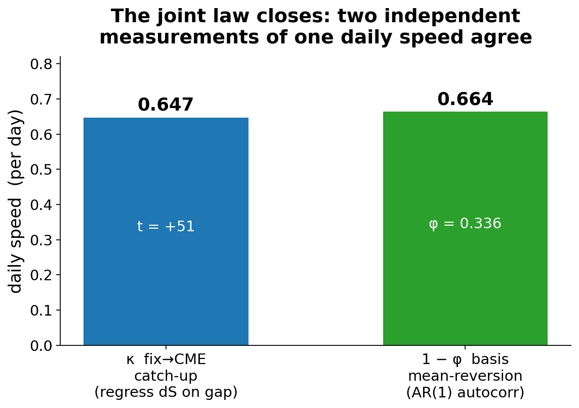
METHODOLOGY · 4 OF 6
The key empirical identity
One number, measured two independent ways, agrees — so the joint law is identified, not fitted.
▪ Catch-up. Regress dS(t+1) on the CME−fix gap → κ = 0.647/day (t = +51).
▪ Reversion. Basis AR(1) autocorr → 1 − φ = 0.66.
▪ They match. CME is the price; the fix reads it ~19 h later.
▪ And CME is a martingale. dF(t+1) on b: |t| < 1 — no executable drift to farm.
Recomputed on data/pl_exp.csv: κ 0.647 (t +51.4), 1−φ 0.664, martingale dF~b slope 0.014 (|t| 0.7).
9

Slide 10
METHODOLOGY · 5 OF 6
Model structure — drift where it belongs
The tradeable leg is a martingale; the catch-up drift lives on the fixing leg the swap references.
CommodityPrice.PLATINUM_CME = P (martingale primary)
Before the fix, the basis drift sat on the TRADEABLE leg —
so the solver farmed a reversion that is unexecutable in reality.
(See the integrity section.)
Regime-switching HMM, 3 regimes (crash μ = −0.33, sane on the CME series). The futures reference this.
CommodityBasis.LME_CME = b (AR(1) vs P, σ 16.5)
The fast mean-reverting echo between the exchange and the fixing.
Observable LBMA fixing S = P + b (composed)
The swap references this — so it inherits the catch-up. The hedge does not.
MarketDataRF_platinum_calibrated_cme.json · calibrated on the CME series (crash μ −0.33 vs pathological −3.66 on LBMA).
10

Slide 11
METHODOLOGY · 6 OF 6
The standing guard at every calibration
The one question asked of every calibration: is there executable drift on the tradeables? There must not be.
Check | Target | Measured
E[dF | b] on CME (martingale) | ≈ 0 | slope 0.014, |t| = 0.7
Catch-up on the fixing leg | large | t ≈ −45 to −51
Basis σ | ≈ 16.5 | 16.50
If any future shows tradeable drift, the calibration is REJECTED before a single solve. This is the guard that a prior model version lacked.
Guard asserts executed green in platinum_hedge_validation.ipynb; recomputed dF~b |t|=0.7 on data/pl_exp.csv.
11

Slide 12
THE SOLVER · 1 OF 4
The solver, in plain English
Backward dynamic programming with a learned, position-free value function.
▪ Work backwards from expiry. Each day, ask: given today's market and book, which hedge maximises expected end-of-deal utility?
▪ Position-free continuation. C_t(market, W) = u(W) + A_t(market, W) is learned by a small net per timestep (~1.4k params). Position-free, so one fit serves every candidate hedge.
▪ The choice sits outside the net. The Bellman max is an explicit search over an allowed action grid — respecting the 50-contract cap and short-only rule — not baked into the fitted value.
▪ Train, then freeze. The policy is trained in the calibrated simulated world and then FROZEN before it ever touches realized data.
diffsolver_v2.py · hedge_solver.py · utility: hedge_bundle._utility_wrap_signed (single source of truth).
12

Slide 13
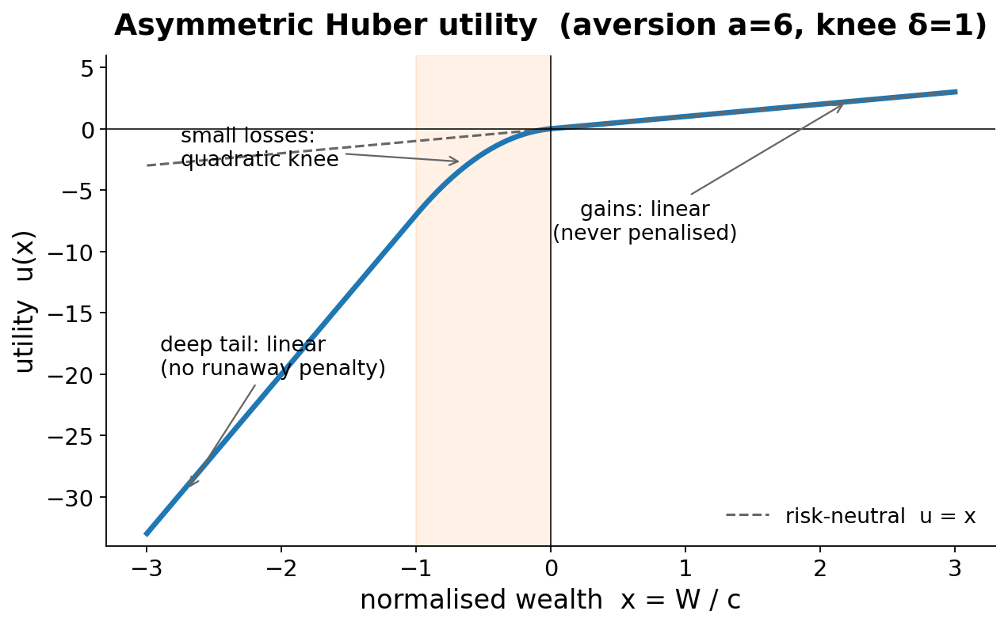
THE SOLVER · 2 OF 4
The objective: downside-asymmetric utility
We optimise utility, not raw P&L — and aversion is the single tuned lever.
Aversion sweep (mean net $/oz)
Aversion | Mean $/oz | Note
2.5 | +4.74 | net-negative bets
6.0 | +18.19 | SHIPPED (best)
12 | — | no reproducible gain*
Gains stay linear (never taxed); small losses curve; the deep tail is linear (no runaway penalty). Raising aversion past 6 buys no reproducible gain.
Full-24 means: la_attribution.csv (av 2.5) · aversion6_24trade_final.csv (av 6). * Av 12 = 10-trade sweep subset, Δ within ±$100/oz seed noise.
13

Slide 14
THE SOLVER · 3 OF 4
The walk-forward protocol — no lookahead
No lookahead anywhere. This is the defensibility core of the backtest.
Calibrate
on data ≤ date
Train policy
in sim world
FREEZE
Roll day-by-day
on REALIZED path
Stamp per-trade
causal bound
Recalibrate
next quarter
▪ Strictly causal. Spot history strictly before each trade date; quarterly recalibration on data ≤ calibration date only.
▪ Real accounting. Rolled through a real futures stepper: variation margin, financing, per-instrument expiry, forced-flat.
▪ Provably causal. Decisions run off the stepper's own wealth — bit-identical when the future is erased.
production_walk_forward.py: calibrate → train → freeze → roll. Future-erasure test proves causality.
14

Slide 15
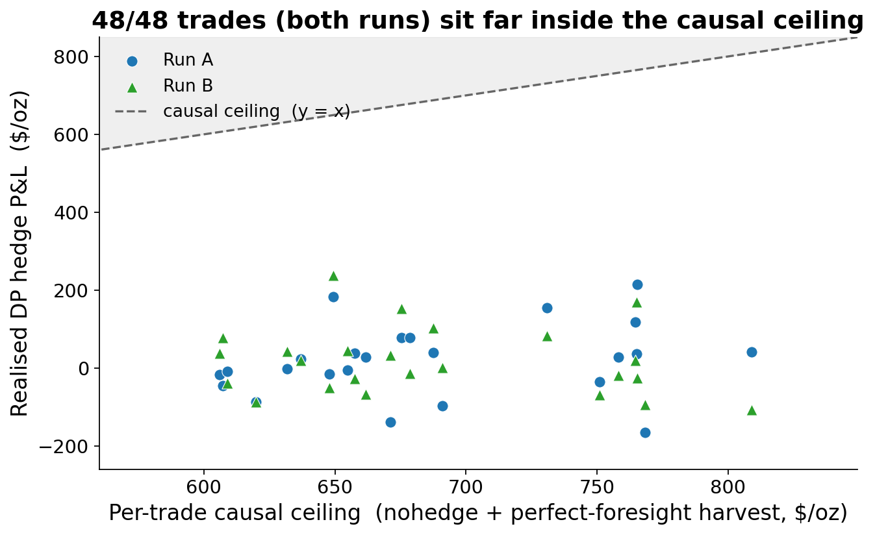
THE SOLVER · 4 OF 4
Verification machinery
Every run carries its own falsification tests — so a wrong answer trips a wire.
▪ Causal ceiling. Per trade: unhedged + perfect-foresight harvest on the traded strip. 48/48 trades (both runs) inside.
▪ Acceptance ladder. Checked per run: hindsight ≥ greedy ≥ textbook.
▪ Bitwise anchors. Fixture V_0 and stepper floats are byte-locked; any code change that moves them fails CI.
Both CSVs: bound_pass = True on 24/24 rows. Bit-gates: fixture V_0 + stepper floats (65-test suite).
15

Slide 16
RESULTS · 1 OF 6
Headline results
Two independent full re-runs of the 24-month walk-forward (Jan-2021 … Dec-2022, monthly trades).
Statistic | Run A (goal) | Run B (re-verify)
Mean ($/oz) | +18.19 | +17.58
Median | +24.56 | +10.33
Min | -166.14 | -106.79
Max | +214.80 | +238.05
Std dev | 92.73 | 87.18
Positive trades | 13 / 24 | 13 / 24
Causal-bound PASS | 24 / 24 | 24 / 24
Unhedged mean | -2.54 | -2.54
aversion6_24trade_final.csv (Run A) · aversion6_reverify_committed_pipeline.csv (Run B). Same realized path; fresh calibration + RNG in B.
16

Slide 17
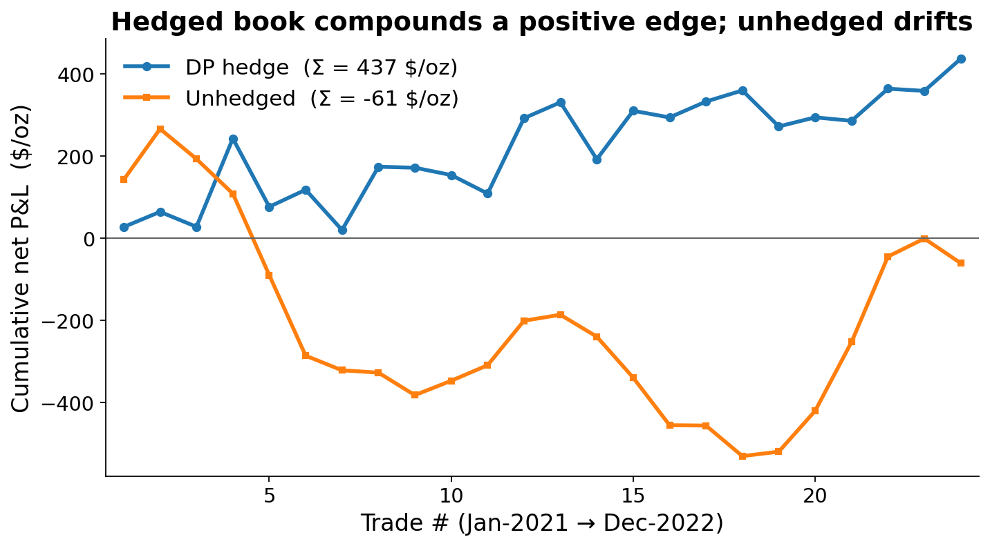
RESULTS · 2 OF 6
Cumulative edge over 24 trades
The hedged book compounds a positive edge; the unhedged book drifts negative.
Cumulative net P&L over the 24 monthly trades: DP hedge +437 $/oz vs unhedged −61 $/oz.
Cumulative sums of the greedy and unhedged columns, aversion6_24trade_final.csv.
17

Slide 18
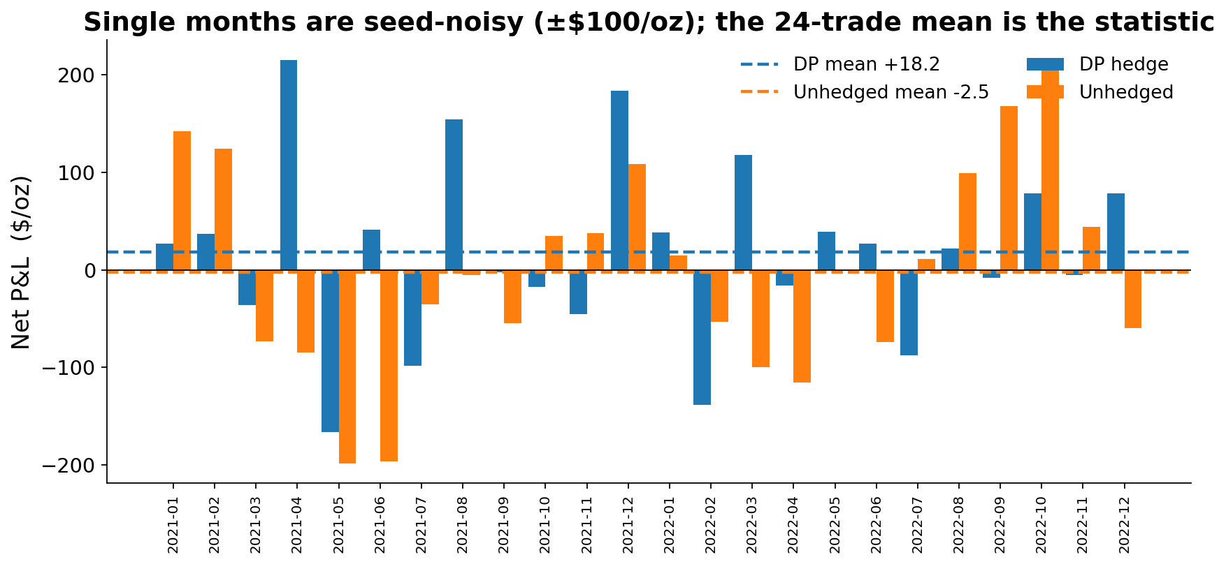
RESULTS · 3 OF 6
Month by month
Individual months are dominated by seed noise (±$100/oz). Do not read single months.
Per-month greedy and unhedged $/oz, aversion6_24trade_final.csv. Dashed lines = 24-trade means.
18

Slide 19
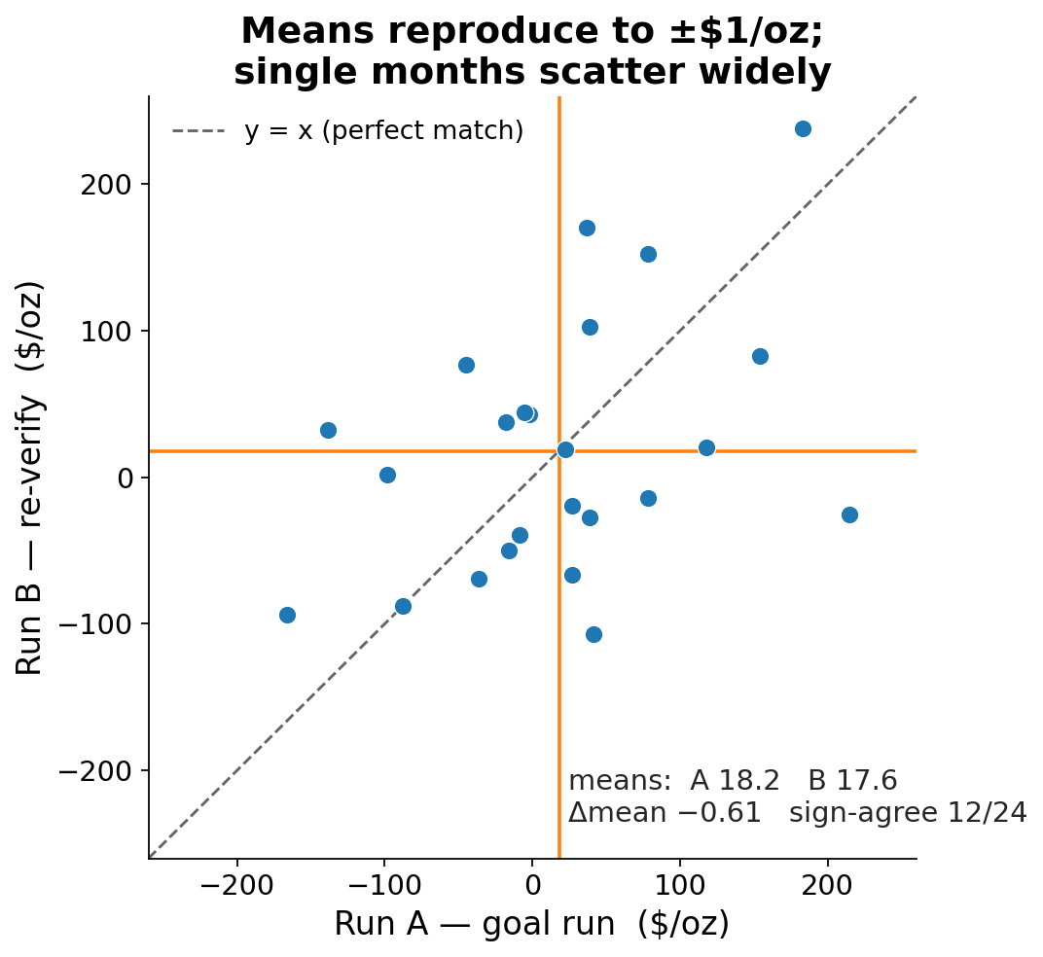
RESULTS · 4 OF 6
Reproducibility — quote means, never months
The mean reproduces to ±$1/oz across independent pipelines; single months do not.
▪ Means agree. Run A +18.19, Run B +17.58; difference -0.61 $/oz.
▪ Months do not. Sign agreement only 12/24; max month-level gap 240 $/oz.
▪ Implication. A single month is a draw from a ±$100/oz distribution. The 24-trade mean is the signal.
Run A vs Run B per trade, both walk-forward CSVs. Δmean −0.61, sign-agreement 12/24, max|Δ| 240 $/oz.
19

Slide 20
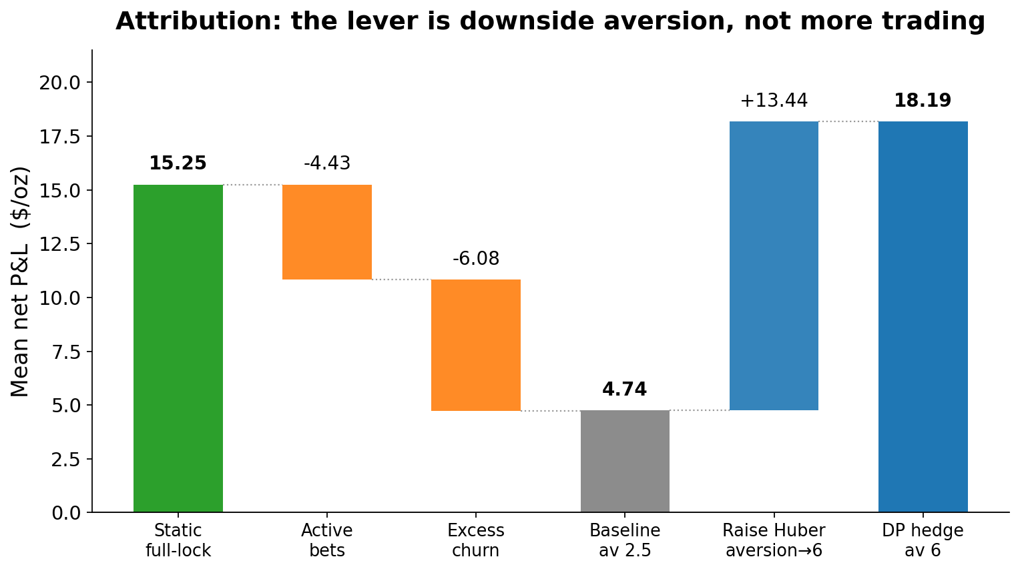
RESULTS · 5 OF 6
Attribution — the lever is aversion
The edge comes from downside aversion, not from trading more.
Baseline (av 2.5) +4.74
= full-lock 15.25
− active bets 4.43
− excess churn 6.08
Raise Huber aversion → 6:
+13.45 → +18.19
Losers recovered hard;
winners kept ~all.
la_attribution.csv (aversion 2.5 baseline) + aversion6_24trade_final.csv (aversion 6).
20

Slide 21
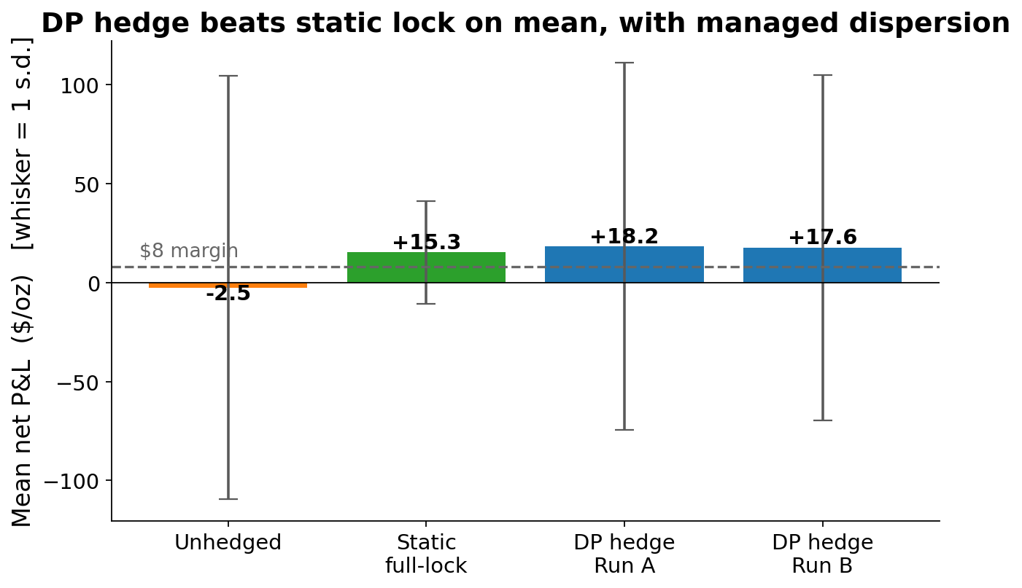
RESULTS · 6 OF 6
Benchmarks
The DP hedge beats the static full-lock on mean, with managed dispersion.
Static full-lock, verified
through the REAL stepper:
+15.25 net =
margin 8.00
+ realized basis drift 8.29
− lock cost 1.01
Full-lock verified through the real stepper. Benchmarks frictionless; net-of-cost reported uniformly.
21

Slide 22
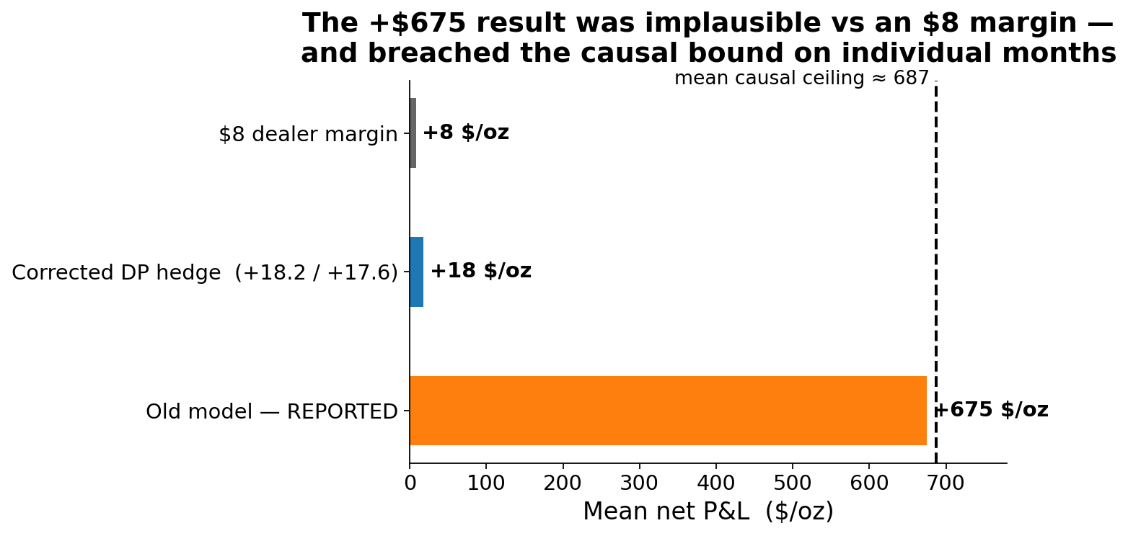
INTEGRITY · 1 OF 3
Integrity: how we caught our own too-good result
An earlier model version reported +$675/oz — implausible against an $8 margin. We did not ship it. We tried to break it.
We had already built a hard causal bound (unhedged + perfect-foresight harvest on the traded strip). The +675 result VIOLATED it on multiple months. A number that beats what perfect foresight allows is not a profit — it is a bug. That triggered a forensic tear-down.
Mean causal ceiling ≈ 687 $/oz (mean of pf_bound, aversion6_24trade_final.csv). Old +675 figure is the pre-fix reported mean.
22

Slide 23
INTEGRITY · 2 OF 3
The forensic exoneration
We localised the error by elimination — accounting and causality were cleared; the model was the culprit.
Suspect | Test | Verdict
Stepper accounting | static-short replay through the real stepper | EXONERATED
Look-ahead in decisions | future-erasure: erase the future, re-decide | EXONERATED (bit-identical)
The model | E[dF | b] on the tradeable futures leg | GUILTY: +0.65·b / day
Root cause: the basis's mean-reversion was placed on the TRADEABLE futures leg. The solver — correctly — farmed a drift of +0.65·b per day. But raw CME is a martingale: that drift does not exist in reality, so it is unexecutable.
Root-cause slope E[dF|b] ≈ +0.65·b/day on the mis-specified leg; corrected model measures |t|=0.7 (nil).
23

Slide 24
INTEGRITY · 3 OF 3
The fix, and the guards now standing
Fix the model; then make the same failure impossible to repeat silently.
▪ Composed-spot inversion. CME is the martingale primary; the basis and its catch-up live on the fixing leg (the swap), not on the hedge.
▪ Bound stamped on every row. Every backtest trade now records and asserts the causal-bound check.
▪ Martingale guard at every calibration. E[dF|b] ≈ 0 is verified on the tradeables before any solve.
▪ Production-trust audit — 7 silent-failure paths closed. Fabricated realized tails; silently-random replay on npz typos; NaN-blind flags; non-atomic writes — all now fail loud.
The strongest trust argument is not that the number is big — it is that we built the machinery to catch it when it was too big, and it worked.
Production-trust audit: commit 0e2bd46. Composed-spot wiring: commit 3008d3c.
24

Slide 25
CLOSING · 1 OF 2
Caveats — stated plainly
What this result is NOT. Said openly, because that is the trust argument.
Caveat | What it means
Single seed per trade | Means are stable across full re-runs; month-level dispersion is ±$100/oz.
2-year OOS window | 2021 rally + 2022 chop — not yet a full cycle.
Flat half-spread costs | Real CME microstructure friction is not calibrated.
Utility-scale convention | Recently moved to calibration-derived (flagged; explicit override available).
Frictionless benchmarks | By convention; net-of-cost is reported uniformly across tracks.
None of these overturn the headline mean; each is a scoped item for the next phase.
25

Slide 26
CLOSING · 2 OF 2
Recommended next steps
Four steps to move from validated prototype to production sign-off.
Step | Why
Multi-seed ensembling per trade | Collapse the ±$100/oz month dispersion; ship a mean, not a single draw.
Realistic friction calibration | Replace the flat half-spread with measured CME microstructure friction.
Guard as a hard gate | Make E[dF|b] ≈ 0 block a calibration, not merely warn.
Longer OOS window | Extend beyond 2021–22 as data accrues; target a full cycle.
The multi-seed step is the single highest-value item: it converts the reproducible mean into a per-trade deliverable.
26

Slide 27
QUANT APPENDIX · 1 OF 4
Appendix — the identified joint law
Five equations and one inequality define the world the policy is solved in.
c₁₂(t) = ln(F2/F1) / (τ2 − τ1) − fwdSOFR # carry; autocorr 0.97
P(t) = F1 · exp(−(rf + c)·τ1) # CME continuous spot (martingale)
b(t+1) = φ·b(t) + A·ΔLME + η , φ ≈ 0.34 # basis AR(1), σ ≈ 16.5
S(t) = P(t) + b(t) # observable LBMA fix (composed)
dS(t+1) = κ·( P(t) − S(t) ) + … , κ = 0.647 ≈ 1 − φ # fix catch-up = basis reversion
E[ dF(t+1) | b(t) ] ≈ 0 # tradeable martingale guard (|t| 0.7)
The identity κ ≈ 1 − φ is the load-bearing fact: the same daily speed appears in the fix's catch-up and the basis's reversion, so the two-clock law is identified rather than assumed.
All coefficients recomputed on data/pl_exp.csv (3,856 daily rows).
27

Slide 28
QUANT APPENDIX · 2 OF 4
Appendix — DiffSolverV2 pseudo-code
# bank: one small MLP per timestep for the position-free continuation
nets = [MLP(in=market_dim+1, hidden=32, out=1) for t in range(T)] # ~1.4k params each
c = deal_scale # utility normaliser
def u(W): # asymmetric Huber (a=6, d=1), in c-units
x = W / c; loss = relu(-x)
pen = where(loss<=d, a*loss**2, a*d**2 + 2*a*d*(loss-d))
return x - pen
# backward sweep: fit C_t = u(W) + A_t via the Huge-Savine twin loss
for t in reversed(range(T)):
S, W, q_prev = sample_states(t) # outer draws
grid = action_grid(q_prev, cap=50, short_only=True) # mask-aware, cap-pruned
q* = argmax_a E_inner[ C_{t+1}(f(S,eps), W + pnl(S,eps,a)) ] # Bellman max OUTSIDE net
# inner expectation via ONE-STEP antithetic MC forks (bootstrap label)
y, dy = bootstrap_value_and_pathwise_grad(t, S, W, q*) # value + AAD Jacobian
A_t = fit(nets[t], value=y - u(W), grad=dy) # twin loss, per-column normalised
clamp A_t to trust region [a_lo, a_hi] # kill off-support extrapolation
# verdict on a held-out split, then hand back a deployable policy
assert ladder(hindsight >= greedy >= textbook)
return policy_artifact(nets, standardization_frames, utility_scale, config_hash)
diffsolver_v2.py · hedge_solver.py · utility exactly hedge_bundle._utility_wrap_signed (a=Huber_Aversion, d=Huber_Delta).
28

Slide 29
QUANT APPENDIX · 3 OF 4
Appendix — calibration → backtest pipeline
for quarter q in walk_forward(2021-01 .. 2022-12):
hist = archive[: q.calibration_date] # strictly no lookahead
world = calibrate(hist) # HMM spot P + AR(1) basis b
assert abs(E[dF | b]) small on every tradeable # martingale guard, else REJECT
policy = DiffSolverV2.solve(world, aversion=6) # train in the simulated world
freeze(policy)
for day in q.trading_days: # roll on the REALIZED path
m = realized_market[day] # strictly causal
a = policy.decide(m, stepper.wealth) # off the stepper's OWN wealth
stepper.step(a) # var margin, financing, expiry, forced-flat
row = record(greedy, nohedge, pf_bound, bound_pass) # per-trade causal ceiling stamped
assert row.greedy <= row.pf_bound # falsification check on every trade
production_walk_forward.py · calibrate_platinum.py. Seed 7, single seed per trade.
29

Slide 30
QUANT APPENDIX · 4 OF 4
Appendix — reproducibility manifest
Every headline number in this deck was recomputed from these artifacts.
Artifact | Path / value
Goal run (Run A) | artifacts/walk_forward/aversion6_24trade_final.csv
Re-verify (Run B) | artifacts/walk_forward/aversion6_reverify_committed_pipeline.csv
Attribution baseline (av 2.5) | la_attribution.csv
Raw data | data/pl_exp.csv (3,856 rows, 2009–2025)
Shipping config | platinum_hedge_shipping.json (Huber, aversion 6, δ 1)
Validation notebook | platinum_hedge_validation.ipynb (11 / 11 cells green)
Test suite | 65 tests (bit-gates: fixture V_0, stepper floats)
Seed | 7 (single seed per trade)
Commit — goal run | 3008d3c
Commit — re-verify pipeline | cfc11da
Commit — production-trust audit | 0e2bd46
65 tests collected · notebook 11/11 executed with 0 error outputs · commit hashes verified in git log.
30

