Slide 1
API’s , API’s , API’s
API’s , API’s , API’s
API’s , API’s , API’s
INTEGRATION
API’s , API’s , API’s
API’s , API’s , API’s
API’s , API’s , API’s

Slide 2












API’s , API’s , API’s
A Service Oriented Architecture & Web Client Application
The Servers

Slide 3
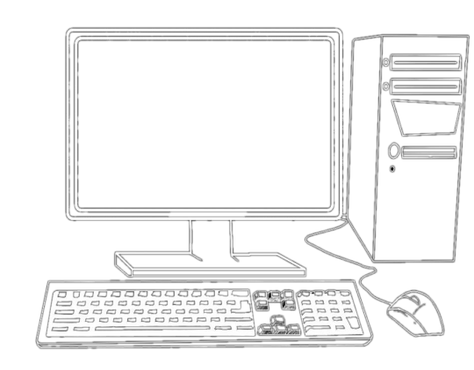




API’s , API’s , API’s
A Service Oriented Architecture & Web Client Application
Your Client
Consume Data
Publish Data

Slide 4


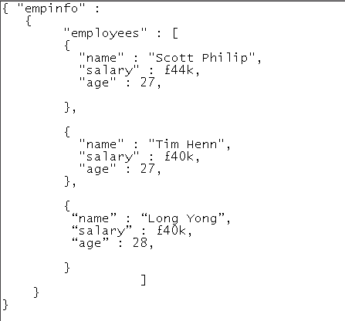
JSON Data
A Service Oriented Architecture & Web Client Application
Drag and Drop GUI Building
Grids from JSON
MondoDb @ 6min

Slide 5
API’S and integration
A Service Oriented Architecture & Web Client Application
Your Client
The Servers
API
Publish Data
Consume Data

Slide 6


The Web as a Pseudo Database
A Service Oriented Architecture &
Web Client Application
CustomForm.html & CustomMap.js
Use public APIs to Post & GET Stories and Reports of the Colorado River Watershed.
The variety of web services and content will shape a holistic narrative of the Colorado River.
{ Longitude, Latitude, Movie Url, Audio Url, Img Url, … }
The Servers
and APIs
Your Client
HTTP
Publish Data
POST
REST
API
GET
Consume Data

