Slide 1

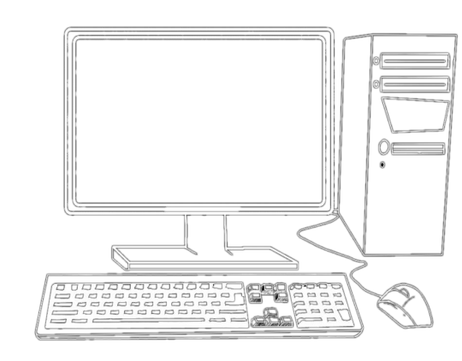












The Web as a Pseudo Database
A Service Oriented Architecture &
Web Client Application
CutomForm.html & CustomMap.js
Use public APIs to Post & GET Stories and Reports of the Colorado River Watershed.
The variety of web services and content will shape a holistic narrative of the Colorado River.
{ Longitude, Latitude, Movie Url, Audio Url, Img Url, … }
Your Client
HTTP
The Servers
Publish Data
POST
REST
API
GET
Consume Data

Slide 2

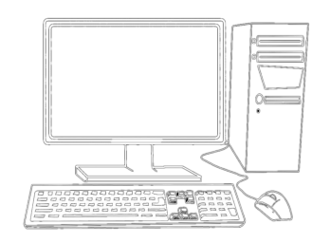
The Web as a Pseudo Database
Web Client Applications
CutomForm.html
Use API to Post Stories and Reports of the Colorado River Watershed.
{ Longitude, Latitude, Movie Url, Audio Url, Img Url, … }
Maintainance Free JavaScript and Html Server

Slide 3
The Web as a Pseudo Database
Web Client Applications
CustomMap.JS
Use a variety of web services to shape the narrative of the Colorado River.
Get
Get
Get

Slide 4
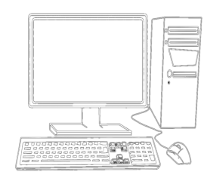
The Web as a Pseudo Database
The Web as a Pseudo Database
A Service Oriented Architecture
Publish Data
Consume Data
By Putting
By Getting
To
From
To
From
PUT | POST
Your Client
HTTP
The Servers
Get

