Slide 1
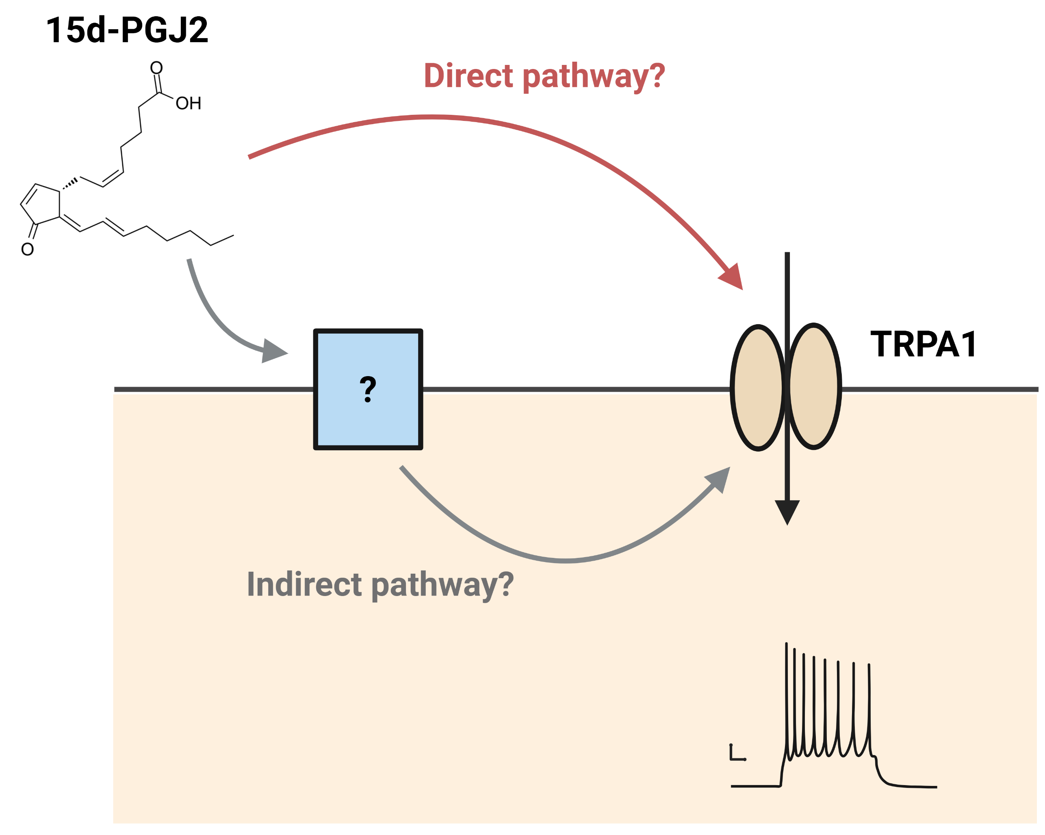
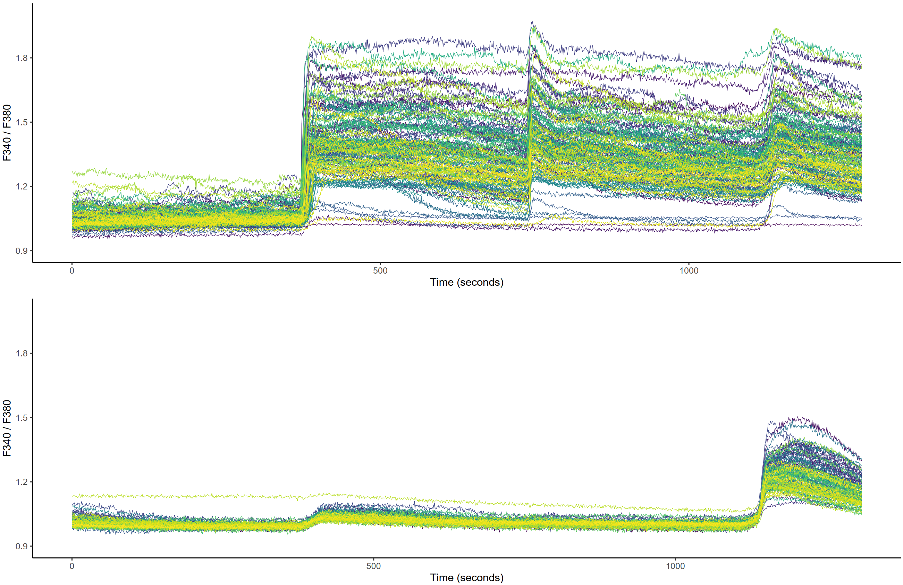
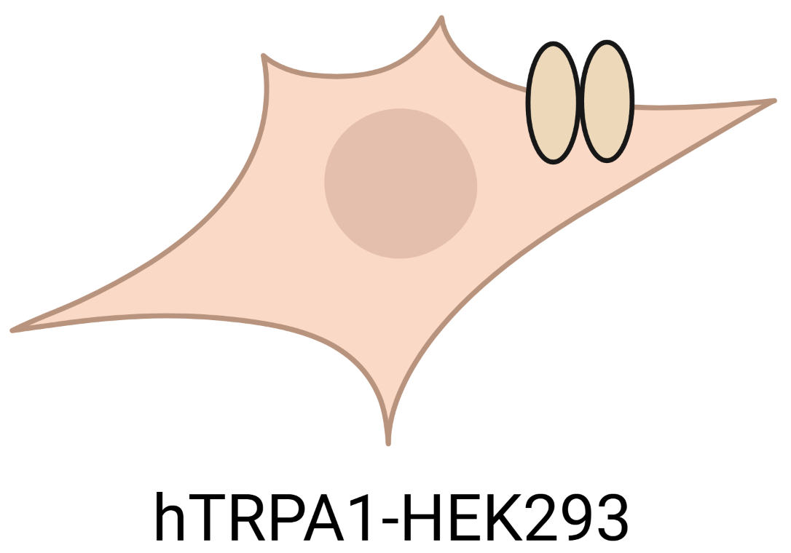

Figure 4. 15d-PGJ2 directly activates TRPA1. (a) Potential mechanisms of 15d-PGJ2 mediated neuronal activation. (b-c) Calcium imaging in human TRPA1-transfected (b, hTRPA1-HEK) and mock-transfected (c, CTRL-HEK) HEK293 cells. (d-e) Difference in Fura-2 ratio to 15d-PGJ2 (d) and responsive cell frequency (e) between hTRPA1-HEK and CTRL-HEK cells.
a
b
15d-PGJ2
AITC
Ionomycin
d
c
e
15d-PGJ2
AITC
Ionomycin

