Slide 1
Advanced Web Solutions
Week 2

Slide 2
AWS – Break down
Wk | Lecture |  | Practical
1 | Introduction. Canvas. Assessment. Agile Methodology |  | Form the teams Create the wireframe
2 | Git/ Github Web applications - basics |  | Review the wireframe with the module tutor Write the list of user stories
3 | Python |  | Create the Github repository. JavaScript
4 | Python | Frameworks / Django | JavaScript. Setup the development environment
5 | Python | Django Models | JavaScript. Get used with Django
6 | Python | Django Templates (Views) | Pick up a user story and develop it.
7 | Django Controllers |  | In-class test. Pick up a user story and develop it
8 | Django Forms |  | Pick up a user story and develop it.
9 | Controlling Forms |  | Pick up a user story and develop it.
10 |  |  | Finalise the development
11 | Testing |  | No more new features. Enhance and test.
12 | Presentations |  | Presentations

Slide 3
Learning Objectives
To understand how to separate the front-end from back-end
To learn about the MVC pattern.

Slide 4
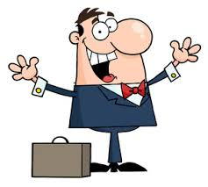

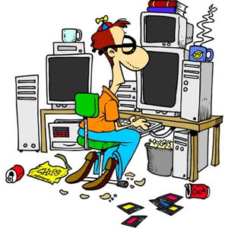
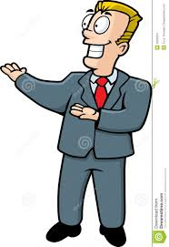
Frontend vs backend
Notes:
Different departments – sale / IT

Slide 5
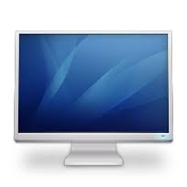
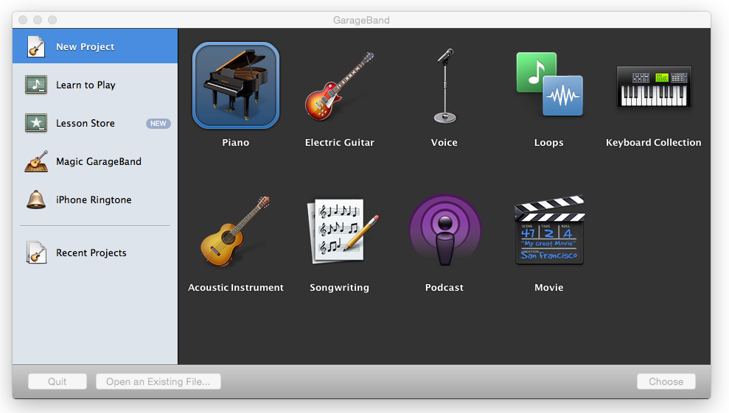
Frontend vs backend
Frontend interacts with the user | Backend doesn’t interact with the user
Database
BACKEND

Slide 6
Frontend vs backend
The classes generating the frontend should be in a package / namespace.
The frontend classes use the backend classes.
The classes generating the backend should be in a package / namespace.
The backend classes NEVER use the frontend classes.

Slide 7
Frontend vs backend
Sanity check!
Is there any backend class containing an import of any class from frontend?

Slide 8
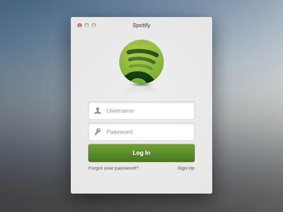
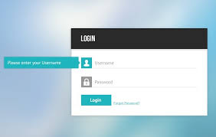
Pros of frontend/backend separation
If separated from the frontend, the backend can be:
thoroughly tested
connected to any frontend.

Slide 9
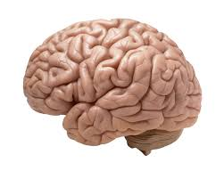
Model View Controller (MVC) Pattern
Model
View
Controller

Slide 10
Model View Controller (MVC) Pattern
represents the data or
contains data or
is interfacing with the database or
holds data in memory that comes from the database
Deals directly with the database
Model

Slide 11

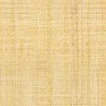
Model View Controller (MVC) Pattern
Is the GUI (Graphical User Interface) (the part of the application that interacts with the user)
Is a view of the data/model
Different views for the same model
View
View
View

Slide 12
Model View Controller (MVC) Pattern
Contains the logic of the application.
Is the Business logic.
Stuff that is not in the model or view.
Controller

Slide 13
Model View Controller (MVC) Pattern
Model
View
Data
Controller

Slide 14
Model View Controller (MVC) Pattern
Model
View
Data
Requests data from the model
Listens to the model
Controller

Slide 15
Model View Controller (MVC) Pattern
The Model is passive.
“Notifies” the view about changes.
(see Observer Pattern)
Model
View
Data
Never includes classes of the View.
Controller

Slide 16
Model View Controller (MVC) Pattern
Model
View
Data
Commands
Controller

Slide 17
Model View Controller (MVC) Pattern
Model
View
Data
Commands
Controller
Tells the Model what to do.

Slide 18
Model View Controller (MVC) Pattern
Model
View
Data
Commands
Controller
Processes the user’s requests and instructs the model with what the user wants.

Slide 19
Model View Controller (MVC) Pattern
Model
View
Data
Commands
Controller
“Listens” to the Model.
What changes were made in the Model?

Slide 20
Model View Controller (MVC) Pattern
Model
View
Data
Commands
Commands
Controller

Slide 21
Model View Controller (MVC) Pattern
Model
View
Data
Commands
Commands
Controller
Changes the view

Slide 22
Model View Controller (MVC) Pattern
Model
View
Data
Commands
Commands
Controller
“Listens” to the View

Slide 23
Model View Controller (MVC) Pattern
Model
View
Data
Commands
Commands
Controller

Slide 24
In practice…
MVC is not suitable for every application.
Keep the MVC in your mind and apply some elements of it.

Slide 25
In practice…
What could help us use the MVC pattern?
How do we know that we get it right?
Frameworks

Slide 26
Frameworks
A framework is a platform that helps the developers to build complex web applications in a structured way.
It is a large codebase meant to provide universal, reusable behaviour for a targeted project.
Frameworks feature inversion of control (i.e. dictate control flow). The developer adds or extends code in specific locations to cutomise the framework to the program’s requirements.

Slide 27
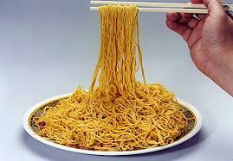
Frameworks
We can write code without a framework.
But, we can end up with …
Notes:
Spaghetti code – long code, difficult to handle it
Hard to test

Slide 28
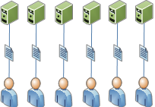
Frameworks
We can write code without a framework.
But, we can end up with …
Notes:
Redundant code

Slide 29
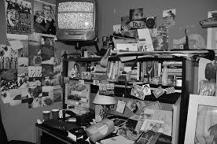
Frameworks
We can write code without a framework.
But, we can end up with …
Notes:
Disorganisation – mixture Python+HTML
Difficult to reuse code
Change one thing, break another

Slide 30
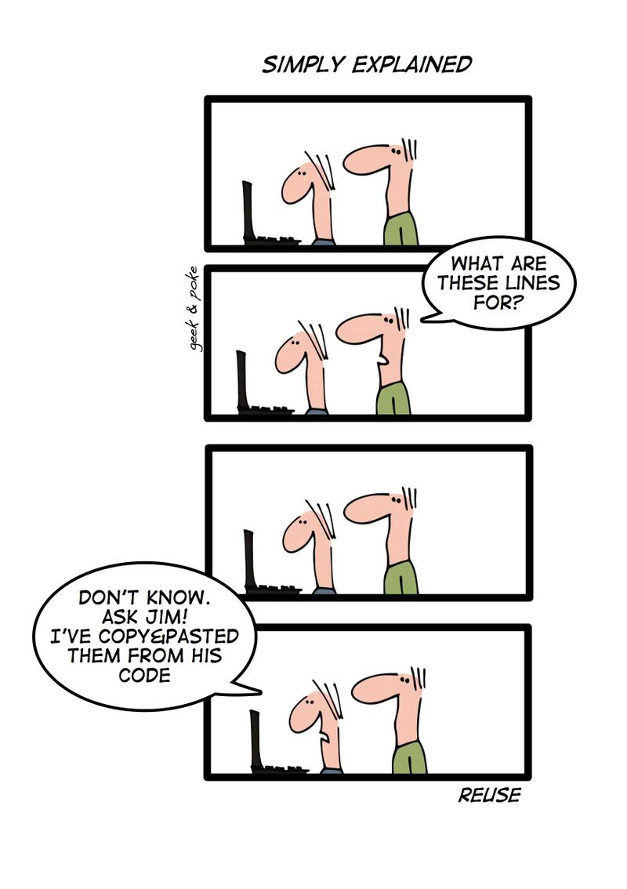
Frameworks
We can write PHP code without a framework.
But, we can end up with …
Notes:
Disorganisation – mixture Python+HTML
Difficult to reuse code
Change one thing, break another

Slide 31
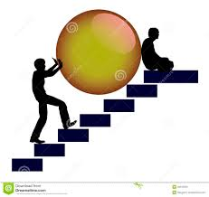
Frameworks
We can write code without a framework.
But, we can end up with …
Notes:
Lack of team work

Slide 32
Frameworks
Why use a framework?
to write clean and organised code
easy to test, change and reuse code
it provides pre-build and pre-tested tools
Inversion of control - the framework takes control of the order of processes
Notes:
Lack of team work

Slide 33
Frameworks
Is the framework the solution for any website/web application?
NO! Not for small applications that can be well organised without using a framework.

Slide 34

Questions

