Slide 1
Condor Populations

Slide 2
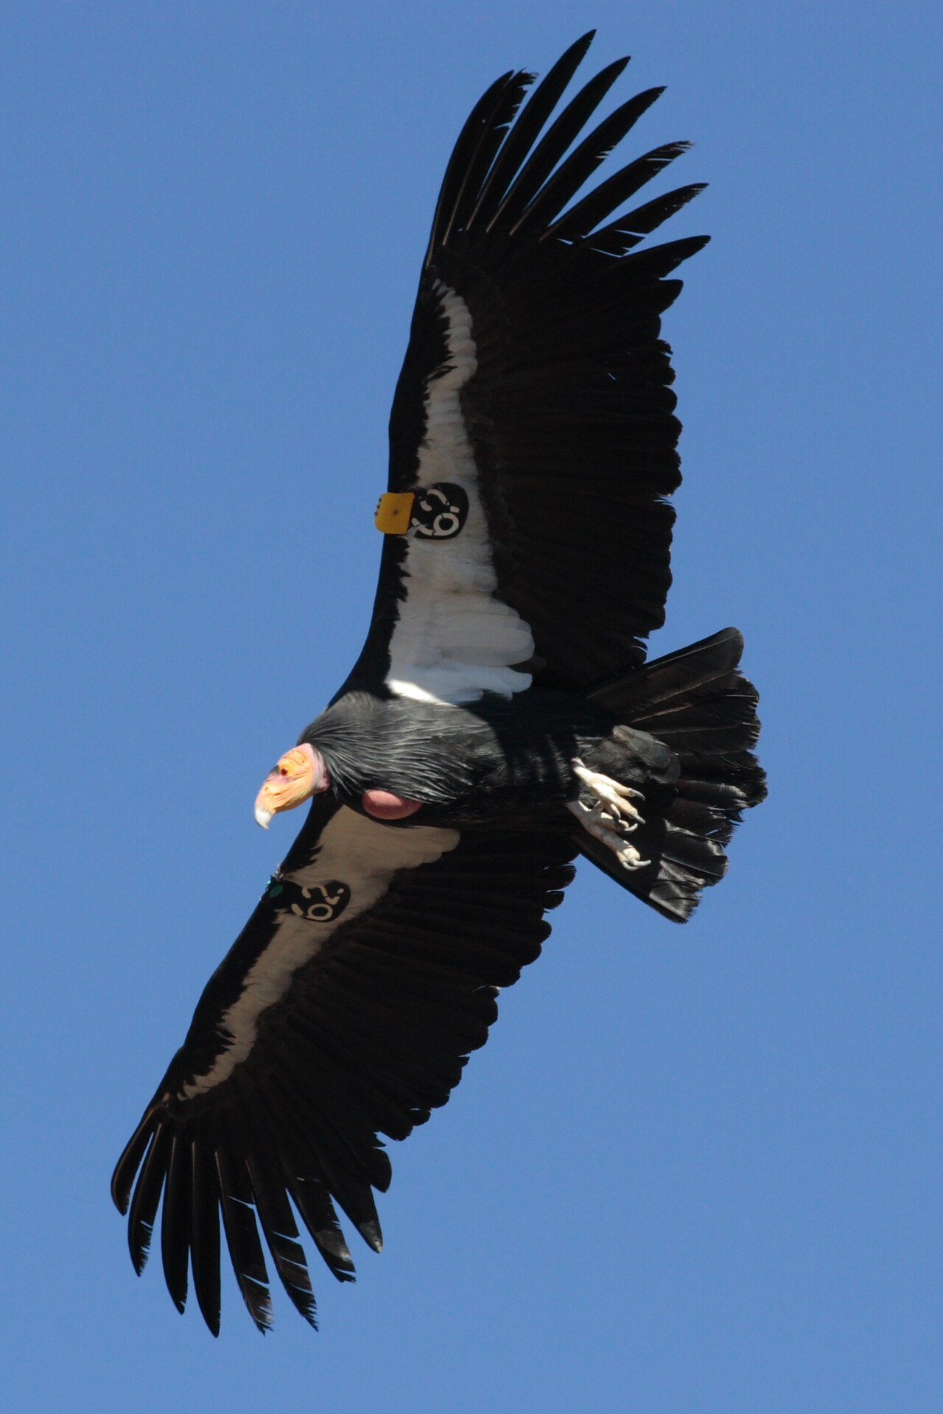
The California Condor
Largest North American Vulture
~9.9ft wingspan
Soars at ~15,000 ft
Native to western California
Wild population in 1987: 22

Slide 3
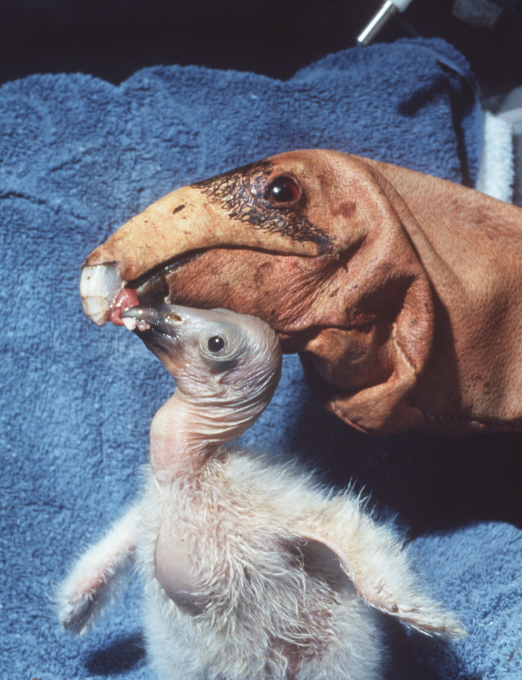
Condor Conservation Effort
Starting in 1987, all 22 wild Condors were captured
Condor pairs will only naturally produce 1 chick every ~3 years
In captivity, ~ 1 chick per year
“Double Clutching” effectively doubles this rate
Juveniles are periodically released to the wild
2022 wild population: 347¹

Slide 4
The Project: Mortality Rates
With a captive breeding program that periodically releases juveniles to the wild, how do mortality rates affect the overall population?
Which age group’s mortality rates have the greatest overall impact?

Slide 5
Assumptions
Reproductive maturity: 7 (captive) or 8 (wild) years
Captive productivity rate: 0.9/yr
Wild productivity rate: 0.3729/yr
Equal male/female population
Captive population capacity: 150
Wild population carrying capacity: 400

Slide 6
Assumptions
80% of year 1 juveniles are released each year
If captive capacity exceeds 150, release all juveniles to the wild

Slide 7
Assumptions
Initial conditions used: 2022 captive Condor population
44 hatchlings
39 1y/o
45 2-7y/o, distributed evenly
86 adults
214 total
0 wild Condors

Slide 8
Methods
Two groups of stock variables: wild and captive
Within each group, separate stock variables for each year of pre-adult life
Within each group, a stock variable representing all adults
Time step of 1 year

Slide 9
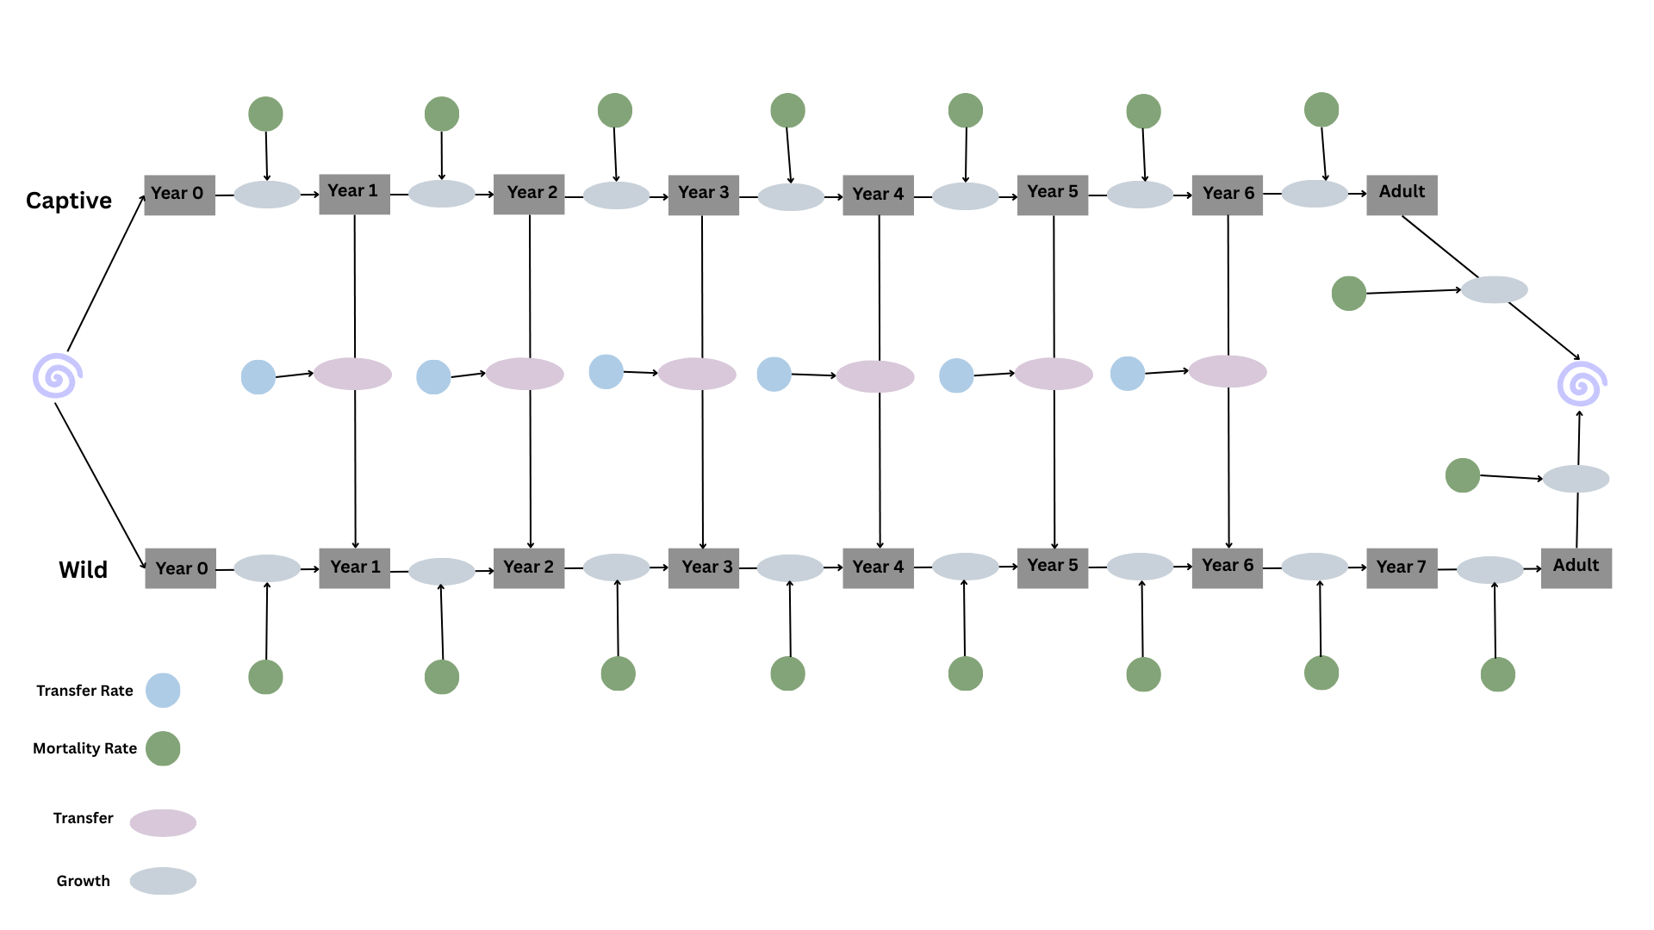
Model Diagram

Slide 10
Methods
At each 1-year time step, use the appropriate mortality rate to determine how many X-year-old condors from the last year survived
That number becomes the population for the current year’s X+1 age group
Then, subtract 80% of our 1 y/o captive condors from the captive population and add them to our wild population’s corresponding age stock.
Use half the adult population (the female population) and the wild and captive productivity rates, respectively, to determine this year’s hatchling populating

Slide 11
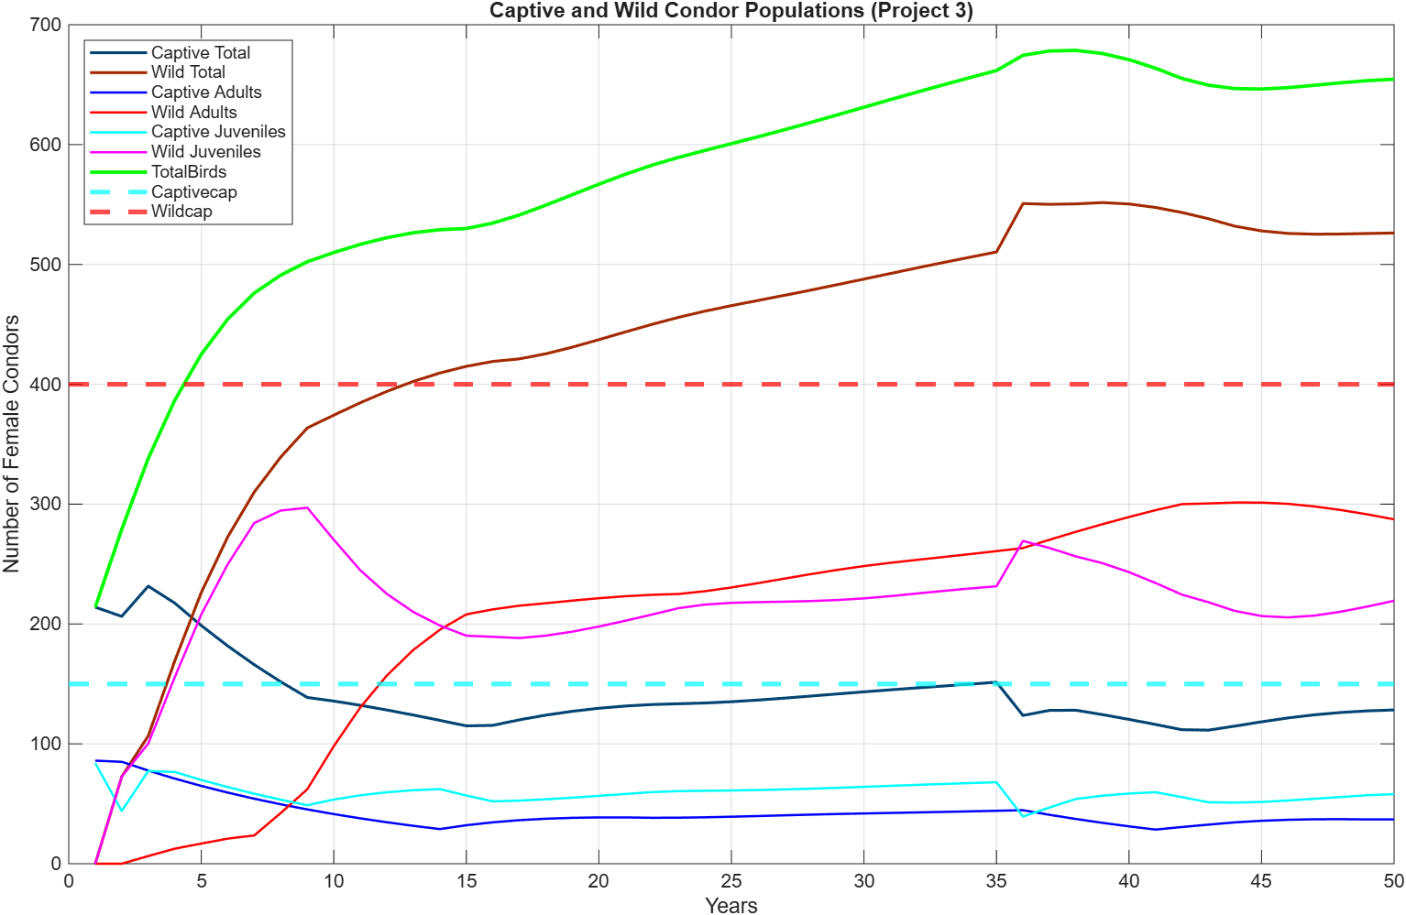
Simulation Results
My1 = 8.6%
Mi = 8.6%
Ma = 8.6%
Total population more than triples by year 50
Note initial release of juveniles due to captive capacity cap

Slide 12
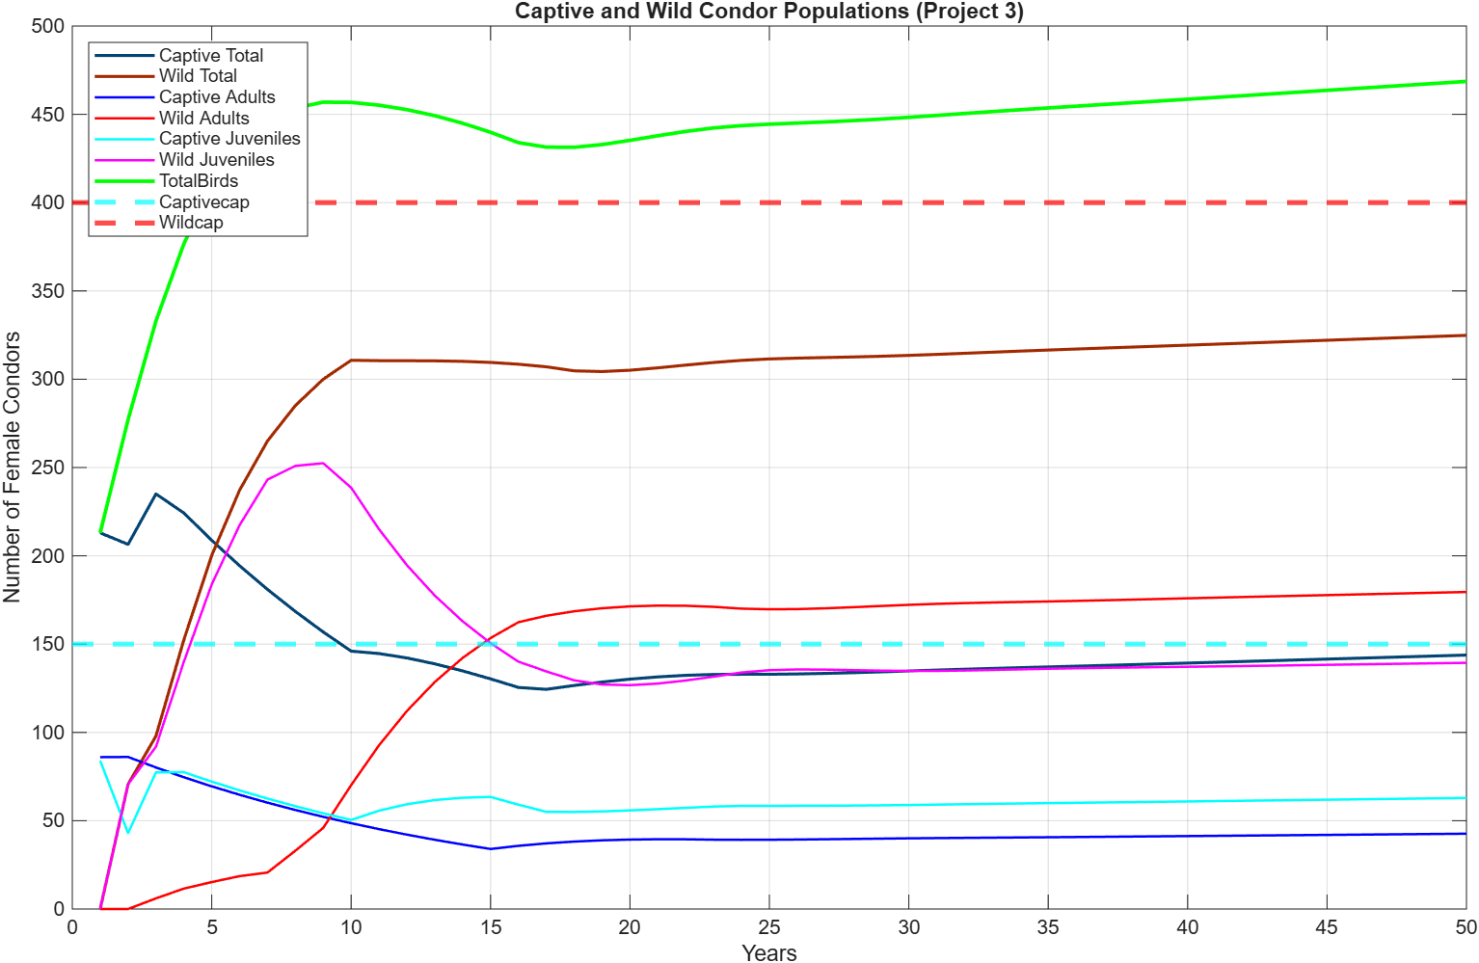
Simulation Results
My1 = 13.8%
Mi = 13.8%
Ma = 6.9%
Total population more than triples by year 50
Note initial release of juveniles due to captive capacity cap

Slide 13
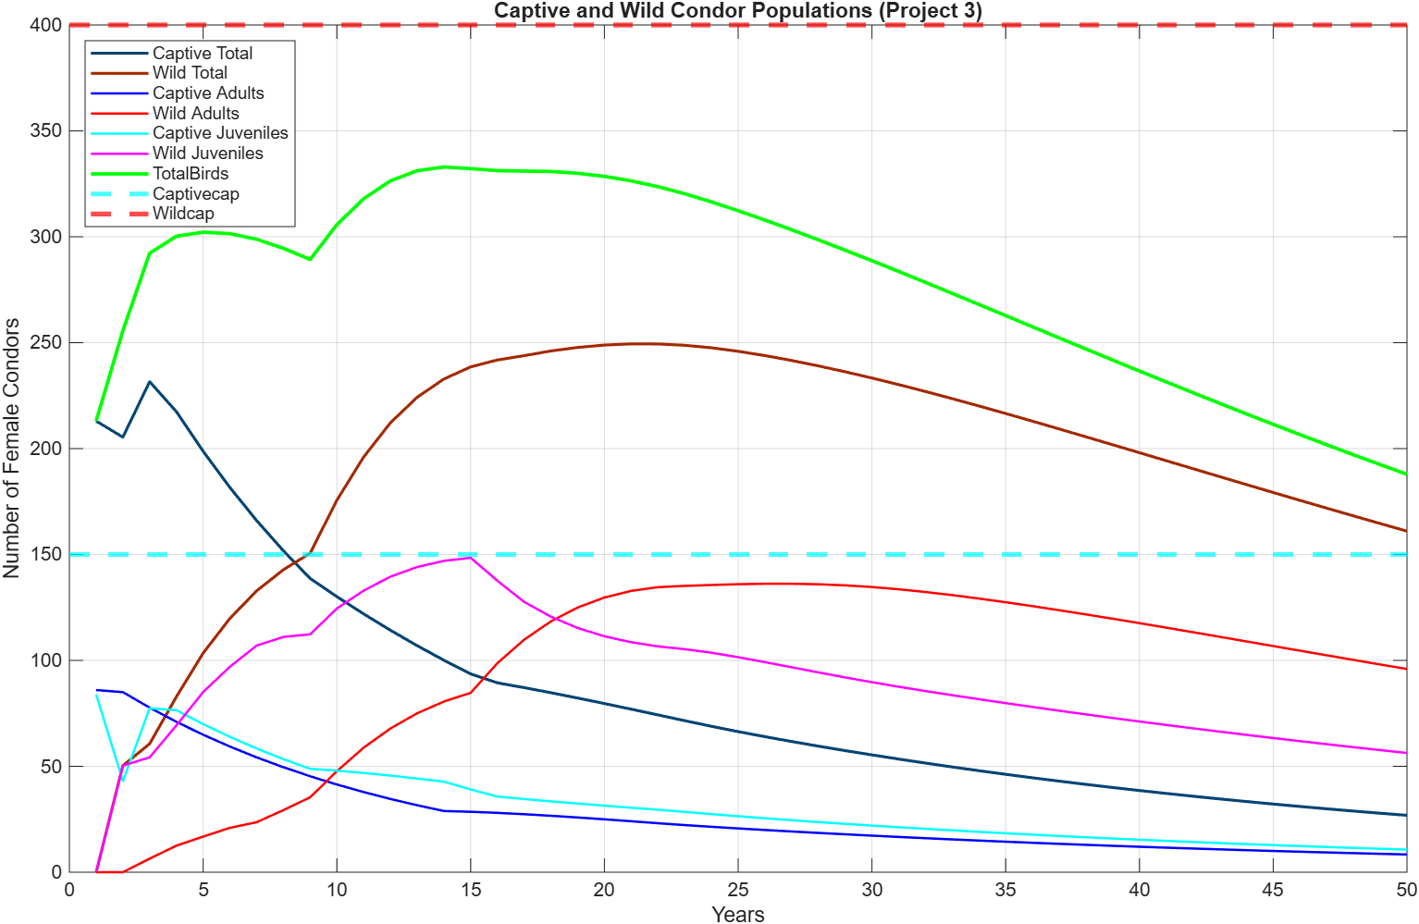
Simulation Results
My1 = 65.9%
Mi = 8.6%
Ma = 8.6%
Total population has declined by year 50
Birth rates are unable to keep up with early mortality

Slide 14
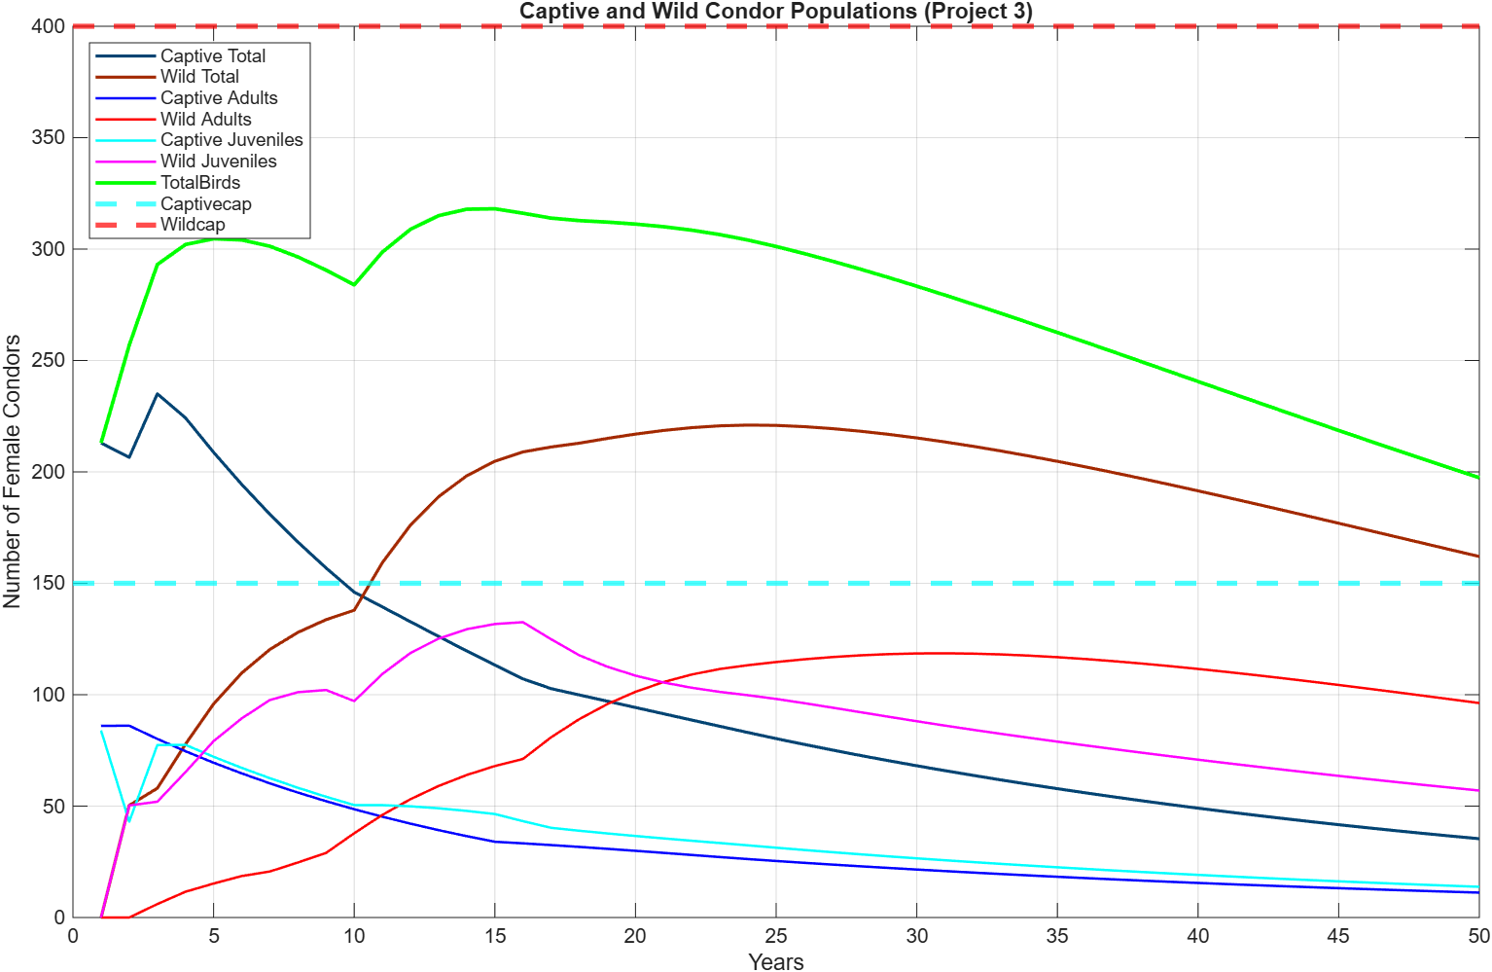
Simulation Results
My1 = 65.9%
Mi = 13.8%
Ma = 6.9%
Similar results to previous simulation
Decreased adult death rate makes up for increased juvenile death rate

Slide 15
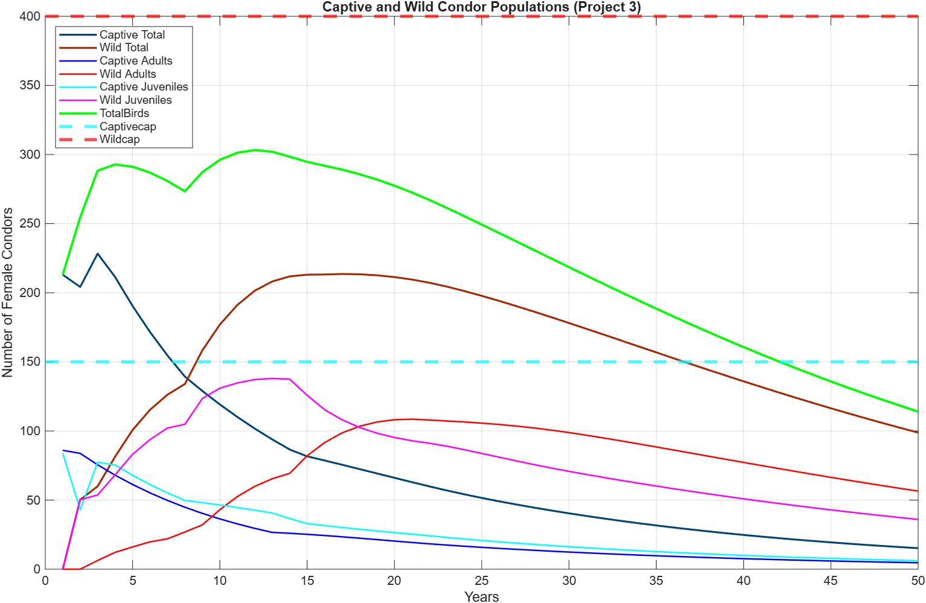
Simulation Results
My1 = 65.9%
Mi = 9.9%
Ma = 9.9%
Total population has declined by year 32
Increased mortality rate nearly halves total population by year 50

Slide 16
Simulation Results
My1 = 65.9%
Mi = 13.8%
Ma = 6.9%
Captive program ends after 5 years
Decreased adult death rate makes up for increased juvenile death rate

