Slide 1
Condor Populations

Slide 2
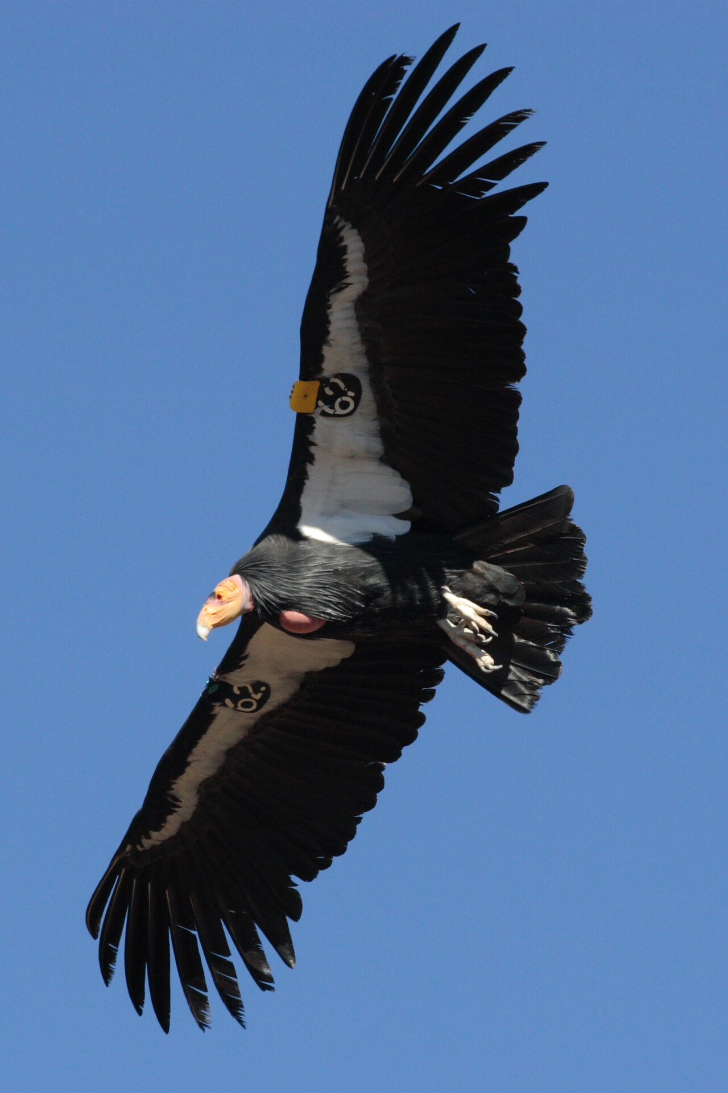
The California Condor
Largest North American Vulture
~9.9ft wingspan
Soars at ~15,000 ft
Native to western California
Wild population in 1987: 22

Slide 3
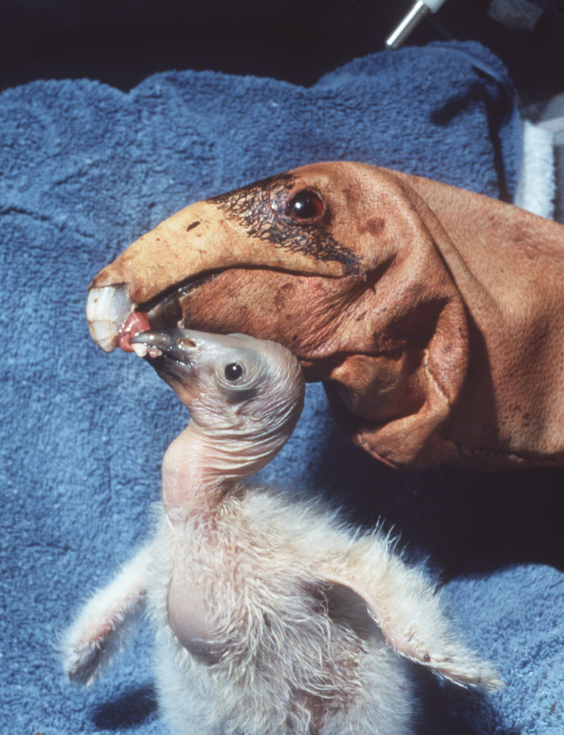
Condor Conservation Effort
Starting in 1987, all 22 wild Condors were captured
Condor pairs will only naturally produce 1 chick every ~3 years
In captivity, ~ 1 chick per year
“Double Clutching” effectively doubles this rate
Juveniles are periodically released to the wild
Estimated 2024 wild population: 369¹

Slide 4
Guiding Questions
In a species with low birth rates, how does a breeding program influence population growth? Does this program accomplish its goal?
Condor mortality rates are difficult to estimate. Given current population statistics and varying initial conditions, can we infer true mortality rates from this model?

Slide 5
Assumptions
Reproductive maturity: 7 (captive) or 8 (wild) years
Captive productivity rate: 0.9/yr (0.8/yr with double clutching)
Wild productivity rate: 0.3729/yr
Equal male/female population
All adults mate

Slide 6
Assumptions
80% of year 1 juveniles are released each year
Captive population capacity: 150
Wild population capacity: 400
If captive capacity exceeds 150, release all juveniles to the wild

Slide 7
Initial Conditions
1987 captive condor population
22 adults
2022 captive Condor population
44 hatchlings
39 1y/o
45 2-7y/o, distributed evenly
86 adults
214 total
0 wild Condors

Slide 8
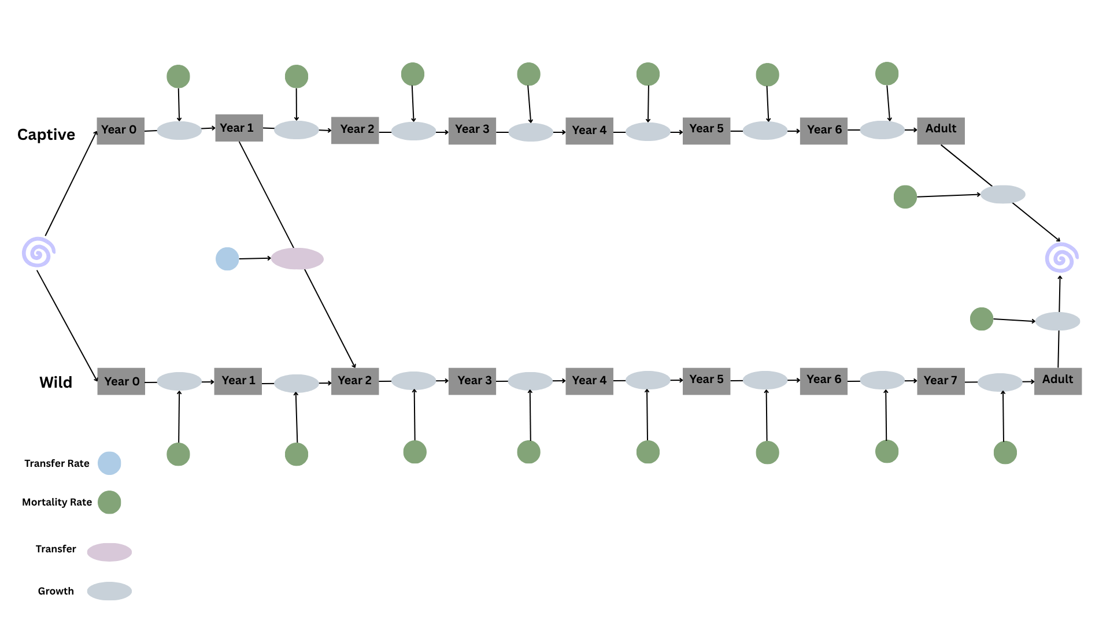
Model Diagram

Slide 9
Methods
At each 1-year time step, use the appropriate mortality rate to determine how many X-year-old condors from the last year survived
That number becomes the population for the current year’s X+1 age group
Then, subtract 80% of our 1 y/o captive condors from the captive population and add them to our wild population’s corresponding age stock.
Use half the adult population (the female population) and the wild and captive productivity rates, respectively, to determine this year’s hatchling populating

Slide 10
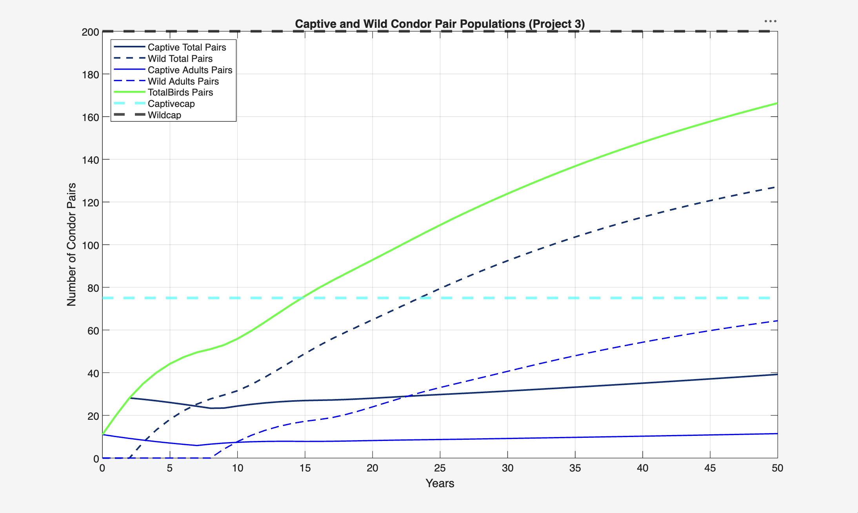
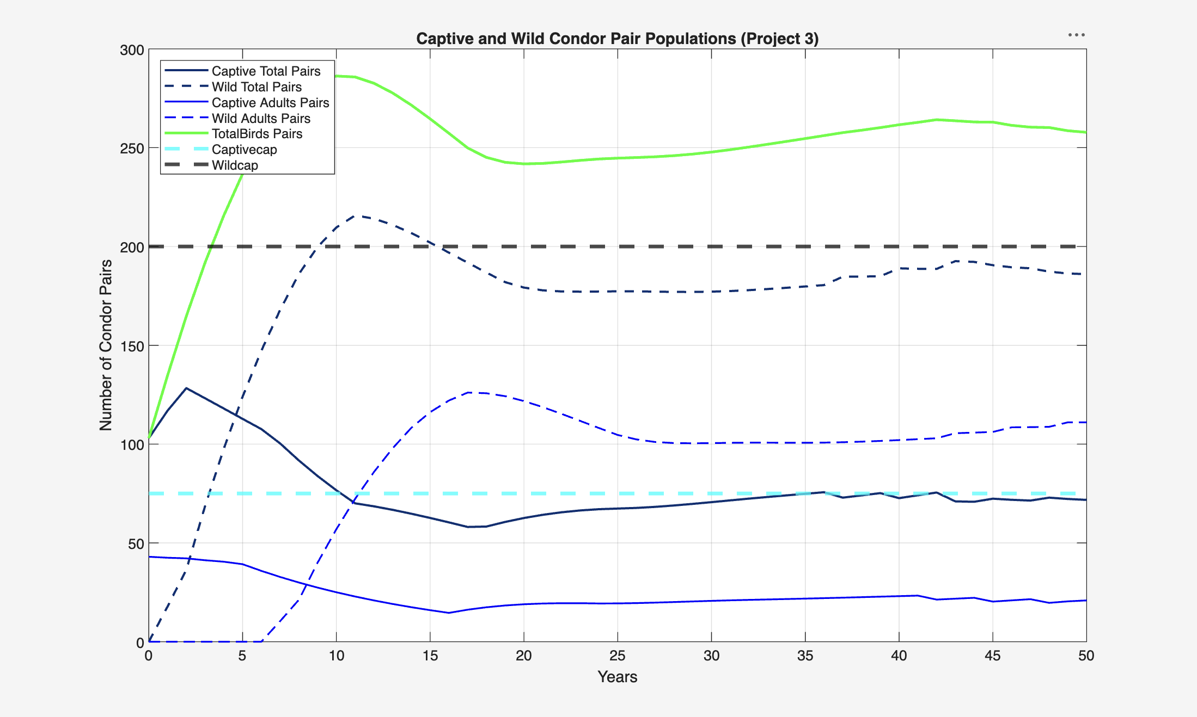
Simulation Results
Assume captive and wild mortality rates of My1 = 8.6%, Mi = 8.6%, Ma = 8.6%

Slide 11
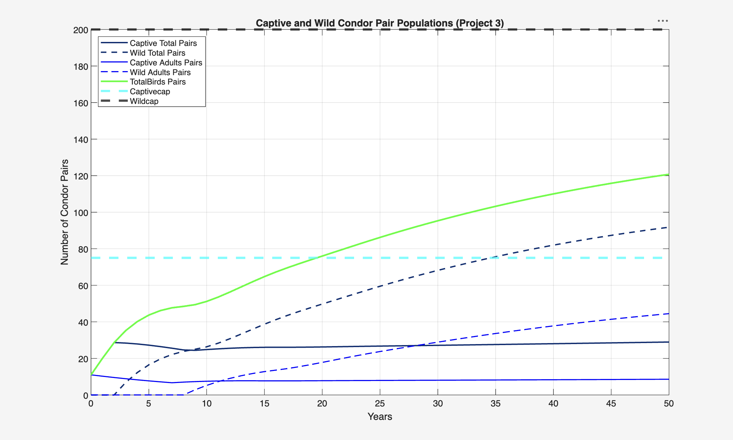
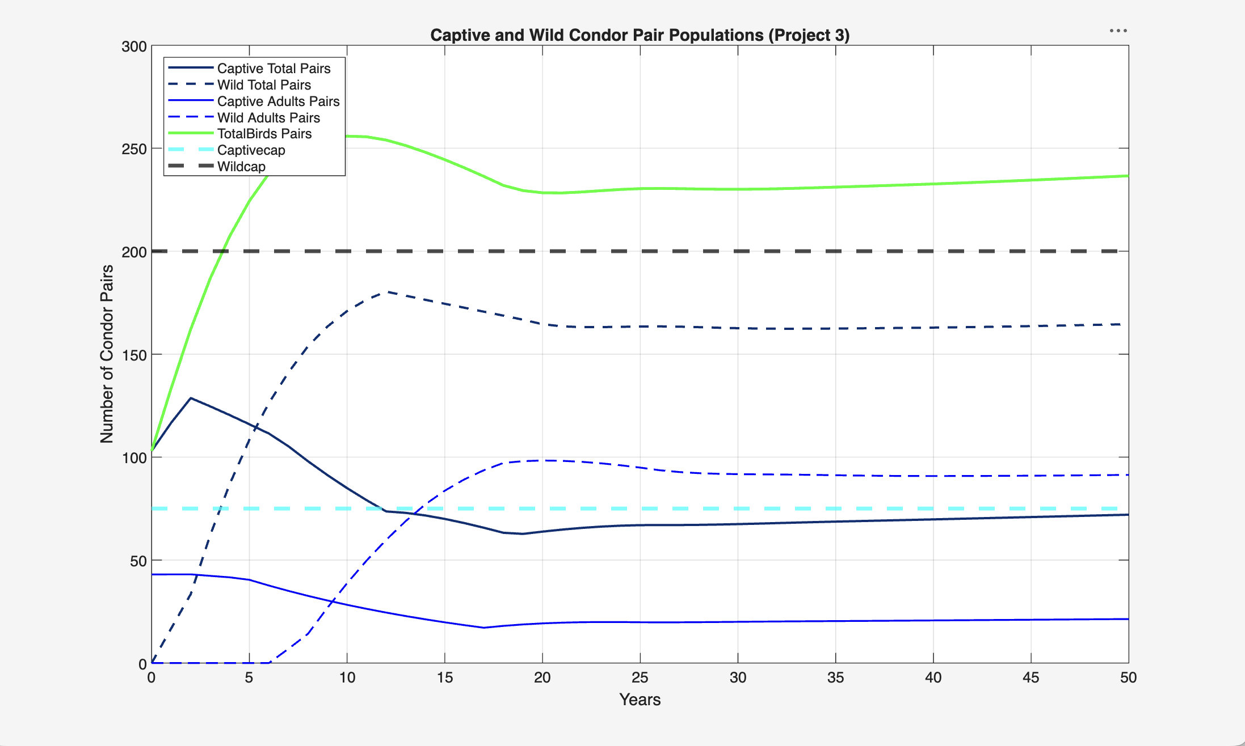
Simulation Results
Assume captive and wild mortality rates of My1 = 13.8%, Mi = 13.8%, Ma = 6.9%

Slide 12
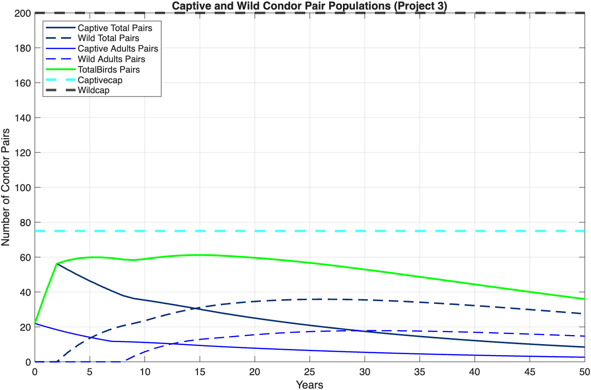
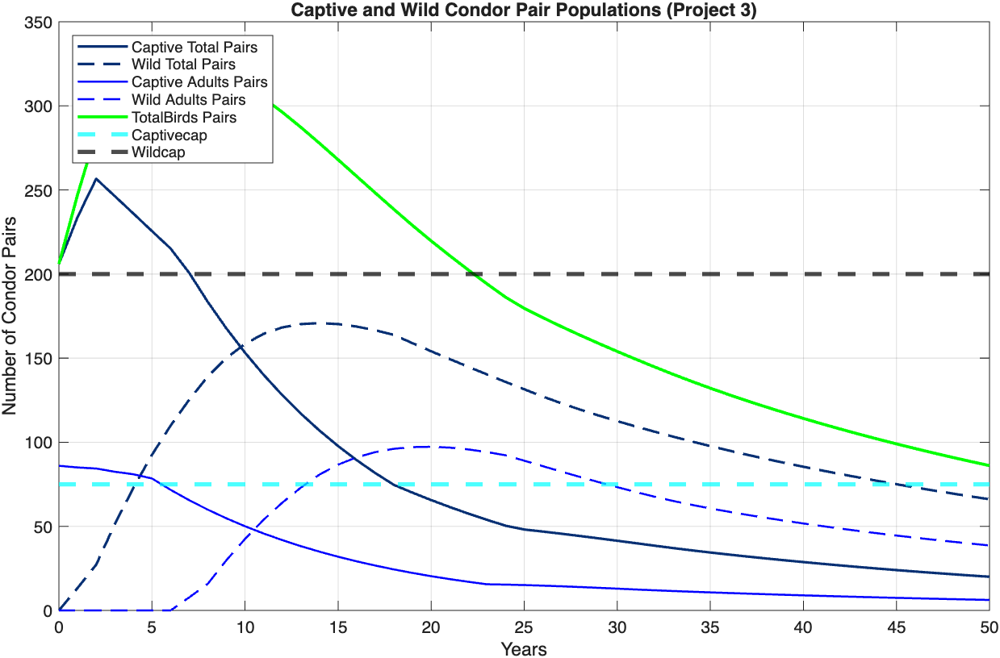
Simulation Results
Assume captive and wild mortality rates of My1 = 65.9%, Mi = 8.6%, Ma = 8.6%

Slide 13
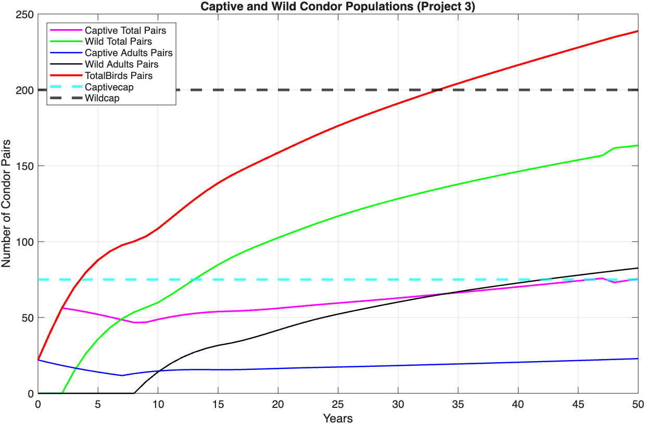
Simulation Results
Wild:
My1 = 65.9%,
Mi = 9.9%,
Ma = 8.6%
Captive:
My1 = 8.6%,
Mi = 8.6%,
Ma = 8.6%
22 Adults

Slide 14

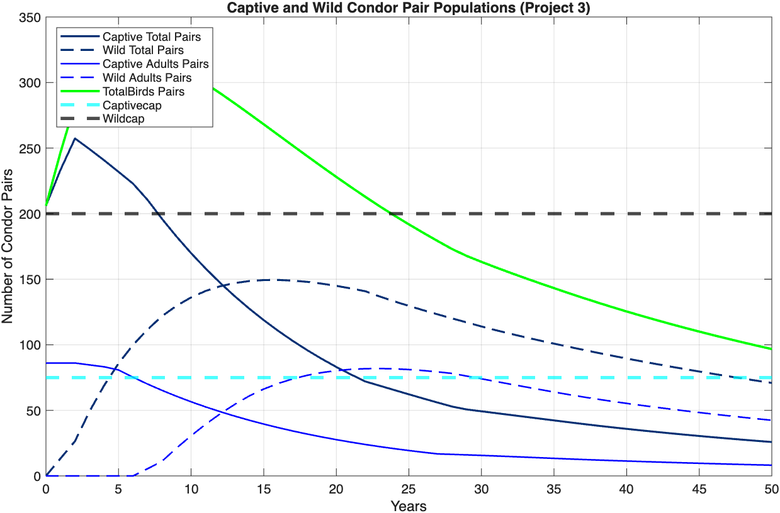
Simulation Results
Assume captive and wild mortality rates of My1 = 65.9%, Mi = 13.8%, Ma = 6.9%

Slide 15
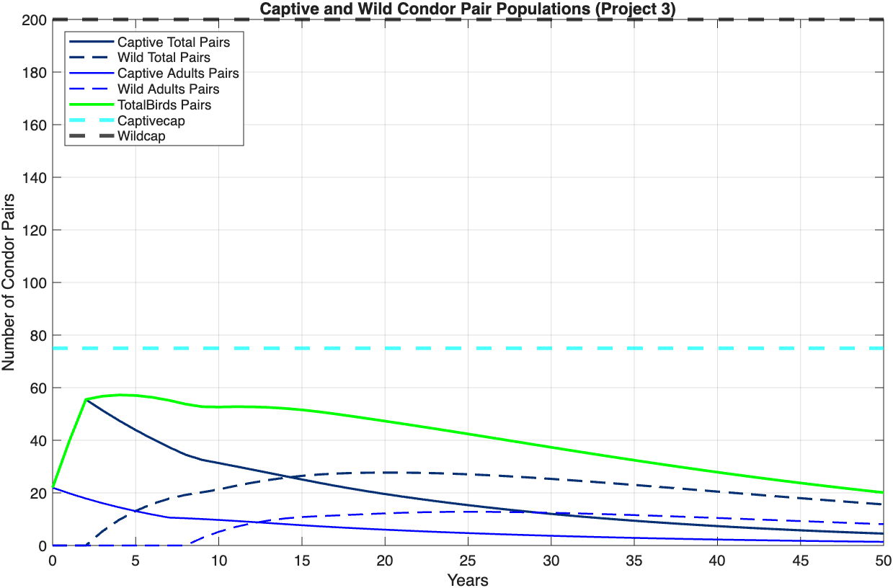
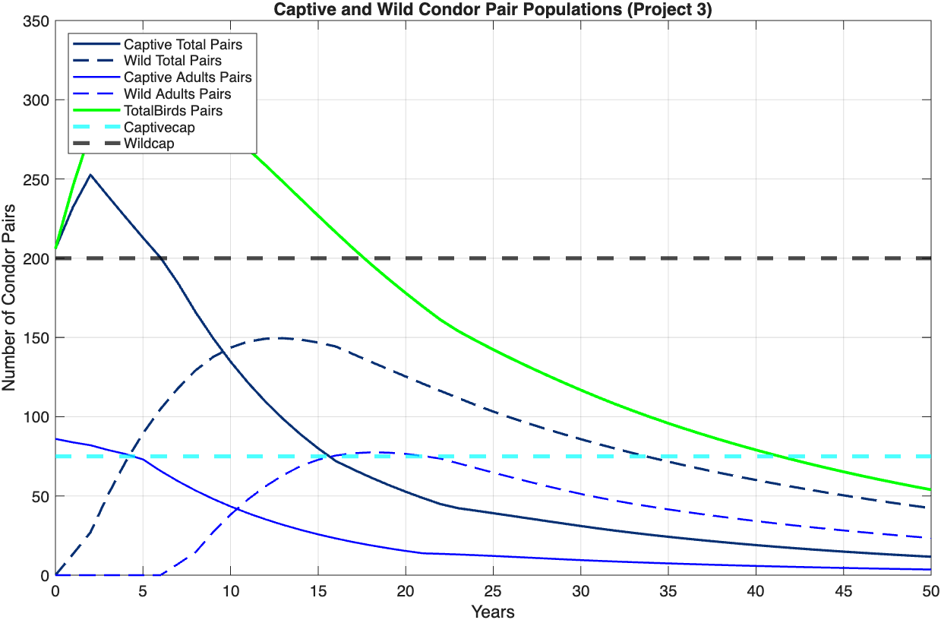
Simulation Results
Assume captive and wild mortality rates of My1 = 65.9%, Mi = 9.9%, Ma = 9.9%

Slide 16
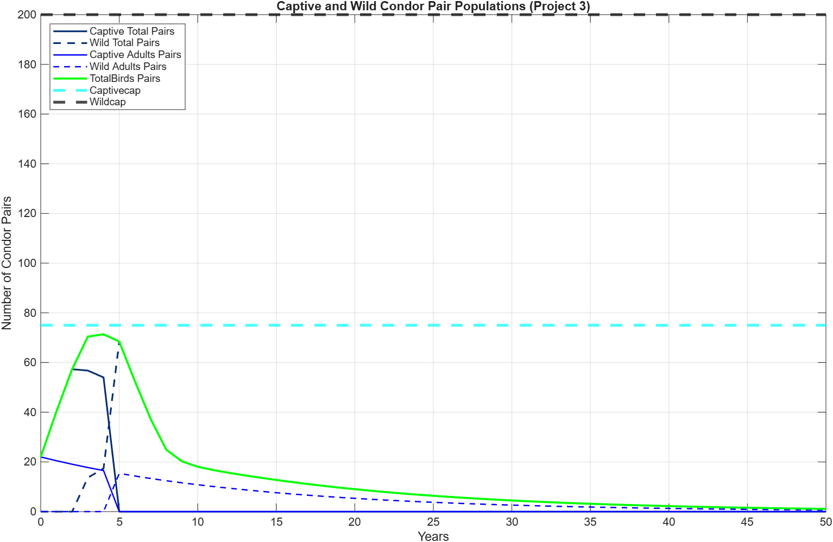
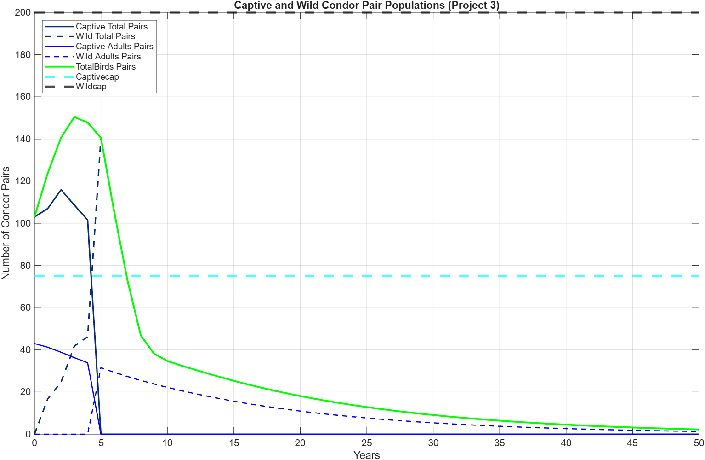
Simulation Results
Assume captive and wild mortality rates of My1 = 65.9%, Mi = 13.8%, Ma = 6.9%, and that captive repopulation efforts run for only 5 years.

Slide 17
Conclusions
A captive repopulation program successfully increases wild populations over 50 years.
Given true population data, lower estimates for mortality rates may be assumed.

